Slide 1

Neural Network
1
Back Propagation Training Algorithm
CSAI 253 - Spring 2024
Prepared By
Dr. Khaled Mostafa ElSayed
kmelsayed@zewailcity.edu.eg
Instructors:
Dr. Khaled Mostafa ElSayed
kmelsayed@zewailcity.edu.eg
Dr. Mohamed Maher Ata
momaher@zewailcity.edu.eg

Slide 2
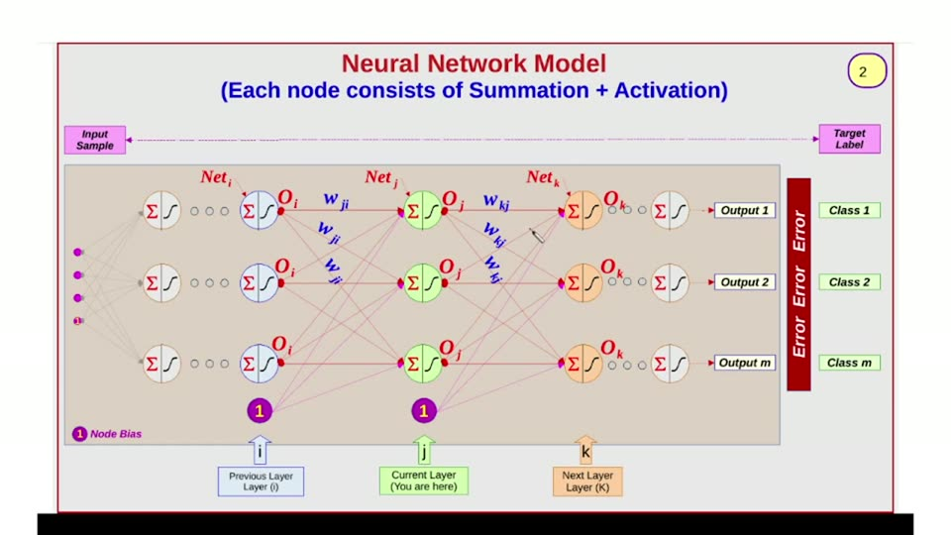

Slide 3
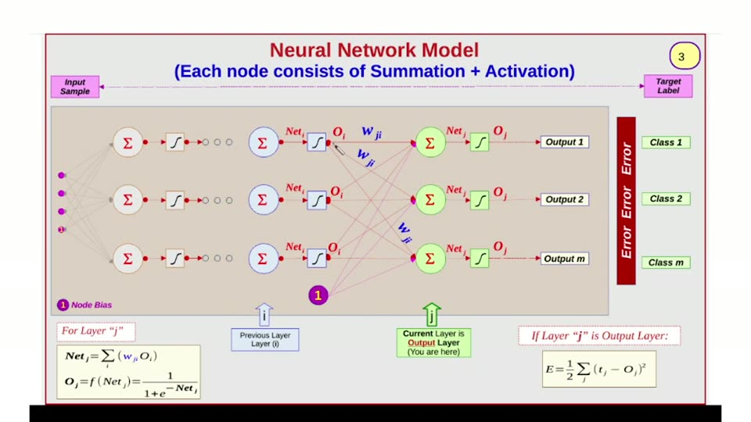

Slide 4
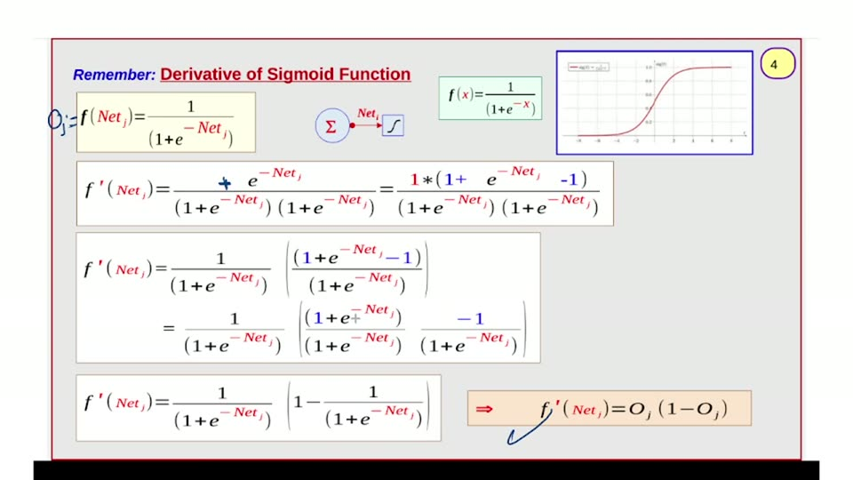

Slide 5
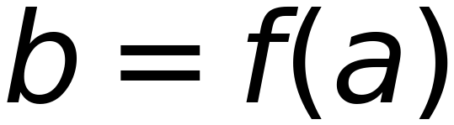
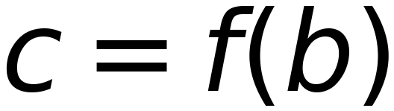

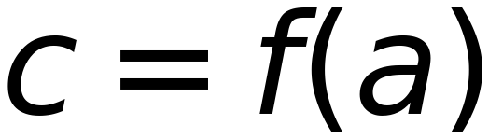
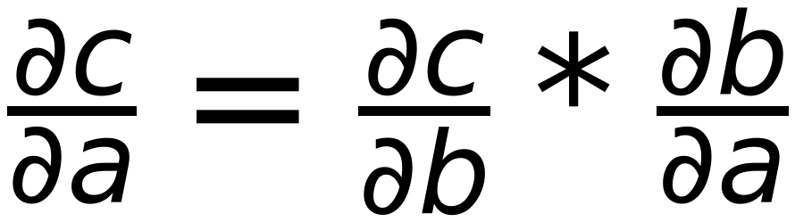
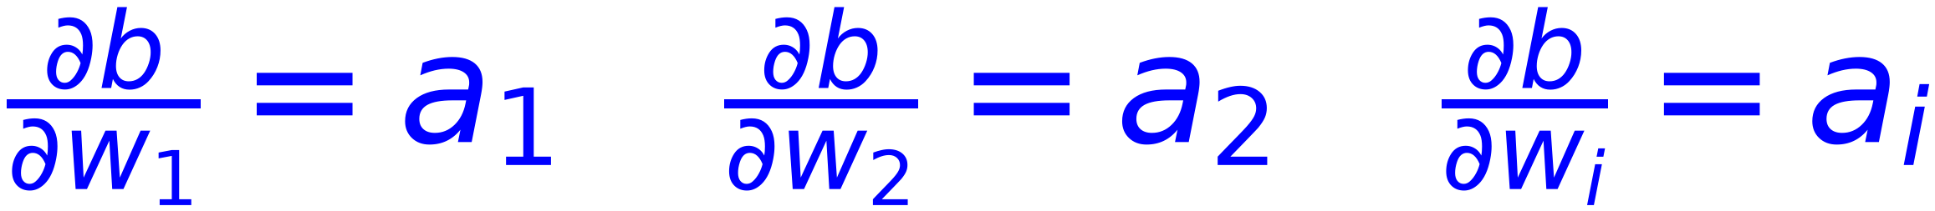


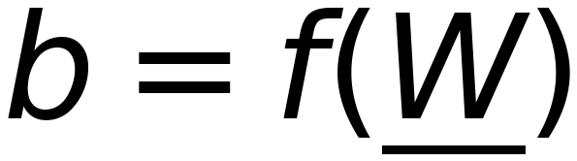
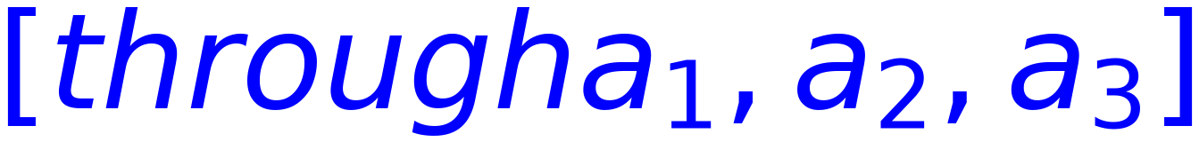
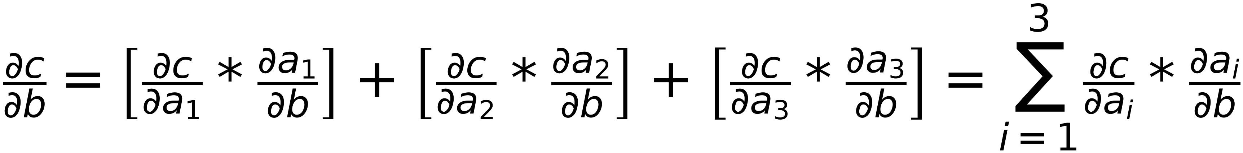
Revision
5
if a is changed , c will be chnaged accordingly)
Chain Rule
Conclusion:
=
then
One Term ONLY
and

Slide 6
6
Update Weights of
Output Layer
( Weights from previous layer to output layer )

Slide 7




Neural Network Model
7
(Weights of Output Layer AFFECTS Calculated Error)
For Layer "j"
↑
↑
If Layer "j" is Output Layer:
Previous Layer Layer (0)
Current Layer is Output Layer (You are here)

Slide 8

8
w_j
w_j
w_j
Σ
Net
Net
Class 1
O
Σ
Σ
Output 1
E
w
O
r
?
w
r
Σ
o
Class 2
Net
Σ
Σ
Net
r
O
Output 2
w
O
Σ
w
Class m
Net
Σ
Σ
Net
Multi Bias
O
1
Output m
w
O
w

Slide 9




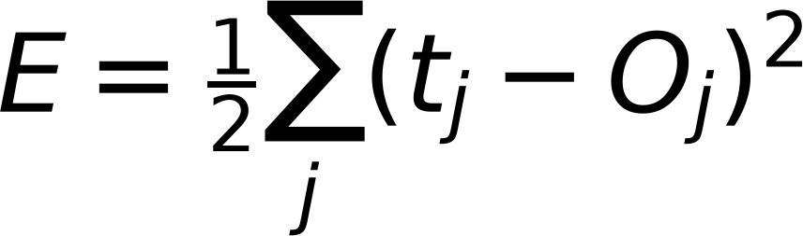
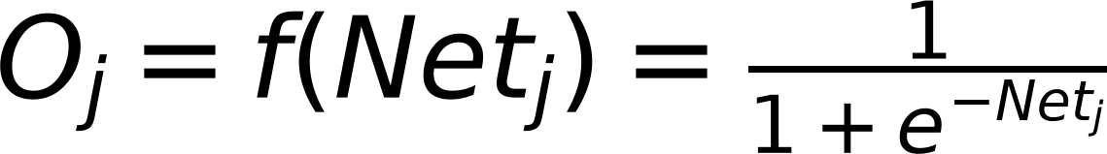
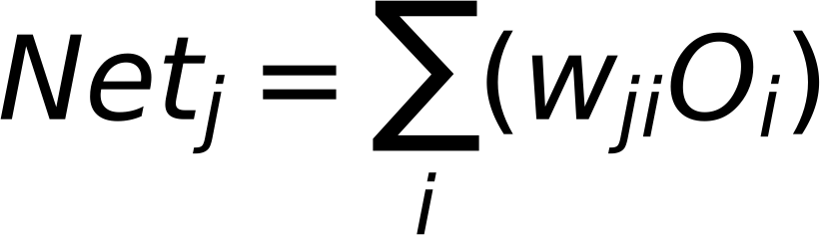
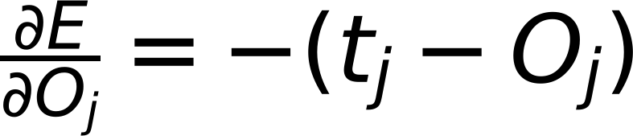
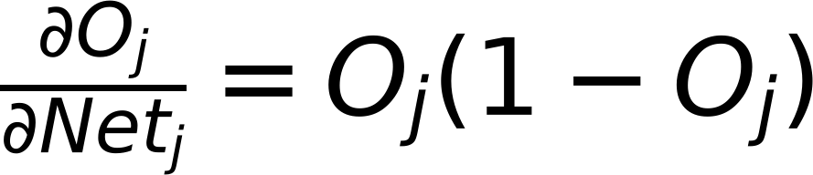
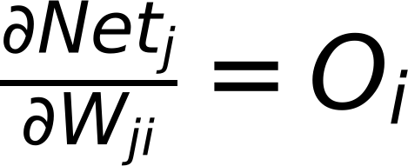

Gradient Descent
9
Error Class 1
$$W_{ji}^{Updated}=W_{ji}^{old}-η\frac{∂E}{∂W_{ji}}$$
E
r
r
Error Class 2
$$W_{ji}^{Updated}=W_{ji}^{old}+Δ_{ji}$$
o
r
Where
$$Δ_{ji}=-η\frac{∂E}{∂W_{ji}}$$
Error Class m
$$E=\frac{1}{2}\sum_{j}{(t_{j}-O_{j})^{2}}$$
For Sigmoid Activation
$$O_{j}=f(Net_{j})=\frac{1}{1+e^{-Net_{j}}}$$
$$Net_{j}=\sum_{i}{(w_{ji}O_{i})}$$
$$\frac{∂E}{∂O_{j}}=-(t_{j}-O_{j})$$
$$\frac{∂O_{j}}{∂Net_{j}}=O_{j}(1-O_{j})$$
$$\frac{∂Net_{j}}{∂W_{ji}}=O_{i}$$
$$\frac{∂E}{∂W_{ji}}=\frac{∂E}{∂O_{j}}*\frac{∂O_{j}}{∂Net_{j}}*\frac{∂Net_{j}}{∂W_{ji}}$$
$$\frac{∂E}{∂O_{j}}=-(t_{j}-O_{j})$$
$$=-(t_{j}-O_{j})*O_{j}(1-O_{j})*O_{i}$$
$$\frac{∂O_{j}}{∂Net_{j}}=O_{j}(1-O_{j})$$
$$\frac{∂Net_{j}}{∂W_{ji}}=O_{i}$$

Slide 10











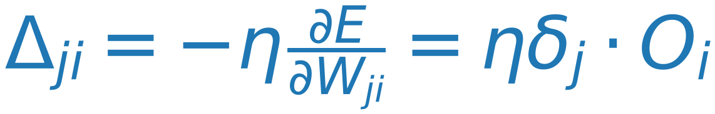
Gradient Descent
10
Class 1
$$W_{ji}^{updated}=W_{ji}^{old}-η\frac{∂E}{∂W_{ji}}$$
E
r
r
Class 2
$$W_{ji}^{updated}=W_{ji}^{old}+Δ_{ji}$$
o
r
Where
$$Δ_{ji}=-η\frac{∂E}{∂W_{ji}}$$
Class m
$$E=\frac{1}{2}\sum_{j}{(t_{j}-O_{j})^{2}}$$
For Sigmoid Activation
$$O_{j}=f(Net_{j})=\frac{1}{1+e^{-Net_{j}}}$$
$$Net_{j}=\sum_{i}{(w_{ji}O_{i})}$$
$$\frac{∂E}{∂O_{j}}=-(t_{j}-O_{j})$$
$$\frac{∂O_{j}}{∂Net_{j}}=O_{j}(1-O_{j})$$
$$\frac{∂Net_{j}}{∂W_{ji}}=O_{i}$$
$$\frac{∂E}{∂W_{ji}}=\frac{∂E}{∂O_{j}}⋅\frac{∂O_{j}}{∂Net_{j}}⋅\frac{∂Net_{j}}{∂W_{ji}}=\frac{∂E}{∂Net_{j}}⋅\frac{∂Net_{j}}{∂W_{ji}}$$
$$\frac{∂E}{∂O_{j}}=-(t_{j}-O_{j})$$
$$=-(t_{j}-O_{j})⋅O_{j}(1-O_{j})⋅O_{i}=-δ_{j}⋅O_{i}$$
$$\frac{∂O_{j}}{∂Net_{j}}=O_{j}(1-O_{j})$$
Where
$$δ_{j}=-\frac{∂E}{∂Net_{j}}=(t_{j}-O_{j})⋅O_{j}(1-O_{j}) (δ_{j} depends on j ONLY)$$
$$\frac{∂Net_{j}}{∂W_{ji}}=O_{i}$$
$$Δ_{ji}=-η\frac{∂E}{∂W_{ji}}=ηδ_{j}⋅O_{i}$$
Where
$$δ_{j}=(t_{j}-O_{j})⋅O_{j}(1-O_{j}) for output Layer$$

Slide 11
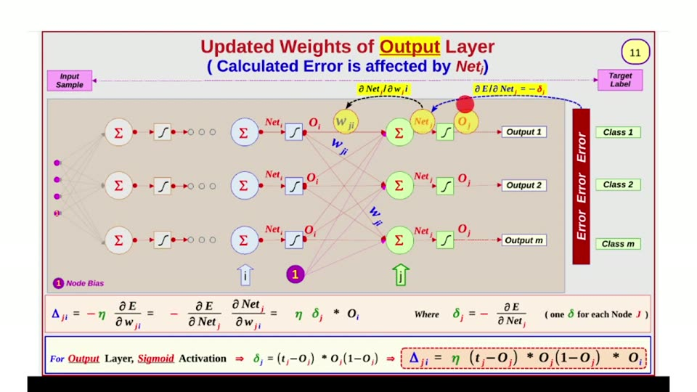

Slide 12






At Output Layer
12
O_i
δ_j
w_ji
O_j
t_j
w_ji
w_ji
O_i
δ_j
w_ji
w_ji
w_ji
O_j
Error
t_j
w_ji
w_ji
O_i
δ_j
w_ji
O_j
t_j
↑
Where:

Slide 13
Update Weights of
Hidden Layer
13
(Weights from previous layer to Hidden layer)

Slide 14


Neural Network Model
14
(Current Layer is Hidden Layer)
Input Sample
Target Label
O_j w_ji
Σ
Σ
Net_j
O_j w_kj
Σ
Net_j
O_k w_kl
Σ
Net_k
Error
Error
f
O_j
f
f
f
Output 1
Class 1
w_ji
w_kj
O_j
w_kl
O_k
O_j w_ji
Σ
f
Σ
Net_j
O_j w_kj
Σ
Net_j
O_k w_kl
Σ
Net_k
Class 2
O_j
f
f
f
Output 2
w_ji
w_kj
O_j
w_kl
O_k
O_j w_ji
Σ
f
Σ
Net_j
O_j w_kj
Σ
Net_j
O_k w_kl
Σ
Net_k
Class m
O_j
f
f
f
Output m
w_ji
w_kj
O_j
w_kl
O_k
1
1
⋮
⋮
⋮
⋮
⋮
For Layer "j"
Previous Layer
(l)
Current Layer
(You are here)
Next Layer
(K)
Note: Layer "j" is NOT Output Layer
X X X

Slide 15
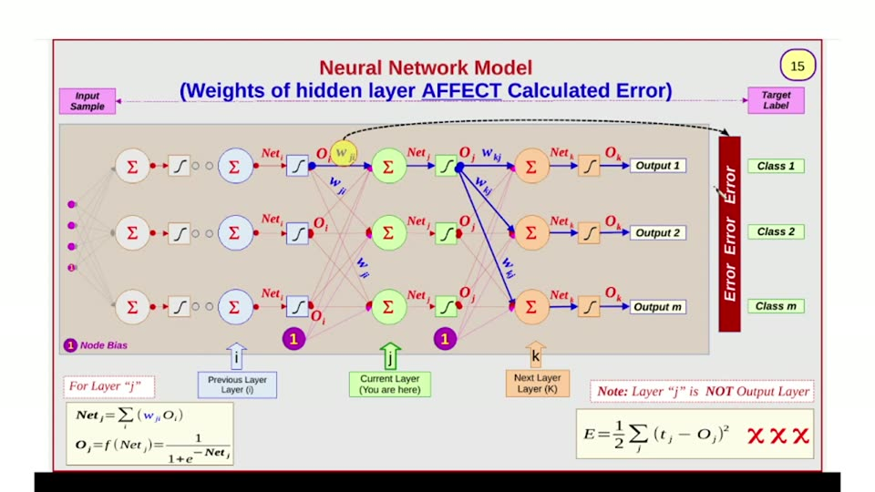

Slide 16
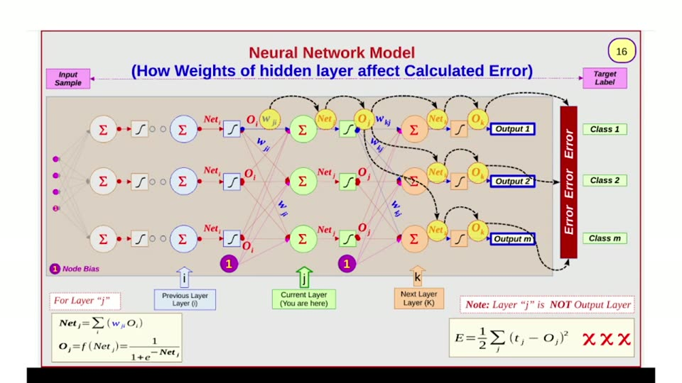

Slide 17
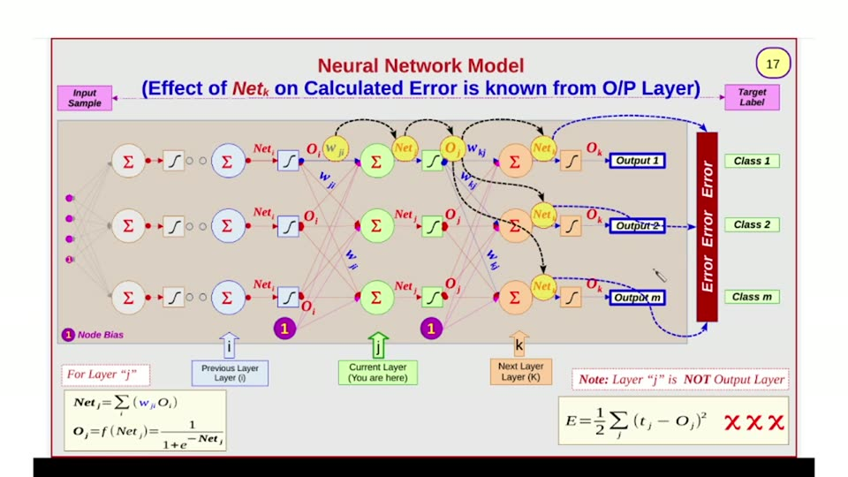

Slide 18
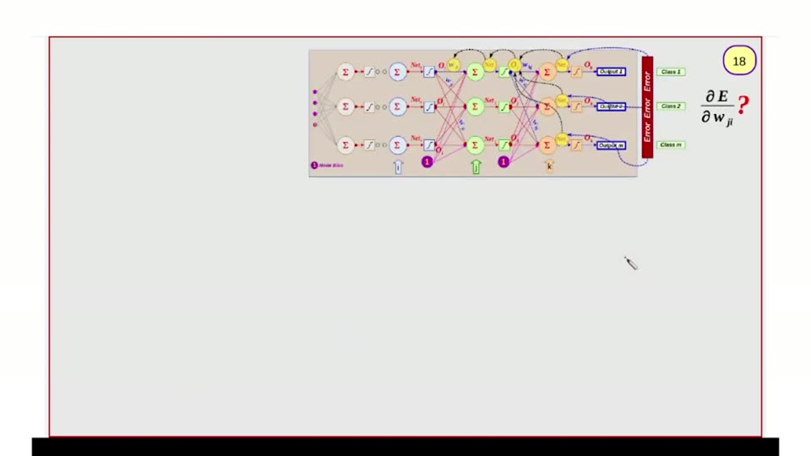

Slide 19
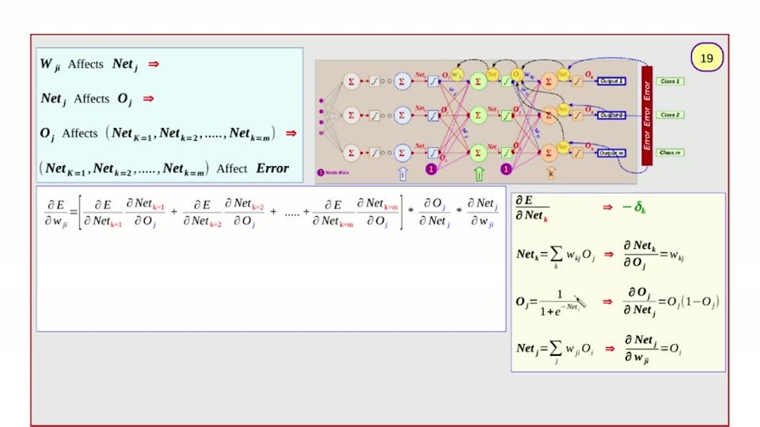

Slide 20
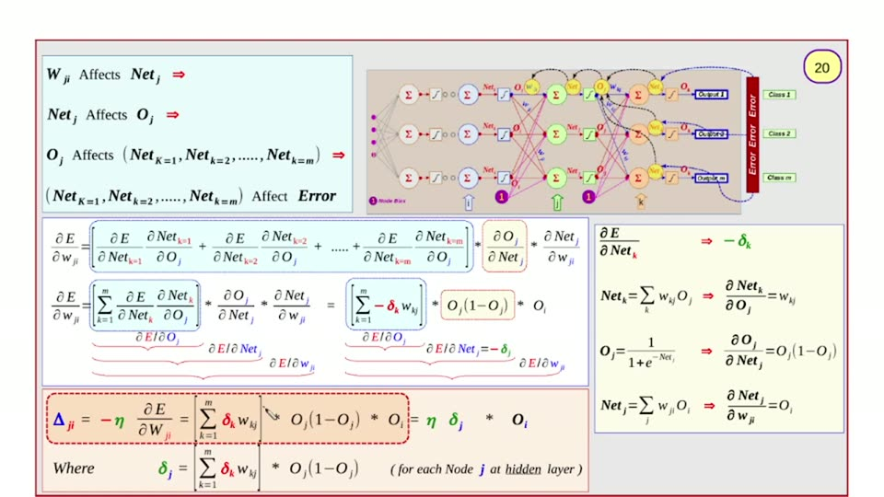

Slide 21
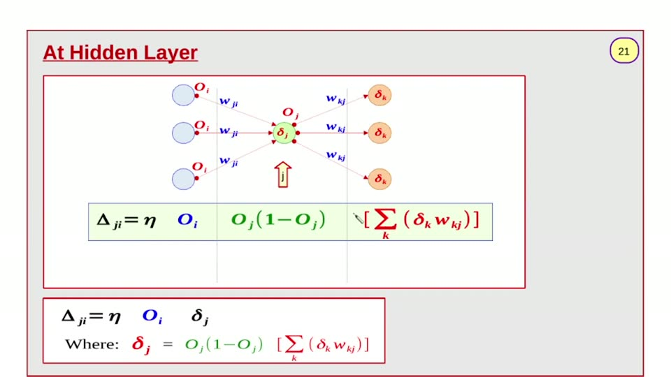

Slide 22
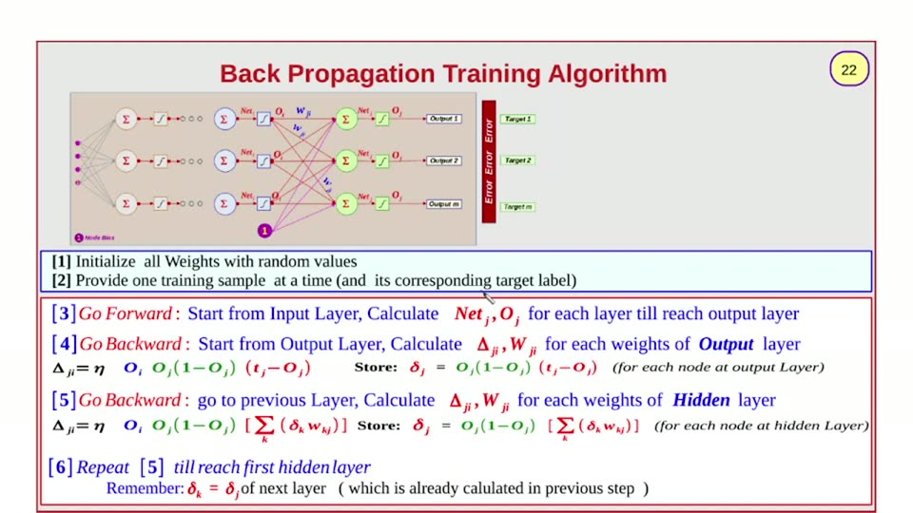

Slide 23
23
Initialization (Random Weights)
Pick Training Sample, and Corresponding Label
Go Forward, Calculate Output
Go Backward, Update weights
Last Sample ?
NO
Yes
Stop criteria is reached
NO
Yes
Max Iteration Is reached
Stop
NO
Yes
Pick First Sample again
Stop with FAIL

Slide 24
Stopping Criteria
24
[1] Total Error = zero (Theoretical)
[2] Total Error < certain value (Threshold)
[3] Percentage Change of Weights is less than certain value (Threshold)
[4] Reach Maximum number of iterations (Epochs) without satisfying [2] or [3]
Stopping is due to reaching Maximum number of iterations = Training is FAILED
Expected Reasons:
[1] The defined Maximum Number of Epochs is small. Try to increase the limit
[2] Under-fitting (Training samples are not adequate). Try to provide more training samples
[3] Model Design is not suitable to training data. Try to add more nodes in hidden layer or add more hidden Layers
[4] Data is NOT separable by Neural Network. Try Another Models (e.g. SVM with Kernels)

Slide 25
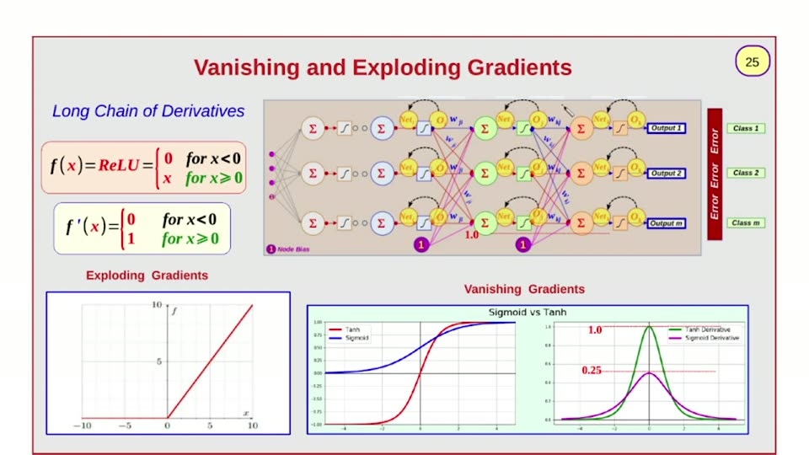

Slide 26
26
Solved Example
[ Update Weights of Output Layer and Hidden Layer ]
Using one training sample

Slide 27
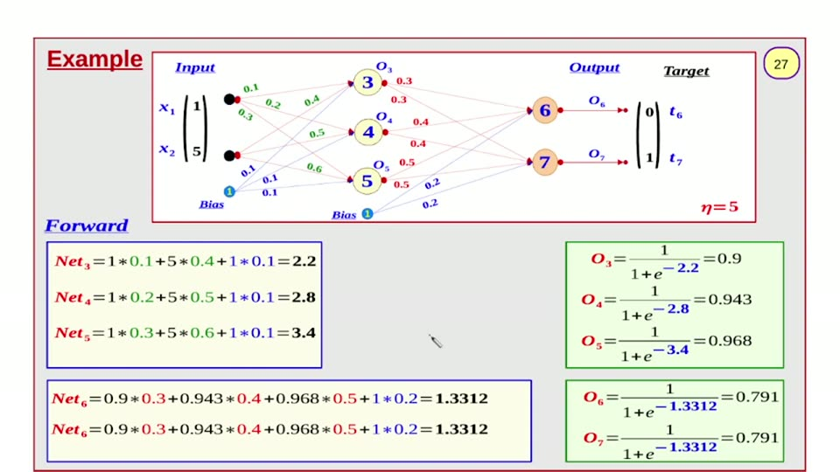

Slide 28
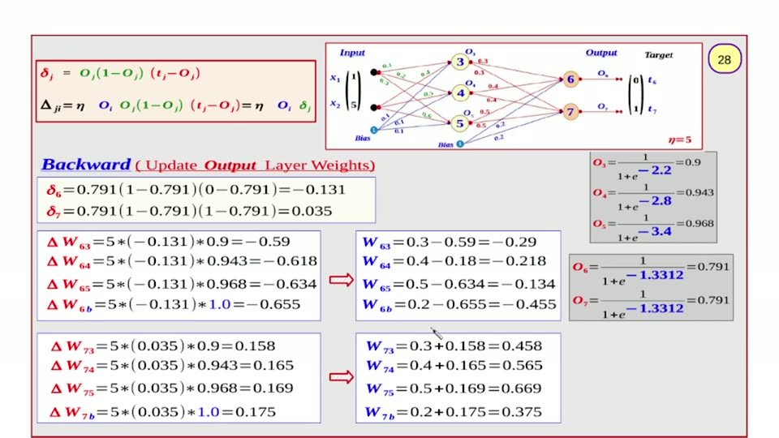

Slide 29
After Updating O/p Layer weights
29
Input
O₃
-0.29
0.1
Target
x₁
0.4
3
Output
t₆
[
1
]
0.2
0.458
[
0
]
0.3
-0.218
6
O₆
0.5
O₄
0.565
t₇
5
x₂
4
0.6
-0.134
-0.445
1
0.1
0.1
O₅
0.669
7
O₇
1
0.1
5
-0.375
Bias
Bias
1
η= 5

Slide 30
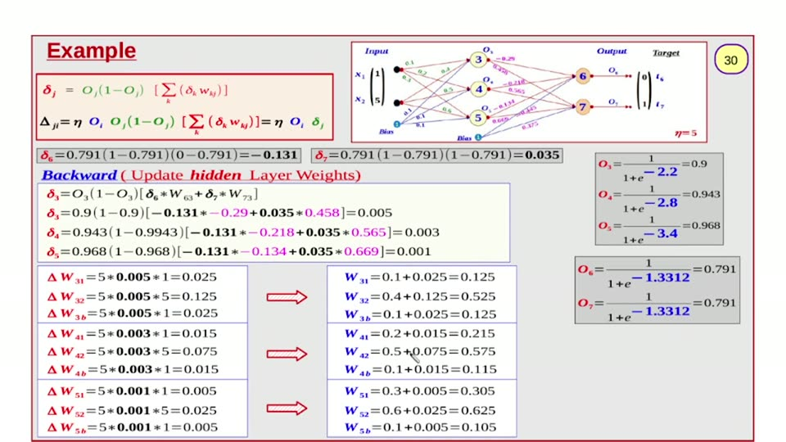

Slide 31


Slide 32
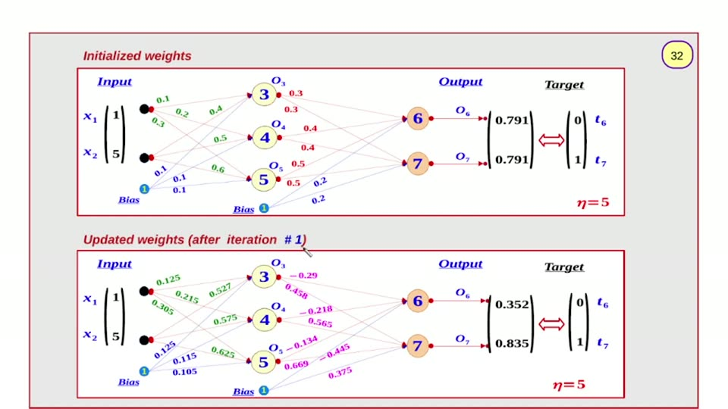

Slide 33
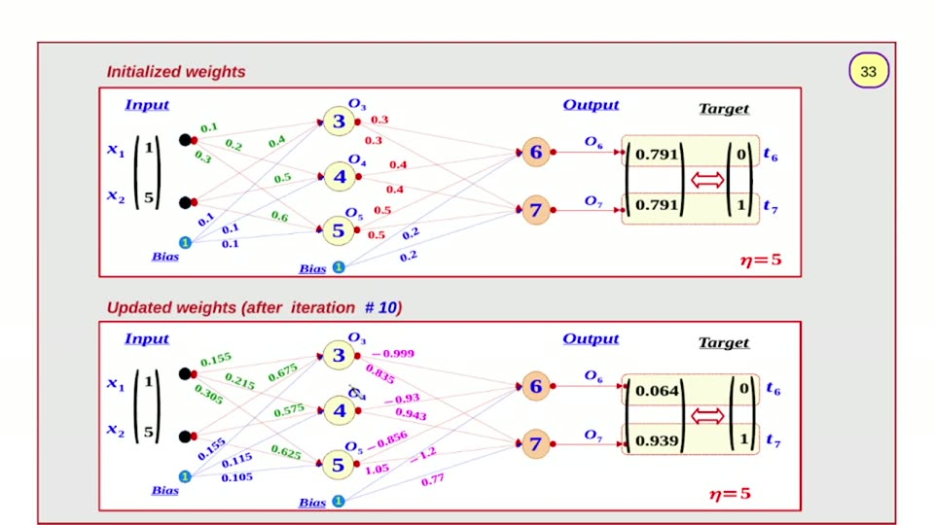

Slide 34


