Slide 1





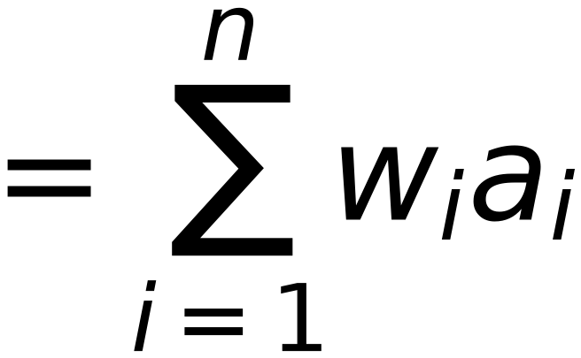



Revision
5
Chain Rule
Conclusion:
One Term ONLY

