Slide 1



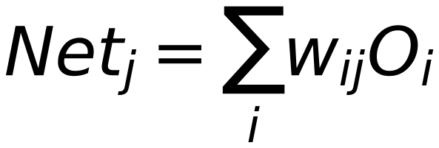
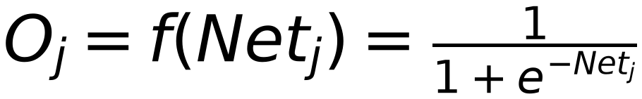
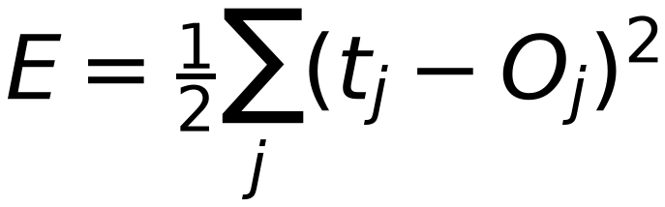
Neural Network Model
17
(Effect of Net_k on Calculated Error is known from O/P Layer)
Input
Sample
Target
Label
Net_i
O_i
W_ij
O_j
W_jk
O_k
Σ
Σ
W_ij
Σ
Net
W_jk
Σ
Net
Output 1
Error Error Error
Class 1
Net_i
O_i
O_j
O_k
Σ
Σ
W_ij
Σ
Net
W_jk
Σ
Net
Output 2
Class 2
Net_i
O_i
O_j
O_k
Σ
Σ
W_ij
Σ
Net
W_jk
Σ
Net
Output m
Class m
1
Node Bias
1
1
k
For Layer "j"
Previous Layer
Layer (i)
Current Layer
(You are here)
Next Layer
Layer (K)
Note: Layer "j" is NOT Output Layer
X X X

