Slide 1


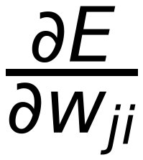
18
Net
Σ
Output 1
Error Error Error
Class 1
Net
?
Σ
Output 2
Class 2
Net
Σ
Output 3
Class m
1
Input Data

