Slide 1
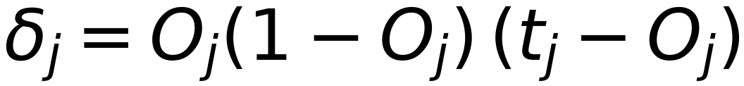
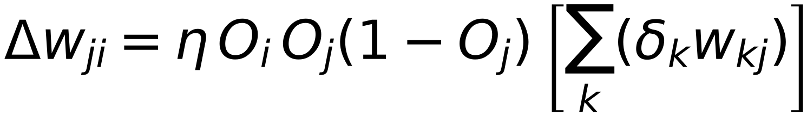
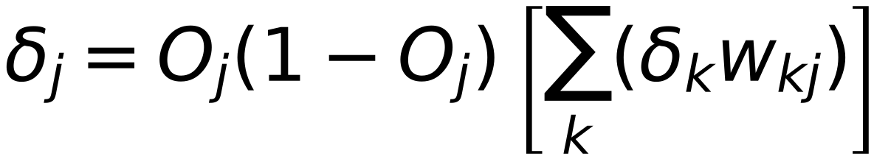
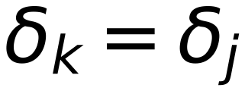
Back Propagation Training Algorithm
22
Neural Net
Netⱼ
Oⱼ
Σ
Σ
Output 1
Target 1
w₁ⱼ
Error 1
Error 2
Error m
w₂ⱼ
Σ
wₖᵢ
Σ
Output 2
Target 2
wₙⱼ
Σ
Σ
Output m
Target m
Input Layer
Hidden Layer
Output Layer
[1] Initialize all Weights with random values
[2] Provide one training sample at a time (and its corresponding target label)
[3] Go Forward : Start from Input Layer, Calculate Netⱼ, Oⱼ for each layer till reach output layer
[4] Go Backward : Start from Output Layer, Calculate Δwⱼᵢ, Wⱼᵢ for each weights of Output layer
Store:
(for each node at output Layer)
[5] Go Backward : go to previous Layer, Calculate Δwⱼᵢ, Wⱼᵢ for each weights of Hidden layer
Store:
(for each node at hidden Layer)
[6] Repeat [5] till reach first hidden layer
Remember:
of next layer ( which is already calculated in previous step )

