Slide 1
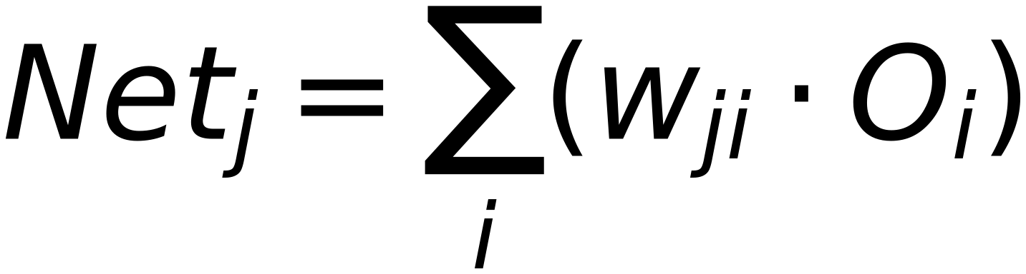
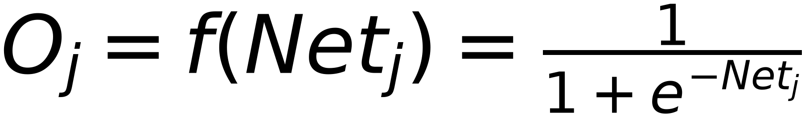
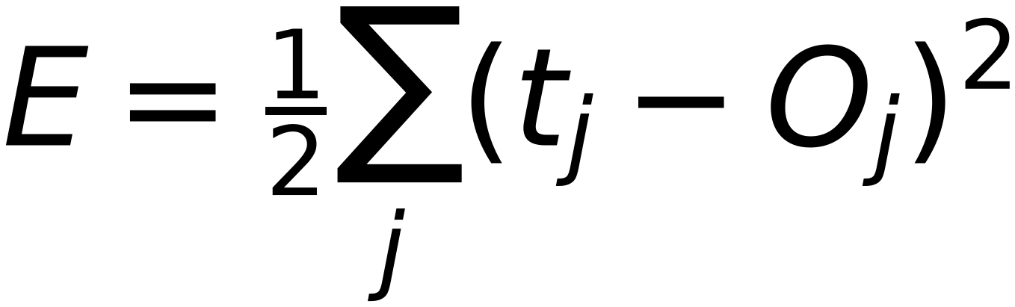
Neural Network Model
3
(Each node consists of Summation + Activation)
Input Sample
Target Label
Net_i
w_ji
Net_j
w_jj
Net_k
Error
Error
Σ
w_ji
Σ
w_jj
Σ
Class 1
f
f
Output 1
O_i
O_j
O_k
Net_i
Net_j
Net_k
Σ
w_ji
Σ
w_jj
Σ
Class 2
f
f
Output 2
O_i
O_j
O_k
Net_i
Net_j
Net_k
Σ
w_ji
Σ
w_jj
Σ
Class m
f
f
Output m
O_i
O_j
O_k
1
Node Bias
1
For Layer "j"
Previous Layer
Layer (i)
Current Layer is Output Layer
(You are here)
If Layer "j" is Output Layer:
$$Net_{j}=\sum_{i}{(w_{ji}⋅O_{i})}$$
↑ i
↑ j
$$E=\frac{1}{2}\sum_{j}{(t_{j}-O_{j})^{2}}$$
$$O_{j}=f(Net_{j})=\frac{1}{1+e^{-Net_{j}}}$$

