Slide 1
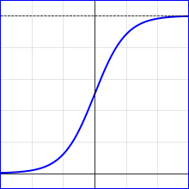
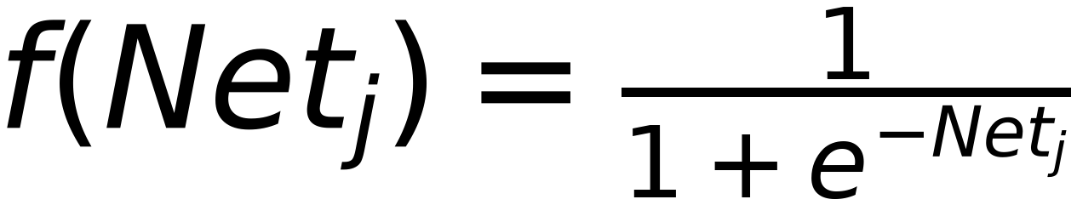
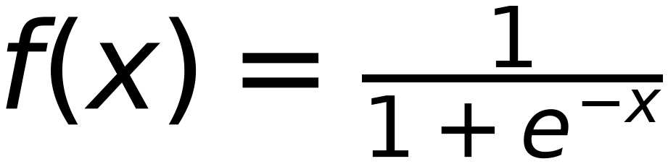
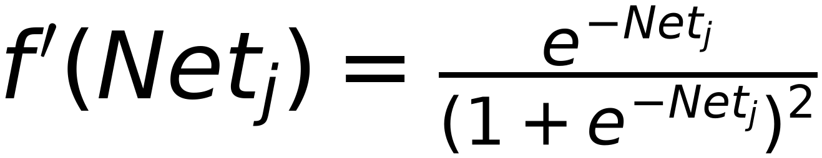
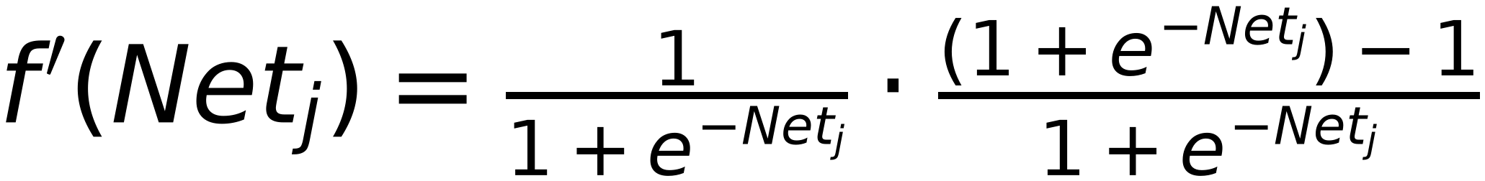
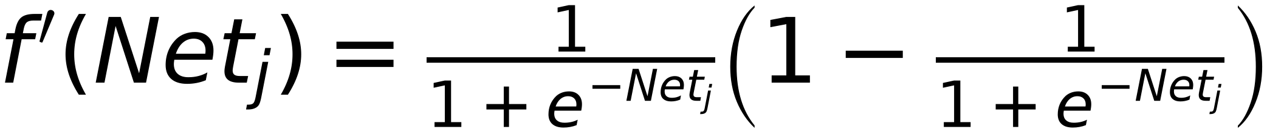
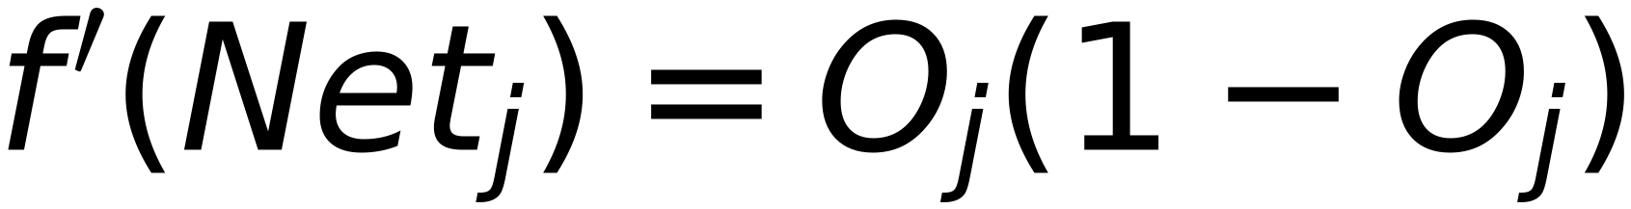
Remember:
Derivative of Sigmoid Function
4
O_j:
$$f(Net_{j})=\frac{1}{1+e^{-Net_{j}}}$$
Σ
Net_j
f
Net_j
$$f(x)=\frac{1}{1+e^{-x}}$$
$$f'(Net_{j})=\frac{e^{-Net_{j}}}{(1+e^{-Net_{j}})^{2}}$$
$$f'(Net_{j})=\frac{1}{1+e^{-Net_{j}}}⋅\frac{(1+e^{-Net_{j}})-1}{1+e^{-Net_{j}}}$$
$$f'(Net_{j})=O_{j}(1-O_{j})$$
$$f'(Net_{j})=\frac{1}{1+e^{-Net_{j}}}\left(1-\frac{1}{1+e^{-Net_{j}}}\right)$$

