Slide 1
RTG-Synch
Case-Study

Slide 2
RTG-Synch: State Machine
State Transition | Description | Effect on Gang-Lock Utilization
(I | S4) -> S1 | A ready gang acquires gang lock on idle core | Locking duration resumes
(I | S4) -> S2 | A ready gang acquires gang lock by preempting a running gang | Locking duration resumes
(I | S3 | S5) -> S5 | A ready gang is blocked by a higher priority running gang | No effect
(S1 | S2) -> S4 | A running gang completes execution and releases gang lock | Locking duration pauses
(S1 | S2) -> S3 | A running gang is preempted by a higher priority gang | Locking duration pauses
(S1 | S2) <-> START | Transient transition marking the start of a new job from user-space | New locking duration starts and previous locking duration is marked ended
Init
(I)
Acquire
(S1)
Preempt
(S2)
START
Preempted
(S3)
Release
(S4)
Block
(S5)

Slide 3
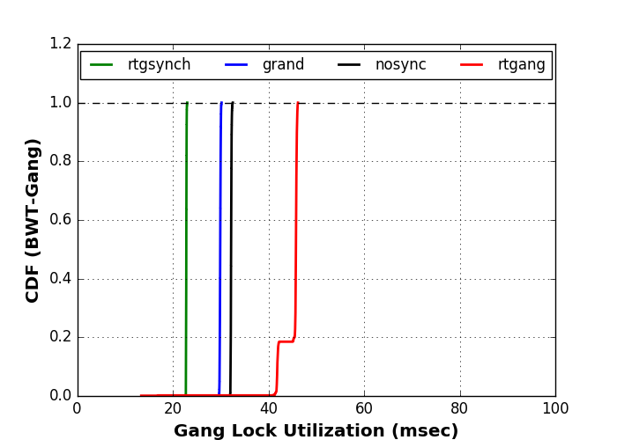
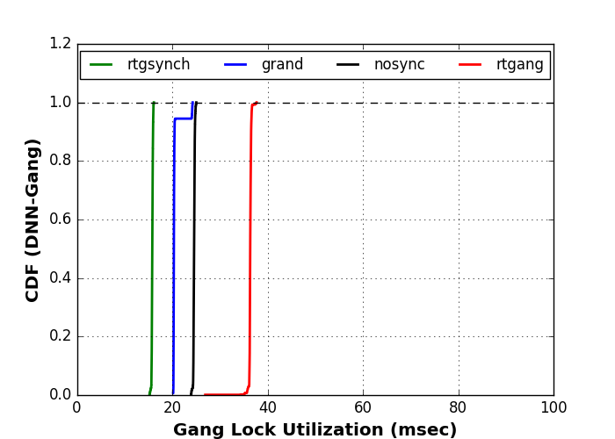

Slide 4
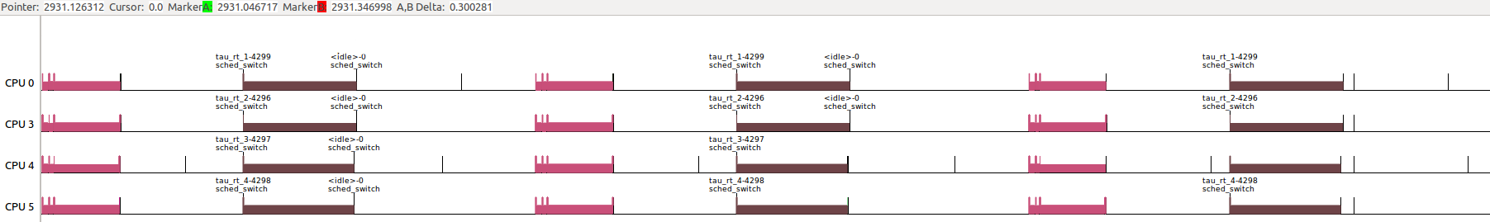
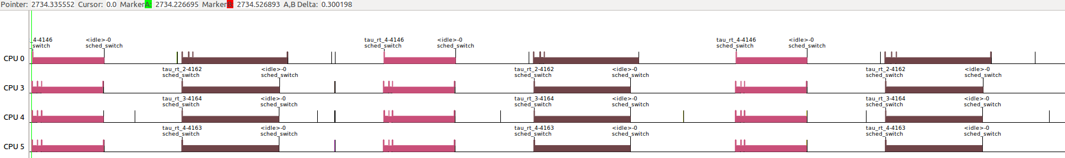
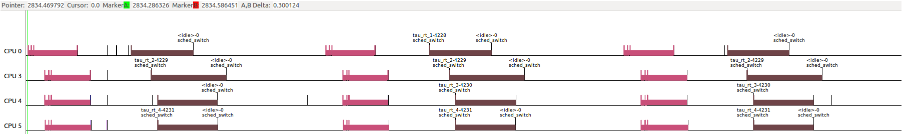
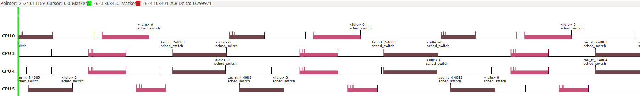
RTG-Synch
G-Random
100-msec
20.3-msec
100-msec
29.5-msec
16.4-msec
22.5-msec
DNN-1
BWT-1
BWT-1
DNN-1
DNN-2
BWT-2
DNN-2
BWT-2
DNN-3
BWT-3
DNN-3
BWT-3
DNN-4
BWT-4
DNN-4
BWT-4
No-Synch
RT-Gang
23.4-msec
100-msec
100-msec
31.4-msec
35.1-msec
46.6-msec
DNN-1
BWT-1
BWT-1
DNN-1
DNN-2
BWT-2
DNN-2
BWT-2
DNN-3
BWT-3
DNN-3
BWT-3
DNN-4
BWT-4
DNN-4
BWT-4

Slide 5
RTG-Synch
100-msec
16.4-msec
22.5-msec

Slide 6
G-Random
20.3-msec
100-msec
29.5-msec

Slide 7
No-Synch
23.4-msec
100-msec
31.4-msec

Slide 8
RT-Gang
100-msec
35.1-msec
46.6-msec

Slide 9
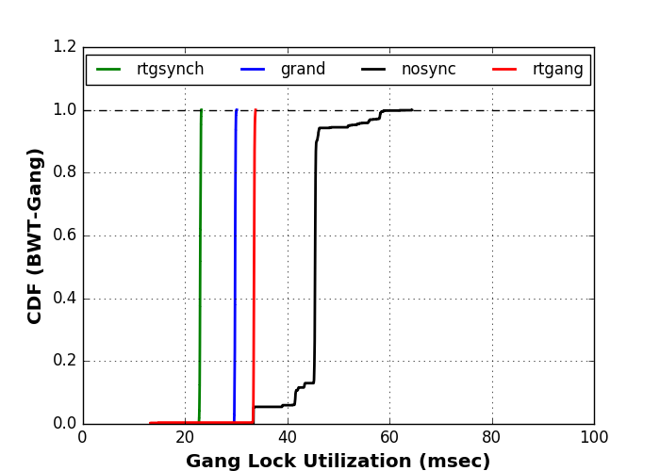
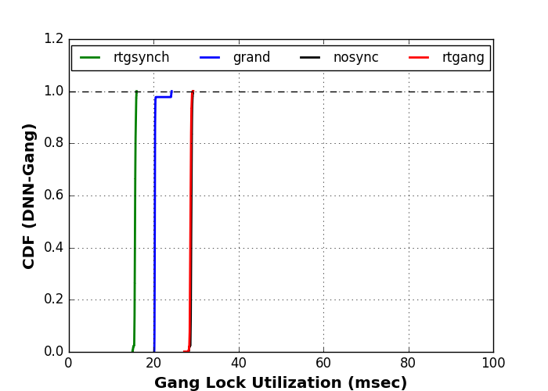

Slide 10
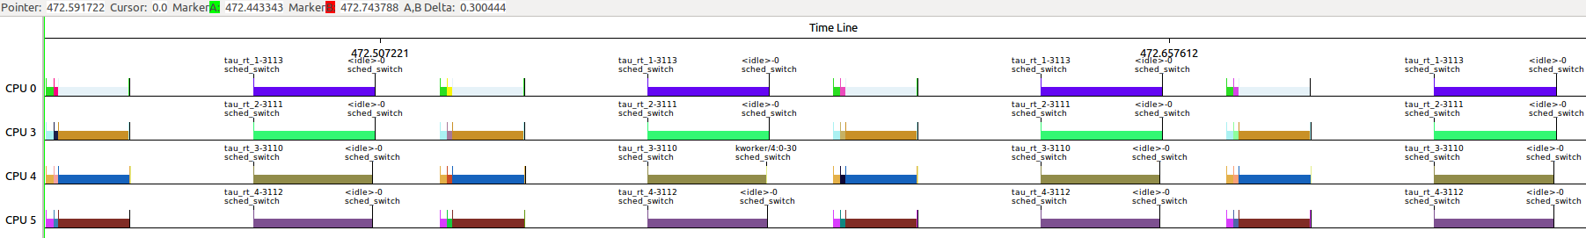
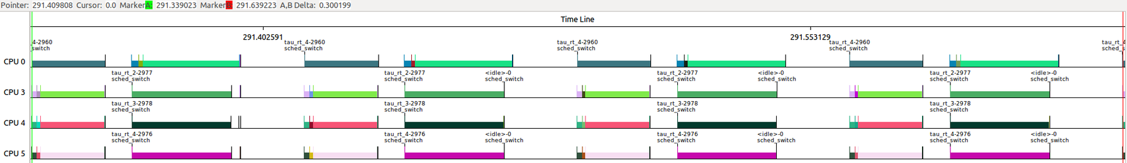
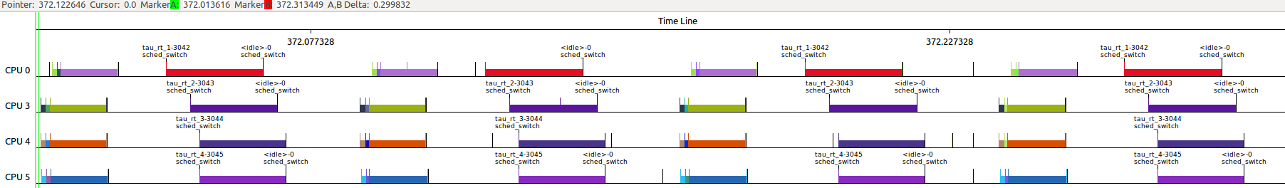
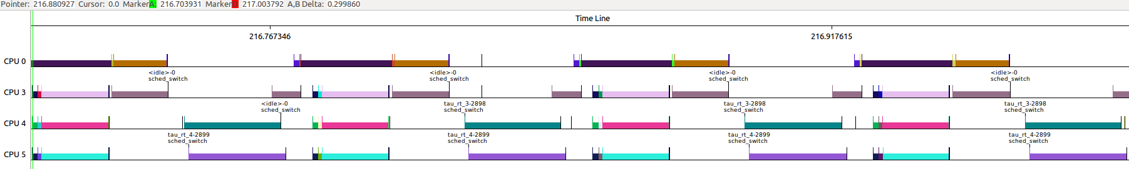
RTG-Synch
G-Random
No-Synch
RT-Gang

Slide 11
