Slide 1
PORTABLE SPRAY PAINTING UNIT FOR AUTOMOBILE
Ahmed Jalil Qureshi D-15-ES-08
Jawad Jillani D-15-ES-32
Masooma Ali D-15-ES-38
M. Awais D-15-ES-48
Sajjad Haider D-15-ES-114

Slide 2
ABSTRACT
In this system, mixing of pigments and spraying of paints is done automatically. For that purpose, a controller is used to control the actuators and sensors to supervise several parameters of the system. Initially, a color will be sensed and the system will provide the exact color after the mixing process. For testing, a spraying unit is attached.

Slide 3
CONTENTS
Introduction
Methodology
Project Description
Project Progress
References

Slide 4
INTRODUCTION
The mixing process is a necessity of every process industry. It’s essential for food, beverage, oil, ink-making, and many more industries. Paint mixing can be used in fabrics, automobile, printing-inks, and coatings. It is well known that any color can be achieved by using the primary colors which are; red, green, and blue. Using this concept of colors, a system will be designed to generate the required color automatically. The testing of the color will be done as well.

Slide 5
METHODOLOGY
A microcontroller will be used to automate the mixing and painting process. Pumps will be used to control the flow of paint. Blenders in container will run constantly to avoid the clotting and drying of paints. After mixing of paint, an automated air sprayer will be used to spray an object of our required color. Status of the process will be checked on display panel.

Slide 6
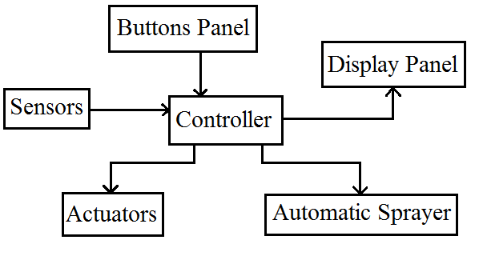
BLOCK DIAGRAM

Slide 7
PROJECT REQUIREMENTS
Paints
Arduino Mega
Containers
Mixing dc long shaft motor
Actuators
Pumps
20*4 LED with I²C
Press buttons
Electric sprayer kit
Color sensor
Mixing container with motor and actuator
Frame structure
Gel battery 12V
Relays
Arduino IDE (Software)

Slide 8
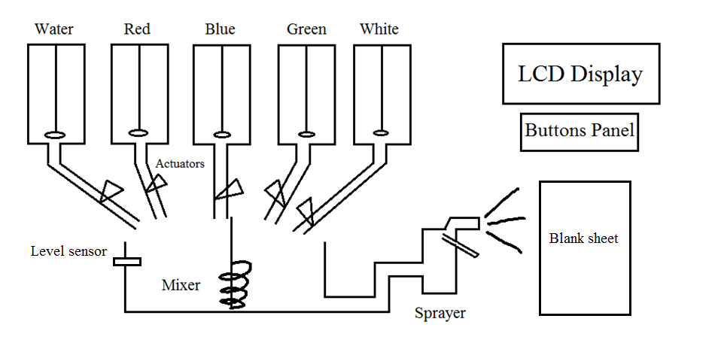
PLANT DESCRIPTION

Slide 9
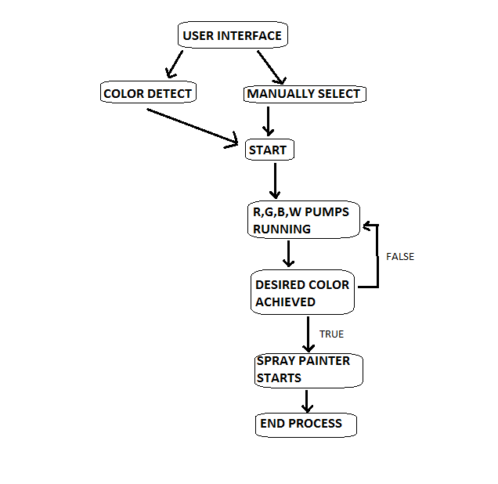
FLOWCHART

Slide 10
CONTROLLER
We will use Arduino mega as our controller.
The controller will determine the color tone from sensor.
It will control the display panel.
It will also control the spraying unit.

Slide 11
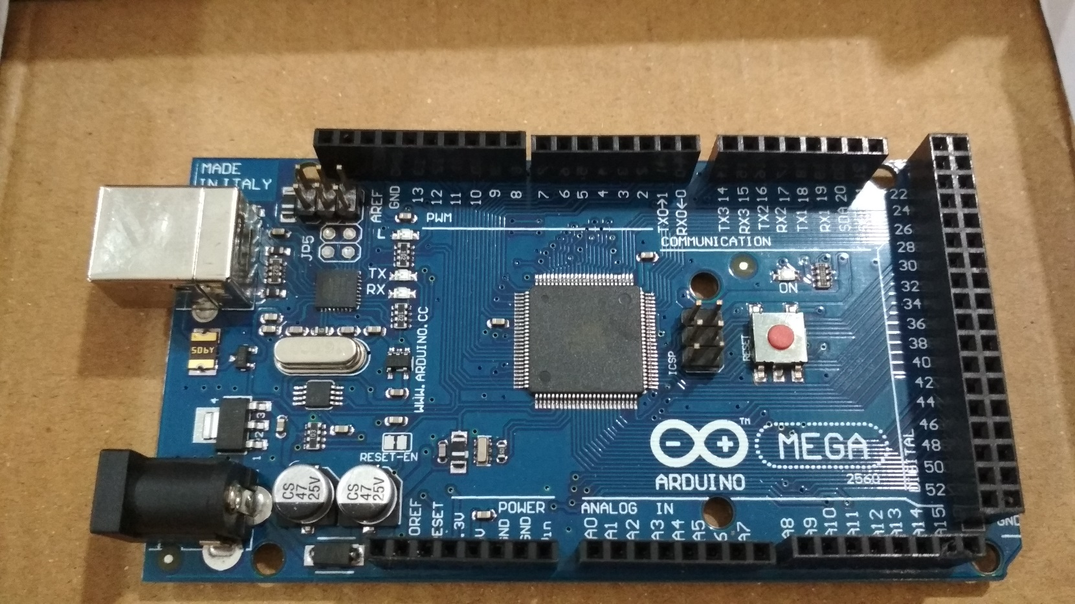
CONTROLLER

Slide 12
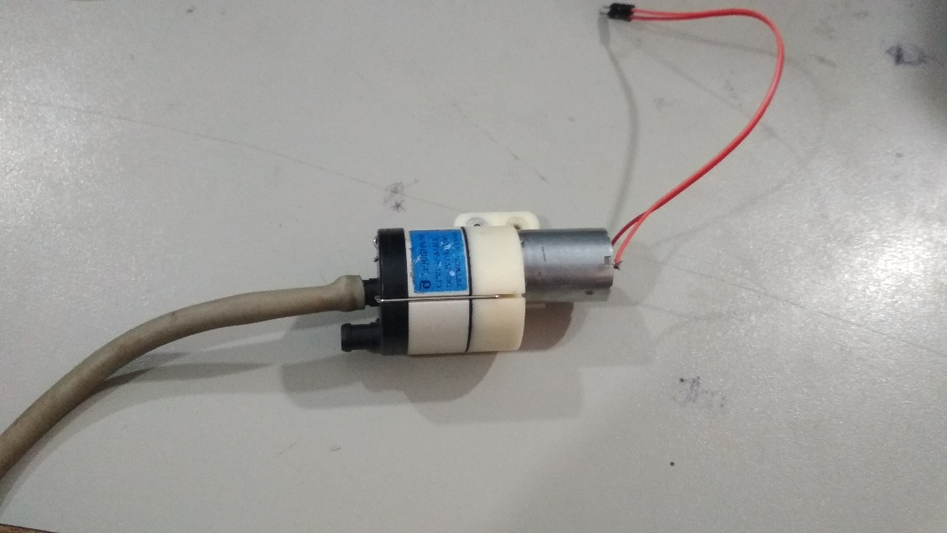
ACTUATORS
Pumps will be used to control the flow and quantity of the fluid.

Slide 13
SENSORS
A color sensor will sense the color at the start.
Another color sensor will sense after mixing.
A level sensor will be used for volume measuring of paint.
A proximity sensor is used to detect if the sheet is present to start spraying.

Slide 14
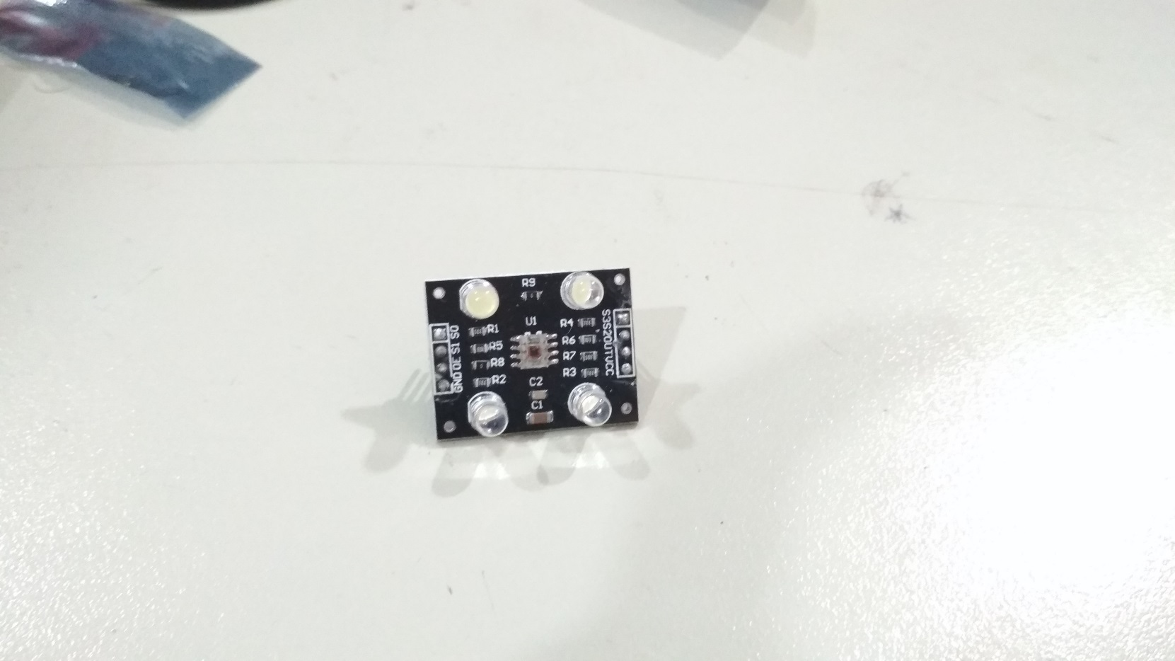
COLOR SENSOR

Slide 15
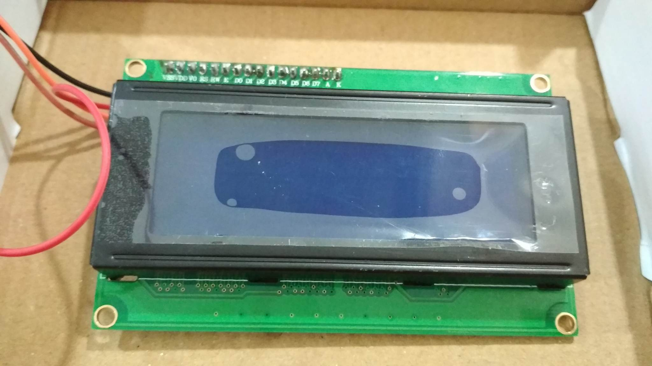
I2C LCD
A 20x4 character LCD is used.
I2C interface is used to so reduced complexity.

Slide 16
AUTOMATIC SPRAYER
A sprayer will be attached in the end which will automatically spray the achieved color on the blank sheet.
It is done for checking and assuring that the output color is the desired color.

Slide 17
FEATURES
Automation
Portability
Cost effective
Simple design
Easily implemented
Diversity in usage

Slide 18
APPLICATIONS
Fabric industries
Automobile industries
Paint-making industries
Coating industries
Cottage industries
Cosmetics industries

Slide 19
COST OF THE PROJECT
The total cost is expected to be 22,600 PKR.
A slight variation should be expected.

Slide 20
COMPLETED TASKS
The project frame has been made.
Containers, pipes and pump have been installed.
LCD has been interfaced using I2C.
Interfacing and controlling panel has been created.
Color sensor has been interfaced with LCD.

Slide 21
TASKS TO BE ACHIEVED
Assembling of all parts together.
Complete coding for the microcontroller.
Setting up sensors and actuators into frame.
Installation of the automatic sprayer.

Slide 22
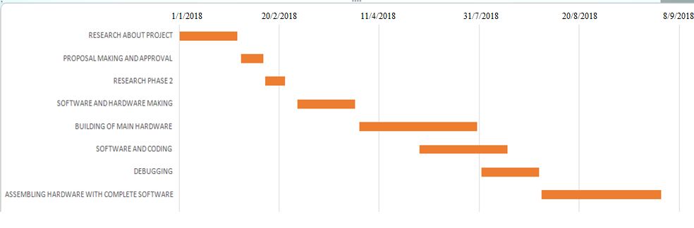
GANTT CHART

Slide 23
REFERENCES
Thompson, Daniel V. The Materials and Techniques of Medieval Painting. Dover Publications, Inc., New York, 1956, ISBN 0-486-20327-1, p. 86.
Darshini B. and E. Esakki Vigneswaran, Industrial process monitoring and control using Raspberry Pi ©2006-2016 Asian Research Publishing Network (ARPN). All rights reserved. VOL. 11, NO. 2, JANUARY 2016 ISSN 1819-6608

Slide 24
QUESTIONS?
THANK YOU ☺

