Slide 1
Nebula Roast Launch
Product team, January 2027

Slide 2
The product
Single-origin beans from the Guji region of Ethiopia
Medium roast with blueberry and cocoa notes
Launch date: 14 March 2027
Notes:
Mention that the retail price of a 250 g bag is 18 US dollars.

Slide 3
Pre-orders by week

Slide 4
Launch budget
Item | Cost (USD)
Packaging | 6,500
Social media ads | 12,000
Launch event | 4,000

Slide 5
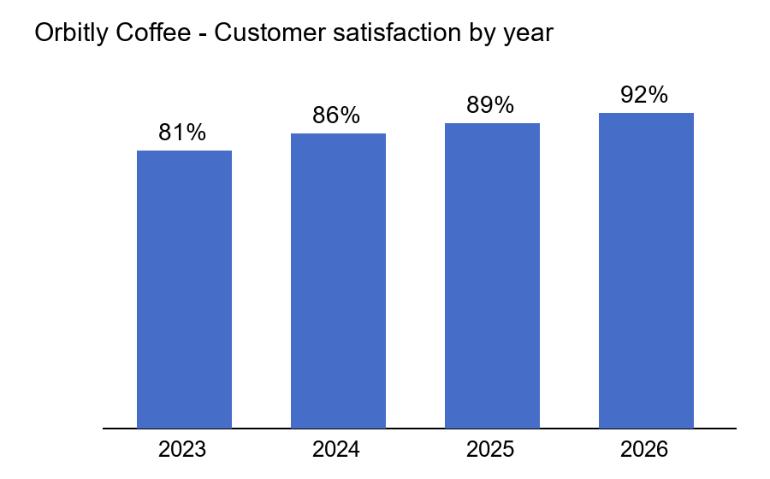
Customer satisfaction

