Slide 1




VISION-ASSISTED CARTESIAN ROBOTIC SYSTEM FOR 3D BLOCK CONSTRUCTION
Ahmed Gharib
Mohie Halawa
Khalil Qanabita

Slide 2

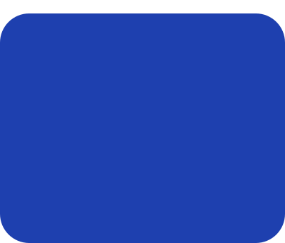
TABLE OF CONTENTS
Motivation & Objectives
Bill of Materials
System Design
Testing & Results
Vision & Control System
Conclusion & Future Work

Slide 3
BACKGROUND & MOTIVATION
Why This Project?
• Industrial pick-and-place systems must do more than move parts.
• Real assembly cells must verify feeding, gripping, placement, and failures.
• Timing-based systems assume success instead of confirming it.
• The goal is a machine that verifies every stage rather than relying on assumptions.

Slide 4
THE PROBLEM
WHAT AN OPEN-LOOP MACHINE CANNOT SEE
Stacking is sequential: block 7 has to be right or block 18 falls off it. A timing-based machine cannot tell success from failure, so it never stops — it turns one silent failure into a pile.
1
Empty or jammed hopper
The gate opens, no block comes out, the belt runs anyway. The claw closes on nothing.
2
Two blocks instead of one
A gate open far enough for one block is open far enough for two. The second arrives out of sequence.
3
A block that is late or crooked
A belt is not a positioning system. The block is picked by its corner, or missed entirely.
4
Lost steps
Open-loop steppers lose steps against a stall, and nothing in the motor reports it.
5
A hand in the workspace, or a controller reset
A person moves a block, or a USB open reboots the board un-homed. The machine's model is silently wrong.

Slide 5




OBJECTIVES
1
Develop a complete self-feeding robotic cell capable of autonomous 3D block construction.
2
Place blocks at any addressable grid cell and stack level within the machine workspace.
3
Support both vertical and horizontal block orientations through a rotating end-effector and dual-grid system.
4
Detect, localize, and verify blocks using an overhead vision system with calibrated grid mapping.
5
Provide a browser-based platform for structure design, execution, and safe operation of the robotic system.

Slide 6
SCOPE AND BOUNDARIES
WHAT “CLOSED-LOOP” MEANS IN THIS PROJECT
Sensor- and vision-confirmed sequencing — not servo position control.
The machine never verifies a motor shaft. It verifies that a block left the hopper, that a block reached the pickup point, that a build phase began and ended, and that a block is visible where one was commanded. Each of those can refuse permission for the step after it.
IN SCOPE
OUT OF SCOPE
CoreXY gantry, Z axis, servo claw, 90° rotation
Self-feeding module with two ultrasonic confirmations
Overhead fisheye camera, detection and grid calibration
Browser console, 3D Build Studio, digital twin
Two serial protocols and the Pi orchestration
Autonomous planning — the human designs the structure
Interrupting a motion already in progress
Metrological (checkerboard) camera calibration
Closed-loop motor control — there are no encoders
Multi-operator accounts and WebRTC video

Slide 7
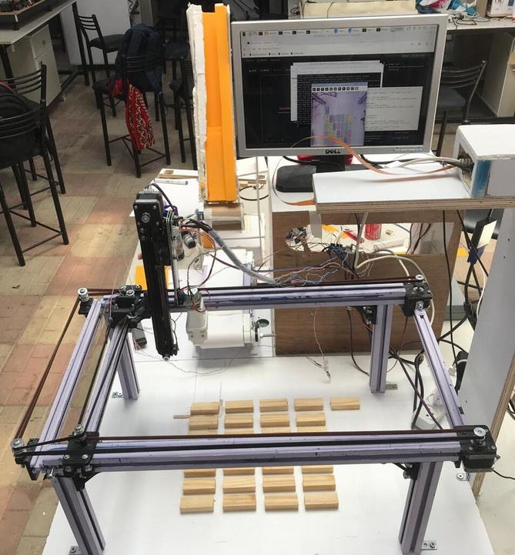
01
SYSTEM DESIGN
The three-controller architecture, the mechanics, and the components the machine is actually made of.

Slide 8

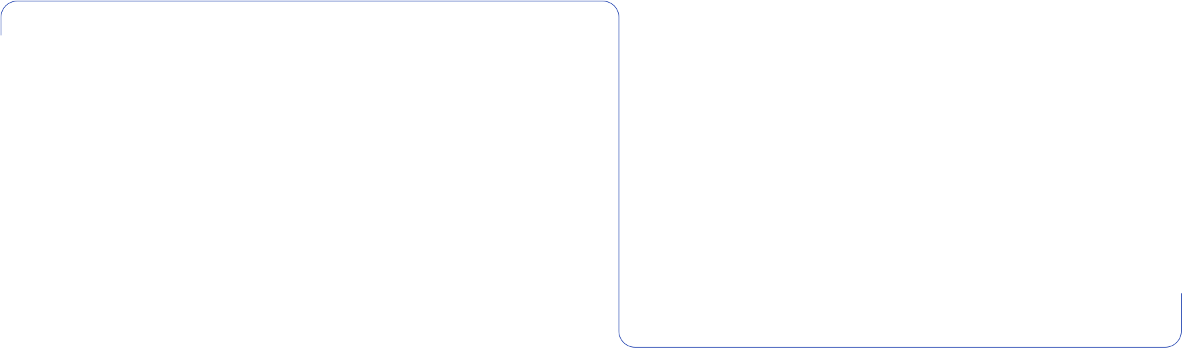
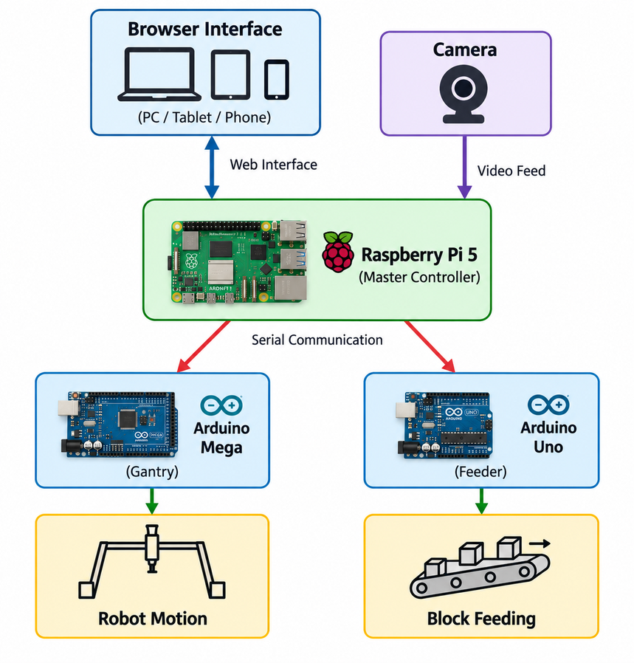
OVERALL SYSTEM ARCHITECTURE
Computer vision detects blocks and guides the robot to build predefined structures.

Slide 9
THREE CONTROLLERS, ONE MASTER
ONE MASTER, TWO ISOLATED SLAVES
Raspberry Pi 5
Arduino MEGA 2560
Arduino Uno
8 GB · THE MASTER
THE GANTRY · 9600 8N1
THE FEEDER · 9600 8N1
Camera capture and the whole vision pipeline
FastAPI web service, WebSocket event stream
The Studio and the browser application
Two-board orchestration
Every safety gate and the session lock
X, Y and Z step generation and direction
Homing, hardware and software limits
Grid-to-steps arithmetic, both grids
Gripper servo and rotation stepper
The fourteen-phase build cycle
Two-stage hopper gate servo
Conveyor belt stepper (A4988)
Alignment servo
Both HC-SR04 ultrasonic sensors
The complete feed state machine
The two Arduinos have no wire between them and neither can command the other. That isolation is a safety property: permission to pick a block up can only be granted where the master can see it.

Slide 10
HOW ONE BLOCK GETS BUILT
DESIGN › COMPILE › FEED › PLACE › VERIFY
1
DESIGN
2
COMPILE
3
FEED
4
PLACE
5
VERIFY
A person places blocks in the Studio, on the machine's real lattice.
Sorted bottom-up, grouped by orientation, emitted as B col row level.
One block doubly confirmed out of the hopper and onto the pickup point.
Only then the fourteen-phase pick, rotate, place and park cycle.
The camera watches; the twin mirrors the build from phase telemetry.
Nothing in this chain is advanced by a timer. Each stage waits for a durable terminal result from the stage before it, and a stage that cannot prove what happened stops the build instead of continuing.

Slide 11


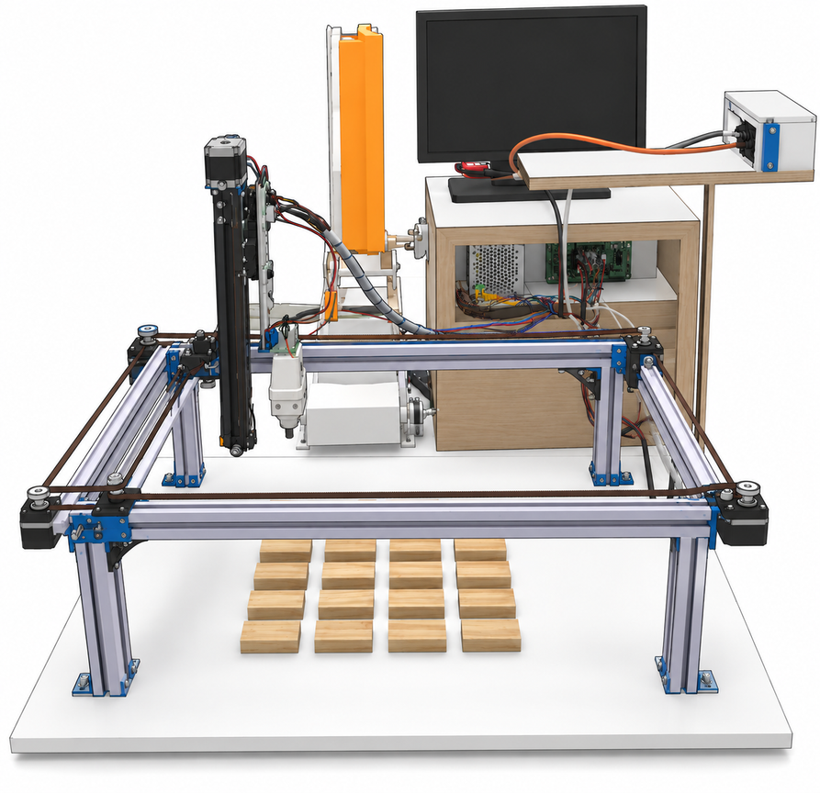
MECHANICAL DESIGN
X-axis motion system
Y-axis gantry
Z-axis actuator
End-effector (gripper)

Slide 12
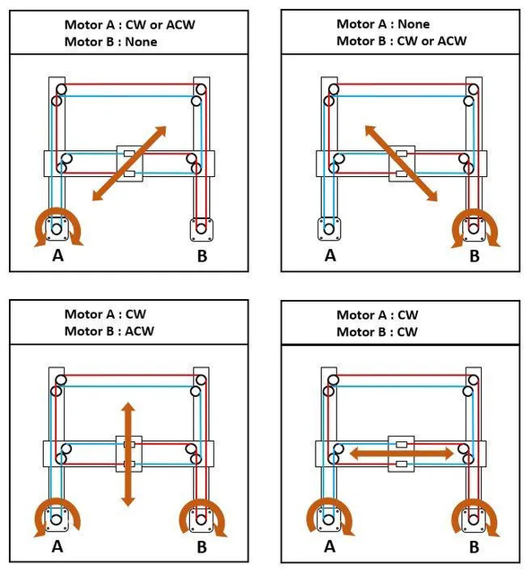
THE X/Y STAGE: COREXY
BOTH MOTORS OFF THE MOVING BEAM
Same sense › the carriage walks along X. Opposed senses › it walks along Y.
Two NEMA17 motors are fixed to the frame and drive one continuous GT2 belt path, so the beam stays light and the envelope stays large.
Guidance is eight castor wheels on 3D-printed carriages running on the aluminium profile.
22.8 cm
38.0 cm
X holder travel · 4,550 steps
Y holder travel · 7,600 steps
200
4
Verified on the machine by watching the shafts
steps per cm (X 199.6, Y 200.0)
limit switches, all NC
CoreXY skeleton and limit-switch homing after Greg06, “Automated Chessboard”, Instructables 2022. Z, the claw, the feeder, the camera and all three controllers were built on top of it.
Homing drives each axis into its own switch; the corner where both are pressed is machine position (0, 0).

Slide 13
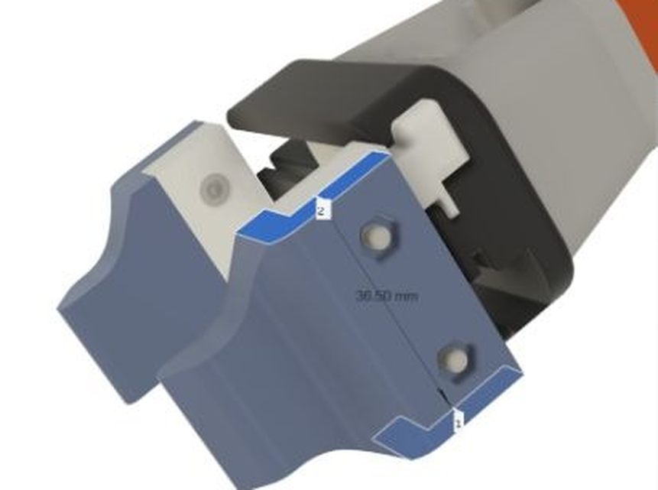
Z AXIS AND END EFFECTOR
LIFT, GRIP, AND A QUARTER TURN
Z axis
One NEMA17 on the moving carriage, on the 15 mm linear rail. 26.5 cm of travel, 1,350 steps.
Both ends are switches
Every build re-zeroes Z on the bottom switch and carries at the top. Neither end is a remembered number.
The claw
One servo, two positions: OPEN 0°, CLOSE 52°, on the block's 2.2 cm face. No sensor at all — hence a fixed 600 ms settle.
Rotation
A 28BYJ-48 through a ULN2003 turns the claw 512 of 2,048 steps at 10 rpm — the second block orientation.
3D-printed two-jaw claw — the reference design's electromagnet is no solution for wooden blocks
The grip centre sits (−0.3, +0.6) cm off the rotation axis, so a 90° turn swings the block round that axis. That swing is corrected as a per-rotation tool offset — not as a grid error.

Slide 14
THE FEEDER
DOSE EXACTLY ONE BLOCK — AND PROVE IT TWICE
1
2
3
4
5
6
7
8
Close
Open in two stages
Wait for EXIT
Shut the gate
Run the belt
Wait for STAGE
Align
Re-read STAGE
container shut
20° › 90° › 160°
a block left the hopper · 10 s
before the belt starts
150 steps/s
a block arrived · 15 s
servo 90° › 120°
it is still there
Two ends of the feed path, three measurements — and nothing after them is assumed.
Refuses to double-load
A gate becomes a doser
Never a success it cannot see
A feed request arriving while the stage sensor already sees a block is refused with stage_occupied — before anything opens.
The container shuts the instant EXIT fires, before the belt starts, so a second block cannot follow the first out.
If the block has gone after the aligner moves, the belt resumes instead of the feeder reporting staged.

Slide 15

TWO GRIDS, NOT ONE GRID WITH A FLAG
ONE ENVELOPE, TWO LATTICES, ONE FEEDER CELL
One envelope
Both lattices share the same 22.8 × 38.0 cm holder travel — a block lying down does not move a limit switch.
One feeder cell
[0,0] is the feeder in both modes and is never built on: 7×6−1 = 41 standing, 3×10−1 = 29 lying.
+1.9 cm registration
VERTICAL · 2.2 × 6.0 cm
HORIZONTAL · 6.0 × 2.2 cm
(6.0 − 2.2)/2 = 1.9 — exactly the overhang of the rotated face, so horizontal [0,0] seats flush against vertical [0,0].
7 × 6 addressable, 41 buildable
pitch 3.8 × 7.6 cm
3 × 10 addressable, 29 buildable
pitch 7.6 × 3.8 cm
cell [0,0] — the feeder, never built on; its centre is the home corner

Slide 16
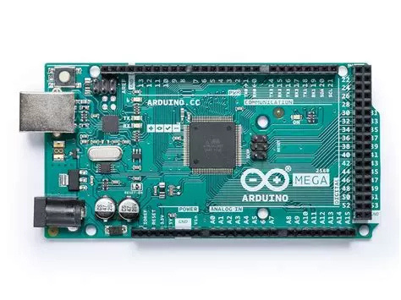
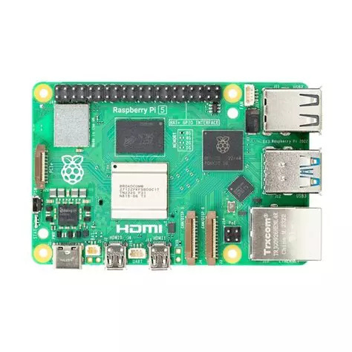
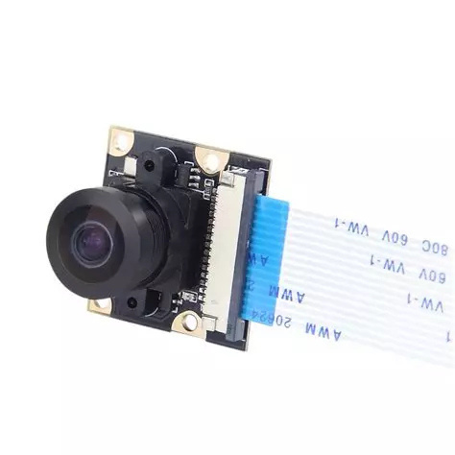
Bill Of Material - 1 of 3
Components - Computing
Arduino MEGA
Raspberry Pi 5
Raspberry Pi 5 Camera Module

Slide 17

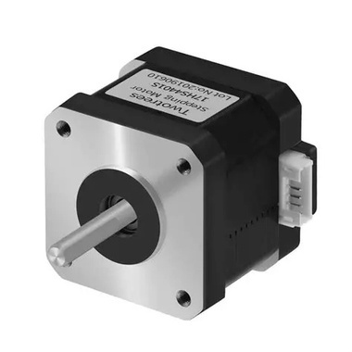
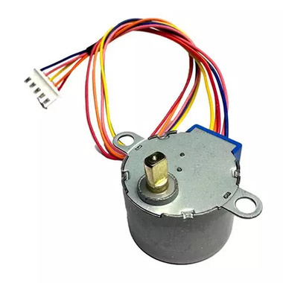
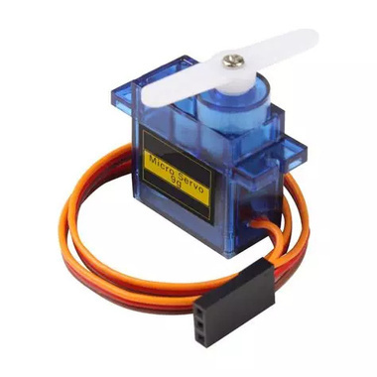
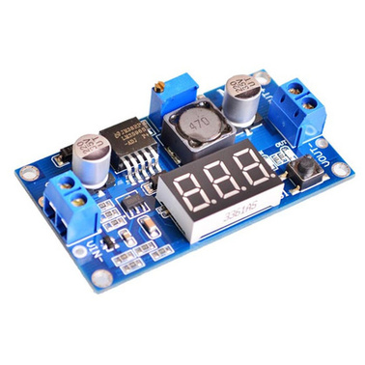
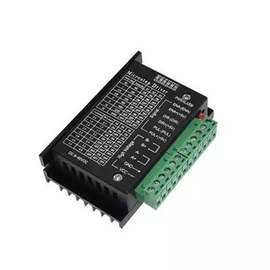
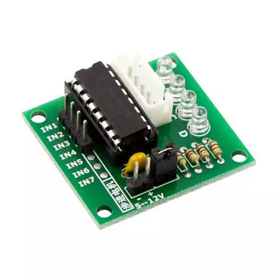
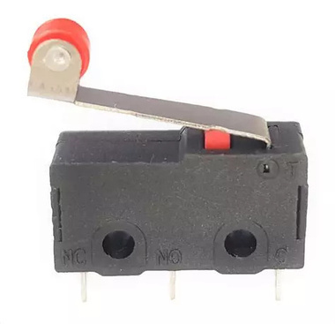
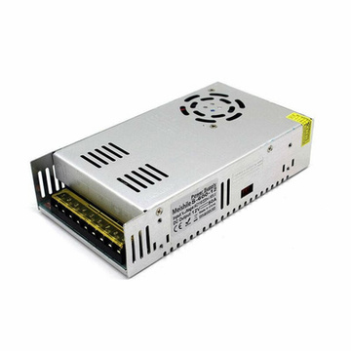
Bill Of Material - 2 of 3
Components - Electrical and Power
3x NEMA17 Stepper Motor
Stepper Motor 28BYJ-48
1X Servo Motor
Adjustable Buck Converter
3x TB6600 Driver
ULN2003 Driver
4x Limit Switch
Power Supply, 12V 15A

Slide 18
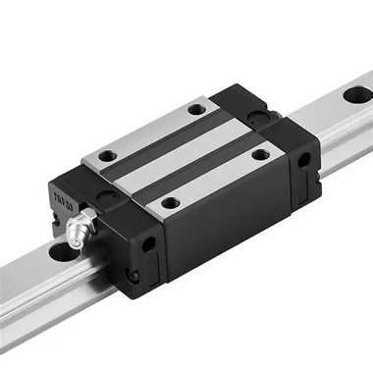
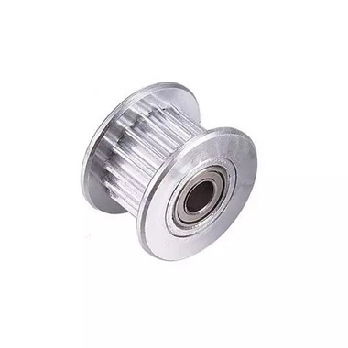
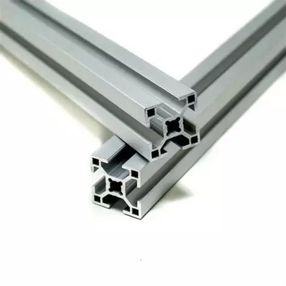
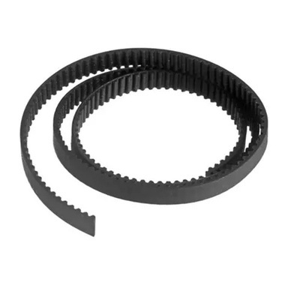
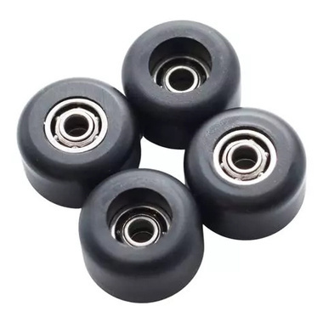
Bill Of Material - 3 of 3
Components - Mechanical
Linear Rail + Linear Motion Bearing
Timing Pulley
Aluminum Profile
GT2 Belt
Bearing Wheels

Slide 19
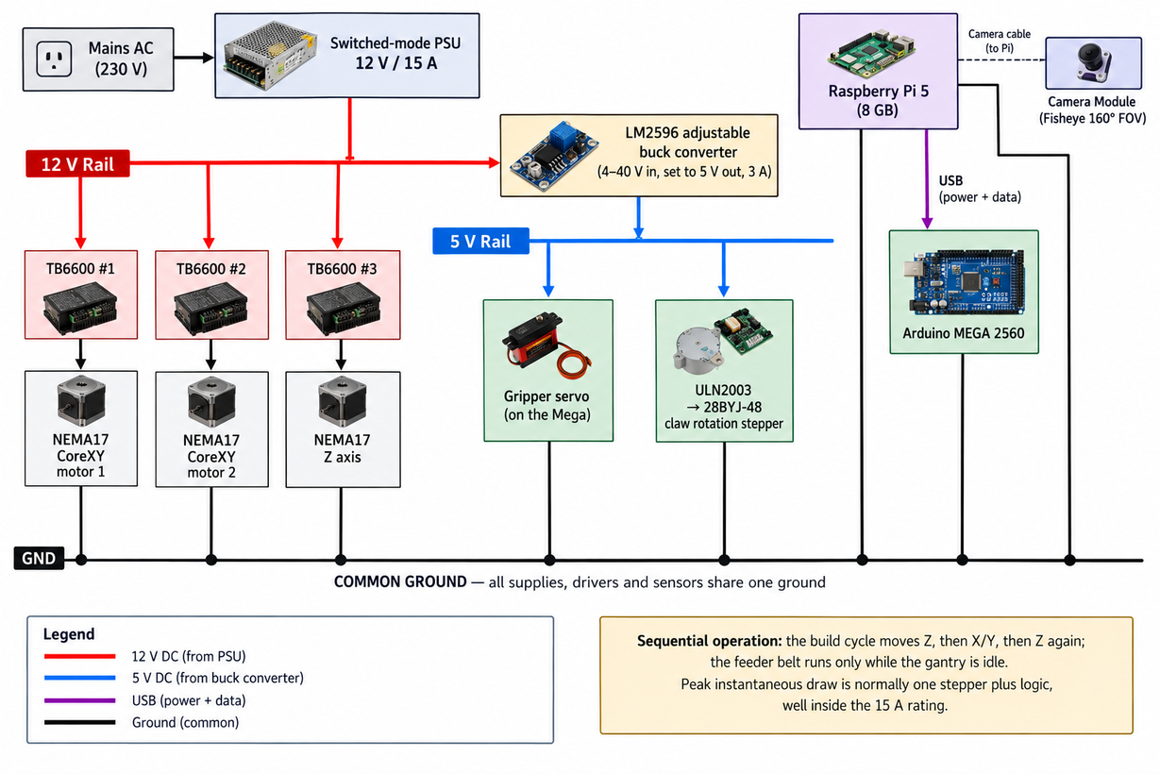
POWER ARCHITECTURE
ONE 12 V RAIL, ONE 5 V RAIL, ONE COMMON GROUND
12 V rail — the three TB6600 drivers and the A4988 on the feeder belt.
5 V rail — an LM2596 buck converter feeds three servos, the ULN2003, both HC-SR04s and the A4988 logic.
Both Arduinos — powered over USB from the Pi, which is also how they communicate.
Why 15 A is not overspecified
The build cycle moves one thing at a time, so the instantaneous draw is usually a single stepper plus logic.

Slide 20
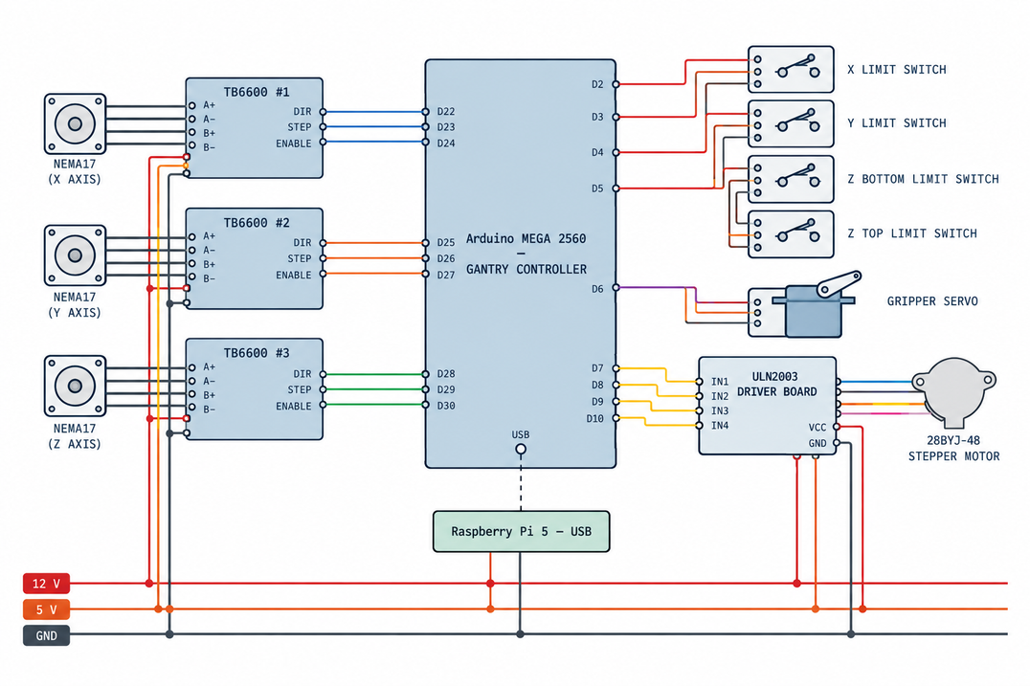
WIRING
TAKEN DIRECTLY FROM THE TWO FIRMWARE SOURCES
Arduino MEGA 2560 — three TB6600 drivers, four limit switches, gripper servo, ULN2003 rotation stepper
Motor and sensor runs use connectors rather than direct solder joints, so a motor can be swapped and the gantry dismantled for transport. There is no enclosure and no cable chain.

Slide 21
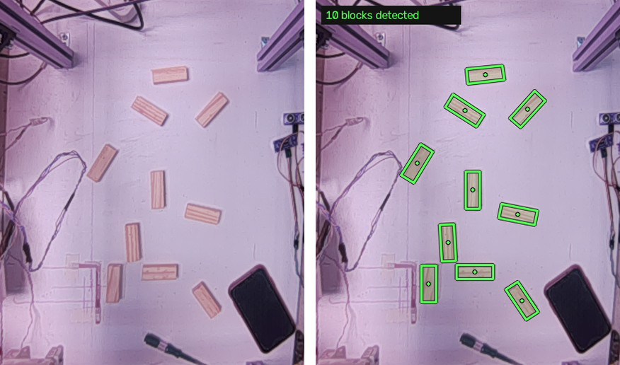
02
VISION & CONTROL SYSTEM
What the camera sees, how a pixel becomes a cell, and the protocol that decides when the machine is allowed to move.

Slide 22
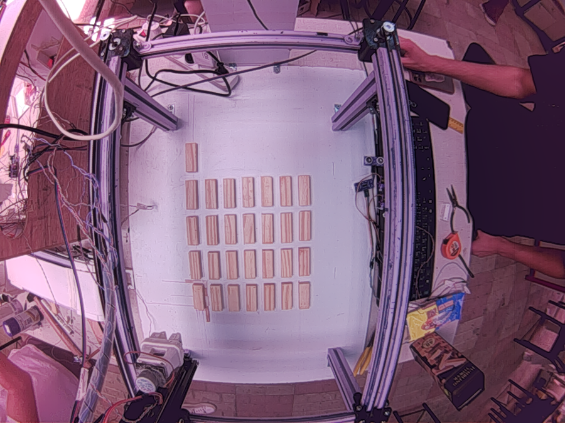
ONE LENS, TWO COSTS
WHAT A 160° FISHEYE AT 50 CM BUYS, AND COSTS
Sensor
OV5647, 5 MP, DORHEA module on the Pi 5 CSI bus
Lens
160° fisheye, mounted rigidly ≈ 50 cm above the surface
Capture
1296 × 972 through Picamera2 — the binned full-field mode
Why binned
It keeps the whole 23 × 38 cm workspace in one frame, and the per-frame cost inside budget
Lens model
Equidistant, 120° output — tuned by eye, not checkerboard-calibrated
THE TWO COSTS
Severe barrel distortion — the aluminium rails are straight on the machine and curved in the image
A colour cast strong enough to be a functional fault, not a cosmetic one
A raw frame straight off the camera, before any correction

Slide 23
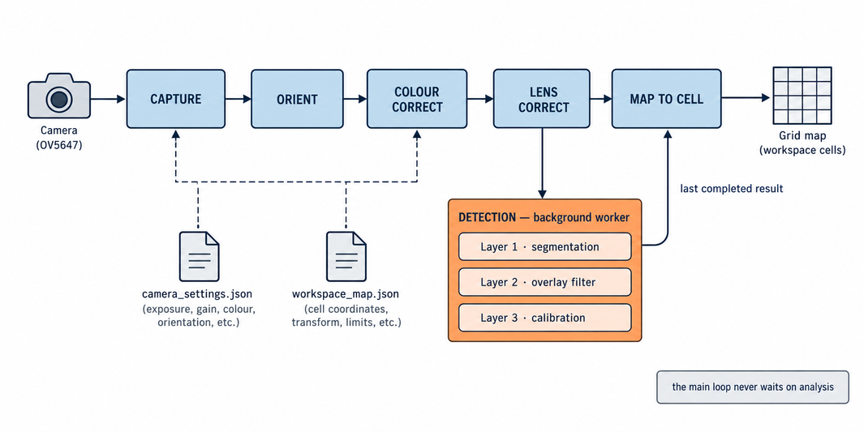
THE VISION PIPELINE
ONE PROCESS OWNS THE CAMERA; ONE FIXED ROUTE
Colour correction runs once, at the captured frame
Detection runs on a background worker
The Pi picks the cell; the firmware turns it into steps
Applied immediately after orientation and before every detector, so every tool in the system sees identical pixels. Colour is deliberately not part of the saved projection identity.
At a lower rate than the video, with the main loop drawing the last completed result. A slow analysis can never stall the stream.
The saved homography converts a pixel to physical centimetres and then to a [col, row]. The Pi never needs a motor step to draw or select one.

Slide 24
BLOCK DETECTION
A HYPOTHESIS, THEN AN ANSWER — THREE LAYERS
1
Segmentation
Warm material by red-minus-blue and red-minus-green, never by brightness — the work surface is overexposed, so a brightness cutoff selects the table and not the blocks.
2
Live overlay
Rejects, then rectifies: duplicates by IoU, boxes running off the frame (the rails), anything further than 0.34 cells from a lattice site (the holder offcuts).
3
Calibration
Ten blocks deliberately off the lattice — all ten found, everything else rejected
Runs once, deliberately, and is the only layer allowed to write a calibration.
TWO RULES KEEP THE OVERLAY HONEST — BOTH ASSERTED BY TESTS
The measured centre is never snapped to the lattice — snapping would hide the misplaced block the overlay exists to show.
The lattice filter never fires on a partial view: under six detections, or if it would reject over 30 % of what it saw, everything is kept.

Slide 25
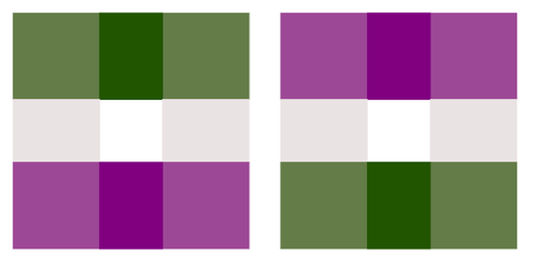
GRID CALIBRATION
WHERE THE MACHINE'S GRID SITS ON THE CAMERA IMAGE
HARD ACCEPTANCE GATES, NOT STATUS READOUTS
Colour parity
every fiducial the right way round
Measured aspect ratio
against the declared geometry
One fiducial of the printed A2 calibration target
FOUR ROUTES, ONE ARTEFACT
Mean and maximum residual
both must pass, not just be reported
Four clicked corners — the fast fallback.
Printed A2 colour target — the primary route.
Evidence-assisted — pools frames when the gantry hides part of the sheet.
Placed-block self-calibration — the rig places its own blocks, so the thing measured is the thing being calibrated.
≥ 95 % physical coverage
every row and column supported
Numerical conditioning
gate at 1e−5, inside a 30-order gap
A refusal still draws what it found — green for blobs that joined a lattice, red for those that did not.

Slide 26
CONTROL HIERARCHY
THE PI DECIDES WHETHER; EACH ARDUINO DECIDES HOW
HIGH LEVEL · RASPBERRY PI
LOW LEVEL · MEGA AND UNO
Chooses the target cell, the stack level and the grid mode
Sequences the feeder before the gantry
Applies every safety gate and owns the session lock
Decides whether a command may be issued at all
Never sends a motor step, a direction bit or a delay
Step generation, direction polarity, homing, limits
The grid-to-steps arithmetic for both modes
Servo and stepper timing, the phase sequence
The feed state machine, belt rate, sensor thresholds
Everything that cannot change without reflashing
WHY THE BOUNDARY IS DRAWN THERE
The firmware owns the step caps, the Z calibration, the servo angles, the pin map and the direction polarity — physical facts nothing can push over serial, so a stale copy on the Pi would be a lie nobody notices until the rig drives into something. A handful of values genuinely exist twice, and an automated test parses the live sketch and fails if either side has moved.

Slide 27
THE ACKNOWLEDGEMENT PROTOCOL
ONE LINE FOR THE HUMAN, ONE LINE FOR THE PI
EIGHT KINDS · FOUR OF THEM TERMINAL
BUILD COMPLETE - block placed at [3,5] level 0
Place time: 31.6s
@12 OK col=3 row=5 level=0
BOOT
READY
RECV
STEP
ERR
SAFE
HELD
OK
Every machine line starts with @ — a character no other line in either sketch begins with, so the Pi's filter is one string test. Key=value and not JSON because on an 8 KB AVR at 9600 baud braces and quotes cost SRAM and airtime for nothing.
Filled = terminal. Exactly one terminal acknowledgement per command.
SAFE
HELD
Refused on validation. Nothing moved, and a retry is fine.
Failed part way through. The claw may still be gripping a block and the position is unknown. It needs a person.
They are separate kinds rather than a flag, so that Pi-side code cannot collapse them into a generic “if not ok: retry”. The retry is the thing that breaks the machine.

Slide 28
THE FOURTEEN-PHASE BUILD CYCLE
EVERY PHASE ANNOUNCED BEFORE IT RUNS
1
raise_clear
Raise Z into the top switch
8
move_to_target
Home, then Y to the row, X to the column
2
home_feeder
Home X/Y to the feeder cell [0,0]
9
rotate_to_grid
Apply the active grid's rotation
3
neutralise_claw
Return the claw to neutral
10
lower_to_level
Lower Z to the target level
4
open_claw
Open the jaws, still clear above
11
release
Open the claw. The block is placed
5
lower_to_ground
Lower Z into the bottom switch — re-zeroes Z
12
park_clear
Raise Z clear of the block just placed
6
grip
Close the claw. The block is held
13
park_home
Return X and Y to the origin
7
lift_block
Raise Z to carry height
14
park_rotation
Return the claw to neutral
Phases 1–11 place the block; 12–14 park the rig. Parking is not decoration — placed but not parked is not a success, and the terminal result is downgraded from OK to HELD.

Slide 29
ONE MESSAGE AUTHORISES MOTION
THE TWO-BOARD HANDOFF, AND THE FIVE LAYERS ABOVE IT
THE HANDOFF
THE GUARD STACK
Pi › Uno
FEED <id>
1
HTTP route
unconfirmed request · mismatched command · stale frame · locked session
Uno › Pi
@id RECV / ACK / STATE / SENSOR / EVENT
Uno › Pi
@id OK state=block_ready result=staged
2
Build worker
a second build already running
Pi › MEGA
B <col> <row> <level>
3
Safety state
MEGA › Pi
@seq STEP step=n/14 phase=… status=begin
a locked session, or no cell selected
MEGA › Pi
@seq OK col=… row=… level=…
Two-board handoff
4
another placement already owns the pickup point
Only that one terminal message, with a matching id, authorises the B.
5
Serial clients
ACK, STATE, SENSOR and EVENT are progress, never success. A terminal with the wrong id is ignored.
After the B is sent, even a SAFE rejection locks the session — a block is already staged.
an overlapping transaction, or the wrong board
The browser is a mirror — a greyed-out button is never the safety mechanism.

Slide 30
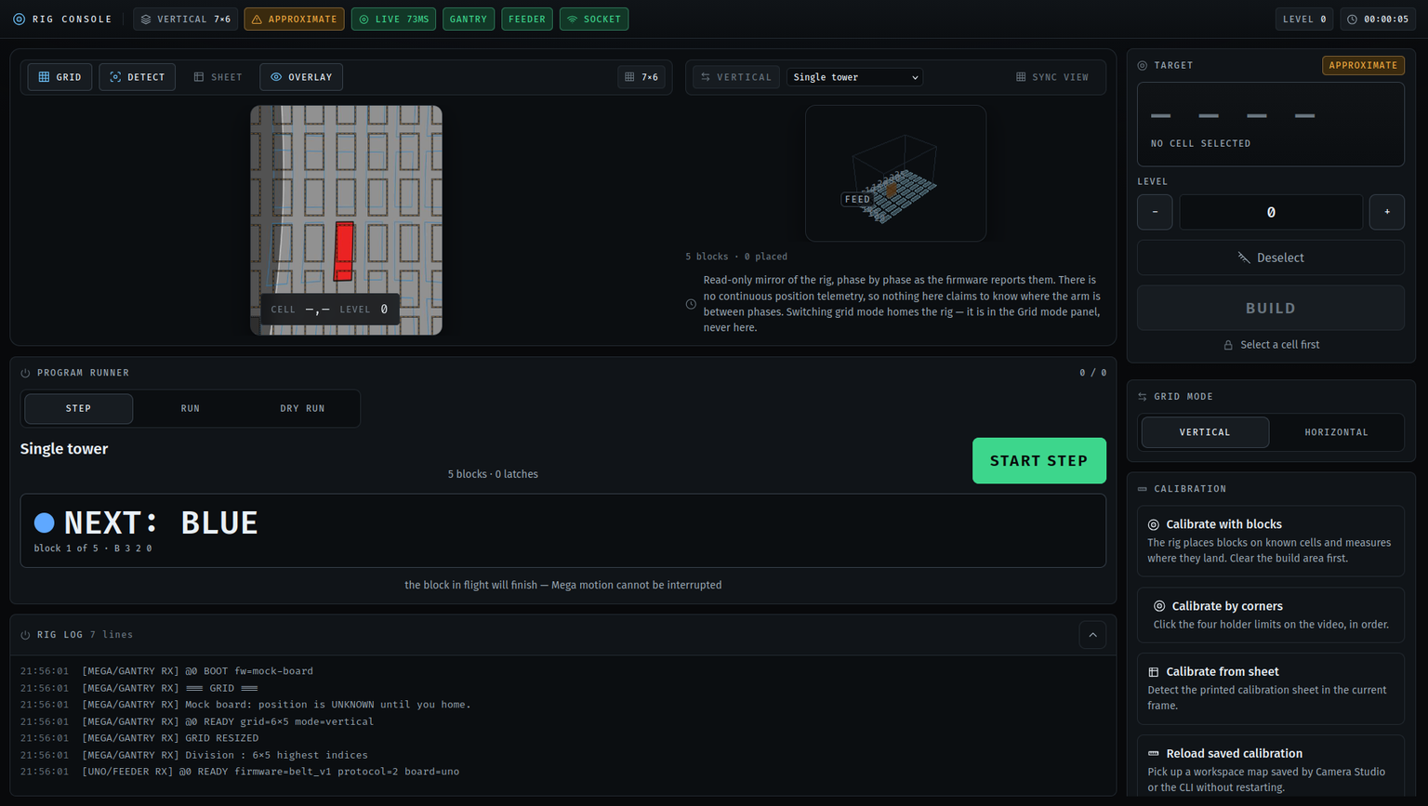
THE OPERATOR CONSOLE
LIVE CAMERA, TAP A CELL, TWO TAPS TO MOVE
Tap a cell.
Selection moves nothing and shows the exact command, B 3 2 1.
Tap BUILD, then CONFIRM.
One correlated FEED, then the B. Two deliberate taps.
Three outcomes.
PLACED (green, selection cleared), REJECTED (amber, nothing moved), ABORTED (red, session locked).
No cancel, no retry.
There is no such control, because the machine cannot honour either.

Slide 31
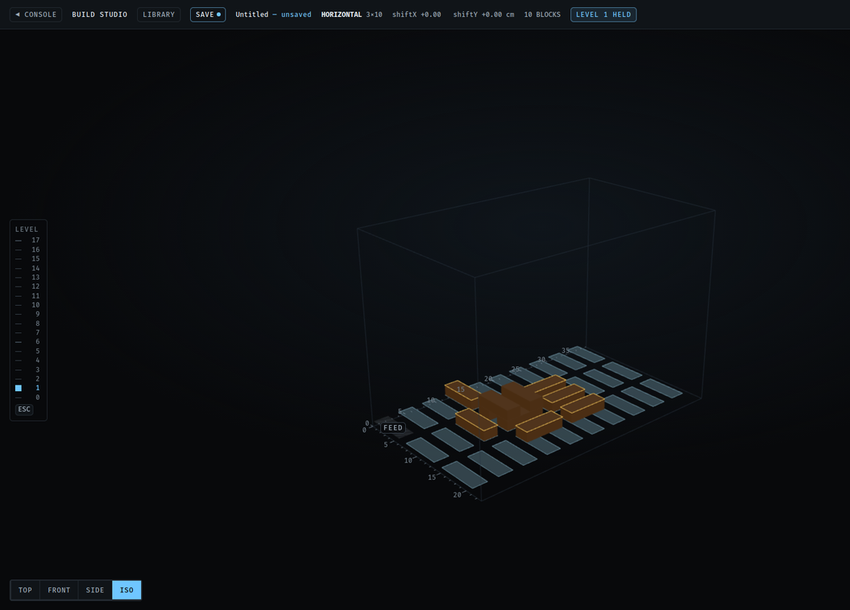
THE 3D BUILD STUDIO
DESIGN, VALIDATE, COMPILE — THEN RUN IT
THE VALIDATOR ASKS THREE QUESTIONS
Support — a centre-of-mass toppling test, not a contact-ratio shortcut.
Collision — in machine space, not grid indices, so a horizontal block spanning two columns is checked correctly.
Reachability — inside the active grid, under the firmware's build ceiling.
THE COMPILER RUNS IN FOUR STEPS
Support graph — which blocks rest on which, from footprint overlap.
Ordering — Kahn's algorithm, bottom-up, grouping same-orientation runs to minimise mode latches.
Emission — a mode command only on an actual change.
Summary — blocks, latches, levels and a time estimate.
Deterministic — twenty compiles, byte-identical output. An invalid model compiles to nothing at all, never to a half-program.

Slide 32
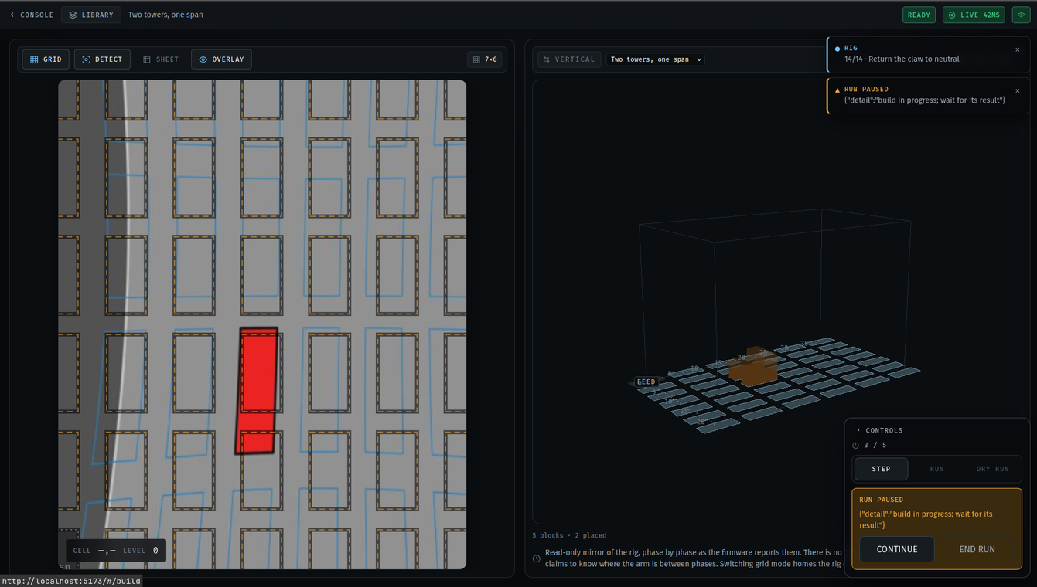
THE LIVE DIGITAL TWIN
IT DRAWS WHAT THE FIRMWARE SAID — AND NOTHING ELSE
It never invents state.
A block is drawn as placed because the server reported a terminal placed result for it, and for no other reason.
After an abort it stops.
A locked session freezes the animation, desaturates every block and demotes everything unconfirmed to a ghost.
Phase-driven, not clock-driven.
An earlier version interpolated a 1.6 s descent from the browser's clock and looped it — a 40 s build showed twenty-five descents that never happened.
If Z jams,
the block glides down, stops just short of the cell and sits there visibly not landing — which is the truth.

Slide 33
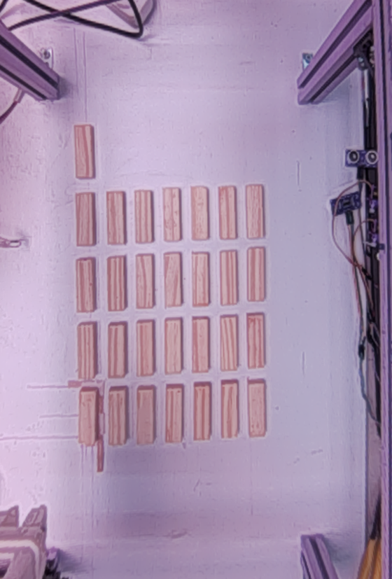
03
TESTING & RESULTS
Sixteen complete builds on hardware, two reference boards, and 560 automated tests.

Slide 34
TESTING METHODOLOGY
EVERY QUESTION ANSWERED AT THE CHEAPEST HONEST LEVEL
Automated software tests
Grid arithmetic, protocol parsers, the compiler, the twin, the homography. The Python and TypeScript grids are held to each other by shared fixtures.
1
no hardware
Protocol-level simulation
A fake MEGA and a fake Uno speak the same acknowledgement grammar, including failure, reset and cancellation. This is how the two-board handoff was tested exhaustively.
2
no hardware
Firmware host builds
A stub-Arduino harness proves the sketch parses and that its output is byte-for-byte the protocol. A clean compile is not treated as a test of behaviour.
3
no hardware
Hardware runs on the rig
Anything touching motion, limits or Z. Every run appends to two logs — a stopwatch per build, and every serial line with the gap since the last one.
4
the real machine
The rig takes half a minute to answer one question, and a wrong answer can drive a claw into a stack — so the logs from level 4 are the primary evidence, and everything else is rehearsal.

Slide 35
CYCLE TIME AND REPEATABILITY
SIXTEEN BUILDS ON HARDWARE, ALL SIXTEEN PLACED
26.1 s
19.8 – 32.2 s
< 45 s
12.57 s
0.18 s
mean cycle, per block
fastest and worst case
the objective
the nine fixed phases
their standard deviation
Mean duration of each build phase, over sixteen builds (seconds)
Light bar = minimum to maximum across all sixteen · solid bar = mean
4.53
4.68
2.91
2.89
2.80
2.76
0.42
0.58
0.41
0.93
0.95
0.49
0.71
0.52
1
2
3
4
5
6
7
8
9
10
11
12
13
14
build phase 1 – 14
Nine phases never move
The variation is travel, and nothing else
Nine of the fourteen have no distance or level dependence at all. Across all sixteen builds they summed to 12.57 s ± 0.18 s — six of them identical to the 0.01 s logging resolution.
Only phases 8 and 13 range widely, 1.48 s to 8.53 s. With no acceleration ramp, a move of N steps takes N times a fixed period.

Slide 36
VISION RESULTS
TWO REFERENCE BOARDS, TWO NEGATIVE RESULTS
29 / 29
33 › 29
37 – 103 ms
0.85 px
0.27 cm
blocks found, both boards
hypotheses after rejection
per analysed frame
mean fit residual
mapping error on a 2.2 cm block
WHAT THE FIT CHOSE, AND WHY
TWO NEGATIVE RESULTS
Chosen on held-out prediction, not training error. Similarity 101.4 px, affine 1.38, homography 1.22, homography + curvature 1.09.
Pitch is static to within 2 %. X 29.38 px (sd 1.24), Y 69.14 px (sd 1.08).
An independent geometry check. The view is 17.7 % anisotropic; two independent estimates agree to 4 %.
Higher resolution finds nothing extra
29/29 at every width from 384 to 1024 px. Illumination flattening costs up to 3,894 ms a frame and finds exactly the same 29.
White balance is right for the sheet, wrong for the board
On the printed sheet it takes the green mask from 0 pixels to 87,836. On a board of blocks it pulls the wood toward the surface: 28 of 29 with it on, 29 with it off.
The 0.27 cm is the saved four-corner format flattening the fit — not the fit itself.
29 blocks, the rails, and two wooden offcuts that are not blocks

Slide 37
04
CONCLUSION & FUTURE WORK
What the machine proves, the limits that are real, and the one item on the list that is not optional.

Slide 38
LIMITATIONS, STATED PLAINLY
LIMITS OF THE HARDWARE, NOT OF THE APPROACH
No hardwired emergency stop
Motion cannot be interrupted
Nothing removes motion energy independently of the software. The stop of last resort is the supply. The machine is run attended.
The gantry does not read serial while it moves, so software stop is stop-after-current-block by construction.
No watchdog
Open-loop steppers, no stall detection
If the Pi crashes or the cable is pulled, the MEGA finishes the command it already holds.
No encoders, no current sensing. A stall produces step pulses that go nowhere.
The lens is tuned, not calibrated
The claw angle is not sensed
Adjusted by eye against straight edges — visually straight, not measurement-grade. The file records source: estimated.
The operator is trusted to start neutral. If not, every placement that session is turned 90°.
And the layer that would let the camera notice a block that never arrived — placement supervision — is fully designed and not built.

Slide 39
FUTURE WORK
ONE ITEM IS NOT OPTIONAL; THE REST ARE
SAFETY, FIRST
A hardwired emergency stop — a latching mushroom button in series with a contactor on the 12 V motor rail
A stop that is observable during motion, and a communications watchdog that brings the rig to a defined state
Close the loop on placement
Measure properly
Protocol and capability
A server-side ledger of what went where
Compare at the park state — a known, repeatable position
A pick-from-cell verb, so the machine can act on a wrong placement
A checkerboard or ChArUco lens calibration
A per-cell table in the saved map, removing the 0.27 cm flattening error
Fix the camera, not the matrix — the colour correction is at its limit
Controller-supplied command ids
Encoders or stall detection — also worth about a third of the cycle time
A faster serial link, and a larger workspace

Slide 40
CONCLUSION
THE CONTRIBUTION IS NOT THE GANTRY
Cartesian gantries are a solved problem. What this project demonstrates is the layer student-scale automation usually leaves out: every physical transition confirmed by something other than a clock.
The feeder
The gantry
reports success because a sensor saw a block — and saw it again after the aligner moved.
narrates each of its fourteen phases before running it.
The twin
And when it cannot prove
draws what the firmware said, and stops short of the cell until the release event arrives.
what happened, it locks and asks for a person rather than retrying.
16 / 16
26.1 s
5
29 / 29
560
hardware builds placed
mean cycle
levels on one cell
blocks detected
automated tests

Slide 41
THANK YOU
QUESTIONS
Ahmed Gharib · Mohie Halawa · Khalil Qanabita
Supervised by Dr. Samer Arandi
Department of Computer Engineering · An-Najah National University

