Slide 1
**Report on Library Management System**
Introduction:
This report delves into the Library Management System, a comprehensive program designed to streamline the management of member, book, and loan records within a library setting. Through a detailed examination of each class and its functions, this report aims to provide a comprehensive overview of the system's capabilities and functionality.

Slide 2
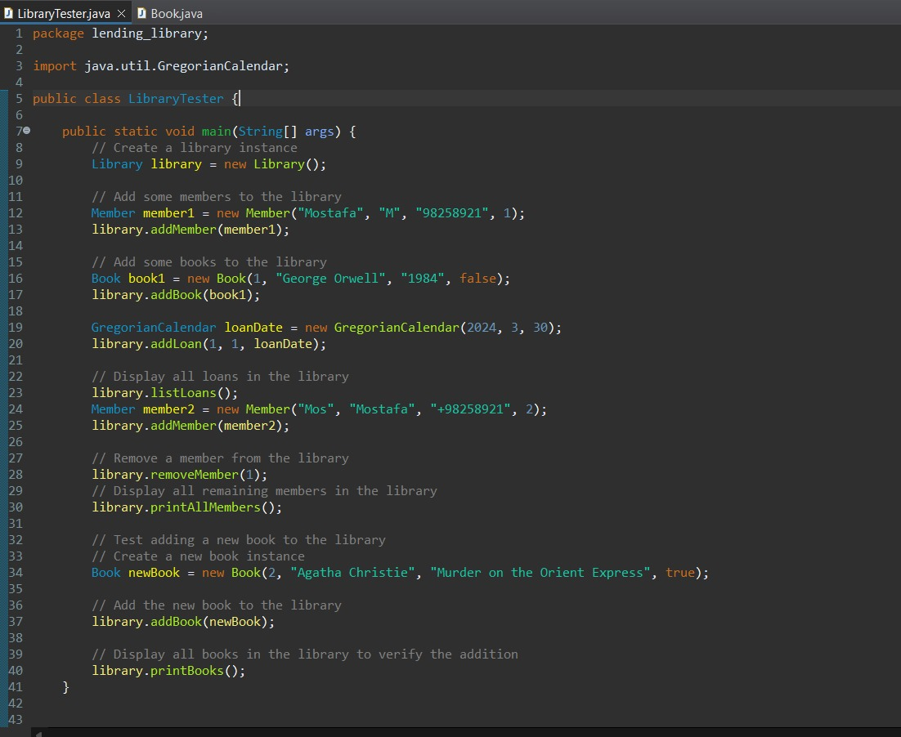
**LibraryTester Class:** The "LibraryTester" class functions as the driving force behind the system, facilitating testing and execution of library functionalities. Its main method serves as the entry point, conducting various tests to ensure the system's safety and efficiency. Key operations such as member removal and book search functionalities are rigorously tested.

Slide 3
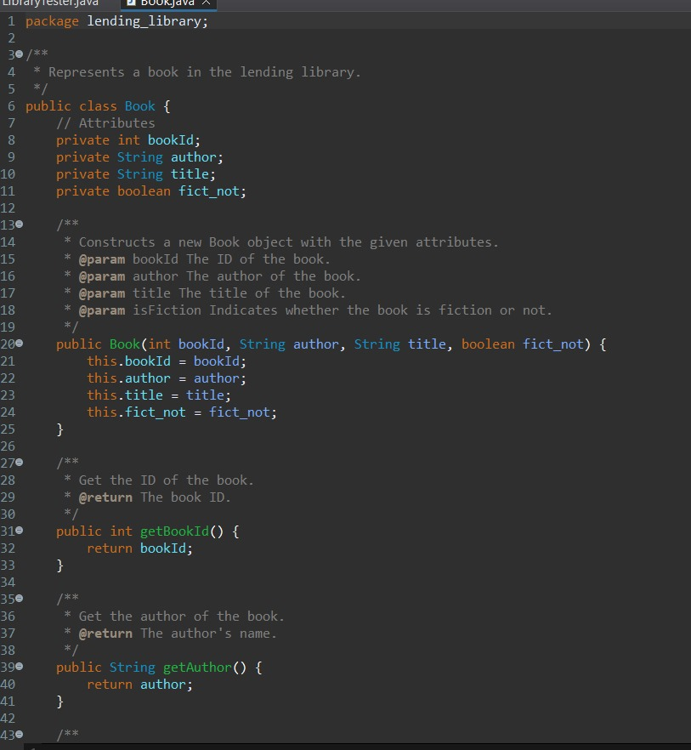
Class "Book": The "Book" class serves as the backbone for managing book-related operations within the library. It encompasses essential functions such as setting and retrieving unique book IDs, author names, book titles, and determining whether a book is fictional or not. These functions enable efficient management of book records, facilitating easy access to book information and categorization.

Slide 4
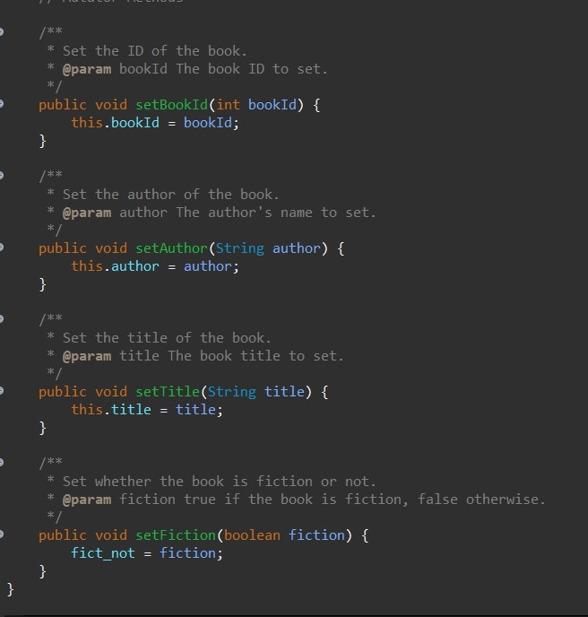
Book class

Slide 5
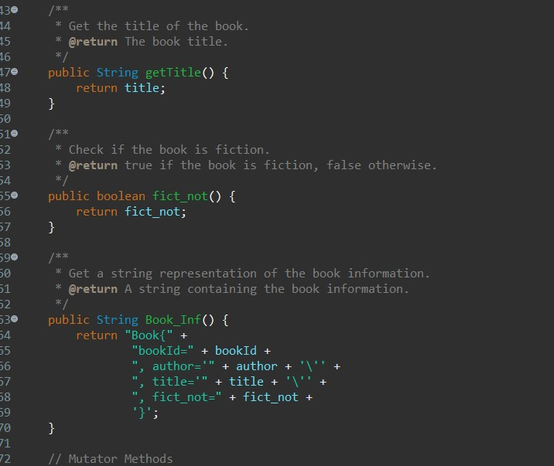

Slide 6
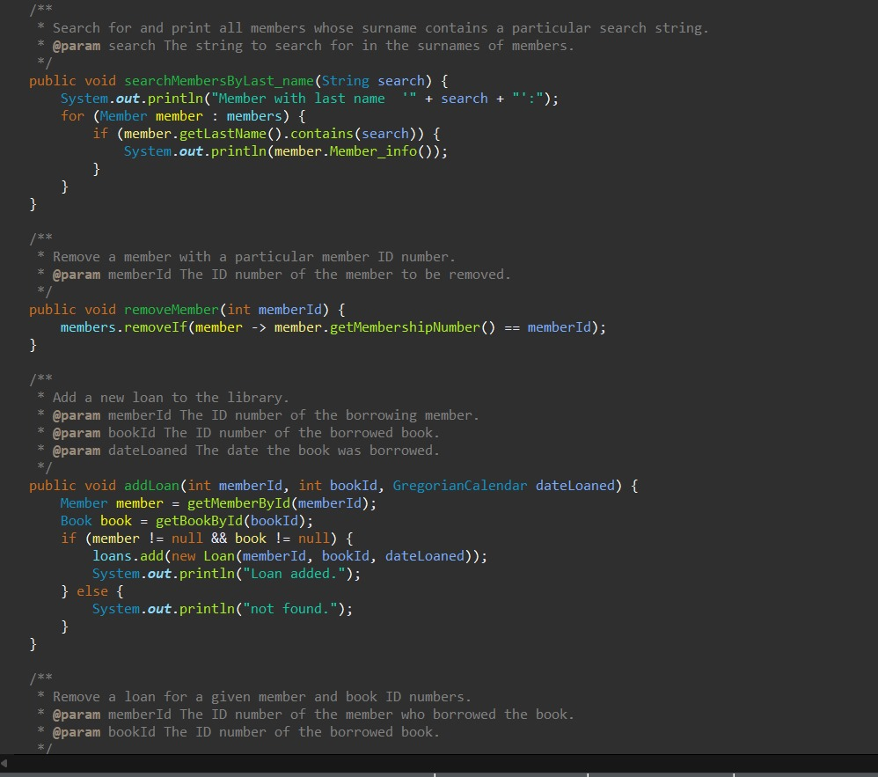
Class "Member": The "Member" class plays a pivotal role in managing member-related tasks within the library system. It offers functions for searching members based on their last names and removing members from the library records. These functions streamline member management processes, ensuring smooth operations and effective organization of member data.

Slide 7
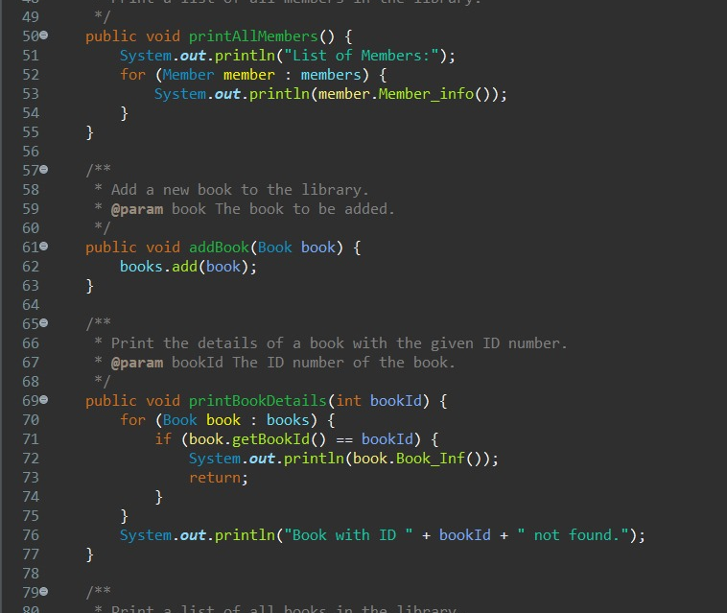

Slide 8
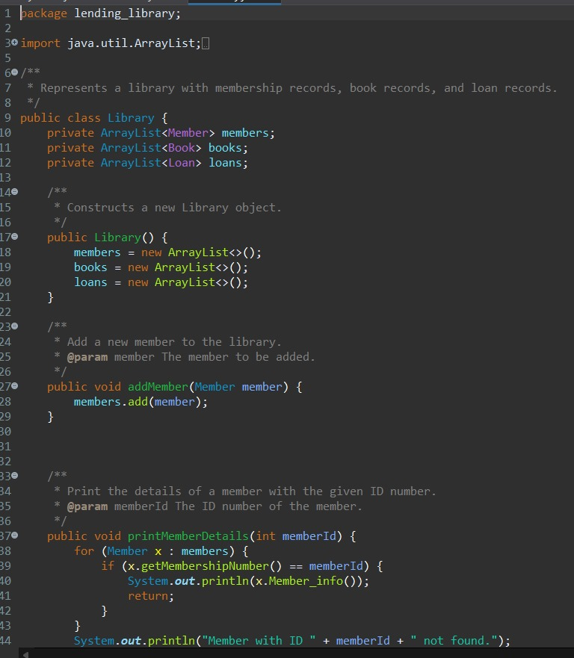
Class "Library": The "Library" class serves as the central hub for orchestrating all library-related activities. It provides a comprehensive set of functions for adding, printing, and removing member, book, and loan records. Additionally, it includes functions for removing loan records and printing lists of loans, members, and books. These functions collectively empower librarians to efficiently manage library resources and transactions, ensuring optimal service delivery to patrons.

Slide 9
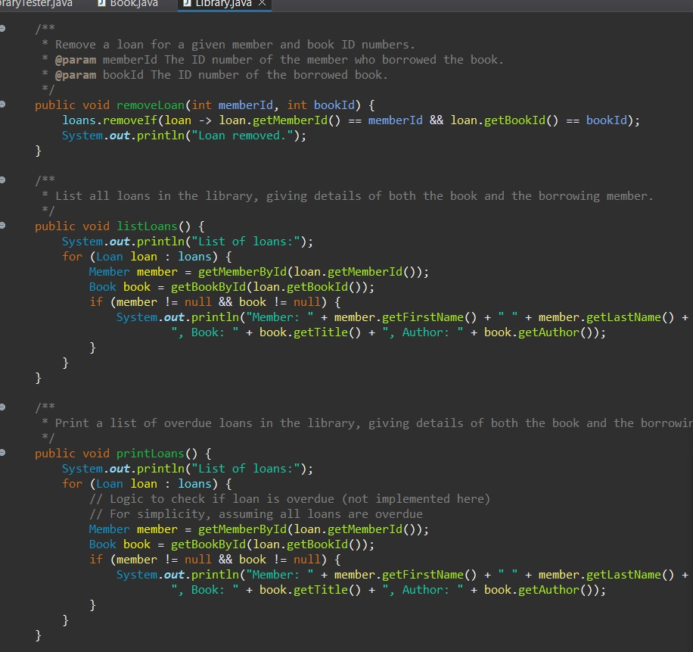
**Loan Class:**
The "Loan" class is pivotal in tracking and recording book borrowing activities within the library. It captures essential information such as member ID, book ID, loan date, and expected return date. Through functions like adding, removing, and listing loans, the class ensures efficient management of library loans.

