Slide 1

Machine Learning Based Movie Recommendation System
PRESENTED BY:
Mirza Majid (200707)
Ahmed Khaled (200148)
Hadiya Nadeem (200144)
SUBMITTED TO:
Dr. Ashfaq Ahmed &
Engr. Muhammad Awais

Slide 2
Presentation Overview
Introduction
Problem Statement & Literature Review
Detailed Methodology
Flow Chart
Task Done
Future Goals
Conclusion
References

Slide 3
Introduction
User experience on e-commerce, social networks, and media streaming by suggesting content based on user data needs to be improved.
Significant negative environmental impact due to high energy consumption and carbon emissions arises.
Traditional models require complex computations, increasing energy demand from fossil fuels.
Project aims to create a context-aware movie recommendation model balancing user satisfaction with energy efficiency.
Utilize search algorithms, constraint satisfaction, and machine learning for smart design and reduced energy use.
Minimize carbon footprint, contributing to sustainable AI-based recommendation systems.

Slide 4
Problem Statement
Recommendation systems enhance user experience on social networks, e-commerce, and streaming platforms using AI to predict preferences. However, their high energy use and carbon emissions challenge the UN SDGs. Therefore, developing energy-efficient recommendation systems that minimize environmental impact is essential.

Slide 5
Literature Review
Table 1: Represents the papers we reviewed.
Paper Title | Relevant Contents
Artificial intelligence in recommender systems [1] | Techniques and algorithms for AI based recommendation systems
A Comprehensive Review of Green Computing: Past, Present, and Future Research [2] | This paper tells how to make use of resources efficiently while minimizing environmental impact
Recommender systems for sustainability: overview and research issues [3] | This paper tells about how AI based recommendation systems can be used to fulfil the UN SDG’s.
[1] Zhang, Qian & Lu, Jie & Jin, Yaochu. (2020). Artificial intelligence in recommender systems. Complex & Intelligent Systems. 7. 10.1007/s40747-020-00212-w.
[2] Paul, Showmick & Saha, Arpa & Arefin, Mohammad & Bhuiyan, Touhid & Biswas, Al Amin & Reza, Ahmed Wasif & Alotaibi, Naif & Alyami, Salem & Moni, Mohammad Ali. (2023). A Comprehensive Review of Green Computing: Past, Present, and Future Research. IEEE Access. 11. 87445-87494. 10.1109/ACCESS.2023.3304332.
[3] Felfernig A, Wundara M, Tran TNT, Polat-Erdeniz S, Lubos S, El Mansi M, Garber D, Le VM. Recommender systems for sustainability: overview and research issues. Front Big Data. 2023 Oct 30;6:1284511. doi: 10.3389/fdata.2023.1284511. PMID: 37965497; PMCID: PMC10642936.

Slide 6
Dataset
In order to select the dataset various websites, including Kaggle were explored for dataset selection [4].
The MovieLens dataset was used for project suitability.[5]
MovieLens dataset gathers movie preferences through user ratings (0-5 stars).
Data collected via MovieLens website, a recommender system.
Dataset comprises movie.csv (movie ID, title, genres) and ratings.csv (user ID, movie ID, ratings, timestamp).
Dataset includes 20,000,263 ratings across 27,278 movies from 138,493 users (1995-2015) [6].
Utilized dataset version generated on October 17, 2016.
[4] https://www.kaggle.com/code/enisteper1/personalized-recommendation-with-transformer/input
[5] https://www.kaggle.com/datasets/grouplens/movielens-20m-dataset
[6] https://www.kaggle.com/code/vedprakashdwivedi/baseline-recommendation-using-knn-item-based-cf
[7] F. Maxwell Harper and Joseph A. Konstan. 2015. The MovieLens Datasets: History and Context. ACM Transactions on Interactive Intelligent Systems (TiiS) 5, 4, Article 19 (December 2015), 19 pages. DOI=http://dx.doi.org/10.1145/2827872

Slide 7
Dataset (Cont’d…)
Table 2: Represents the first few columns of the movie.csv file .
movieId | title | genres
1 | Toy Story (1995) | Adventure|Animation|Children|Comedy|Fantasy
2 | Jumanji (1995) | Adventure|Children|Fantasy
3 | Grumpier Old Men (1995) | Comedy|Romance
4 | Waiting to Exhale (1995) | Comedy|Drama|Romance
5 | Father of the Bride Part II (1995) | Comedy
6 | Heat (1995) | Action|Crime|Thriller
7 | Sabrina (1995) | Comedy|Romance
8 | Tom and Huck (1995) | Adventure|Children

Slide 8
Dataset (Cont’d…)
Table 3: Represents the first few columns of the ratings.csv file .
userId | movieId | rating | Timestamp
1 | 2 | 3.5 | 2005-04-02 23:53:47
1 | 29 | 3.5 | 2005-04-02 23:31:16
1 | 32 | 3.5 | 2005-04-02 23:33:39
1 | 47 | 3.5 | 2005-04-02 23:32:07
1 | 50 | 3.5 | 2005-04-02 23:29:40

Slide 9
Detailed Methodology
To design the movie recommendation system three different methods were used.
The first one being Collaborative filtering using KNN.
The second method is Content based filtering which makes use of cosine similarity.
The third method is the Hybrid method which used both KNN and cosine similarity.
The hybrid method is also implemented using Constraint Satisfaction Problems.

Slide 10
Flow Chart
Recommendation algorithms
Movielens Dataset
Pre-Processing
movies.csv
Create User-Movie matrix & Genre-Based Matrix
Collaborative filtering using KNN
Extracting relevant columns
ratings.csv
Merge the two dataframes
Content based filtering (Cosine Similarity)
Load Data
Hybrid method with and without constraints
Optimizing system performance
Model Evaluation using Accuracy, recall, F1 score etc.
Fig. 1: Flow chart of Technique 1.

Slide 11
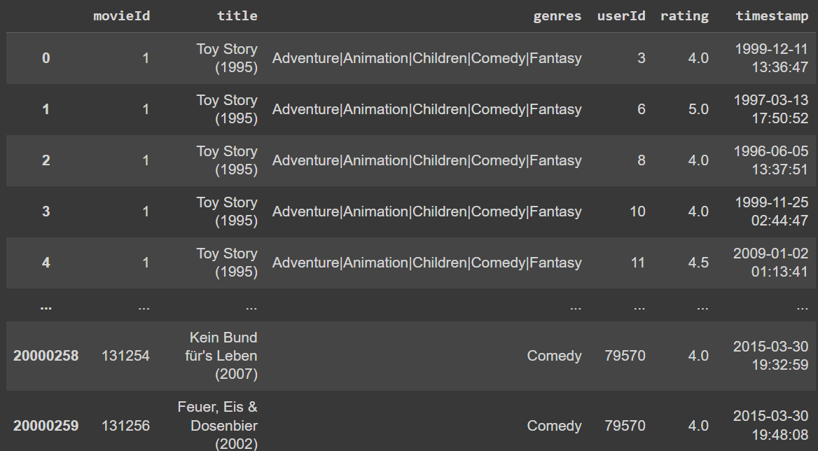
Merged Dataframe

Slide 12
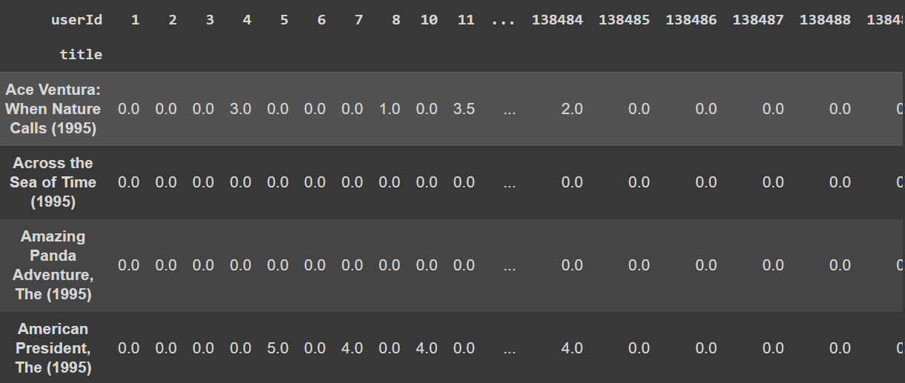
User-Movie Matrix for CF

Slide 13
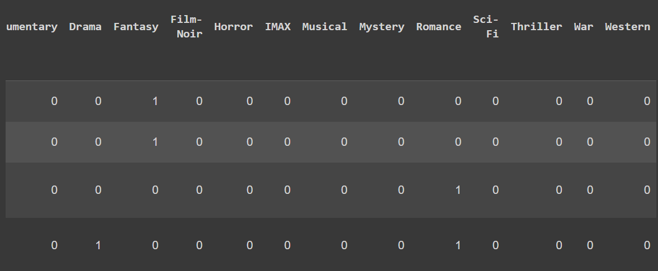
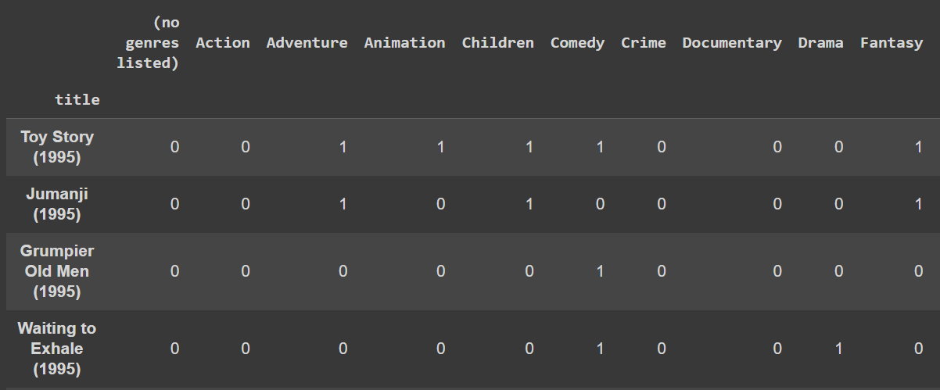
Genre-Based Matrix for CBF

Slide 14
Collaborative filtering using KNN
Pre-process user-movie interaction data and convert it to a sparse matrix format to enhance memory and computational efficiency.
k-NN model initialized using cosine similarity to identify movies that match user preferences.
Model trained to recommend movies similar to a randomly chosen movie based on user choices, calculating distances and indices of similar movies.
Lists created to store recommended movie titles and their distances. Iterate over distances, excluding the chosen movie, and append the results to the lists.
Lists converted to pandas Series, combine into a Data Frame, sort by distances, and print the best recommendations, providing users with tailored movie suggestions.

Slide 15
Content based Filtering using cosine similarity
Cosine similarity between the chosen movie's genres and all other movies' genres in the dataset calculated.
The chosen movie’s genres reshaped into a 2D array for compatibility with the cosine similarity function.
Cosine similarity values flattened to get a 1D array.
Indices of the movies with the highest cosine similarity values, excluding the initial index to avoid recommending the same movie extracted.
Indices used to retrieve the titles from the user_movie_table Data Frame and provide a list of the top 5 most comparable films based on genre similarity.

Slide 16
Hybrid Recommendation Engine
Movie titles checked to match the input provided by the user.
For matching titles, collaborative filtering applied using a pre-trained k-NN model based on user ratings to find similar movies.
Content-based filtering performed to identify similar movies according to their genres using a genre matrix.
Results from both collaborative and content-based filtering combined.
A hybrid set of movie recommendations provided that incorporates both user ratings and genre similarities.

Slide 17
Hybrid Recommendation Engine using CSPs
The extract_year function extracts the release year from a movie title if it is present, facilitating constraint testing based on release year.
The satisfies_constraints function checks a movie's compliance with specified constraints, such as minimum average rating, genre inclusion, and release year range.
satisfies_constraints takes parameters including the movie title, dataset, minimum average rating, desired genres, and a year range.
The function verifies if the movie is present in the dataset and if it meets the provided constraints.
If all specified constraints are met, the function returns True; otherwise, it returns False, indicating that the movie does not meet the requirements.

Slide 18
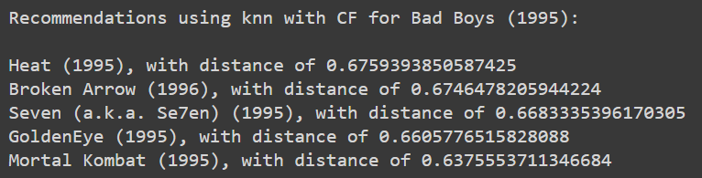
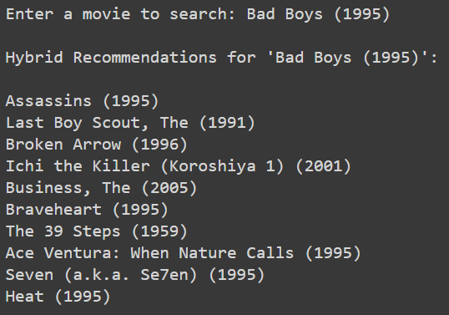
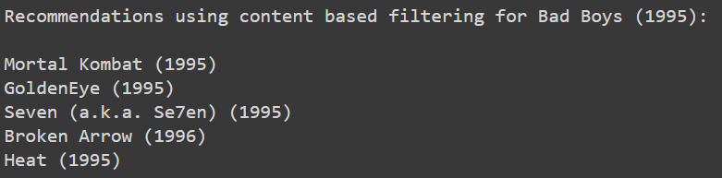
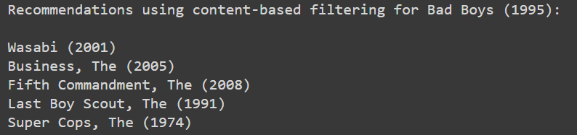
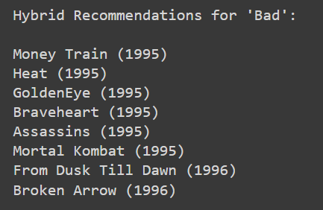
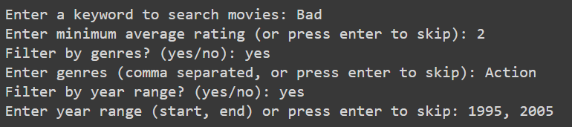
Code Outputs

Slide 19
Future Goals
Research and implement more advanced techniques and algorithms to improve recommendation accuracy and efficiency, exploring newer methods of collaborative filtering, reinforcement learning, and deep learning tailored to different user contexts.
Develop better renergy optimization techniques to reduce system energy usage, including dynamic resource allocation and model compression to enhance overall efficiency.
Ensure the recommendation system is scalable and capable of handling large data and user interactions by leveraging cloud-based infrastructures, optimizing system architecture, and establishing efficient deployment pipelines for production environments.
Design the system for continuous learning and adaptation, allowing it to adjust to changing user preferences and content dynamics through feedback loops and real-time performance monitoring.

Slide 20
Conclusion
The hybrid recommendation method outperformed both collaborative and content-based filtering in accuracy, precision, recall, and F1 score, achieving perfect scores of 100% in all metrics.
Collaborative filtering showed strong performance with 80% accuracy and an F1 score of 85.71%, but had lower precision at 75%, indicating occasional recommendations of less relevant items.
Content-based filtering had the lowest performance, with 60% accuracy and an F1 score of 66.67%, demonstrating moderate effectiveness in making accurate recommendations.
The results highlight the superiority of the hybrid approach, combining the strengths of both methods to enhance recommendation accuracy and efficiency.
The system demonstrated efficient computational resource usage (CPU 23.7%, memory 47.5%), low energy consumption (35.6 units), and eco-friendly operation with a carbon offset of 4.47 tonnes, showcasing its effectiveness in making relevant recommendations while being resource-efficient and environmentally friendly.

Slide 21
References
[1] Zhang, Qian & Lu, Jie & Jin, Yaochu. (2020). Artificial intelligence in recommender systems. Complex & Intelligent Systems. 7. 10.1007/s40747-020-00212-w.
[2] Paul, Showmick & Saha, Arpa & Arefin, Mohammad & Bhuiyan, Touhid & Biswas, Al Amin & Reza, Ahmed Wasif & Alotaibi, Naif & Alyami, Salem & Moni, Mohammad Ali. (2023). A Comprehensive Review of Green Computing: Past, Present, and Future Research. IEEE Access. 11. 87445-87494. 10.1109/ACCESS.2023.3304332.
[3] Felfernig A, Wundara M, Tran TNT, Polat-Erdeniz S, Lubos S, El Mansi M, Garber D, Le VM. Recommender systems for sustainability: overview and research issues. Front Big Data. 2023 Oct 30;6:1284511. doi: 10.3389/fdata.2023.1284511. PMID: 37965497; PMCID: PMC10642936.
[4] https://www.kaggle.com/code/enisteper1/personalized-recommendation-with-transformer/input
[5] https://www.kaggle.com/datasets/grouplens/movielens-20m-dataset
[6] https://www.kaggle.com/code/vedprakashdwivedi/baseline-recommendation-using-knn-item-based-cf
[7] F. Maxwell Harper and Joseph A. Konstan. 2015. The MovieLens Datasets: History and Context. ACM Transactions on Interactive Intelligent Systems (TiiS) 5, 4, Article 19 (December 2015), 19 pages. DOI=http://dx.doi.org/10.1145/2827872

Slide 22
Thank you
Questions
&
Suggestions

