Slide 1
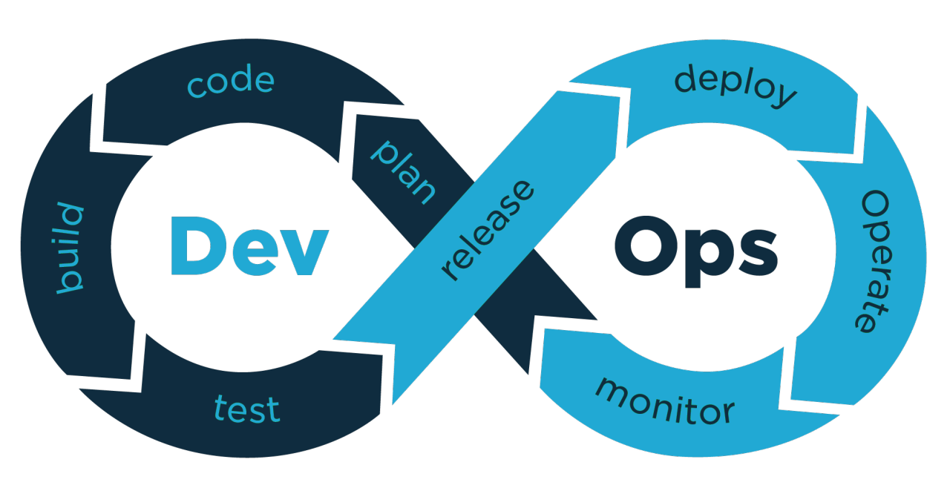
Final Graduation project 2024
Automated Deployment Pipeline
Supervised By: Eng. Ahmed Mourad

Slide 2




Presented by:
Ahmed Khamis Abdelmoniem
Ahmed Elsayed Ghanem
Nourhan Ashour Mohamed
Mazen Mohamed

Slide 3
Agenda
Introduction to pipeline CICD.
Tools and Technologies Used.
Initial Setup & Planning .
Jenkins & CICD Integration.
Continuous Integration.
Continuous Deployment.
Kubernetes Deployment.
Conclusion .

Slide 4
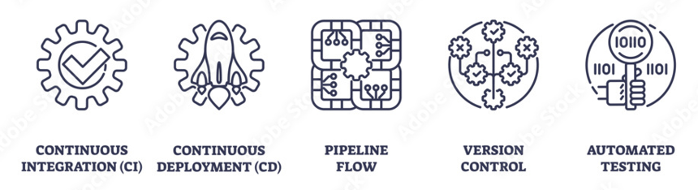
Introduction to DevOps and CI/CD
Project aims to automate the pipeline using Jenkins, Docker, and Ansible
CI/CD as core practices in DevOps

Slide 5
Tools and Technologies Used
Jenkins: CI/CD pipeline
Docker: Containerization platform for consistent deployments
Ansible: Automation for App configurations and Deployment
Git: Version control system.
Kubernetes: for container orchestration

Slide 6
Initial Setup & Planning
Docker: Installed and verified by running a test container.
Ansible: Installed on the control machine.
Jenkins: Installed on a Linux-based server.

Slide 7
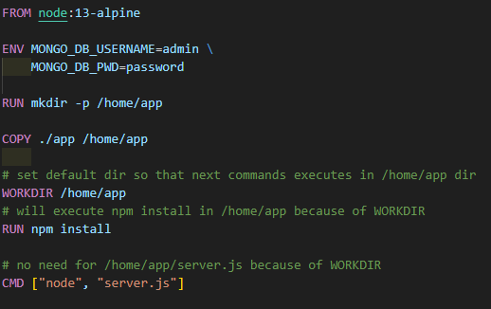
Docker Setup
Create Dockerfile
Build Docker Image
Run Docker Container
Test Application: Verify functionality via browser

Slide 8
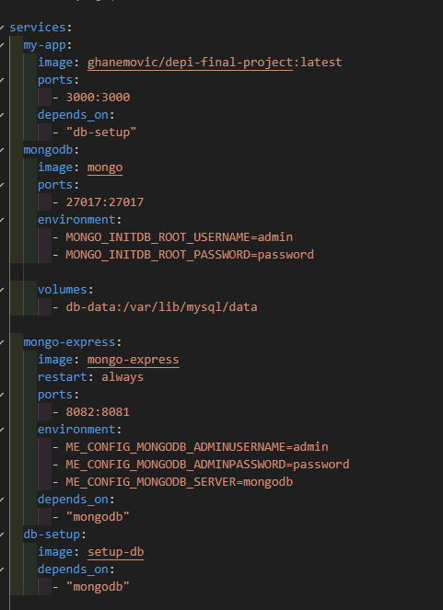
Docker Compose
Build Docker Compose file
Run Docker Compose file

Slide 9
Jenkins & CICD Integration
Jenkins: Automatically build and test the application
Git : Automates detection of code changes
Docker Hub: Pushing Docker images after successful builds
Testing: Ensures code quality before deployment
Ansible: Automates deployment across AWS using playbook

Slide 10
Pipeline Continuous Integration
Set Up New Jenkins Pipeline:
Integrate Git repository for automatic builds on code commits.
Configure webhooks to trigger builds automatically upon code changes.
Build Steps:
Build application (using npm).
Test Steps:
Tests ensure the application functions as expected with every build.
Post-Build Actions:
Push Docker image to Docker Hub and Send notifications to Slack.

Slide 11
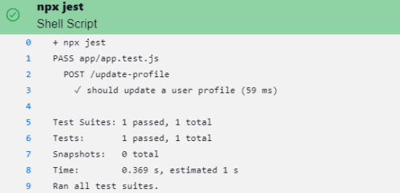
Automated testing
Integrated unit tests to run automatically with every build.
Ensure the application works as expected.

Slide 12
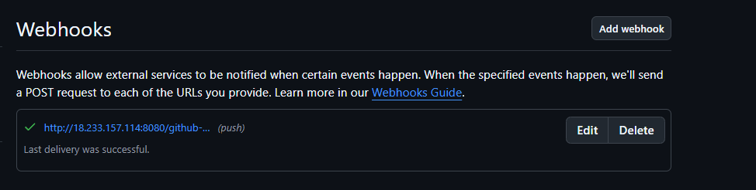
Webhooks as Post-Build Actions
Enable Webhooks :
Notify Jenkins of repository changes.
Trigger automatic builds on code commits.

Slide 13
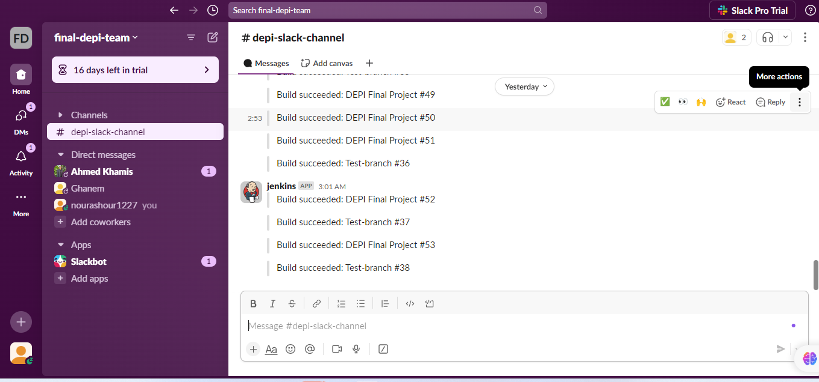
Slack notification
Send real-time notifications to Slack channels for build status updates.
Keep the team informed about successes or failures immediately.

Slide 14
Ansible Setup
Ansible :
Install Ansible for Configuration Management.
Verify installation using: ansible --version.
Create Inventory File:Define target servers in the hosts file.
Write Ansible Playbooks: Automate tasks like package installation ,app deployment, and service management.

Slide 15
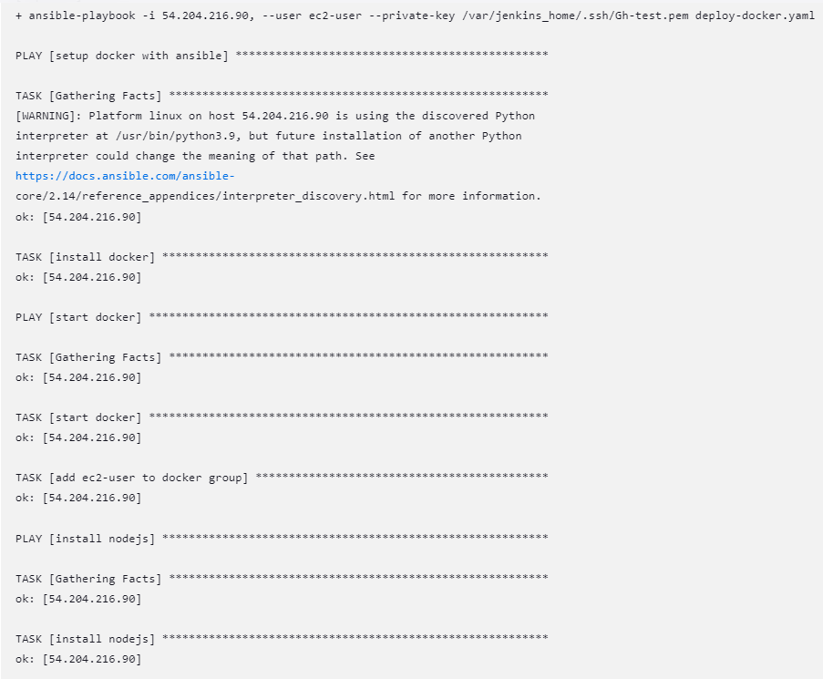
Continuous Deployment Using Ansible
We used Ansible to automate Deployment of the Application on EC2 Server.
Install Docker
Install Nodejs

Slide 16
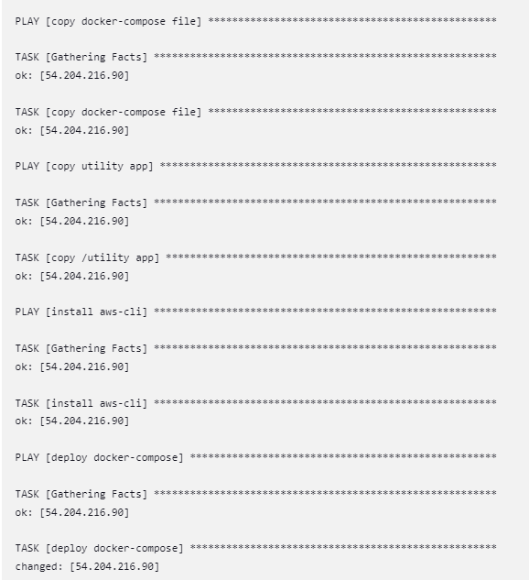
Continuous Deployment Using Ansible
Copy docker-compose file
Deploy docker-compose file on EC2-Server

Slide 17
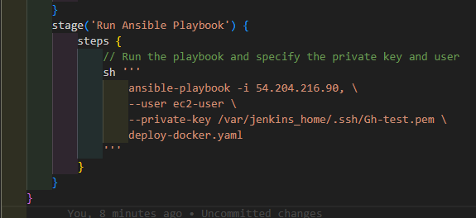
Pipeline Continuous Deployment
Jenkins deploys the application using Ansible.

Slide 18
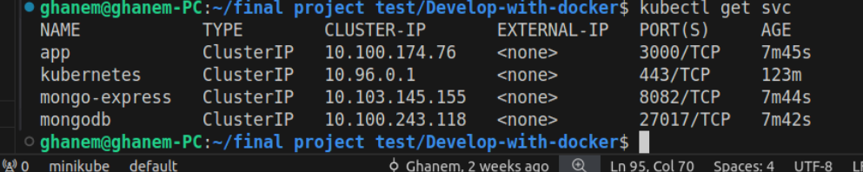
Kubernetes Deployment
kubectl apply -f <generated-k8s-files>
Set Up Kubernetes: Kubernetes clusters were set up using minikube .
Convert Docker Compose to Kubernetes: Utilized Kompose command.
Deployment : using kubectl apply command.

Slide 19
Conclusion
Importance of automated pipelines in modern development
Tools like Jenkins, Docker, and Ansible streamline deployment
The project demonstrates scalability with Kubernetes integration

Slide 20
Thank you

