Slide 1
A* search routing Algorithm
Miniproject By Ahmed Khatter
For Digital Design 2

Slide 2
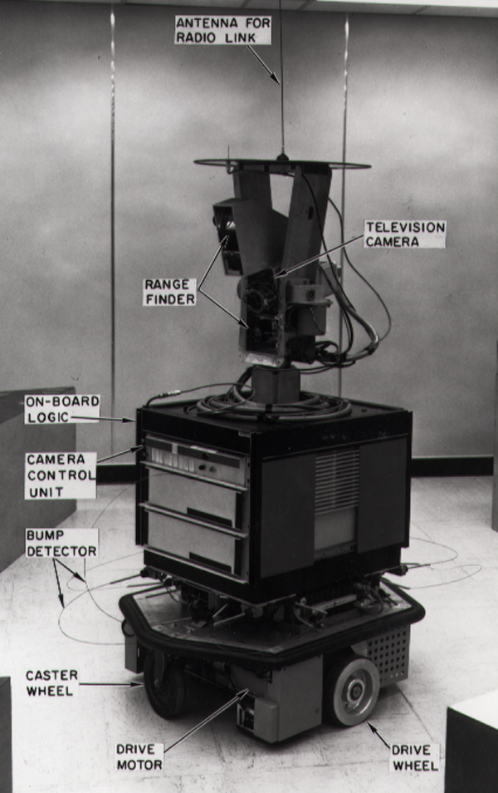
Beggining
The A* algorithm was first used by researchers working on
Shakey the Robot's path planning.

Slide 3
A* routing
This algorithm was made to find the shortest most efficient path in a graph
This is done by giving every node three variables f,g, and h
G is the distance between the node and the source
H is the distance between the node and the target
F is the addition of both

Slide 4
Optimization
This algorithm was then modified a lot in order to meet the required outcome
The changes mainly revolve around the fact that every layer can only move in a specific direction
M1: Horizontal
M2: Vertical
M3: Horizontal

Slide 5
Conclusion
The algorithm is tough to debug.
And it was a tough challenge to understand the optimizations necessary to make this algorithm efficient
Eventually All test cases passed with flying colors

