Slide 1
Clustering with K-means
Introduction to Unsupervised Learning

Slide 2
Outline
Unsupervised Learning
Clustering
K-Means algorithm
Calculating similarities
Choosing the right value of K
Application of K-means

Slide 3
Objectives
Introducing Unsupervised Learning
Importance of clustering
Understanding K-means Algorithm

Slide 4
Unsupervised Learning
Unsupervised Learning
Clustering
Dimensionality Reduction
Anomaly Detection

Slide 5
Unsupervised Learning
Data is not labeled
We can’t train models in a supervised learning manner (no desited output)
We have to find similarities into data

Slide 6
What is clustering
Groups similar data points into clusters (families).
Each cluster contains similar individuals.
Different clusters contain dissimilar individuals.

Slide 7
What is clustering
The number of clusters depends on the data
The number of clusters depends also from the clustering algorithm hyper-parameters
Clustering groups observations of a dataset into distinct clusters.
Each observation belongs to only one cluster (mutual exclusivity).
Therefore, the same observation cannot belong to multiple clusters.

Slide 8


Importance of clustering
Used by Amazon, YouTube, Netflix for recommendations.
Enables personalization and segmentation.
Drives data-driven business strategies.

Slide 9
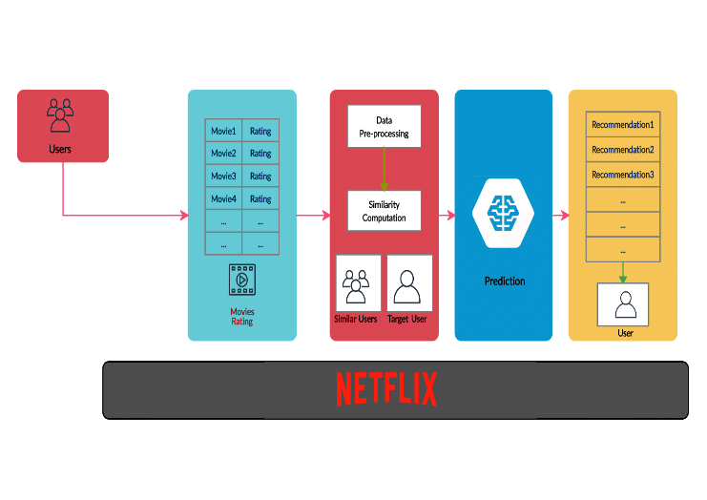
Recommendation systems
Clustering plays a major role in recommendation systems
Clustering allows to understand the data, finding profiles and groups
➔ This brings business values and allows to make profits using ads

Slide 10
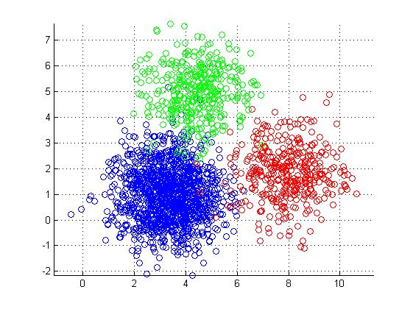
What is K-Means ?
Popular unsupervised clustering algorithm.
Groups data into K distinct clusters.
Each observation belongs to one cluster only (exclusive membership).

Slide 11
What is K-Means ?
Here K-Means algorithm with K=3 is trained

Slide 12
Principles of K-Means
Randomly initialize K centroids.
Assign each data point to the nearest centroid.
Recompute centroids as the mean of their cluster.
Repeat until centroids stop moving (convergence).

Slide 13
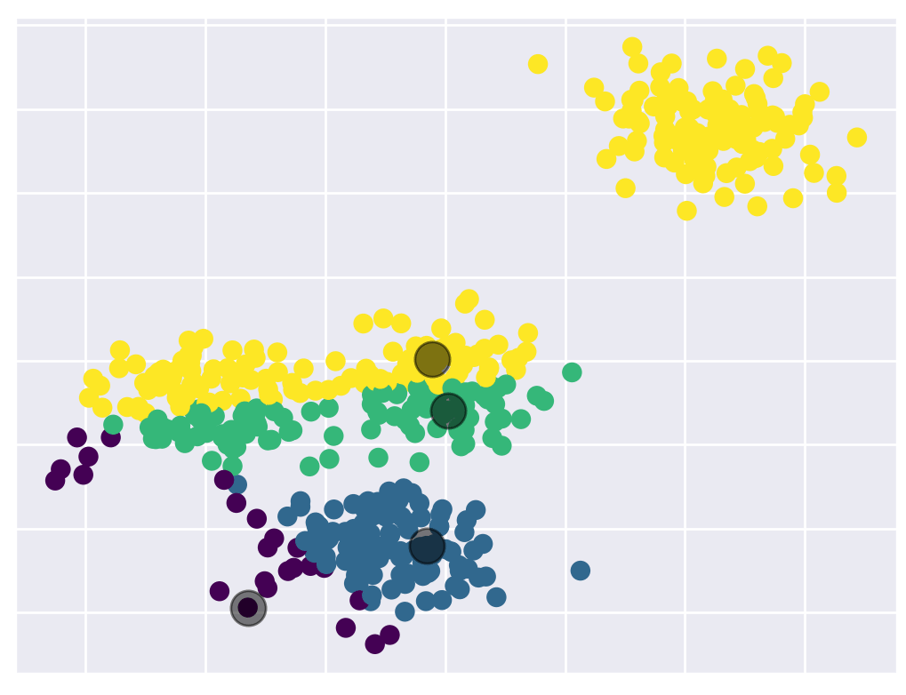
Principles of K-Means
After fixing the number of cluster (4 in this case)
The centroids (center of the clusters) is recalculated at each iteration
The algorithm stops after converging (the centroids don’t change anymore)

Slide 14
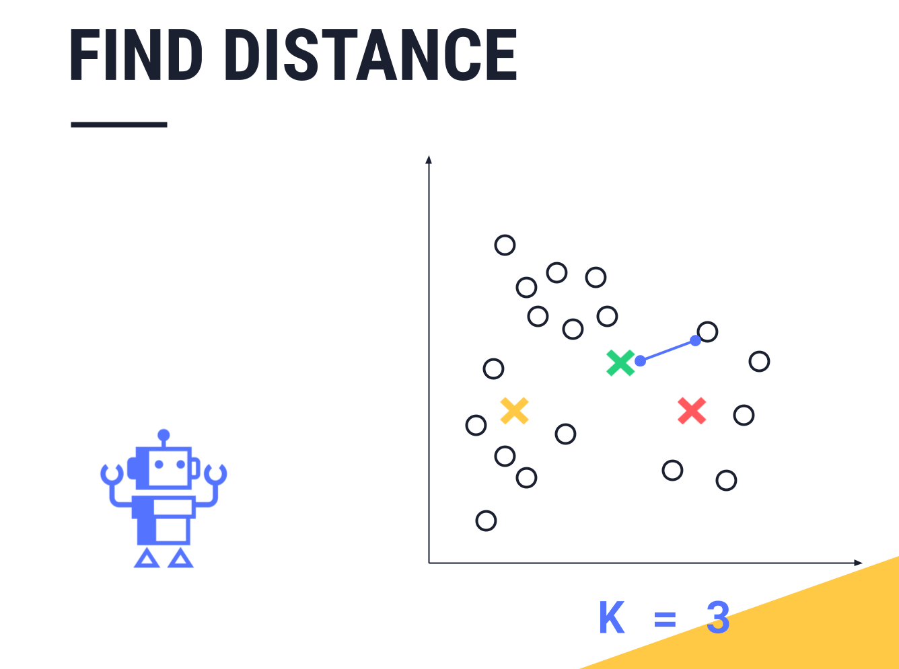
Similarity between samples
K-Means relies on distance measures to determine similarity.
Close points → small distance → same cluster.
Far points → large distance → different clusters.
The distance is calculated using the features of each sample

Slide 15
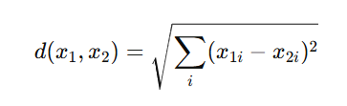
Distance Metrics
Euclidean Distance:
Straight-line, Simple geometric distance.
Assumes clusters are spherical and equal-sized.
Continuous numerical data (e.g., height, weight, pixel values).
Sensitive to scale → data should be standardized (mean = 0, variance = 1).

Slide 16

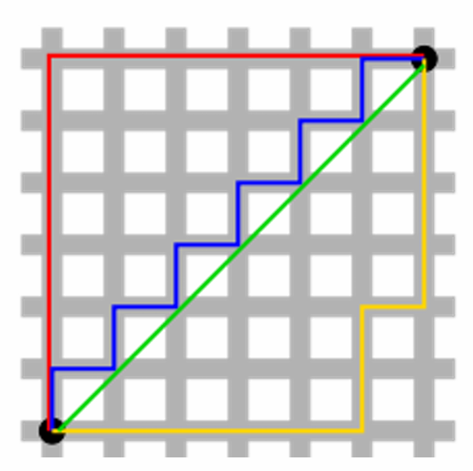
Distance Metrics
Manhattan Distance:
Taxi cab distance
Simple geometric distance.
Data with features on different scales or sparse features (like text counts).
More robust to outliers than Euclidean distance.

Slide 17
Distance Metrics
Plenty of other distances:
Cosine Distance (embedding, text data)
Mahalanobis Distance (Takes into account feature correlations)
Hamming Distance (categorical data)

Slide 18
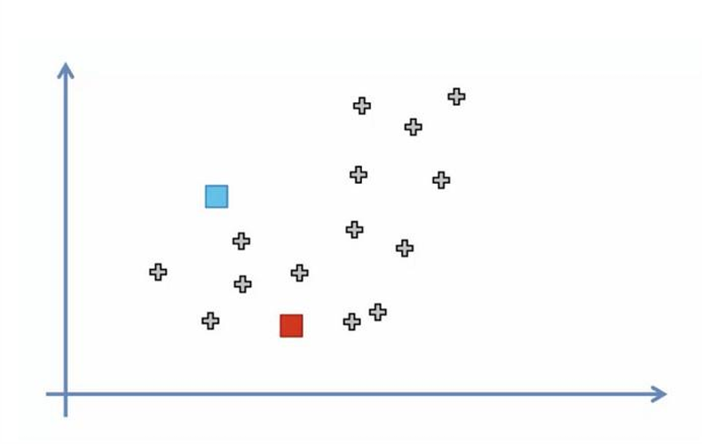
Example
Select K (i.e: 2) random points as cluster centers called centroids

Slide 19
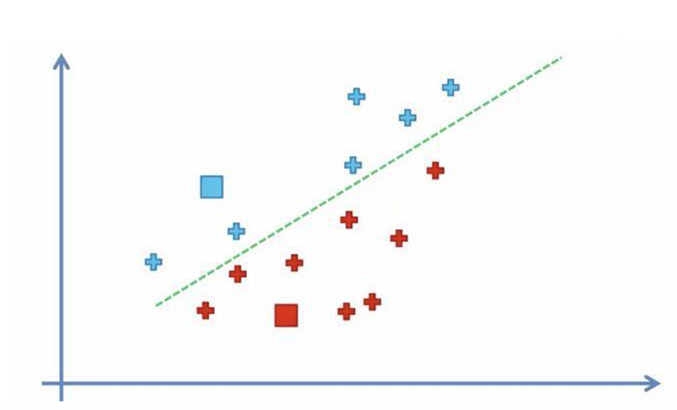
Example
Assign each data point to the closes cluster by calculating its distance with respect to each centroid

Slide 20
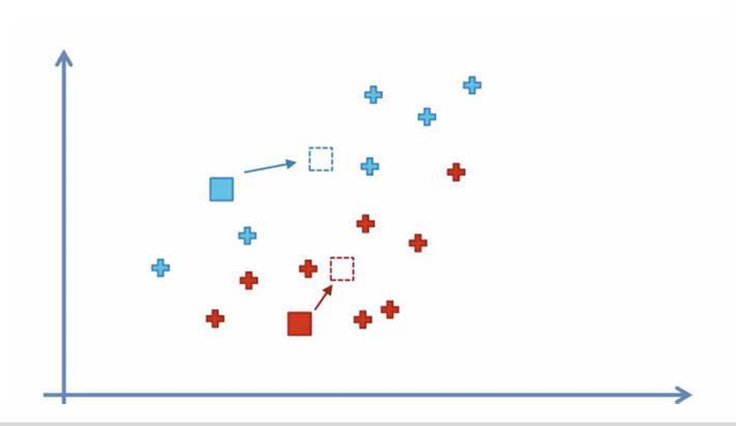
Example
Determine the new cluster center by computing the average of the assigned points

Slide 21
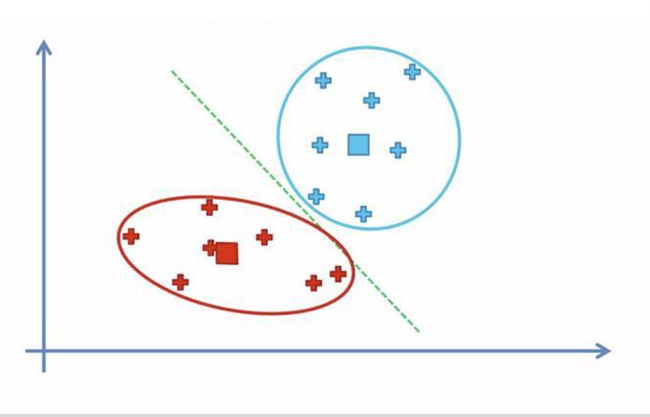
Example
Repeat steps 2 and 3 until none of the cluster assignments change

Slide 22
Choosing the right number of clusters
No fixed rule for choosing K.
Too small K → clusters too broad, lose detail.
Too large K → fragmented clusters, lose meaning.
Need to balance generalization and specificity.

Slide 23
Elbow Method
Run K-Means with several K values.
Compute within-cluster variance (inertia) for each K.
Plot K vs variance.
“Elbow point” = optimal number of clusters.

Slide 24

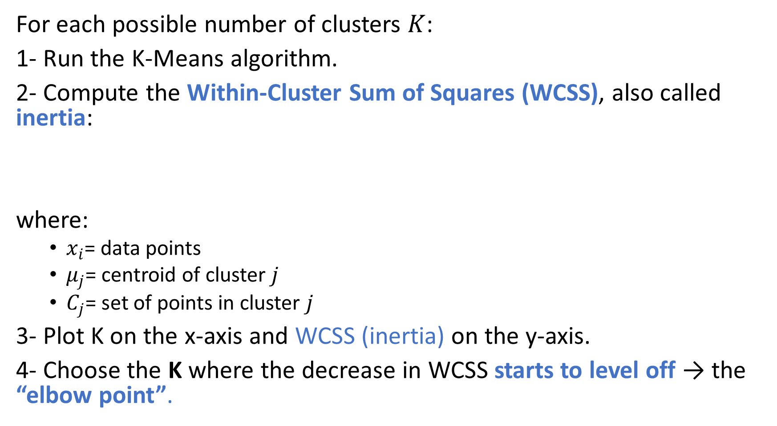
Elbow Method
For each possible number of clusters $K$:
1- Run the K-Means algorithm.
2- Compute the Within-Cluster Sum of Squares (WCSS), also called inertia:
where:
  $x_{i}$= data points
  $μ_{j}$= centroid of cluster $j$
  $C_{j}$= set of points in cluster $j$
3- Plot K on the x-axis and WCSS (inertia) on the y-axis.
4- Choose the K where the decrease in WCSS starts to level off → the “elbow point”.

Slide 25
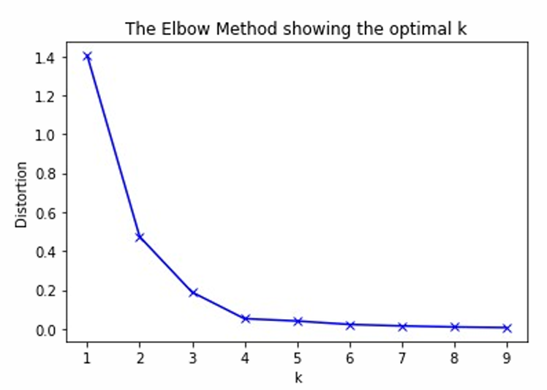
Elbow Method

Slide 26
Advantages and Limitations of K-Means
Advantages:
  Simple and fast.
  Works well with spherical clusters.
  Easy to interpret.
Limitations:
  Must specify K.
  Sensitive to initialization.
  Works poorly with non-spherical or overlapping clusters.

Slide 27
Summary
K-Means = simple and powerful unsupervised algorithm.
Groups similar observations based on distance.
Optimal K found using the Elbow Method.
Useful for segmentation, recommendation, and discovery.

