Slide 1
ANTI-REFLECTION COATING
Design and Bandwidth Analysis
Quarter-Wave Matching of a Glass Substrate (εr = 2.25) at 10 GHz
EECG 252 — Electromagnetic Fields and Waves | Project 1B
Group 6 | Cairo University, Faculty of Engineering | Spring 2026
Anas Elghzaly
Radwa Ali
Amin Mohamed
Ahmed H. Abdel-Haleem
Ahmed A. Elsayed
Course Instructor: Dr. Mohamed Alaa

Slide 2
THEORY & SINGLE-LAYER DESIGN
Key Principle
Group 6 — Design Results
Two partial reflections cancel by destructive interference when:
① Thickness: d = λc / 4 (quarter-wave inside coating)
② Impedance: ηc = √(η₀ · ηs) (geometric mean)
Substrate
Glass (εr = 2.25)
Substrate impedance
ηs = 251.3 Ω
Coating permittivity
εr,c = 1.50
Coating impedance
ηc = 307.8 Ω
Coating thickness
d = 6.12 mm
Design frequency
f₀ = 10 GHz
Derivation Verification
Zin = ηc² / ηs = η₀ → Γ = 0 ✓
Return Loss = −20 log₁₀(|Γ|) [dB]
εr,c = (η₀/ηc)² = (377/307.8)² = 1.50
Zin = (307.8)² / 251.3 = 377 Ω = η₀ ✓
Γ = (377−377)/(377+377) = 0 ✓

Slide 3
TWO-LAYER BINOMIAL DESIGN
Maximally Flat (Binomial) Approach
Binomial Design Parameters
Layer | εr | ηc (Ω) | Thickness
Layer 1 (air side) | 1.22 | 341 Ω | 6.79 mm
Layer 2 (glass side) | 1.84 | 278 Ω | 5.53 mm
Two sequential λ/4 layers step η₀ → ηc1 → ηc2 → ηs.
Matching condition:
εr,c2 / εr,c1 = √εr,s = √2.25 = 1.5
Choosing εr,c1 = 1.22 → εr,c2 = 1.84
Layer
εr
ηc (Ω)
Thickness
Layer 1 (air side)
1.22
341 Ω
6.79 mm
Layer 2 (glass side)
1.84
278 Ω
5.53 mm
Verification
Air
Layer 1
Layer 2
Glass
Zin,2 = ηc2² / ηs = (278)² / 251.3 ≈ 307.4 Ω
Zin,1 = ηc1² / Zin,2 = (341)² / 307.4 ≈ 379 Ω ≈ η₀ ✓
Three partial reflections → complete destructive interference
η₀ = 377 Ω
εr = 1.22
6.79 mm
εr = 1.84
5.53 mm
εr = 2.25
ηs = 251.3Ω
Incident wave →
BW improvement: ~49% wider than single-layer (9.80 GHz vs 6.56 GHz)

Slide 4
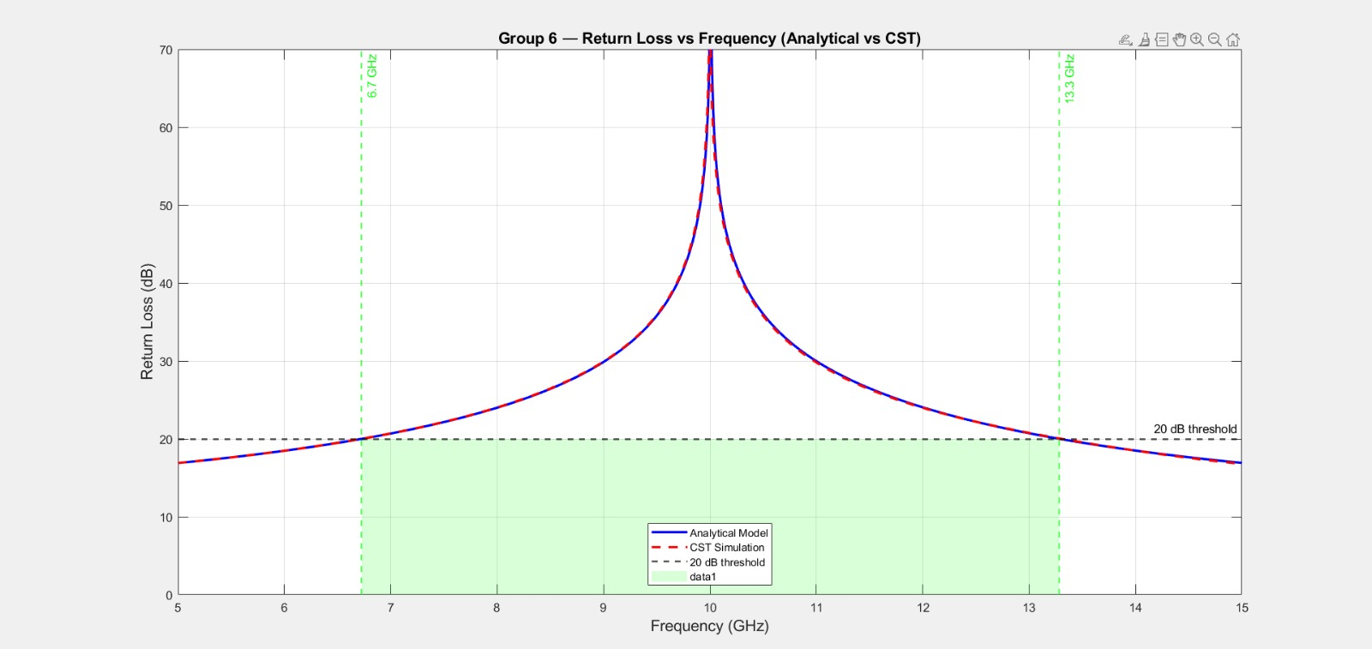
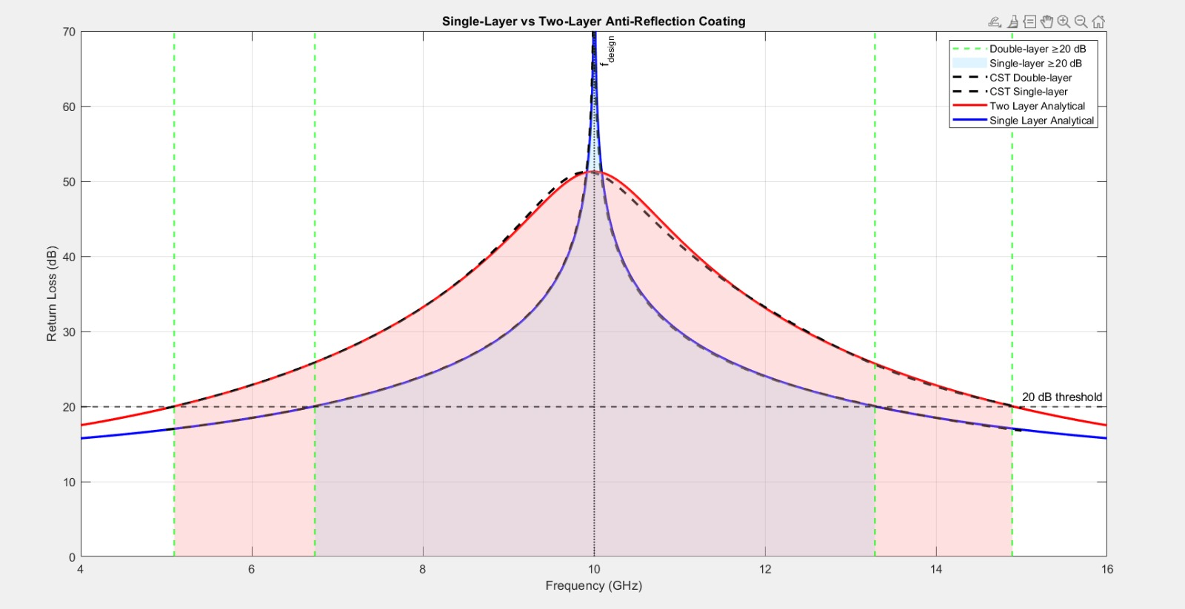
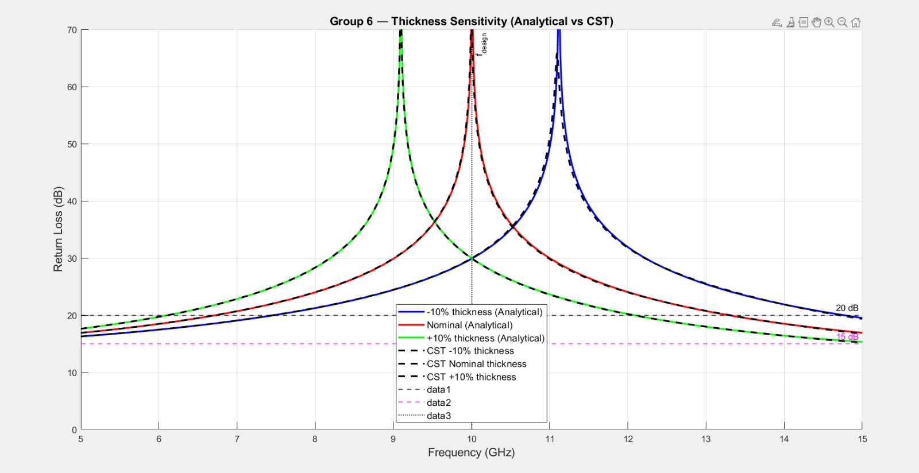
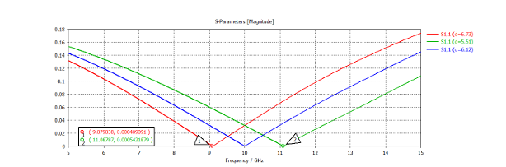
ANALYTICAL & SIMULATION RESULTS

Slide 5
COMPARISON & CONCLUSIONS
Cross-Group Comparison: Group 6 (Glass) vs Group 9 (Alumina)
Parameter
Group 6 (Glass)
Group 9 (Alumina)
Why the Difference?
Relative permittivity εr
2.25
9.80
Higher εr → lower ηs
→ larger mismatch ratio
→ steeper |Γ| roll-off
→ narrower bandwidth
Substrate impedance ηs
251.3 Ω
120.4 Ω
Mismatch ratio η₀/ηs
1.50
3.13
20 dB BW (single-layer)
6.4 GHz
2.2 GHz
Fractional BW
64%
22%
Conclusions
01
Design Verified
02
Wide Bandwidth
03
Two-Layer Gain
04
Robust to Errors
Single-layer: εr,c=1.50, d=6.12 mm. Γ=0 at 10 GHz confirmed by analytical model and CST full-wave simulation (−72 dB null).
Mild impedance contrast (η₀/ηs=1.50) yields a broad 20 dB BW of 6.4 GHz (64% fractional).
Binomial design expands BW to ~9.8 GHz (+49%), spreading the impedance step over two λ/4 stages.
±10% thickness error keeps return loss > 30 dB at f₀ due to the shallow, broad Γ null near f₀.

