Slide 1
SAMCO EGYPT
Project Intelligence Hub
Board presentation: source-governed decision intelligence, project isolation, and controlled publishing.
The platform keeps source data separate by project, calculates through the canonical control layer, and publishes only verified payloads to management views.
Designed & Created |
Engr. Ahmed Labib
Notes:
[Sources]
Local portfolio.json and project payloads.
No external sources.

Slide 2
BOARD VIEW
SAMCO PROJECT INTELLIGENCE HUB | 02
Evidence becomes a controlled management view
Portfolio signals are aggregated only after every source remains inside its own project boundary.
RECOGNIZED PROJECTS
SECTORS
PORTFOLIO CONTRACT VALUE
DATA GUARDRAIL
4
3
EGP 4567.3M
N/A
Current discovered portfolio
Folder-driven classification
Source-backed total
No portfolio trust score published
Board conclusion
The operating model is designed to prevent cross-project leakage, avoid fabricated management values, and expose missing evidence before it becomes a decision. The decision dashboard aggregates verified project signals; detailed controls remain project-scoped.
Designed & Created |
Engr. Ahmed Labib
Evidence-led project controls
Notes:
[Sources]
website/public/data/portfolio.json
12-logs/guardrail_report_latest.md

Slide 3
OPERATING PIPELINE
SAMCO PROJECT INTELLIGENCE HUB | 03
One source path to board-ready views
Calculation, validation, reporting, and publishing are separated so a display cannot overwrite source evidence.
Project folders
Canonical engines
Verified payloads
Vercel delivery
→
→
→
Data, contracts, letters, evidence, schedule, and delay sources
Python calculations, project context, source lineage, and validation
Per-project JSON, charts, output manifests, and AI context
Same-page workspace, Decision Dashboard, and direct outputs
Control rule: every source row, calculated metric, chart payload, report artifact, and AI context carries project_id and project_key.
Designed & Created |
Engr. Ahmed Labib
Evidence-led project controls
Notes:
[Sources]
tools/generate_nextjs_website_data.py
tools/validate_streamlit_vercel_pipeline.py
tools/vercel_project_pipeline.ps1

Slide 4
PROJECT ISOLATION
SAMCO PROJECT INTELLIGENCE HUB | 04
Each project is a separate evidence boundary
The shared dashboard can aggregate management signals without allowing a project workspace to read another project’s records.
Within one project
Across the portfolio
• Project manifest and stable project_id
Only derived, verified portfolio metrics are aggregated. The Decision Making Dashboard is clearly portfolio-scoped; project AI, letters, claims, and outputs stay within the selected project.
• Data and schedule sources
• Letters, contracts, evidence, and claims
• Delay logic, report outputs, and AI context
No fallback to another project is permitted when data is missing.
Designed & Created |
Engr. Ahmed Labib
Evidence-led project controls
Notes:
[Sources]
core/project_context.py / project manifests
tools/validate_project_isolation.py

Slide 5
DECISION INTELLIGENCE
SAMCO PROJECT INTELLIGENCE HUB | 05
Signals, confidence, actions, and evidence gaps
The design language follows the supplied dark chart reference: compact controls, high signal density, and restrained accent colours.
Portfolio composition
Decision components
01 Executive KPI and data-trust indicators
02 Predictive warnings and scenario impacts
03 Management decision brief and action tracker
04 Technical knowledge advisor and evidence-aware AI
Designed & Created |
Engr. Ahmed Labib
Evidence-led project controls
Notes:
[Sources]
website/public/data/portfolio.json
website/src/app/page.tsx
Charts design/samco_dashboard_charts.html

Slide 6
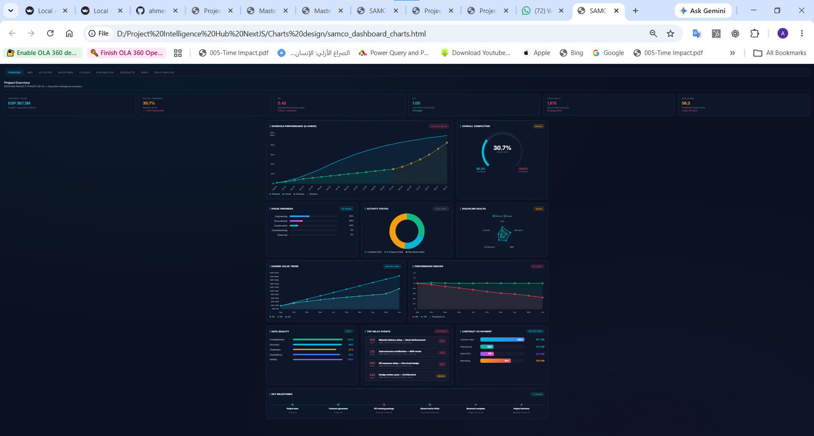
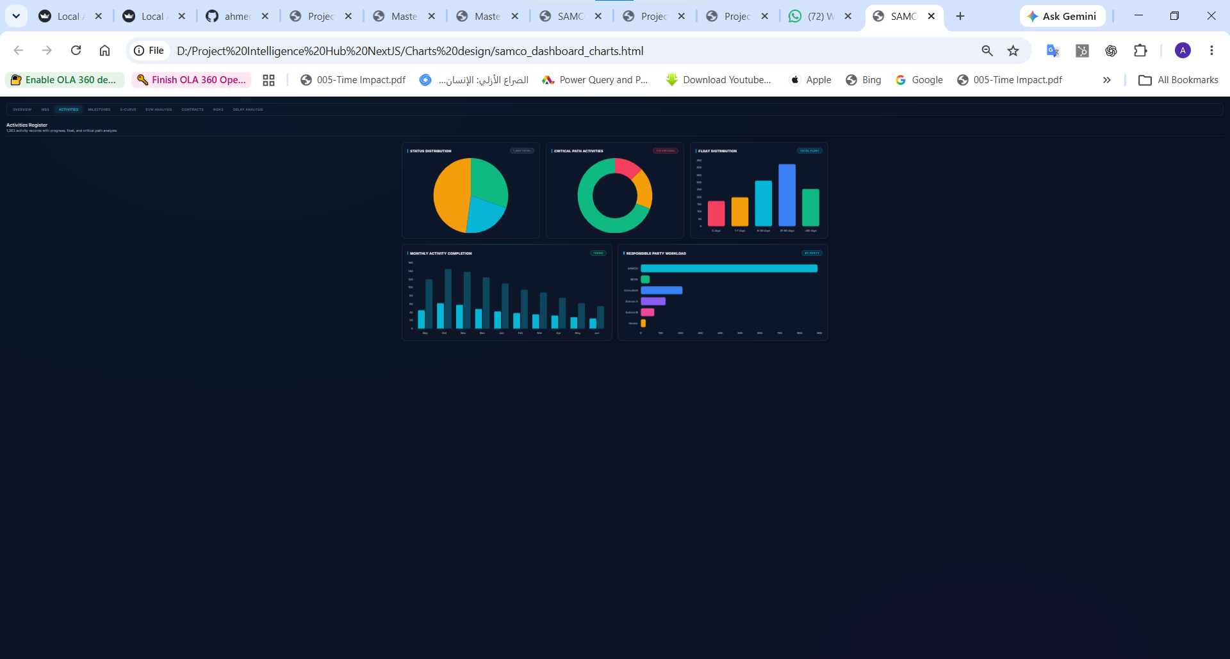
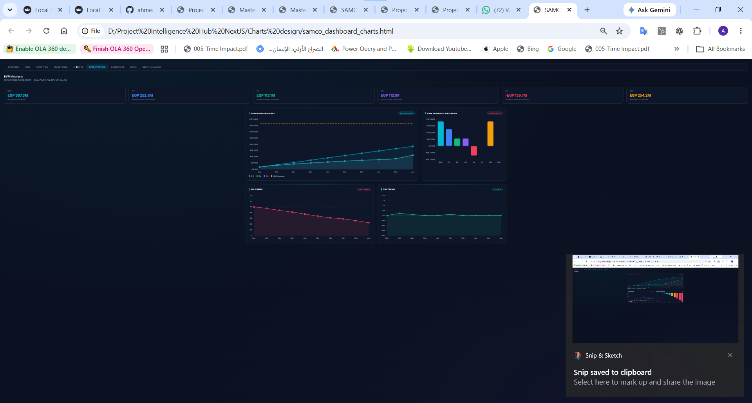
PROJECT WORKSPACE
SAMCO PROJECT INTELLIGENCE HUB | 06
Every tab has a source-backed control view
The application does not embed reports inside working tabs. Charts provide active control views; Output Studio remains the formal delivery surface.
Overview
Activities
EVM Analysis
Chart views are loaded from the selected project payload only.
Chart views are loaded from the selected project payload only.
Chart views are loaded from the selected project payload only.
Designed & Created |
Engr. Ahmed Labib
Evidence-led project controls
Notes:
[Sources]
User-provided chart-reference screenshots.
website/src/app/page.tsx
tools/project_chart_payloads.py

Slide 7
DATA ONBOARDING
SAMCO PROJECT INTELLIGENCE HUB | 07
New projects can be added without new code
Project discovery, template seeding, validation, and regeneration operate from the folder and its manifest.
1
Create or add the project folder
Sector folder discovery and manifest preserve a stable project identity.
2
Place source-controlled data
Schedules, payments, letters, contracts, risks, evidence, and project-local templates.
3
Run validation and generation
Data quality findings remain attached to the owning project; no missing-data fallback.
4
Publish validated outputs
Only changed project payloads and report artifacts regenerate and publish.
Designed & Created |
Engr. Ahmed Labib
Evidence-led project controls
Notes:
[Sources]
projects/ folder structure
tools/validate_project_isolation.py
tools/generate_nextjs_website_data.py

Slide 8
AI GOVERNANCE
SAMCO PROJECT INTELLIGENCE HUB | 08
AI supports decisions, not assumptions
Groq is available as a server-side, read-only reasoning provider after the selected project’s evidence is assembled.
What AI can do
Hard safety boundaries
• Classify executive, claim, letters, data-quality, and technical questions
• No fabricated dates, costs, delay days, clauses, or EOT
• Match the Technical Knowledge Bank to natural-language queries
• No cross-project context in selected-project mode
• Explain affected evidence, logic gates, and follow-up actions
• Missing evidence is stated as missing, never estimated
• Draft evidence-aware recommendations within the active scope
• Contractual conclusions remain subject to verified source evidence
Designed & Created |
Engr. Ahmed Labib
Evidence-led project controls
Notes:
[Sources]
website/src/app/api/analyze-delay/route.ts
website/src/lib/ai/project-context.ts
knowledge/technical_question_bank/

Slide 9
CONTROLLED DELAY ANALYSIS
SAMCO PROJECT INTELLIGENCE HUB | 09
Internal analysis stays evidence-gated
The governed engine analyses the selected project’s available schedule, relationship, evidence, and event sources; unverified outcomes remain indicative.
INTERNAL SCOPE
AUTOMATION
CPM LOGIC
P6 RULE
Retained
Evidence-gated
Relationship-led
P6 verification
Sources and calculations preserved
No source means no conclusion
Predecessor, successor, type, lag
Required before final conclusion
Professional conclusion
When evidence is complete, the engine can identify events, map activities, recommend fragnet logic, test path and float effects, and surface evidence gaps. It does not label compensation or final EOT without the required CPM and contract evidence.
Designed & Created |
Engr. Ahmed Labib
Evidence-led project controls
Notes:
[Sources]
src/construction_system/tia_source_governance.py
src/construction_system/tia_report_engine.py
Selected project delay-analysis sources

Slide 10
BOARD DECISION
SAMCO PROJECT INTELLIGENCE HUB | 10
Approve the control model and evidence standards
The next value step is governed adoption: complete source inputs, set owners, and use the management view for controlled intervention.
1
Adopt the project_id data boundary
2
Set source-data owners
Require every new project and input template to be registered through the project manifest.
Assign accountable owners for progress, cost, schedule, letters, contracts, risks, and evidence.
3
Use evidence gates for decisions
4
Run the verified publish workflow
Treat data quality, missing evidence, and P6 verification as visible decision conditions.
Use the local watcher to regenerate, validate, sync, deploy, and confirm public assets.
Outcome: a board-level decision platform backed by project-scoped evidence, controlled AI assistance, and an auditable publishing chain.
Designed & Created |
Engr. Ahmed Labib
Evidence-led project controls
Notes:
[Sources]
Board brief and operating pipeline validation results.
No external sources.

