Slide 1
8x8 LED Cube
with Snake Game
CC Rossi, Ahmed Ismail,
Ryan Sartin, Joshua Dunn

Slide 2
Project Description
We are making an 8x8x8 LED Cube
Each layer is lit individually
Persistence of vision (POV) is used to trick the eye into thinking many layers are on simultaneously
Ground (logic 0) is sent to one of the eight layers using a 3-to-8 decoder to select it while logic high is sent to the other layers.
4 I/O expanders are then used to send a logic high to LED’s in specified columns (16 pins per I/O expander) while logic low is sent to the rest.

Slide 3
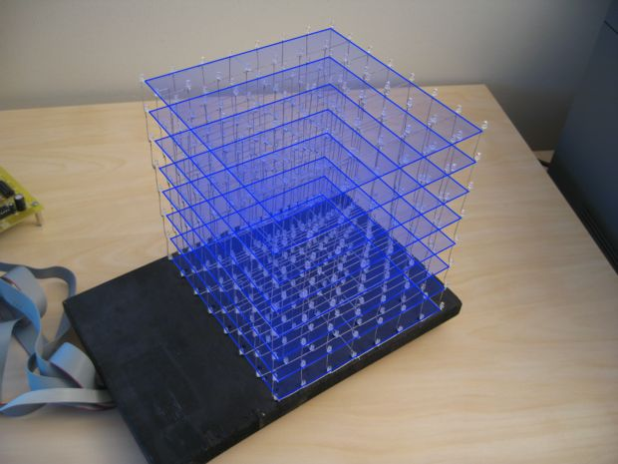
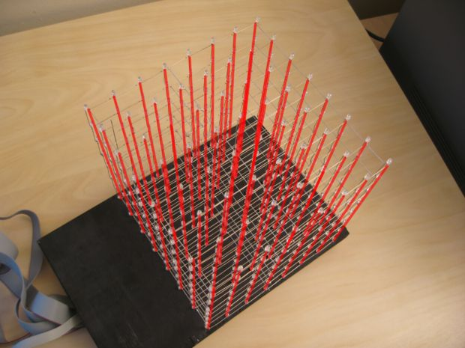
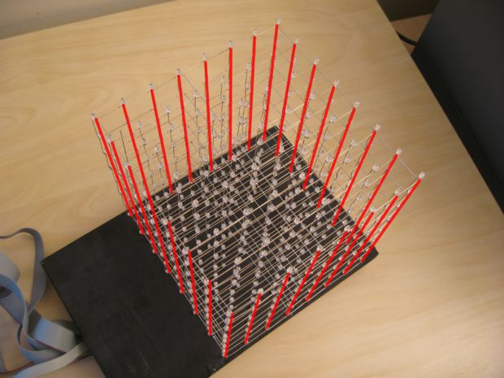
LED Cube

Slide 4
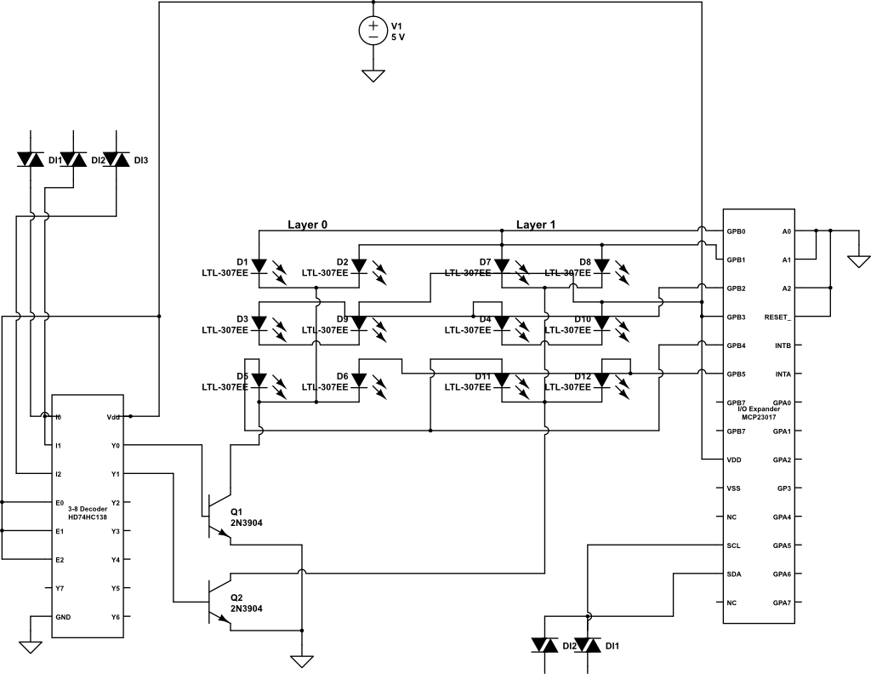
Block Diagram

Slide 5
Parts List and Progress
3mm Diffused Blue LEDs (512 count)
1 HD74HC138P 3-to-8 decoder
  Used for selecting/powering a layer of the cube
8-16 NPN BJTs/NFETs
  Used for each layer, may require 2 each
4 MCP23017 16-bit IO Expanders (I2C)
  Used for powering one of the 64 columns
Mbed microcontroller and external 5V supply
Solder/Wire/Patience
Currently have all parts to develop existing schematic. Have tested new backend software on smaller cube hardware, and game development has begun.

Slide 6
Challenges Ahead
I2C IO expander speed above 400KHz not supported by mbed pin hardware
  Why is this important? Persistence of vision and ghosting
  Alternative design: flip-flop based multiplexor schematic
    Disadvantage: more wires/hardware involved
Current draw from individual IO expander when LEDs from 16 pins are powered
  Alternatives Additional drivers/expanders
User input method for the game

