Slide 1
CIE 427 - Plant Disease Classification using PySpark
Ahmed Saad - 201800251
Ehab Mansour - 201800506

Slide 2
Problem Statement

Slide 3
Problem Statement
Increasing global population and need for food security is leading to an urgent need to improve crop yields.
Plant diseases continue to be a significant threat to crop production, with yield losses of up to 14% to 20% cost 220 billions USD [1].
Widespread use of smartphones can be leveraged for detecting and diagnosing plant diseases, and developing mobile diagnostics to increase food production.
Notes:
[1] https://www.cphdforum.org/index.php/2022/05/26/plant-disease-crop-loss/

Slide 4
Analysis & Pipeline

Slide 5
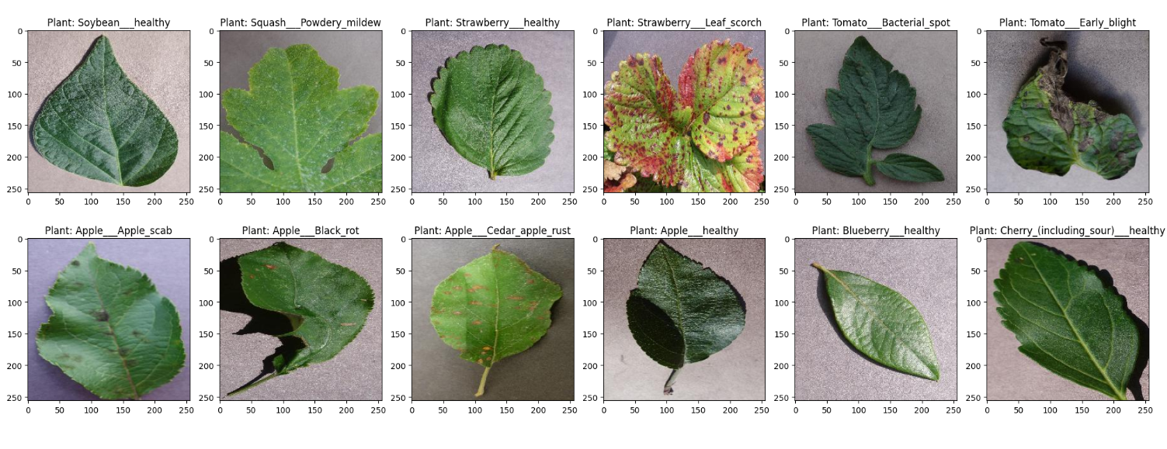
Analysis
Sample of Data

Slide 6
Analysis
2. Number of images: 210k images of 38 types of plants.
3. Each image is 256x256 pixels.
4. There are 14 unique plants and 26 types of diseases.
5. 14 unique plants:
Tomato - Grape - Orange - Soybean - Squash - Potato - Corn_(maize) - Strawberry - Peach - Apple - Blueberry - Cherry_(including_sour) - Pepper,_bell - Raspberry.

Slide 7
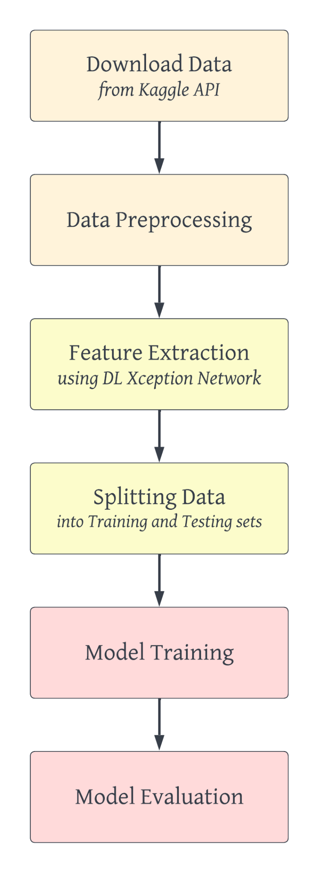
Pipeline
Download data using API
Processing: ordinal encoding for plants’ names.
Feature Extraction using pic2vec
Splitting Data: no overlapping
Model Training: OneVsRest & Logistic Regression Classifier
Evaluate model On test set

Slide 8
RESULTS

Slide 9
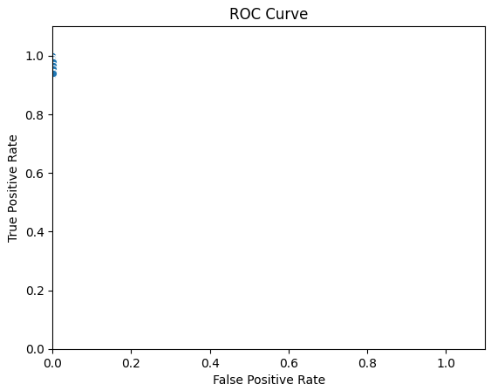
Local Results
Local
Accuracy: 98.49% for the training set and 97.81% for the testing set.
ROC curve:
There are high values in True Positive Rate (TPR) and low values in False Positive Rate (FPR).

Slide 10
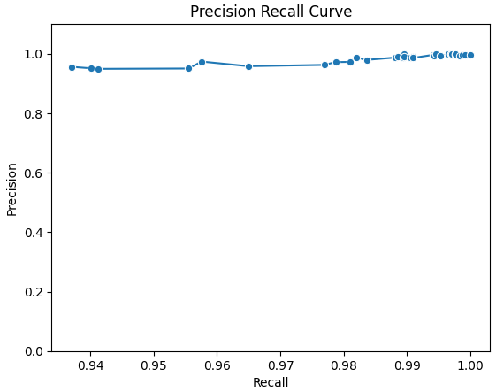
Local Results
Precision and Recall Curve:

Slide 11
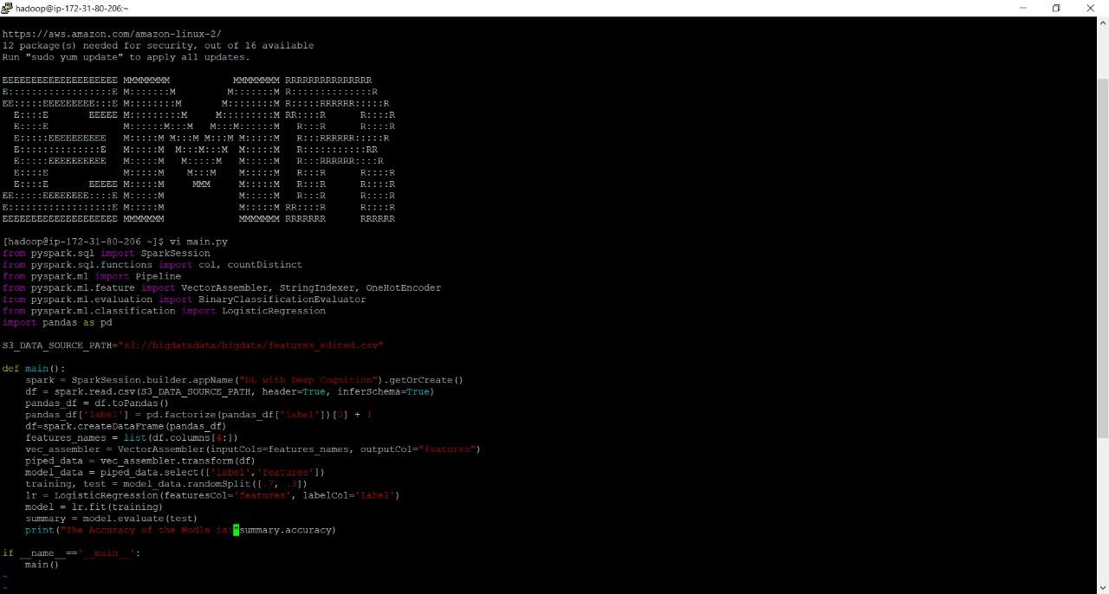
AWS Results
We upload half of the data to S3 socket at AWS and then apply the model on it and connect using putty and SSH to the AWS server to apply the model.

Slide 12
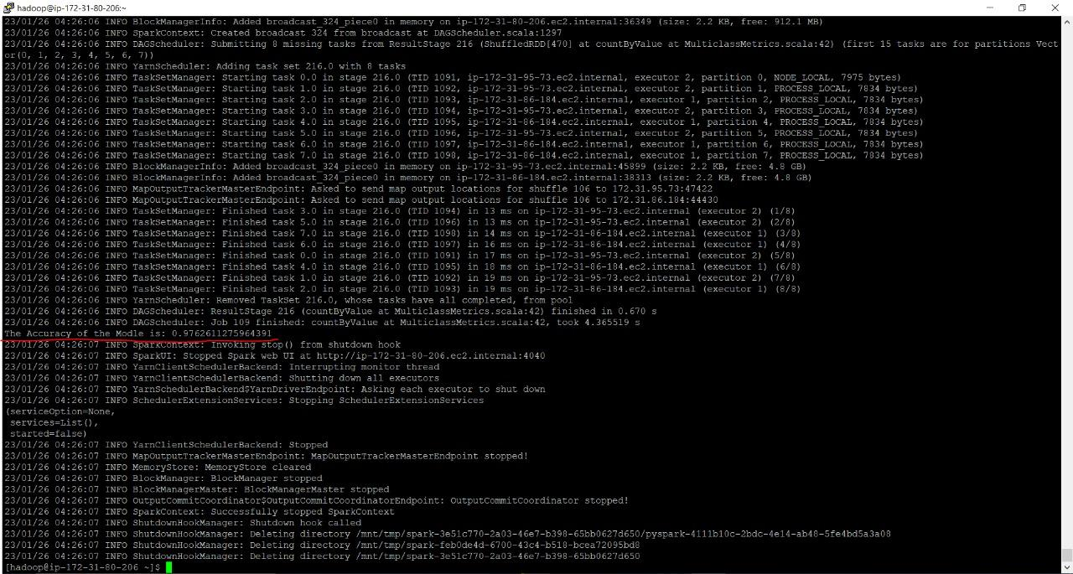
AWS Results
It gave an accuracy of 97%, and it run about 108 task to finish processing

Slide 13
Future Enhancements

Slide 14
Future Enhancements
There are several potential future enhancements that can be made to this project:
Data Augmentation
Model Ensemble
Feature Engineering
Upgrading to newer versions of PySpark
Mobile Application to use the Model

Slide 15
Thank You!

