Slide 1
Course Pilot
Supervised by
Dr. Hanaa Bayoumi
TA. Mohamed Atta
Implemented by
20190041 | Ahmed Tarek Fawzy Ibrahem
20190562 | Mo’men Hatem Mohamed Ali
20190019 | Ahmed Badr Shaaban
20190632 | Youssef Khaled Abd-ElShafi
20190050 | Ahmed Essam-Eldin Abdelfattah
Graduation Project
Academic Year 2022-2023
Final Year Presentation

Slide 2
01
Motivation

Slide 3


Introduction
- Most students search for a platform to study materials in order way and can express their opinion and feedback to make this material improved and better on the other side Many professors and instructors want to share our materials and want students to benefit from it and want feedback to improve materials.

Slide 4
Problem significance
Problem
Many Platforms support only materials, and these materials may be too big or have negative feedback and it’s this hard to solve this problem or may take a long time to be solved.
Why and how
The Usage of Platforms became many, and Students and professors were unable to dispense with the educational platforms.
We will use sentiment analysis to make student rate courses and enhance materials and make materials easier by summary it.

Slide 5
Problem significance
Related Work
Similar projects | Advantages | Disadvantage | Reference
A Study on Coursera | That focuses on analyzing the sentiment of course reviews rather than summarization or recommendation | They only use single language (English) and use Machine Learning approach (SVM) | [1]

Slide 6
Problem significance
Related Work
Similar projects | Advantages | Disadvantage | Reference
Sentiment Analysis and Summarization of Student Feedback for Course Improvement. | sentiment analysis and summarization technique to analysis Feedback and provide techniques to analysis students feedback and provide suggestion for course improvement | They only use single language (English) and use Machine Learning approach (Modified Naive Bayes Classifier) | [2]

Slide 7

Problem significance
Related Work
Similar projects | Advantages | Disadvantage | Reference
 | Professor Upload Material of his course and student can see it | Student can’t write his review or summarize material | [3]

Slide 8
02
Proposed Framework
We will talk about project architecture and datasets and our steps for preprocessing and the model we used

Slide 9
Proposed Framework
Data Collection
Preprocessing
Challenges and Solutions
Algorithms
Summarization

Slide 10
Data Collection
Name | Stands for | Size | Accuracy | Reference
BRAD | Book Reviews in Arabic dataset | 500K | MNB = 86% , SVM = 90% | [3] [7] [11]
Amazon | Amazon Book Reviews for English | 2M | SVM = 81% | [5]

Slide 11
Preprocessing
Text Tokenization and remove punctuations
Digits and English letters Removal
Emoji Removal
Stop Words Removal
Word Stemming / Lemmatization

Slide 12
Challenge 1
Challenge
Solution
Dataset is not balanced for classes and biased for positive class
We solve this problem by balance all labels

Slide 13
Challenge 2
Challenge
Solution
After training the accuracies was less than 75% and neutral class biased with positive class
We use 2 sequences model for objective – subjective
Data
Objective
Subjective
Neutral
Positive
Negative

Slide 14
Challenge 3
Challenge
Solution
diacritical marks in brad dataset for Arabic language when count it in dataset was 1345161 diacritical marks.
We does not remove the diacritical marks in cleaning phase, and it makes result better in evaluation and testing phase.

Slide 15
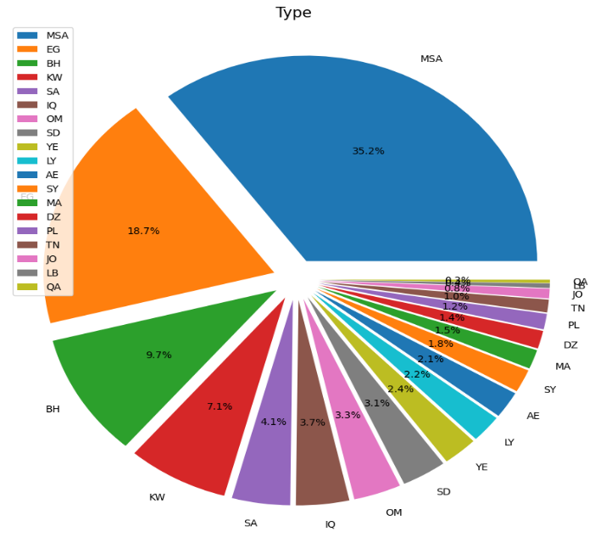
Challenge 4
Challenge
Solution
BRAD dataset contains more than one Arabic dialect that prevents the model from determining the correct label of the review.
for dialect detection, we use pre-trained model from hugging face called Arabic Bert Dialect identification, with F1 score equal to 0.92 .

Slide 16
Challenge 5
Challenge
Solution
Challenge review may be a combination of 2 language (Arabic and English).
Make a language detection to determine the language of review based on the number of words of that language. Then apply review to its language model as we create two different models for each language.

Slide 17
Challenge 6
Challenge
Solution
the review contains an equal number of words of the two languages.
we apply the review to the Arabic model as it was multilingual and can accept any language or any combination of words of different languages.

Slide 18
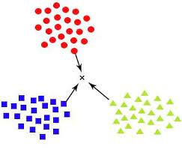
KNN Model
we tried K-nearest neighbors to make sentiment analysis classifier that predicts the sentiment based on the similar reviews and convert review into numerical for using TF-IDF vectorizer.
Testing results
Objective - Subjective |  | Positive - Negative
F1 class 0: 0.69 | F1 class 1: 0.18 | F1 class 0: 0.15 | F1 class 1: 0.71
F1: 0.55 | Accuracy: 55% | F1: 0.56 | Accuracy: 57%

Slide 19
Decision Tree Model
we used decision tree to make sentiment analysis classifier that predicts the sentiment based on the similar reviews and convert review into numerical for using TF-IDF vectorizer.
is
very
good
Testing results
Objective - Subjective |  | Positive - Negative
F1 class 0: 0.64 | F1 class 1: 0.58 | F1 class 0: 0.66 | F1 class 1: 0.71
F1: 0.61 | Accuracy: 61% | F1: 0.69 | Accuracy: 69%

Slide 20

Naïve bayes Model
we used Naïve bayes to make sentiment analysis classifier that predicts the sentiment based on the similar reviews and convert review into numerical for using TF-IDF vectorizer.
Positive
negative
neutral
$$P(W|P)$$
Testing results
Objective - Subjective |  | Positive - Negative
F1 class 0: 0.76 | F1 class 1: 0.65 | F1 class 0: 0.80 | F1 class 1: 0.84
F1: 0.72 | Accuracy: 72% | F1: 0.82 | Accuracy: 82%

Slide 21
Logistic Regression Model
I am happy
We used logistic regression to make sentiment analysis classifier that predicts the sentiment based on the similar reviews and convert review into numerical for using TF-IDF vectorizer.
So bad
Testing results
Objective - Subjective |  | Positive - Negative
F1 class 0: 0.76 | F1 class 1: 0.71 | F1 class 0: 0.81 | F1 class 1: 0.83
F1: 0.74 | Accuracy: 74% | F1: 0.82 | Accuracy: 82%

Slide 22
Support Vector Machine Model
We used SVM to make sentiment analysis classifier that predicts the sentiment based on the similar reviews and convert review into numerical for using TF-IDF vectorizer.
I am happy
So bad
Testing results
Objective - Subjective |  | Positive - Negative
F1 class 0: 0.75 | F1 class 1: 0.70 | F1 class 0: 0.83 | F1 class 1: 0.85
F1: 0.73 | Accuracy: 73% | F1: 0.84 | Accuracy: 84%

Slide 23


Long Short-Term Memory Model
h1
R
h2
R
$$σ$$
h3
R
$$σ$$
h4
h5
R
Embedding
Flatten
ANN
LSTM
Objective - Subjective |  | Positive - Negative
F1 class 0: 0.75 | F1 class 1: 0.69 | F1 class 0: 0.82 | F1 class 1: 0.84
F1: 0.72 | Accuracy: 72% | F1: 0.83 | Accuracy: 83%

Slide 24
Convolutional Neural Networks Model
R
R
$$σ$$
R
$$σ$$
R
Embedding
Convolutional
max pooling
Flatten
ANN
Objective - Subjective |  | Positive - Negative
F1 class 0: 0.75 | F1 class 1: 0.68 | F1 class 0: 0.82 | F1 class 1: 0.85
F1: 0.72 | Accuracy: 72% | F1: 0.84 | Accuracy: 84%

Slide 25
CNN-LSTM Model
h1
R
h2
R
$$σ$$
h3
R
$$σ$$
h4
h5
R
Embedding
2 Convolutional
Flatten
5 LSTM
ANN
Objective - Subjective |  | Positive - Negative
F1 class 0: 0.72 | F1 class 1: 0.67 | F1 class 0: 0.85 | F1 class 1: 0.82
F1: 0.70 | Accuracy: 71% | F1: 0.84 | Accuracy: 84%

Slide 26
Transformer Model
Decoder
Add & norm
Encoder
Feed forward
Add & norm
Feed forward
Add & norm
Masked Multi-head attention
Add & norm
Multi-head attention
Add & norm
Masked Multi-head attention
Input embedding
Output embedding

Slide 27
Transformer Model
Objective - Subjective |  | Positive - Negative
F1 class 0: 0.88 | F1 class 1: 0.90 | F1 class 0: 0.96 | F1 class 1: 0.96
F1: 0.89 | Accuracy: 89% | F1: 0.96 | Accuracy: 96%
MARBERT For Arabic model
Objective - Subjective |  | Positive - Negative
F1 class 0: 0.81 | F1 class 1: 0.80 | F1 class 0: 0.89 | F1 class 1: 0.90
F1: 0.80 | Accuracy: 80% | F1: 0.90 | Accuracy: 90%
DistilBert For English model

Slide 28
Machine Learning algorithms

Slide 29
Deep Learning algorithms

Slide 30
03
summarization
We will talk about summarization task and the model we used

Slide 31
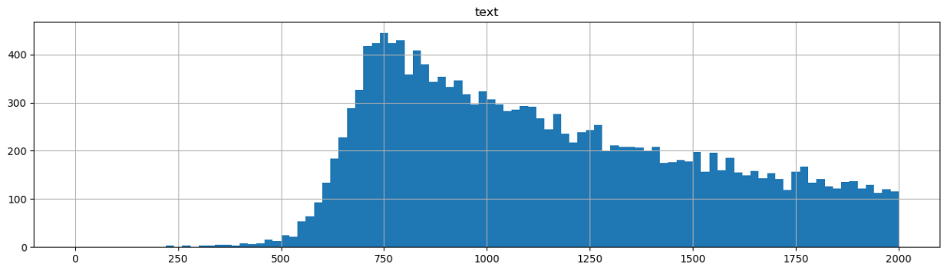
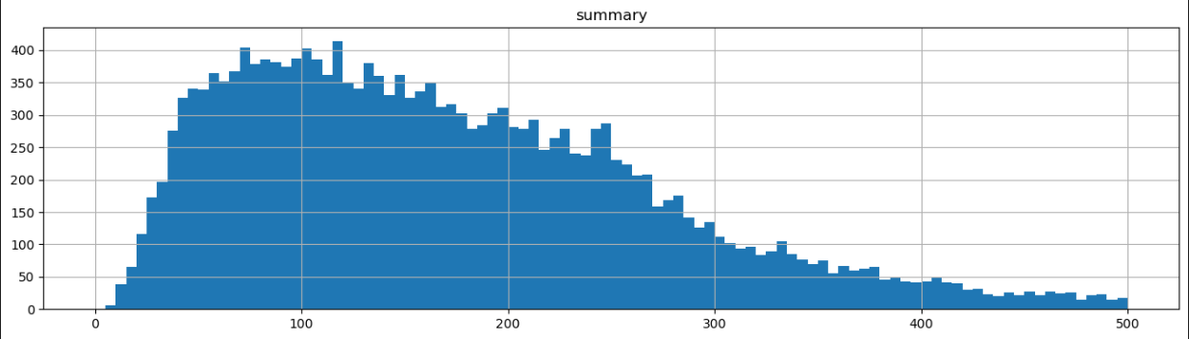
Summarization
We use pszemraj/led-large-book-summary pre-trained language model that trained using Large-scale Encoder-Decoder (LED) architecture on a dataset of book summaries, and use Bill-Sum dataset that lengths as following:

Slide 32
Summarization
Bill-Sum
ROUGE-1 = 40.58 | ROUGE-2 = 17.34 | ROUGE-L = 25.126 | ROUGE-LSUM = 35
Book-Sum
ROUGE-1 = 31.7 | ROUGE-2 = 5.3 | ROUGE-L = 16.1 | ROUGE-LSUM = 29

Slide 33
04
System Analysis
We will talk about project architecture and system requirements

Slide 34
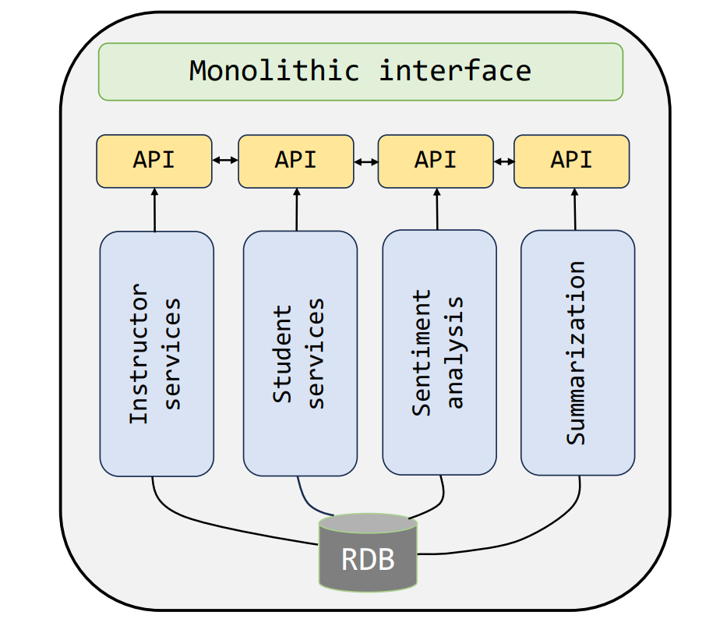
System Architecture

Slide 35


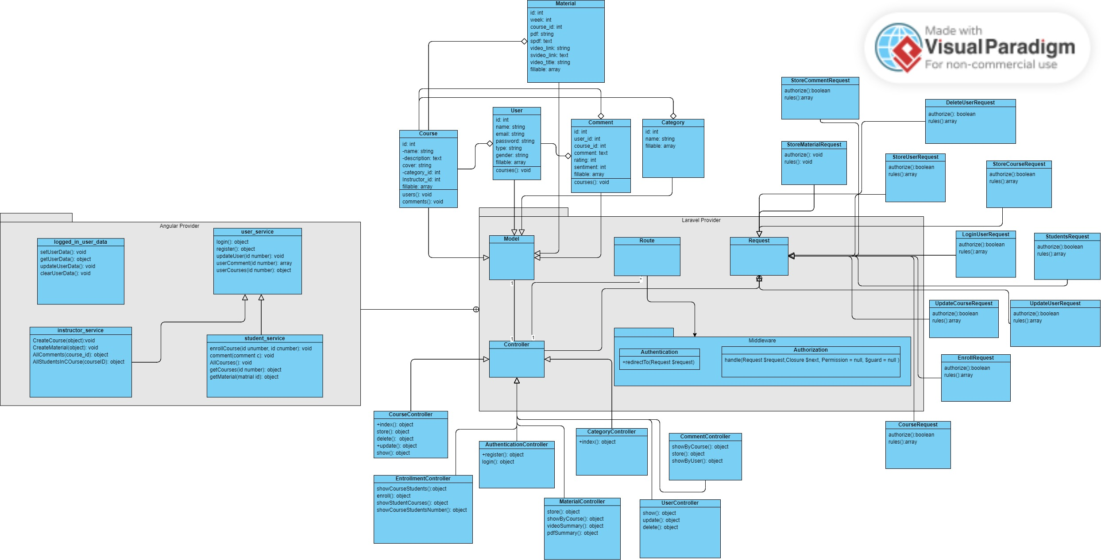
Class diagram

Slide 36
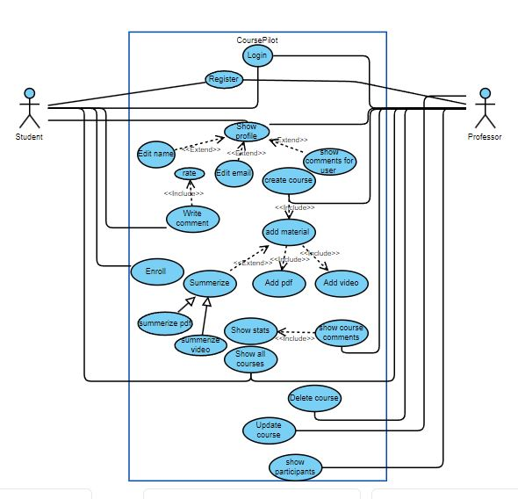
Use case diagram

Slide 37
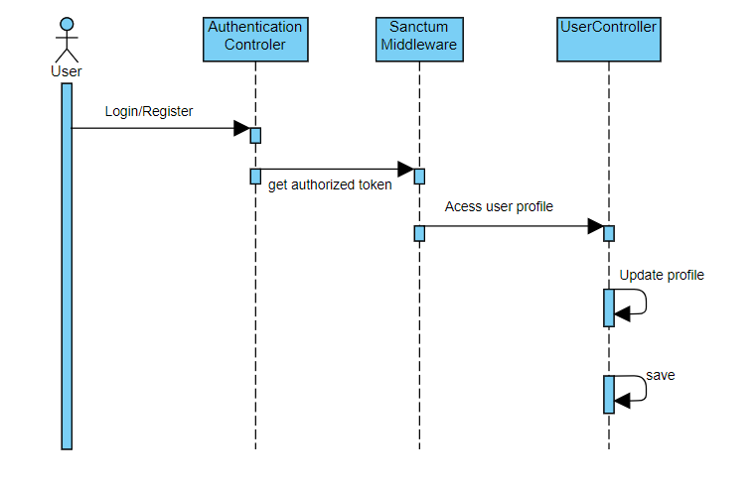
Sequence Diagram
User Authentication and Profile

Slide 38
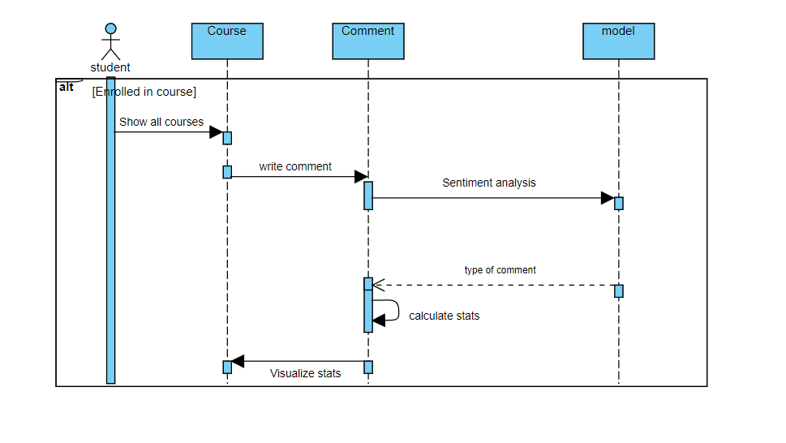
Sequence Diagram
Review Analysis and Visualization

Slide 39
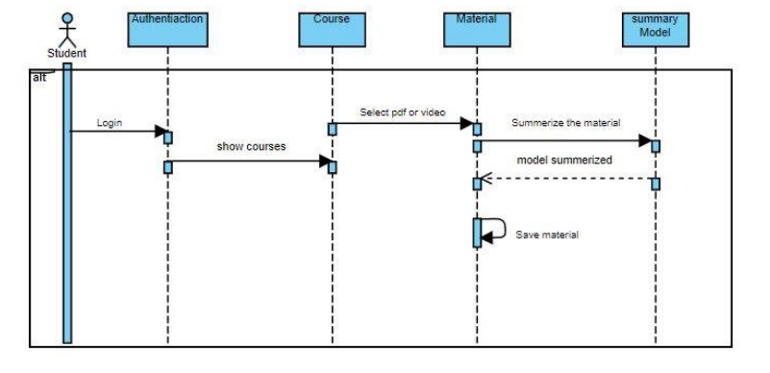
Sequence Diagram
Summarize Material

Slide 40
05
Time Plan
We will talk about tasks that have already done, and the planned tasks

Slide 41
Work done in previous Months
Time Plan
Oct 2022 | Nov 2022 | Dec 2022 | Jan 2023
Evaluate current ideas. Choosing project idea. Study frontend (HTML, CSS, Bootstrap). Determine needed technologies. | Project analysis Searching for related work. Study similar research Search for appropriate dataset. | Prepare for ML & NLP model. Choosing backend tool. Study Django Framework. Making page views. | Continue studying NLP & Django Software architecture Use Case Diagram Class Diagram Start frontend implementation (70%)
Feb 2023
Sequence Diagram. Complete Page View (Demo). Data preprocessing. Experiment LSTM model. Study Transformers. Continue implementing Frontend(50% responsive).
Notes:
- Describe work done in each month.
In October 2022, we start search for project idea, evaluate each one based on user needs, prepare for frontend development.
Selection of appropriate technologies for the project.
In November 2022, First we look for similar website which do sentiment analysis on text.
Determine user need or problem with current complain system services.
Once choosing project idea, we search for the appropriate dataset for citizens reviews.
In December 2022, studying data preprocessing and deep learning model.
Choosing Backend tool.
Studying Django framework.
Start in page views (demo) for mid year documentation
In January 2023, continuing in ML & NLP, Start in system architecture & diagrams.
Complete 70% of Frontend development.

Slide 42
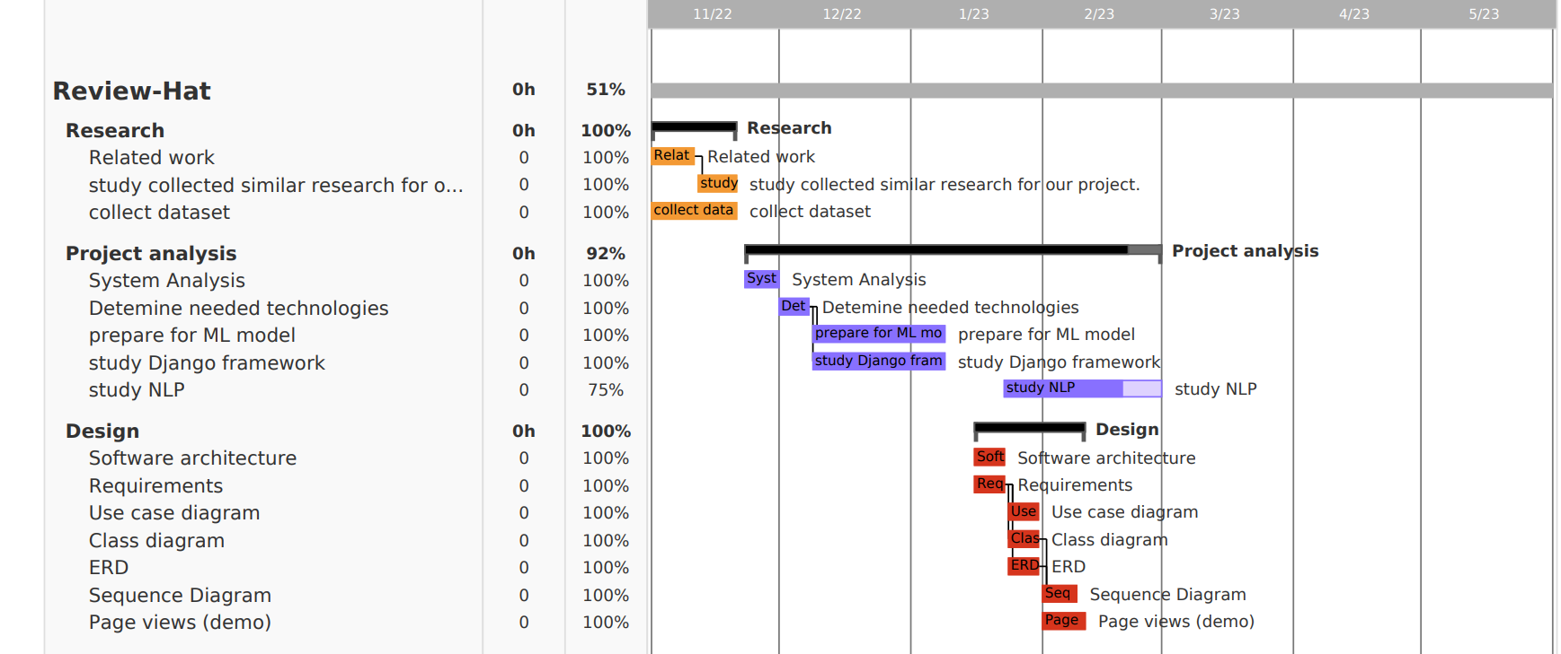
Time Plan
Gantt chart for work done in previous months
Notes:
In Research phase take 20 days from 1/11/2022 to 20/11/2022.
Project analysis and preparing take 60 days from 21/11/2022 to 21/1/2023
Design phase take 30 days from 15/1/2023 to 15/2/2023.

Slide 43
Time Plan
Upcoming work
March 2023 | April 2023 | May 2023
Experiment Different classifier (SVM and Naïve Bayes, Transformers). Working on front-end Working on back-end. | Experiment Different classifier (KNN and CNN and CNN with LSTM). Complete Front-end. Complete Back-end. | Build Arabic model using Transformer. Build English model (Transformer). Arabic Dialect detection.
June 2023
Compare Classifiers result. Integrate front-end with back-end. Performance evaluation. Model deployment. Testing.

Slide 44
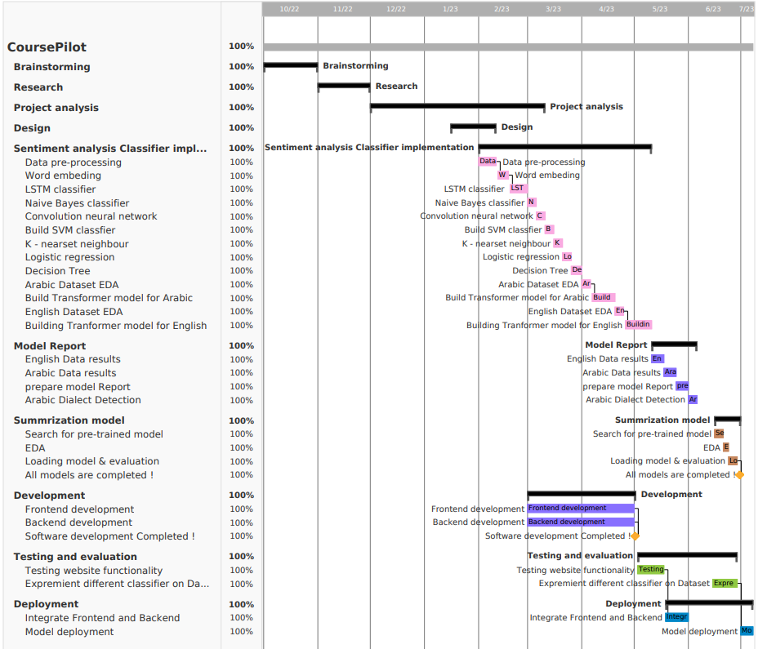
Time Plan
Gantt Chart for planned months

Slide 45
06
Demo
We will talk about front-end and show our demo

Slide 46
Designing UI Steps
1
2
3
Research the competition
Sketch out Initial Layout
Designing the pages

Slide 47
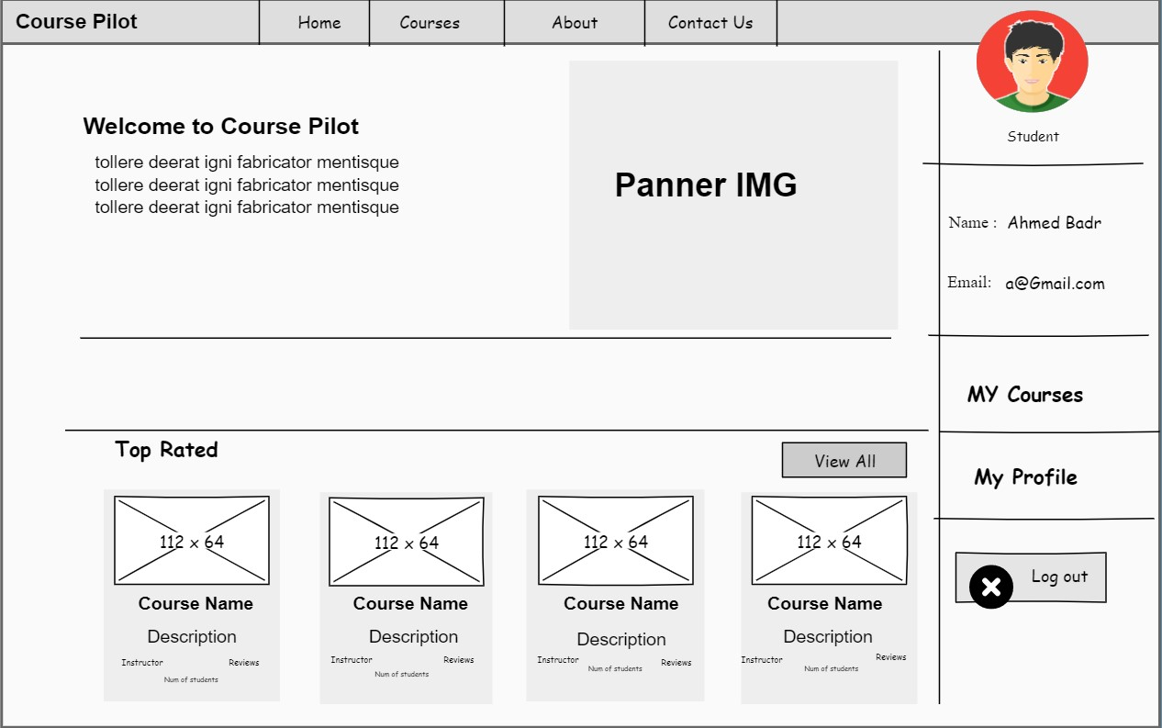
Designing UI Steps
Home page layout

Slide 48
Front End
Technologies
HTML
CSS
Bootstrap
TypeScript
Angular
Responsive Front-End Pages
(Desktop,Tablet,Mobile)
accessibility front end development
(Tabs ,Font Resize)
front-end performance
(Compress the files, caching in local storage)

Slide 49
Why Angular ?
- Code Consistency and reusability
- Allows to develop powerful single-page applications
- Dependency injection and data binding
- Seamless integration and high and productivity
- Pre-built material design elements

Slide 50

Thanks
Graduation Project
Academic Year 2022-2023
Final Year Presentation

