Slide 1
Multiple Hotel System
Graduation Project For Bachelor's Degree June 2023

Slide 2
Multiple Hotel System
Submitted by :
Ahmed Sayed Mahfouz
Mahmoud Mohammed Roz
Ahmed Samir Ahmed
Sofian Gamal Ali
Tarek Hesham El-said
Ahmed Shawkat ahmed
Supervised by:
[Dr.Laila Abdelhamid ]

Slide 3
Introduction
we have tried our best to make the complicated process of Design and Development of web and mobile app based Multiple Hotel system as simple as possible using structured and modular technique and menu oriented interface
This project is used by two types of users
Admin of system & other admins with different permissions
2. Guest

Slide 4
Purpose
The main purpose of system is perform each employee’s activity in computerized way rather than manually which is time consuming.
The entire activity is to automate the process of day to day activities of hotel like :
Assign a room to customer’s checkout on app
Releasing the bill of room in short time
room activities very safe

Slide 5
Existing Features
The “Multiple Hotel System” has been designed to computerized the following functions :-
manage rooms functions & details.
manage guest profile with sending passcode with e-mail.
manage orders from guests as (new - processing - end).
manage hotel branches from centerized place (master hotel).
Room assigning related to guest’s need.
mange category of services provided by the hotel.
manage the payment gateway provided by guest.

Slide 6
System facilities
guests can order a service with app
guests can review the bill all the time
admin can manage rooms services with computerized way without manually which is exhausting way

Slide 7
Software Requirements
System Development Software
Operating System : Windows
Language and Frameworks : PHP ,Laravel , Bootstrap ,Mysql
Server : Apache Xampp
Browser : Mozilla Firefox
Platform : VScode,PHPStorem and Android studio (flutter)
User Required Software
Browser for admin
Android or ios phone for guest

Slide 8
Hardware Requirements
System Development Software
CPU : Intel core i5 g5, 2,67 GHz
RAM : DDR4 8GB
HDD : 1TB
Monitor : Color Monitor
User Required Hardware
RAM : 1GB
HDD : 16 GB
Monitor : Color Monitor

Slide 9
Software Development Process(waterfall model)
Analysis
Design
Implementation
Verification
Maintenance

Slide 10



Workflow of system
System send information for user
admin manage guest information
System handle api from user to admin and vice versa
user send request as api

Slide 11
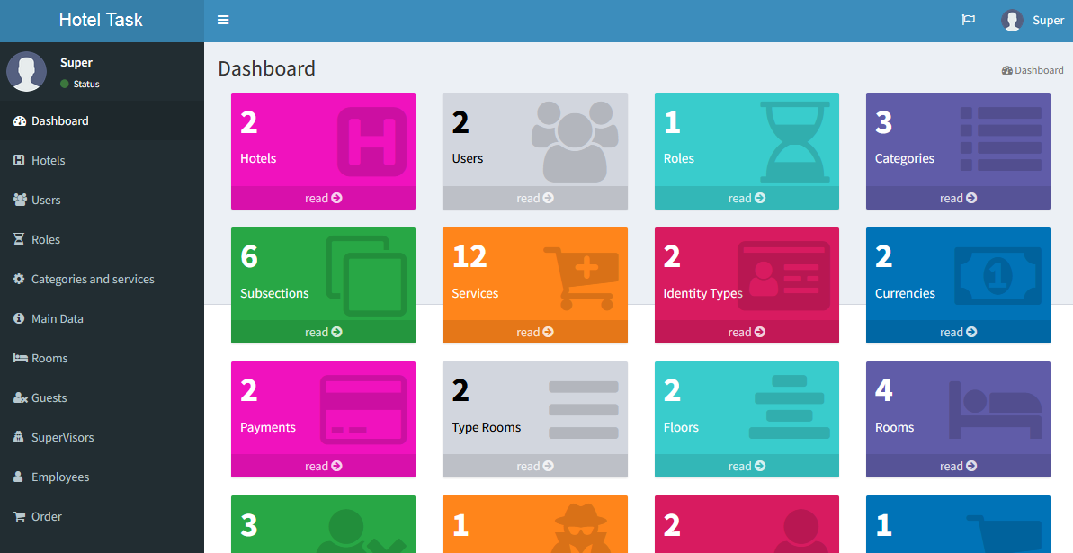

Slide 12
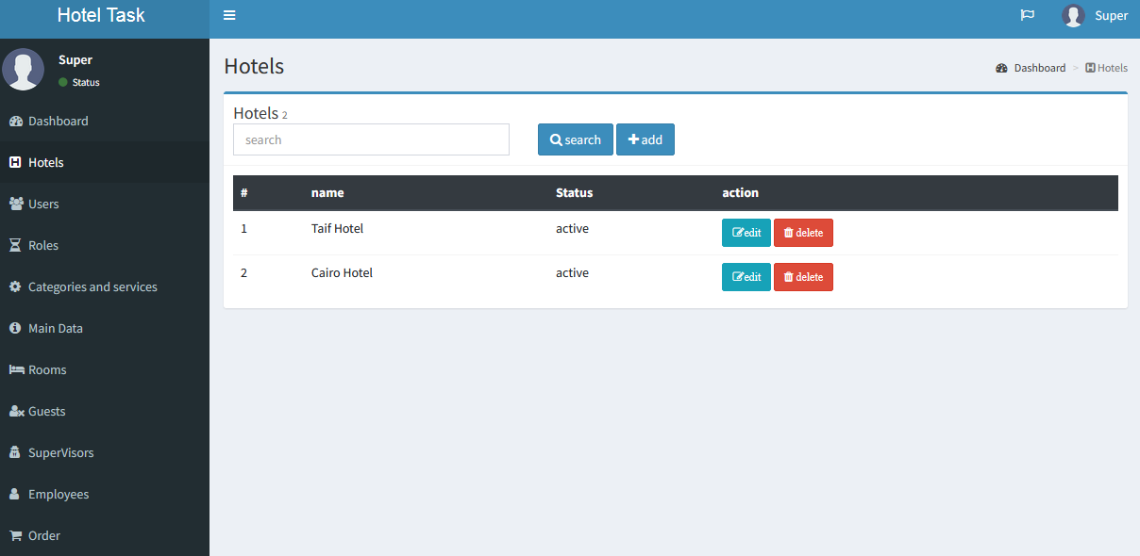

Slide 13
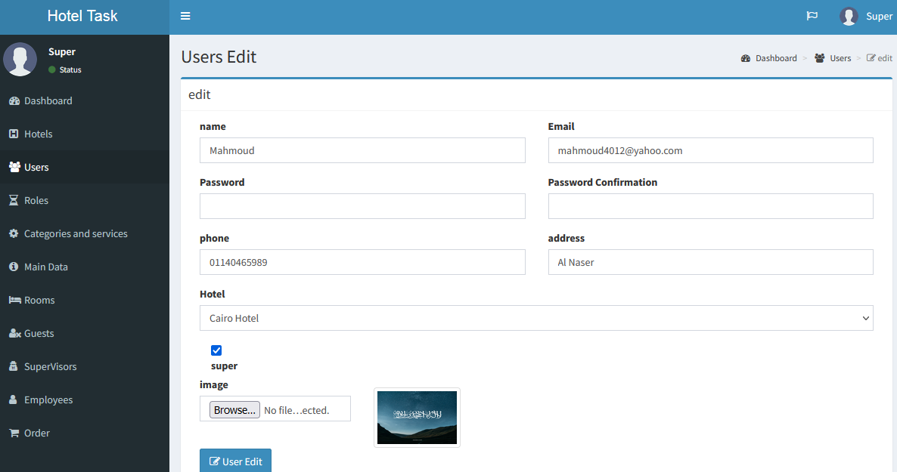

Slide 14
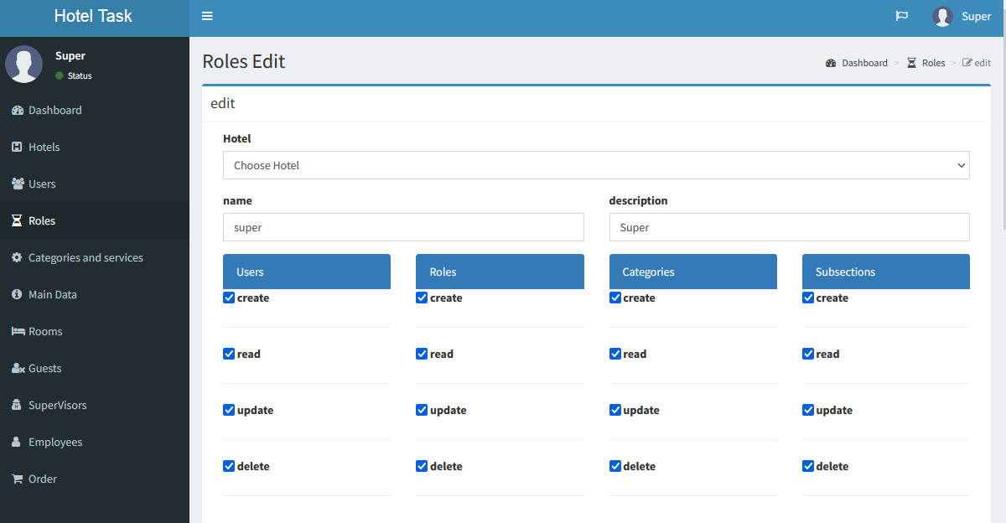

Slide 15
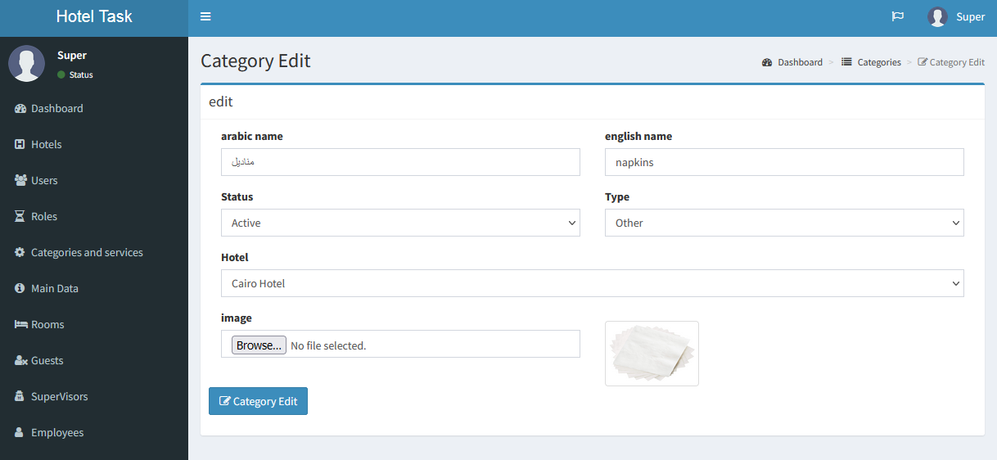

Slide 16
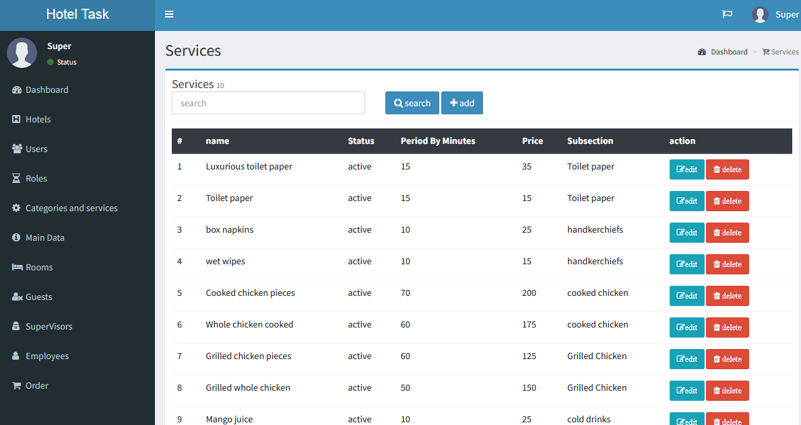

Slide 17
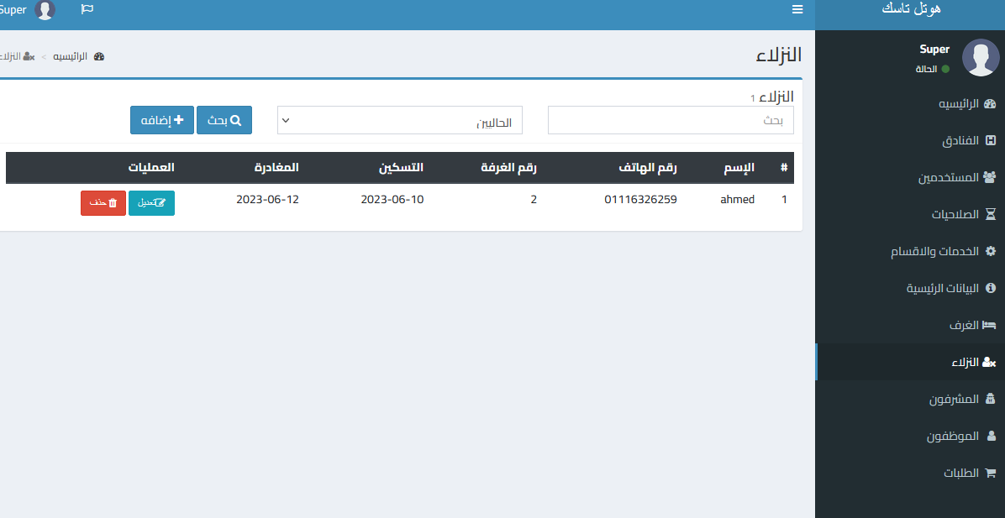

Slide 18
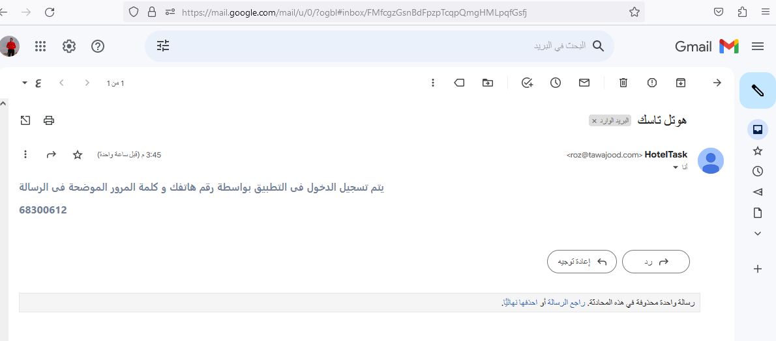

Slide 19
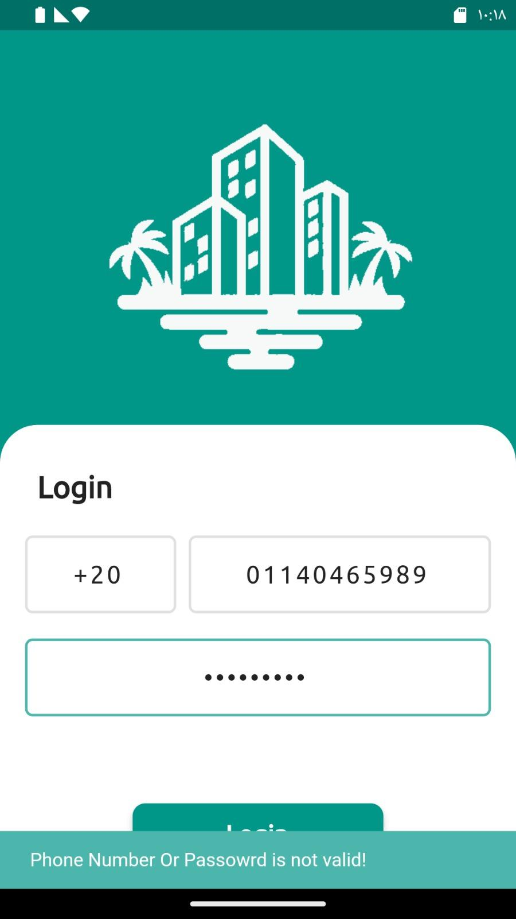
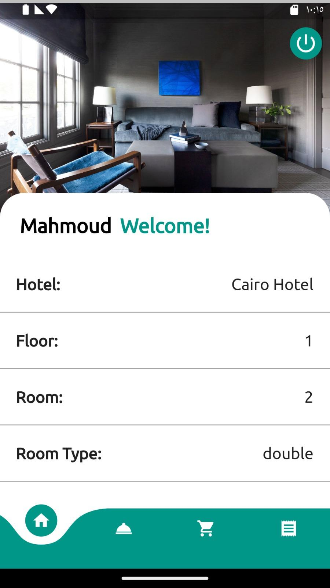

Slide 20
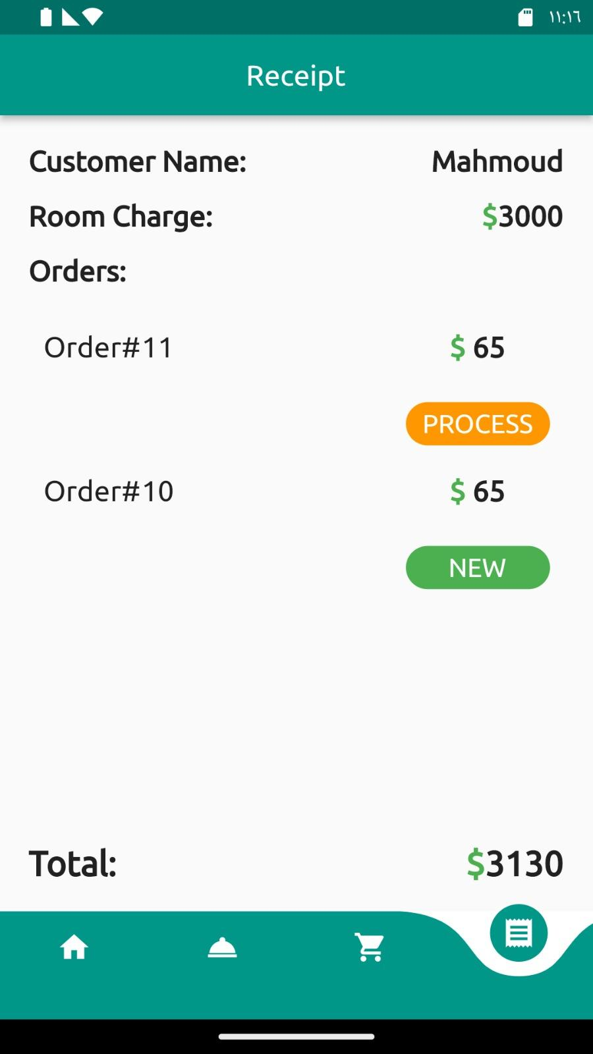
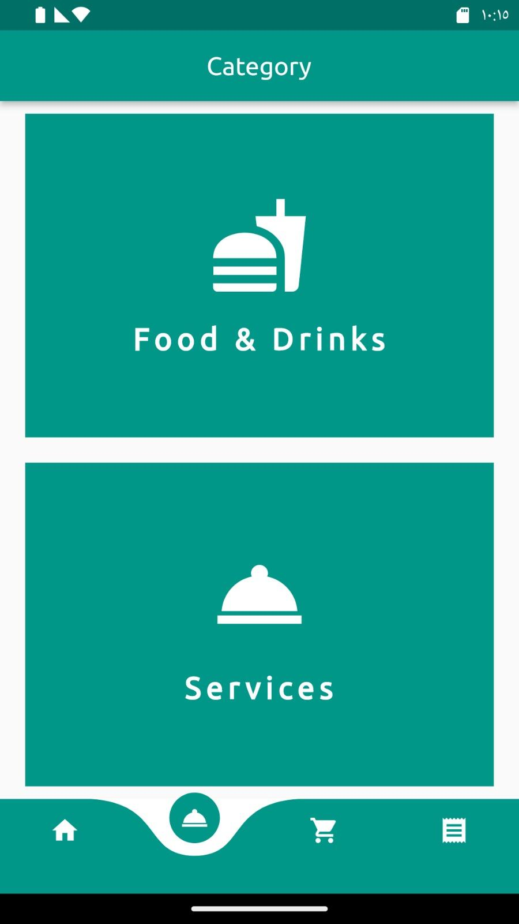

Slide 21
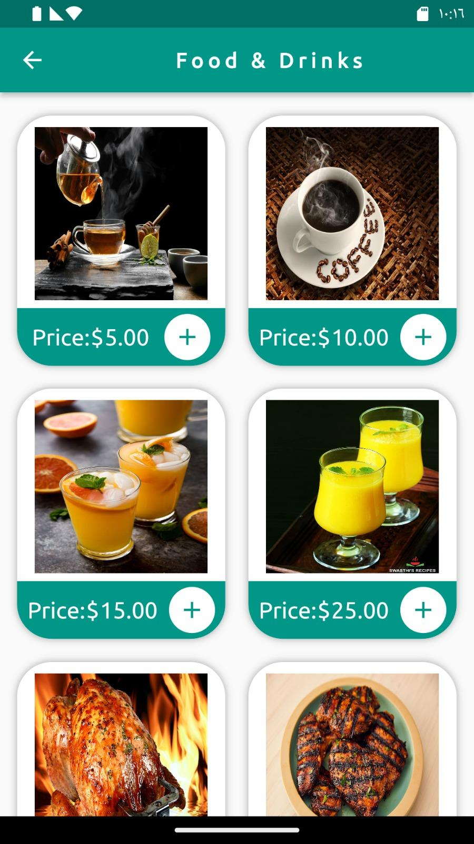
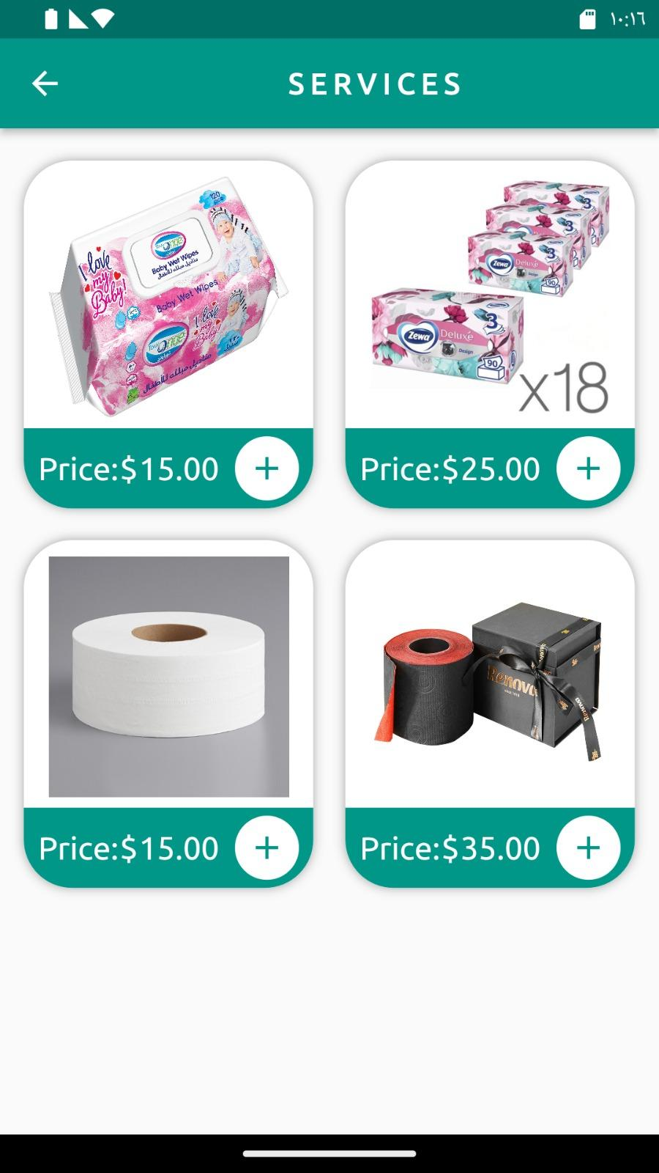

Slide 22
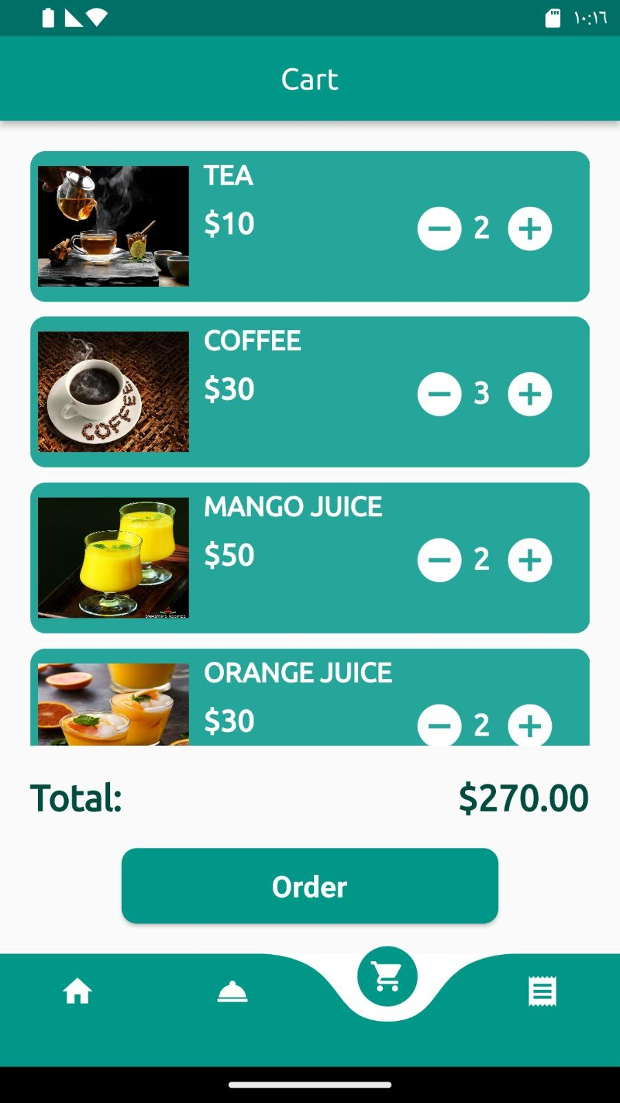
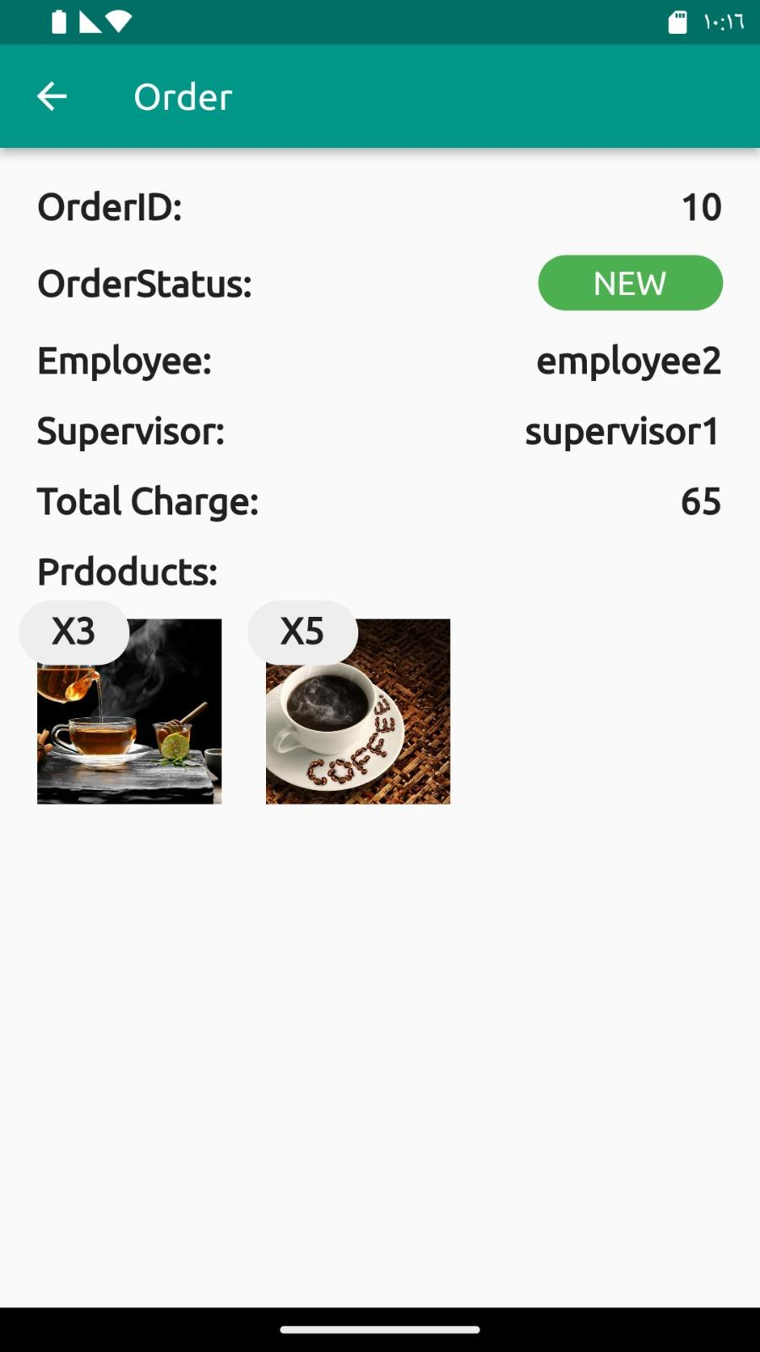

Slide 23
Future work
Here is our plan for the coming versions of Multiple hotel System:
Develop a machine learning model to manage inventory resource and suggest the optimal solutions as we studied in the subject of operation research.
Make the authentication easier using social media’s api
Globalize the app and make and add features Suit the opinions of the guests.

Slide 24


Slide 25
Thanks

