Slide 1
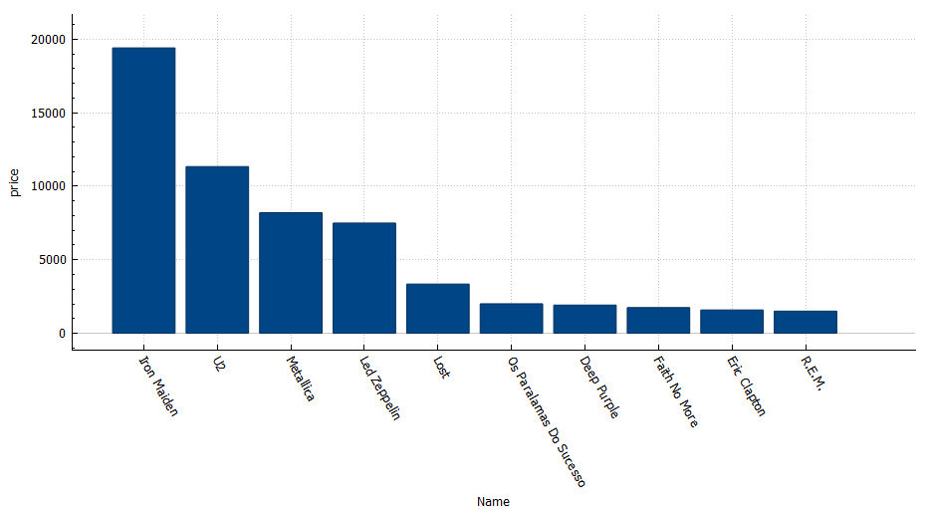
Top 10 Price Tracks is Sold
<visualization>
We note that the artist Ahmed sold his songs for a total price of 19404

Slide 2
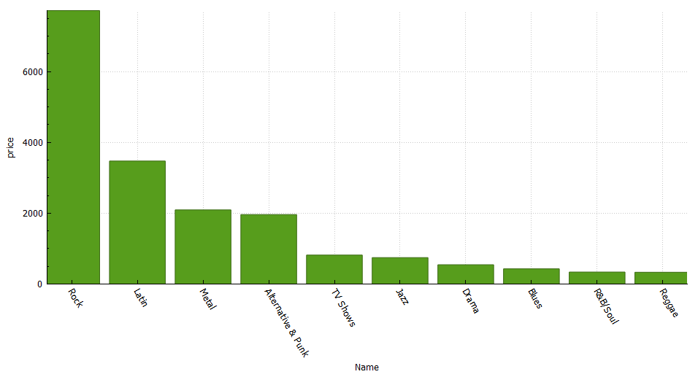
Top 10 Popular Songs
<visualization>
The type of best-selling songs, with a very big difference, is the type of rock, at a price of 7720

Slide 3
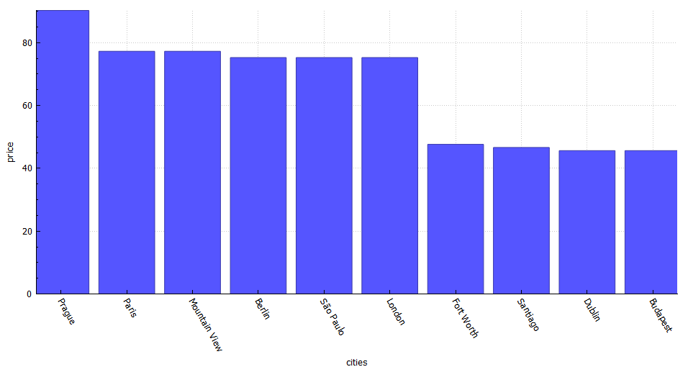
Top 10 Buying Cities for Music
<visualization>
The most famous city in the world)Paris) was not the first to buy songs, but the city of Prague was the first to buy at a price of 90.24

Slide 4
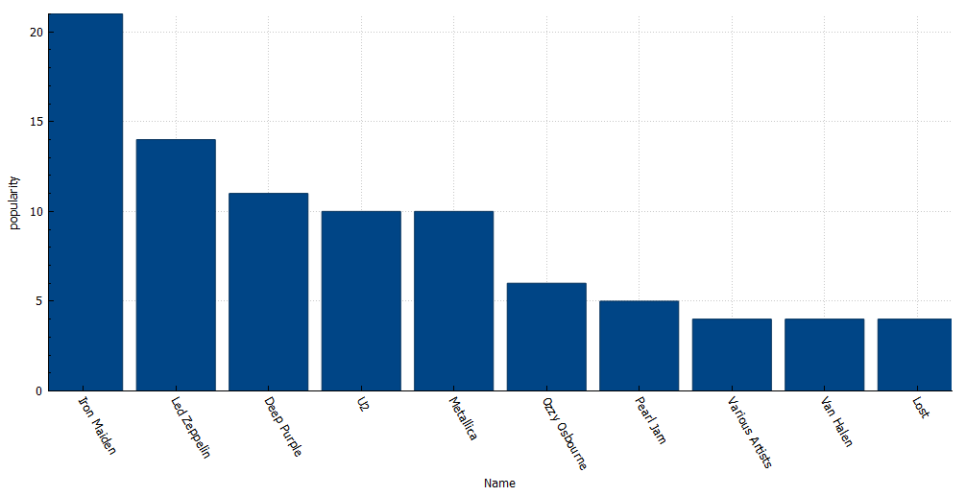
Top 10 Popular Artist
<visualization>
The artist Iron Maiden is the most famous in terms of the number of albums with 21 albums

