Slide 1
AI MASTERCLASS • SESSION 02
DATA, EDA &
DATA CLEANING
Understanding your data before building AI models
DATA
EDA
CLEANING
Mansouri Ahmed | BrainerX School, Constantine
Session 02 • Data & EDA

Slide 2
WHAT WE COVER TODAY
01
WHAT IS DATA?
WWWWW-H Framework — Who, What, When, Where, Why, How
02
EDA — EXPLORATORY ANALYSIS
Visualise before modelling. Univariate & Multivariate
03
VISUALIZATION TOOLS
Matplotlib & Seaborn — when to use each
04
DATA CLEANING
Missing values, wrong types, duplicates, outliers
05
HANDS-ON EXERCISES
Real datasets: Online Retail, Titanic, medical data

Slide 3
01
WHAT IS DATA?
The raw material of all AI systems.
DATA
Before writing a single line of Python, you must understand your data deeply.

Slide 4
WHAT IS DATA?
Data is any recorded information that can be processed, analysed, and used to make decisions or train AI models.
📊 STRUCTURED
📝 UNSTRUCTURED
⏱️ TIME SERIES
🌐 SPATIAL
Tables, spreadsheets, databases. Rows & columns. Easy to process.
Text, images, audio, video. No fixed format. Harder to process.
Data ordered by time. Stock prices, weather, sensors.
Location-based data. GPS, maps, geographic info.
Every app you use generates data — your clicks, your location, your voice, your face.

Slide 5
THE WWWWW-H FRAMEWORK
Before analysing any dataset, always ask these 6 questions
WHO
WHAT
WHEN
Who collected this data? Who are the subjects?
What information is stored? What do the columns mean?
What time period does it cover? Is it still relevant?
e.g. A hospital, a company, a government
e.g. Age, price, GPS coordinates
e.g. 2009–2011, last 30 days
WHERE
WHY
HOW
Where was it collected? Geographic or system origin?
What was the purpose? Why does this data exist?
How was it collected? Manual entry, sensors, scraping?
e.g. UK-based company, global customers
e.g. Inventory management, fraud detection
e.g. Sales system logs, IoT sensors

Slide 6
EXERCISE — ONLINE RETAIL 2 DATASET
📦 Online Retail 2
WHO
An online retail company (UK-based)
Kaggle / UCI Repository
Real UK e-commerce data Dec 2009 – Dec 2011 541,909 rows × 8 columns
WHAT
Each row = line-item in an invoice. InvoiceNo, Quantity, UnitPrice, CustomerID…
WHEN
December 2009 to December 2011
InvoiceNo
Invoice number
StockCode
Product code
Description
Product name
WHERE
UK business — but customers are global worldwide
Quantity
Units ordered
InvoiceDate
Date & time
UnitPrice
Price per unit
WHY
CustomerID
Anonymized ID
Inventory management, accounting, and order tracking
Country
Customer country
HOW
Extracted from sales system logs automatically — reduces human error

Slide 7
02
EXPLORATORY DATA ANALYSIS
"Look at your data before you model it."
EDA is the practice of using statistics and visualisations to understand your data's structure, patterns, and problems.
EDA

Slide 8
WHY DO EDA BEFORE MODELLING?
1
👁️ See What Numbers Can't Show
A correlation of 0.5 tells you little. A scatter plot tells you everything. Patterns, clusters, anomalies — only visible visually.
2
🧠 Build Intuition About Your Data
You need to KNOW your data — its range, its gaps, its outliers — before you trust any model trained on it.
3
🧹 Guide Data Cleaning
EDA reveals WHERE the problems are: missing values, wrong types, duplicates, impossible values. Clean what matters first.
4
✅ Support Better Decisions
Which features actually matter? EDA tells you. Don't spend hours engineering useless variables.
5
📖 Tell a Story With Evidence
Good data science is storytelling. EDA gives you the evidence. Every chart is a sentence in your story.

Slide 9
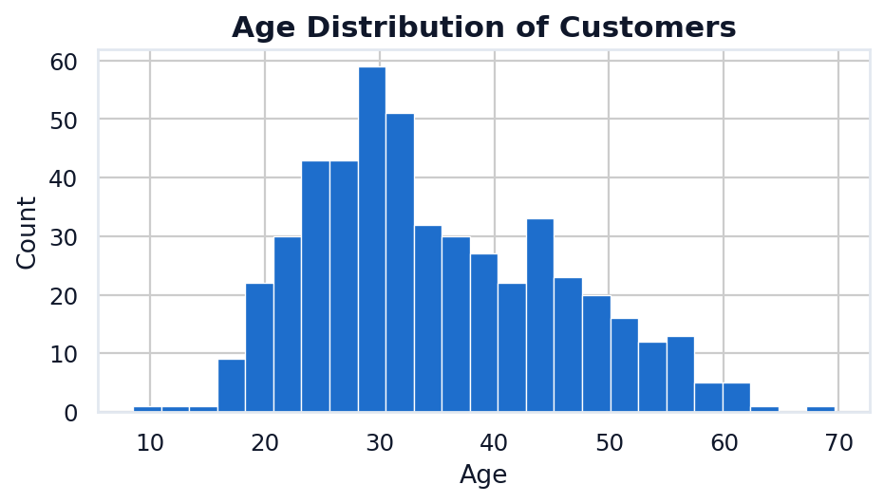
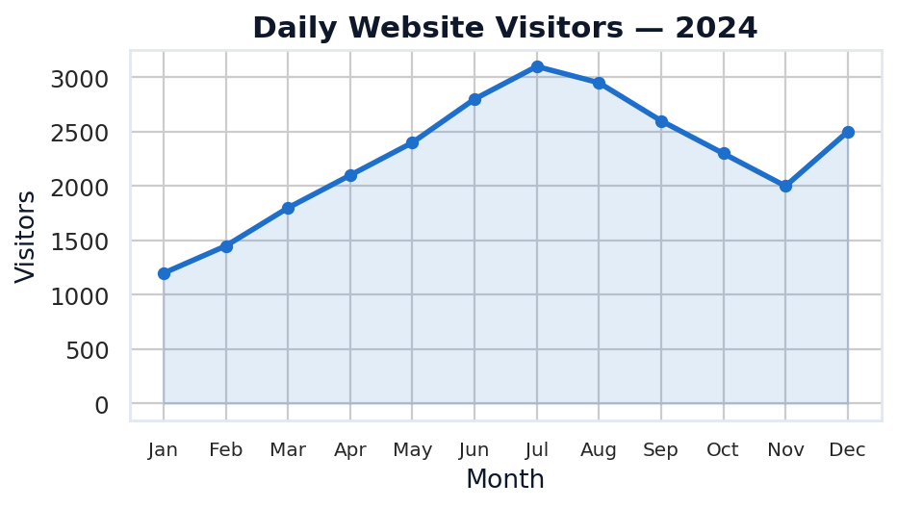
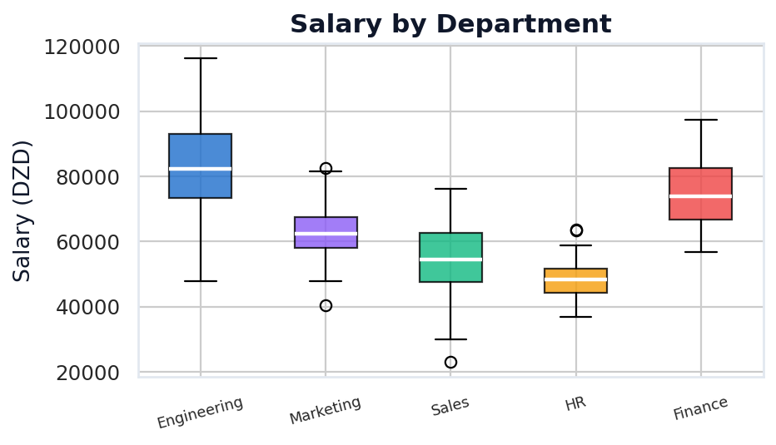
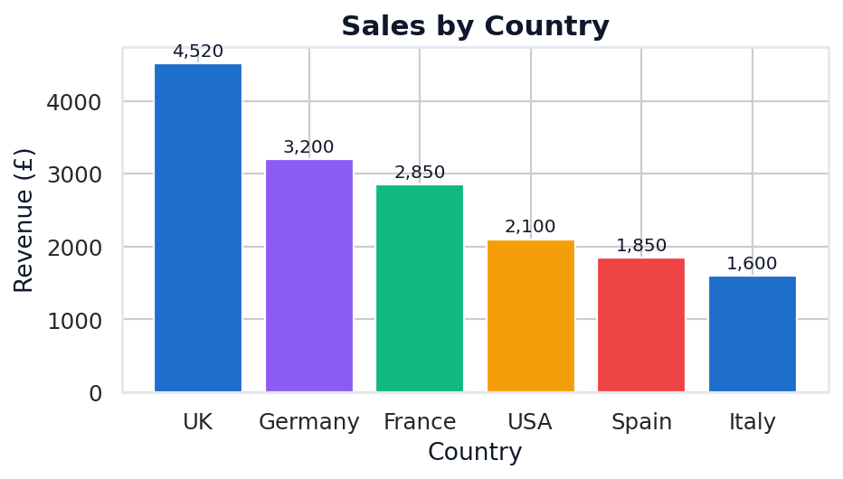
UNIVARIATE ANALYSIS
One variable at a time
📌 Analyse ONE variable at a time to understand its distribution, range, and typical values.
📊 HISTOGRAM
📈 LINE CHART
Shows the distribution of a numeric variable — how values are spread across ranges.
Shows how a variable changes over time — essential for time-series data.
→ Age distribution of customers
→ Daily website visitors
→ Price distribution of products
→ Monthly sales revenue
→ Income distribution
→ Stock price history
📦 BOX PLOT
📉 BAR CHART
Shows median, quartiles, and outliers at a glance — great for comparing groups.
Compares counts or values across categories — the most common chart.
→ Salary by department
→ Sales by country
→ Score by student group
→ Number of orders per day
→ Height by age group
→ Customers per age group

Slide 10
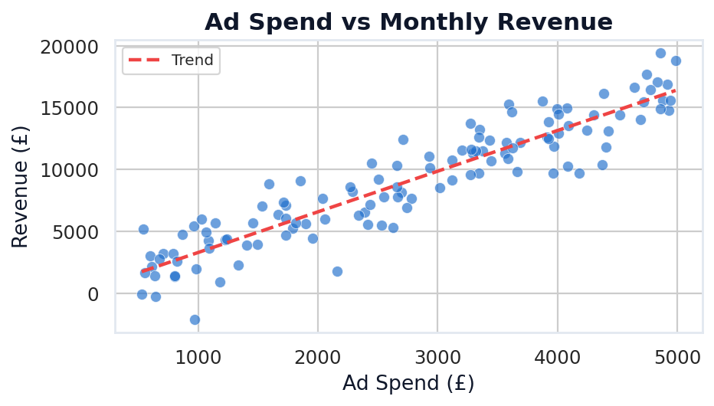
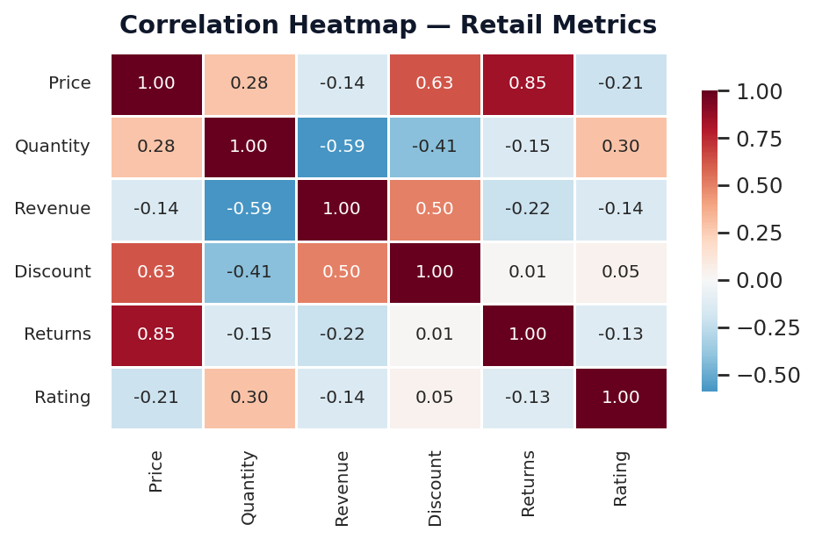
MULTIVARIATE ANALYSIS
Discovering relationships
📌 Analyse TWO or more variables together to find relationships, patterns, and correlations.
🔵 SCATTER PLOT
🌡️ CORRELATION HEATMAP
Plots two numeric variables against each other. Reveals correlation direction and strength.
Shows correlation between ALL numeric variables at once. Values from -1 to +1.
Use when: checking if variable A increases as B increases.
+1 = perfect positive / -1 = perfect negative / 0 = no correlation
📌 Ad spend vs Revenue / Height vs Weight
📌 eCommerce metrics / Financial indicators

Slide 11
WHICH CHART TO USE? — QUICK DECISION GUIDE
YOUR QUESTION
BEST CHART
TYPE
How is this variable distributed?
Histogram / Box Plot
Univariate
How does this value change over time?
Line Chart
Univariate
How many items are in each category?
Bar Chart
Univariate
Is there a relationship between A and B?
Scatter Plot
Bivariate
How correlated are ALL my features?
Correlation Heatmap
Multivariate
How do distributions differ by group?
Grouped Box Plot
Multivariate
Compare 3 numeric variables at once?
Bubble Chart
Multivariate
What proportion does each category have?
Pie / Donut Chart
Univariate

Slide 12
✏️ EXERCISE — PICK THE RIGHT CHART
For each scenario below, decide which chart type to use and why.
1
A retail store wants to know which age group makes up the largest portion of its customers.
✅ Histogram / Bar Chart
2
You need to show how daily website visitors changed over the past year.
✅ Line Chart
3
An economist analyses the link between inflation, unemployment, and GDP growth.
✅ Scatter Plot + Correlation Heatmap
4
You need to check whether most employees earn similar salaries or if there are big outliers.
✅ Box Plot
5
You want to check if higher ad spend leads to higher revenue (monthly data).
✅ Scatter Plot

Slide 13
VISUALIZATION TOOLS — MATPLOTLIB & SEABORN
MATPLOTLIB
SEABORN
Foundation & Full Control
Built on Matplotlib — Statistical Focus
"The Swiss Army knife of Python plotting."
"Beautiful statistical charts with less code."
✅ Full low-level control over every element
✅ High-level statistical visualisations
✅ Works with NumPy arrays and lists
✅ Works natively with Pandas DataFrames
✅ Excellent for custom layouts and subplots
VS
✅ Beautiful defaults — less styling needed
✅ Best for annotated, publication-ready charts
✅ Heatmaps, violin plots, pair plots built-in
⚠️ More verbose — more lines of code
⚠️ Less flexible for custom chart layouts
⚠️ Statistical plots need manual work
⚠️ Must understand its opinionated API
import matplotlib.pyplot as plt
import seaborn as sns
plt.plot(x, y) / plt.bar(x, y) / plt.hist(x)
sns.heatmap(df.corr()) / sns.boxplot(x, y)

Slide 14
03
DATA CLEANING
"Clean data = trustworthy AI."
Garbage in, garbage out. No matter how good your model is, dirty data produces wrong predictions.
CLEAN

Slide 15
WHAT IS DATA CLEANING?
Data cleaning is the process of detecting and correcting errors, inconsistencies, or missing information in a dataset — to make it accurate, consistent, and ready for analysis or ML.
❓
MISSING VALUES
🔤
INCORRECT TYPES
👥
DUPLICATES
📡
OUTLIERS
PROBLEM:
PROBLEM:
PROBLEM:
PROBLEM:
Empty cells that most ML models cannot handle.
Numbers stored as text. Dates as strings. Wrong format.
Same row appears multiple times — distorts training data.
Values far outside normal range — may be errors or special cases.
FIX:
FIX:
FIX:
FIX:
Fill with mean/median or remove the row.
Convert: df['col'].astype(float) pd.to_datetime()
df.drop_duplicates() Keep first occurrence.
Investigate first. Cap, transform, or remove.

Slide 16
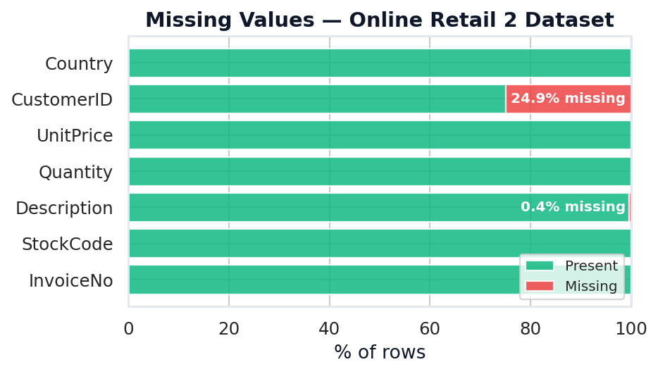
MISSING VALUES — HOW TO HANDLE THEM
WHY DOES DATA GO MISSING?
1
DROP THE ROW
Best when: very few rows missing, missing at random, enough data left.
Survey not filled
User skipped a question
df.dropna(subset=['Age'])
Sensor failure
IoT device stopped transmitting
2
FILL WITH MEAN / MEDIAN
Data entry error
Human forgot to fill the field
Best when: numeric column, data is roughly symmetric.
System migration
Old records lost during transfer
df['Age'].fillna(df['Age'].mean())
Private data
User opted out of sharing
Missing values visualised — Online Retail 2 Dataset
3
FILL WITH MODE
Not applicable
Best when: categorical column, one value is dominant.
Field doesn't apply to this row
df['City'].fillna(df['City'].mode()[0])

Slide 17
DUPLICATES & INCORRECT DATA TYPES
👥 DUPLICATES
🔤 INCORRECT DATA TYPES
What are they?
Common type problems:
Rows that are identical or nearly identical — caused by data entry errors, system bugs, or merging datasets multiple times.
❌ Price stored as $99.99
String with $ symbol — can't compute
❌ Date as '2023-01-15'
Why dangerous?
String — can't sort or do time math
A model trained on duplicates will overfit to repeated data points, resulting in inflated performance metrics.
❌ 'True'/'False' as strings
Should be boolean — comparisons fail
❌ ID stored as float
How to detect & remove:
CustomerID 1234.0 — comparison issues
Fix it with:
df.duplicated().sum() # count dups
df[df.duplicated()] # see dups
df['price'] = df['price'].str.replace('$','').astype(float)
df.drop_duplicates() # remove all
df['date'] = pd.to_datetime(df['date'])
df.drop_duplicates(['email']) # by col
df['active']= df['active'].map({'True':True,'False':False})
df['id'] = df['id'].astype(int)

Slide 18
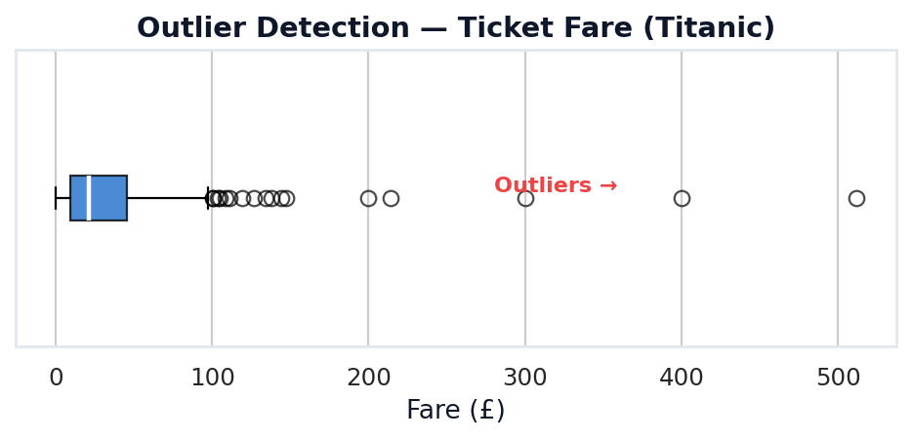
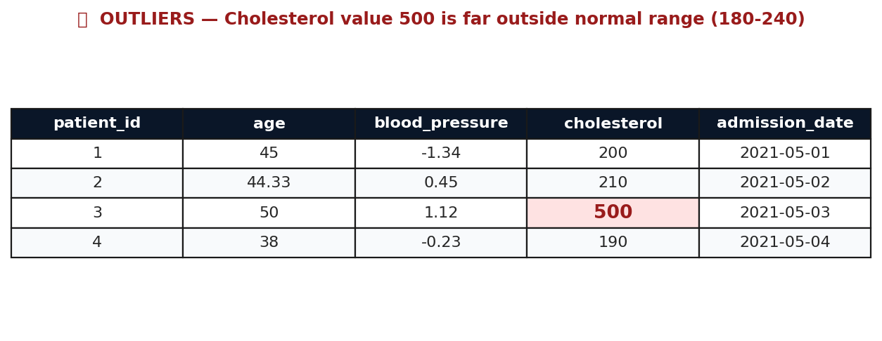
OUTLIERS — DETECT, DECIDE, HANDLE
⚠️ An outlier is a data point that falls far outside the normal range. It might be a genuine extreme value, a typo, or a sensor error. Always investigate before removing.
VISUAL METHOD Box Plot
Z-SCORE METHOD
IQR METHOD
The box plot's whiskers extend to 1.5 × IQR. Any point beyond the whiskers is flagged as an outlier.
Z-score measures how many standard deviations a value is from the mean. Values with |Z| > 3 are considered outliers.
IQR = Q3 − Q1 (middle 50% of data). Lower fence = Q1 − 1.5×IQR Upper fence = Q3 + 1.5×IQR
📌 Use first — always visualise before computing.
📌 Works best with normally distributed data.
📌 Most robust method — works for skewed data too.
sns.boxplot(data=df, x='salary')
from scipy import stats
Q1=df['col'].quantile(0.25)
df[np.abs(stats.zscore(df['salary'])) > 3]
Q3=df['col'].quantile(0.75)
IQR=Q3-Q1
df[(df['col']>Q1-1.5*IQR)&(df['col']<Q3+1.5*IQR)]

Slide 19
THE DATA CLEANING PIPELINE
1
LOAD & INSPECT
2
FIND MISSING
3
HANDLE MISSING
4
FIX DATA TYPES
df.shape / df.info() / df.head()
df.isnull().sum()
dropna() / fillna(mean)
astype() / pd.to_datetime()
df.describe() / df.dtypes
▶
df.isnull().mean() * 100
▶
fillna(mode) / forward fill
▶
str.replace() / map()
5
REMOVE DUPLICATES
6
DETECT OUTLIERS
7
VALIDATE & SAVE
df.duplicated().sum()
sns.boxplot() / Z-score / IQR
df.info() / df.describe() again
df.drop_duplicates()
▶
Investigate → cap or remove
▶
df.to_csv('clean_data.csv')
→ Always run df.info() and df.describe() BEFORE and AFTER cleaning to compare.

Slide 20
BEFORE vs AFTER — DATA CLEANING IN ACTION
❌ BEFORE CLEANING
✅ AFTER CLEANING
date
category
price
rating
date
category
price
rating
04/01/2023 PM
Electrncs
twenty
4
2023-04-01 12:00:00+00
Electronics
199.99
4
2023-04-02
Books
$34.35
5
2023-04-02 00:00:00+00
Books
20.0
5
2023/04/03
Clothing
49.99
4 stars
2023-04-03 00:00:00+00
Clothing
49.99
4
03-04-2023
Fod←Typo
9.99
10
2023-04-04 00:00:00+00
Food
9.99
5 (capped)
2023-04-05T...
Furniture
20€
5
2023-04-05 08:00:00+00
Furniture
20.0
5
🔑 Key rule: Uniform date format / Numeric prices (float) / Consistent categories / Ratings capped at valid range / No extra whitespace

Slide 21
SESSION 02 — KEY TAKEAWAYS
DATA
EDA
Every AI project starts with data. Always apply the WWWWW-H framework to understand your dataset before touching the code.
Never skip exploratory analysis. Visualise distributions, find patterns, and detect anomalies BEFORE modelling.
CHART CHOICE
CLEANING
Match your chart to your question. Distribution → Histogram. Trend → Line. Relationship → Scatter. All features → Heatmap.
Dirty data = wrong AI. Handle missing values, fix data types, remove duplicates, and investigate outliers every time.
PIPELINE
MINDSET
Always follow the 7-step cleaning pipeline: Load → Inspect → Missing → Types → Duplicates → Outliers → Validate.
80% of real AI work is data preparation, not modelling. Master this and you are already better than most beginners.

Slide 22
CHART GALLERY — ALL 6 ESSENTIAL PLOTS
HISTOGRAM
BAR CHART
LINE CHART
Distribution of one numeric variable
Compare categories or groups
Trend over time (time series data)
BOX PLOT
SCATTER PLOT
HEATMAP
Distribution + outlier detection
Relationship between two numeric variables
Correlation between all variables at once

Slide 23
YOUR DATASET FOR THIS SESSION
Online Retail II Dataset
HOW TO DOWNLOAD
kaggle.com/datasets/mashlyn/online-retail-ii-uci
1
Go to kaggle.com
Create a free account if you don't have one
Source
UCI Machine Learning Repository / Kaggle
2
Search for:
Rows
1,067,371 real transactions
Online Retail II UCI
3
Click Download
Columns
8 columns: InvoiceNo, StockCode, Description, Quantity, InvoiceDate, UnitPrice, CustomerID, Country
Download the .xlsx file (~45MB)
Period
December 2009 – December 2011 (2 full years)
4
Open Jupyter
Load with pandas read_excel()
Origin
UK-based online gift retailer — customers worldwide
5
Start exploring!
Why perfect?
Run df.info() and df.describe()
Contains ALL data issues: missing CustomerID, negative quantities, duplicates, outliers in price
import pandas as pd df = pd.read_excel('online_retail_II.xlsx', sheet_name='Year 2009-2010') print(df.shape) df.head()

