Slide 1





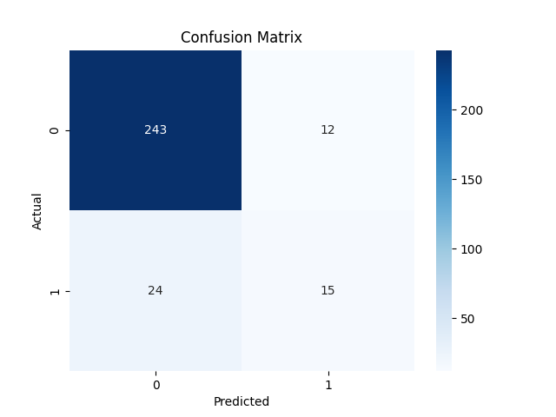


Employee Attrition Prediction Using Machine Learning Ahmed Mujtaba Butt
Data Preprocessing
Handled missing data
Encoded categorical variables
Scaled numerical features
Removed outliers
Exploratory Data Analysis
Conducted a thorough analysis of the dataset
Visualized the distribution of employees with respect to different features
Analyzed the correlation between various features and attrition
Identified patterns or trends that may influence employee attrition
Attrition Prediction
Split the dataset into training and testing sets
Choose logistic regression as the machine learning algorithm for binary classification
Trained the model on the training set
Evaluated the model on the testing set using various performance metrics
Model Improvement
Experimented with diffrent hyperparameter
Fine-tuned the model
FINDINGS
Employees who left the company had lower job satisfaction, job involvement, and work-life balance than those who stayed.
Employees who left the company had lower years at the company, years in current role, and years with current manager than those who stayed. This may indicate that they lacked career growth or stability.
CHALLENGES
The dataset was imbalanced, with more employees who stayed than those who left.
The dataset had many features, some of which may be irrelevant or redundant for the prediction task.
The dataset had some outliers and anomalies.
PERFORMANCE
The best model was Logistic Regression with C=10, penalty=l2, and solver=sag.
The model achieved an F1 score of 0.50 on the testing set, and 0.52 on the cross-validation.
The model had a high accuracy indicating that it was able to correctly classify most of the employees who left or stayed.

