Slide 1

NETFLIX DATA ANALYSIS 2020
Presented By:
Ahmed Meshref
Paul Arah

Slide 2
TABLE OF CONTENTS
01
02
03
PROBLEM & SOLUTION
OUR PROCESS
SUMMARY
Overview of Netflix and problem proposed
Data Analysis processes taken to solve the problem
Visualizations and findings summary

Slide 3
CONTEXT
The Rwanda Revenue Authority(RRA) is a financial services institution located in Kigali Rwanda. Their mandate is to collect tax revenue on behalf of the Republic of Rwanda. Due to the prevailing COVID-19 pandemic, its tax collection figures for the 2020-2021 fiscal year deteriorated by over 10% to a value of $1.3 Billion. They are now planning in advance to improve their fiscal tax revenue for 2021-2022. A key goal of theirs is to invest in digital transformation. In line with their digital agenda, the institution is planning to establish an effective revenue collection platform to influence their decision making processes. They want to gain better insights from the vast amount of data they collect daily as well as from the media and other platforms. RRA published a Request for Proposal(RFP) which was submitted to tech companies that specialize in data analytics.

Slide 4
UNDERSTANDING THE PROBLEM
Due to the harsh economic realities of the COVID-19 pandemic, Netflix aims to understand its commercial performance in 2020 compared to the last five years. This is achieved by performing exploratory data analysis on Kaggle’s updated Netflix data and exploring viable metrics like shows trends, countries with the most movie production, etc.

Slide 5

NETFLIX
Netflix is a streaming service that offers a wide variety of award-winning TV shows, movies, anime, documentaries, and more on thousands of internet-connected devices. (Netflix, 2021)

Slide 6



DATA AND TOOLS
DATASET
JUPYTER
ANALYSIS TOOLS
VISUALIZATION
Latest Netflix dataset from kaggle
Interactive computing tool
Numpy & Pandas
Matplotlib & Seaborn

Slide 7
ANALYSIS PROCESS
EXPLORING
ANALYSIS
02
04
01
03
CLEANING
SUMMARY
Understanding the dataset
Perform analysis & Visualization
Cleaning the dataset
Findings & Summary

Slide 8
UNDERSTAND THE DATA
01

Slide 9





DATASET COLUMNS
Type: Show Type
- Movie
- TV Show
Country: country produced the movie
Release_year: the original year when the show was produced.
Title: Show Title
Date_added: the date when the show was added to Netflix (mm - day - year)
Listed_in: all genres which the movie relates to
Other self-explanatory columns: cast, description, rating, and director.

Slide 10
MORE INSIGHTS
 | COUNT | Function | DESCRIPTION
NULL VALUES | ~ 3000 | df.isnull().sum() | Around 3000 missing values were found across multiple columns.
DEPLICATES | 0 | df.duplicated().any() | No duplicates were found
UNIQUE ROWS | 7789 | df.nunique() | All rows were unique

Slide 11
02
DATA CLEANING

Slide 12
CLEANING
 | Function | DESCRIPTION
DROP NULL | df.dropna() | Drop null values to create more robust analysis
DATE FORMAT | pd.to_datetime(df['date_added']) | Change date format of the date_dated column
CREATE YEAR_ADDED COL | df['date_added'].dt.year | Extract the year added into a new column for a show as it is required in the analysis.

Slide 13
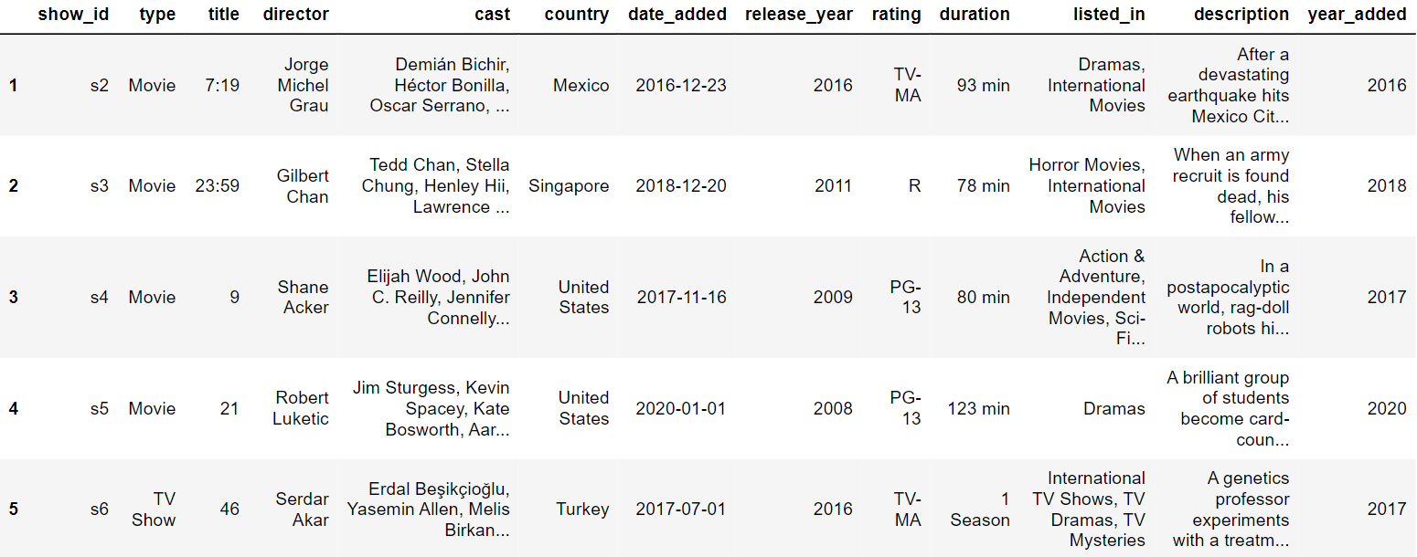
CLEAN DATA HEAD

Slide 14
DATA ANALYSIS & VISUALIZATION
03

Slide 15
ANALYSIS QUESTIONS
Compare the number of Movies & Shows added to the website from year 2008-2021.
Compare number of movies & TV Shows released in each one of the last 5 years.
Show movies VS TV shows trend in the last 5 years at Netflix.
What is the number of movies VS TV shows in 2020?
Which are the top 5 countries that produces movies in the last 5 years?
Analyze the US contribution to movies and TV shows in the last 5 years.

Slide 16
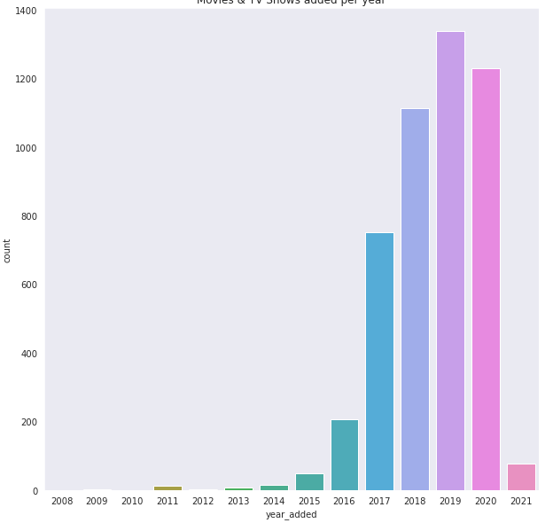
MOVIES & SHOWS ADDED 2008-2021

Slide 17
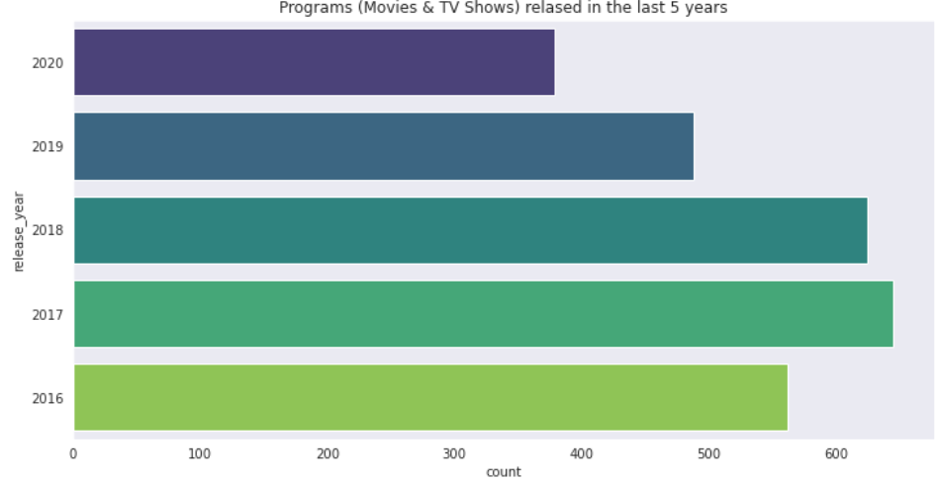
MOVIES & SHOWS RELEASED 2016-2020

Slide 18
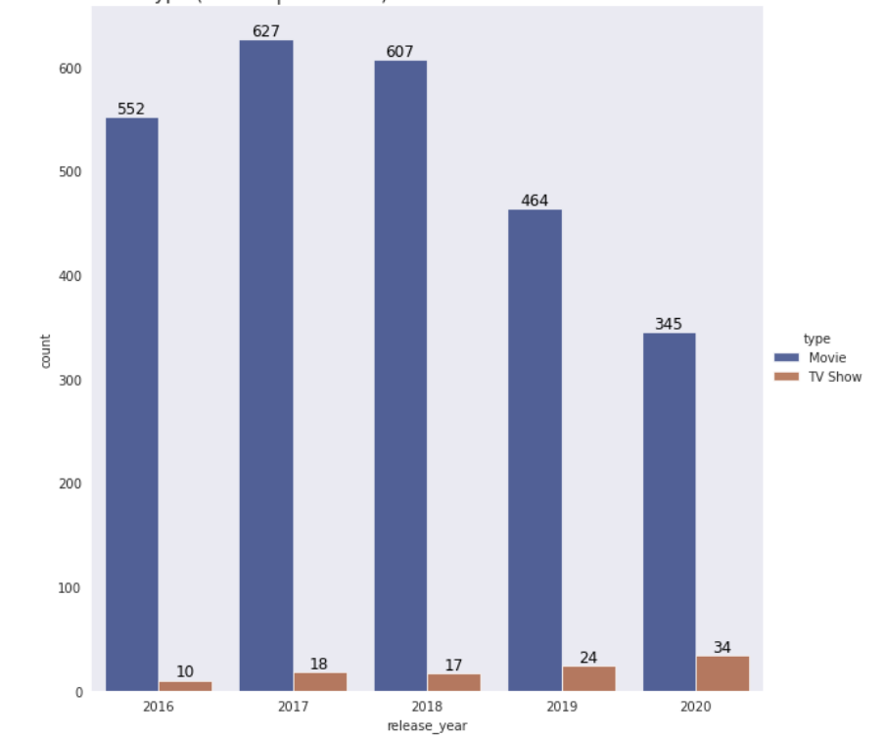
SHOWS VS MOVIES TREND

Slide 19
SHOWS VS MOVIES 2020
SHOWS TYPES
91%
Movies
9%
TV Shows

Slide 20
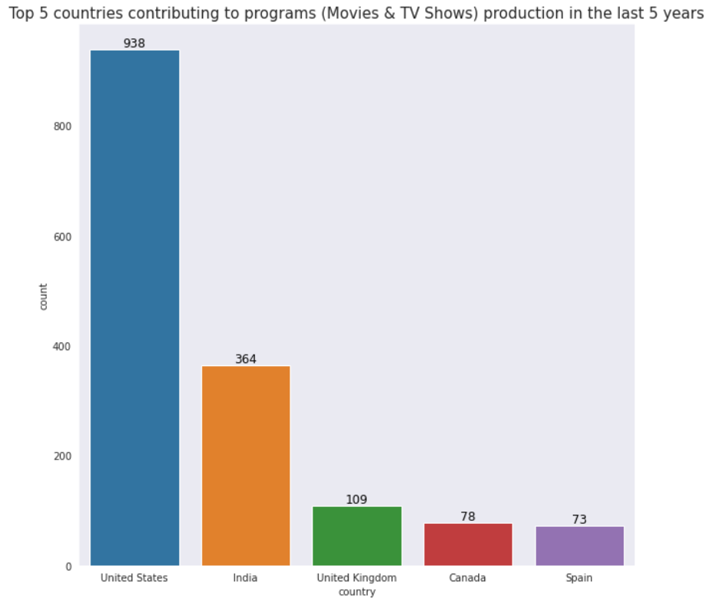
TOP COUNTRIBUTERS 2016-2020

Slide 21
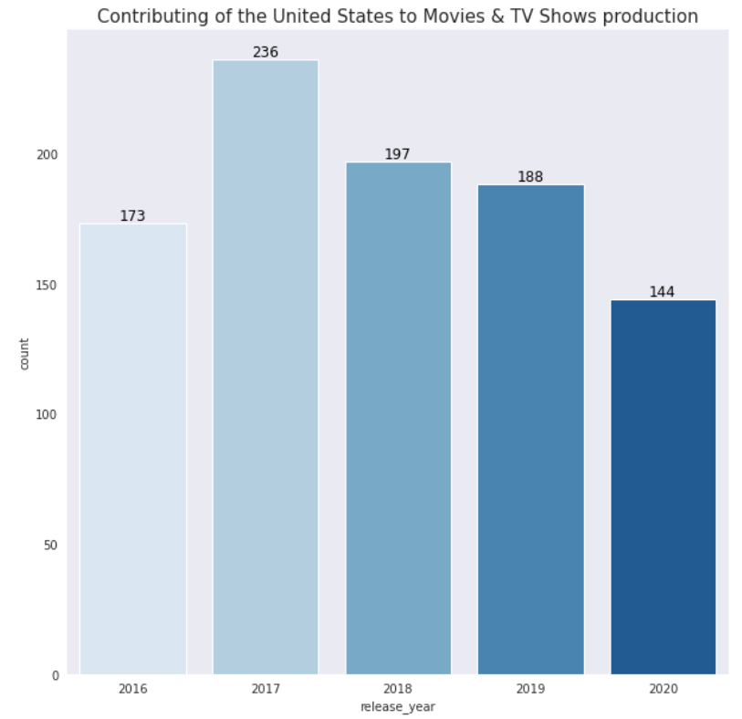
US CONTRIBUTION 2016-2020

Slide 22

KEY FINDINGS
04

Slide 23
1229
Shows were added to the netflix in 2020 compared to 1337 in 2019. Shows added in 2020 are 8% less than shows added in 2019.

Slide 24
SHOW PRODUCTION TREND
2017
2019
2020
645 shows produced
488 shows produced
379 shows produced
2020 witnessed 41.24% reduction in the number of produced shows compared to 2018.

Slide 25
285%
Increase of TV Shows production in 2020 compared to 2016.

Slide 26
Movies production is higher than TV Shows production by 82% in 2020.
91%
9%
Movies
TV Shows

Slide 27
TOP CONTRIBUTORS IN 2020
38%
14%
US
INDIA
US and INDIA contributed to more than half of the shows released in 2020

Slide 28
SUMMARY
In conclusion, we explored the following fields in the dataset: The show types, countries, release year for movies. Title of different shows, dates, etc. Using the the right data cleaning and exploratory data analysis techniques, we were able to remove redundant values and derive insights from the data. Movies had a 91% prevalence over TV shows with 9%. 2019 was the year with highest number of movies added while 2017 was the year with the highest release of new movies. The United states is the highest contributor, followed by India. Netflix has seen a whooping 285% growth in TV shows since 2016 till date.
By netflix publicly available data that shows a growing revenue over the years, we can conclude that this increase of TV shows most likely has translated into an increase in revenue for netflix.

Slide 29
THANK YOU!
Do you have any questions?
a.meshref@alustudent.com
ALU

Slide 30
REFERENCES
1- “Unlimited movies, TV shows, and more.,” Netflix. [Online]. Available: https://www.netflix.com/eg-en/. [Accessed: 07-Mar-2021].
2- S. Bansal, “Netflix Movies and TV Shows,” Kaggle, 18-Jan-2021. [Online]. Available: https://www.kaggle.com/shivamb/netflix-shows. [Accessed: 07-Mar-2021].

