Slide 1
⬅
PROJECT



Sign Language Translator
−


Slide 2



Application platform
Android Application
Window Phone Application
complete application available for user
beta version coming soon for user

Slide 3
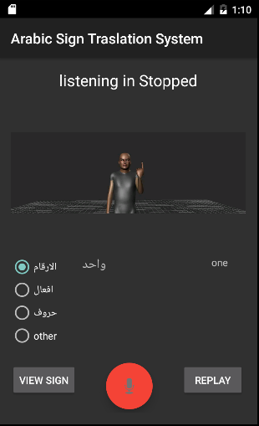
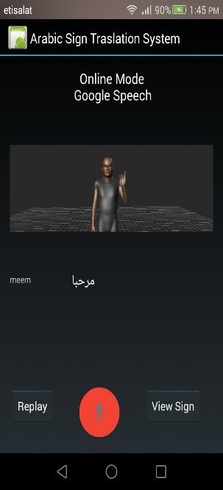
Application Interface
Offline Translation
Online Translation
01
Offline Mode
02
Online Mode
Depend on Sphinx
Depend on Google API

Slide 4
Features
Sign Language Translator is a mobile app. that interprets spoken Arabic into sign language using a friendly avatar.
translations, enabling easier communication with the deaf & hard of hearing community without having to know sign language.
Translation
Online Mode
Real-Time Arabic-to-Sign Language Translation
Google speed API
Arabic Speech
Sign of the Day
More than 100 Arabic word
Choose your speech domain to get right result
Replay your Sign
Replay sign for single character

Slide 5
Application Overview
Speech status
Avatar
Domain of Speech
Result of Speech
View Sign of text
Replay Sign
Start Speech

