Slide 1
Modular Decomposition

Slide 2
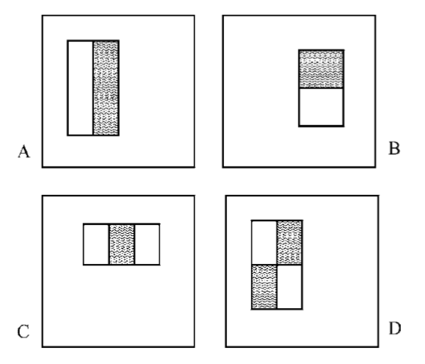
Face Detection
It uses Haar cascades to extract features from an image and train a machine learning model to recognize a face.
Haar features are extracted on 24x24 rectangles.
Notes:
There are 25 stages.
Each stage contains a different number of haar feature with the lowest containing 9 features and the highest containing 211
The cascade classifier is used to reject windows that are non-face rapidly

Slide 3
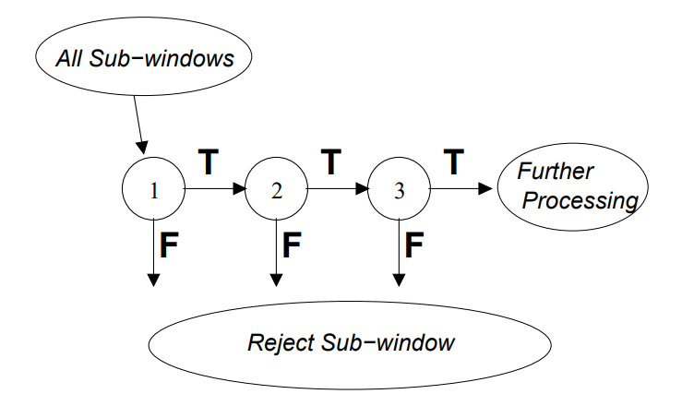
Face Detection
Adaboost was used to select a number of Haar features.
The selected Haar features forms a strong classifier
It uses a Cascade classifier for rapid detection.
Notes:
The output of adaboost a weighted combination of weak classifier that forms a strong classifier

Slide 4
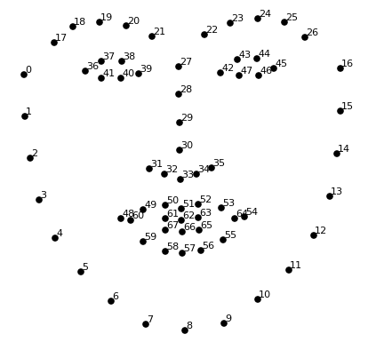
Emotion Detection
Extraction of facial landmarks
The process extracts 68 facial landmarks on the face.
The facial landmarks can be analysis to detect shape of the face, the position and orientation of the eyes, the position of the nose, and the shape of the mouth.

Slide 5
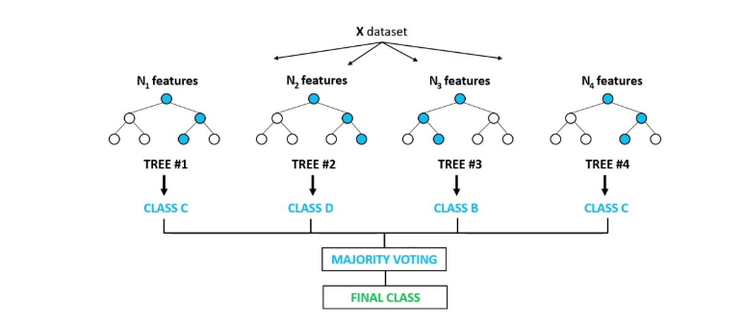
Emotion Detection
The extracted facial landmark are used to predict the emotion
The prediction is done using Random Forest Classifier
Emotions that can be detected are
Fear
Happy
Neutral
Anger
Sadness
Contempt
Disgust
Surprise

Slide 6
Product Identifier
Product identification and detection algorithm
Two cascaded CNN was to detect and identify the product.
First CNN detects retail products based
Second CNN detects the logo retail products
Product Detection
Logo Detection

Slide 7
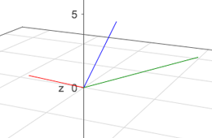
Apparel Recommender
Recommend to the user an outfit based on their preference
Also follows some generic fashion rules
TF-IDF is used to vectorize the user’s wardrobe
Results are 3D vectors since three features were used

Slide 8
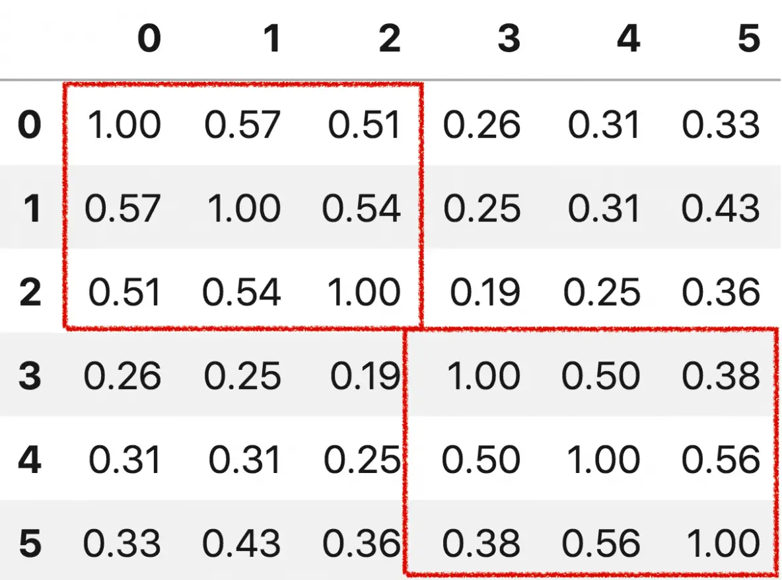
Apparel Recommender
Cosine similarity matrix is used to get the closest outfit.
The outfit must follow some rules
E.g. Wearing a short and a blazer together is not recommended.

Slide 9
System Testing and Verification

Slide 10
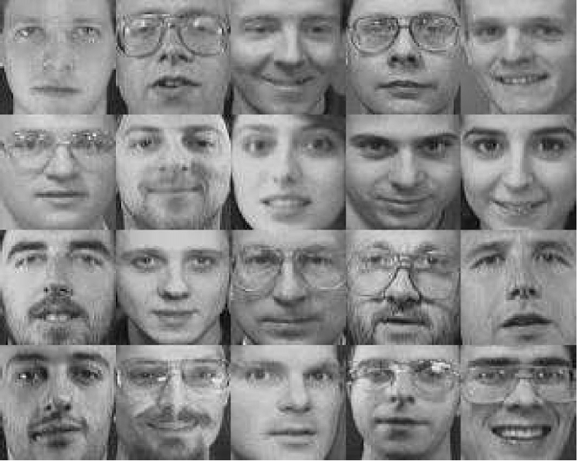

Face Detection
Dataset | Accuracy
Olivetti | 97%
LFW | 93%

Slide 11
Emotion Detection
The model was train and tested using the Cohn-Kanade (CK and CK+) Dataset.
The system was able to achieve a real-time accuracy rate of 77% in detecting eight different emotions.
Notes:
Subjects making a range of facial expressions, including anger, contempt, disgust, fear, happiness, sadness, and surprise.

Slide 12
Product Identifier
The original dataset was divided 85% training and 15% testing.
The model reach an accuracy of 75%

Slide 13
Apparel Recommender
Testing the apparel recommender system proved to be a challenging task.
As a result, the system was tested using user feedback as the primary evaluation metric.
Specifically, users were asked to provide feedback on whether they liked the recommended outfits or not.
Overall, the user feedback was positive, indicating that the system provided satisfactory recommendations.

Slide 14
Limitaions

Slide 15
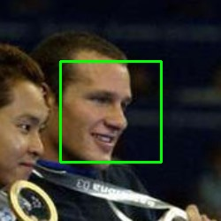
Face Detection
It can produce false positives in complex backgrounds or under challenging lighting conditions
It may miss faces that are partially occluded or not facing the camera directly.

Slide 16
Emotion Detection
The condition of lighting can affect the results of the detector
Emotions, in general, are influenced by the situational and contextual factors
It is difficult to rule out the possibility of fake emotions
Notes:
Laughing because of happiness or awkwardness

Slide 17
Product Identifier
The main limitation is the change in lighting and orientation of products.
This greatly decreases the accuracy of the model.
Dented or deformed products are difficult to detect

Slide 18
Apparel Recommender
Fashion recommendation is a complex system.
Providing rules to define fashion simplifies its complexity.
Such rules are usually not enough to fully capture the nuances of fashion.

