Slide 1

Mobile Application
Framework: Flutter
Programming Language: Dart
High performance, cross platform applications

Slide 2

Home Page

Slide 3
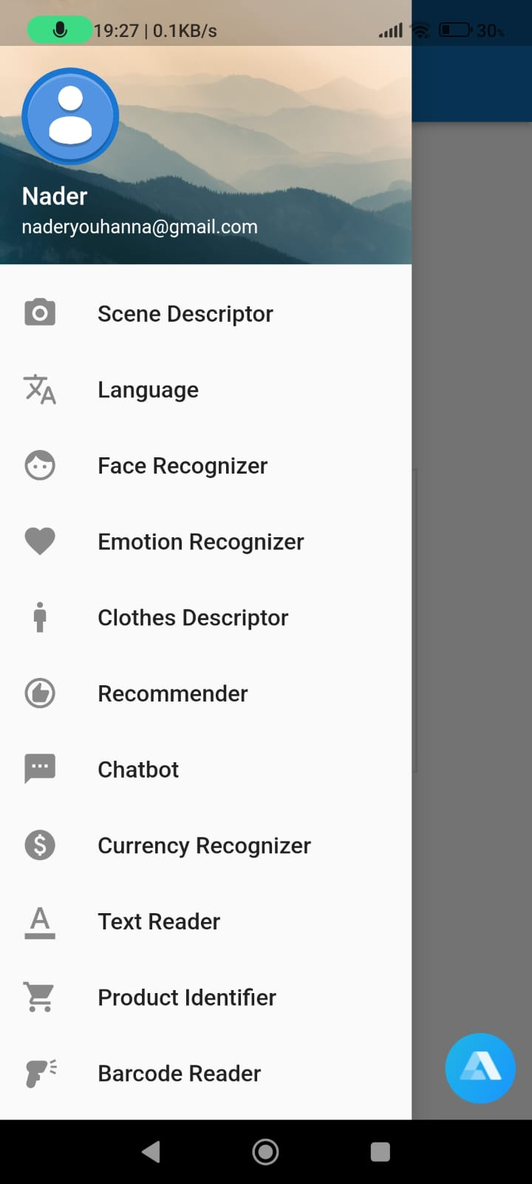
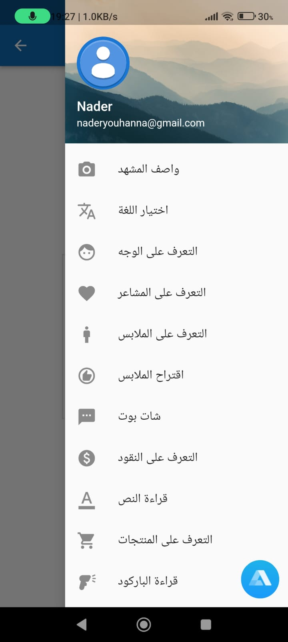
Navigation
Using Side Bar Menu
OR
Using voice commands

Slide 4
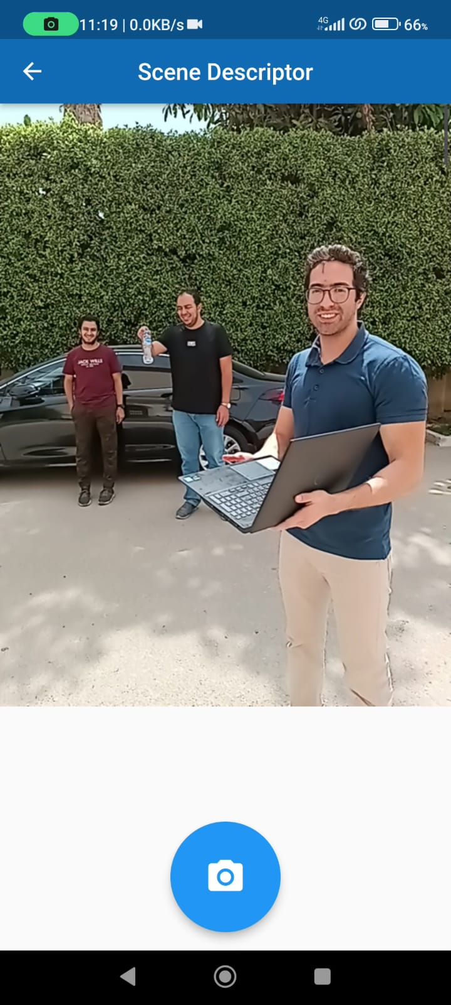
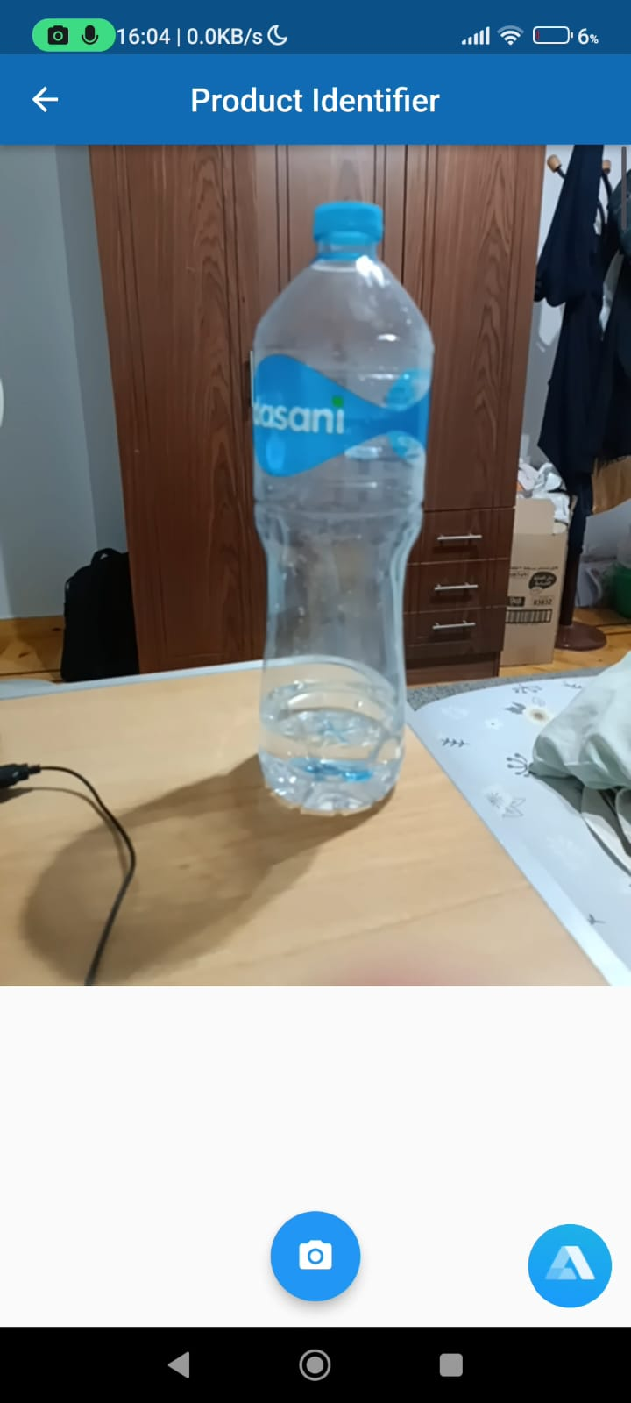
Application Modules

Slide 5


Chatbot
Q: What’s the weather like ?
A: (sound) It’s currently sunny and warm
Q: Where is Germany located ?
A: (sound) Germany is situated in central Europe

Slide 6
Eigenfaces: Literature Review
Turk, M. & Pentland, A. (1991). Face Recognition Using Eigenfaces. Journal of Cognitive Neuroscience
Classic paper in face recognition
Introduces the Eigenfaces technique that uses Principal Component Analysis (PCA)

Slide 7
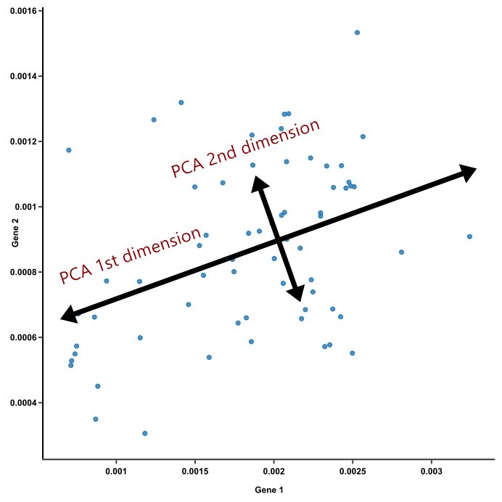
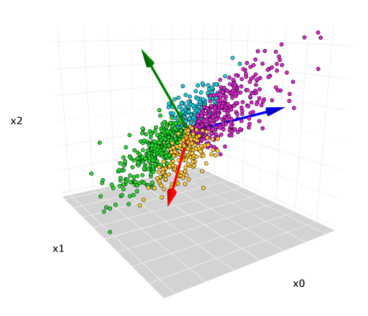

Eigenfaces: Modular Description
Uses Principal Component Analysis
Training examples are points in the feature space
Select features with greatest variability$≡$ largest variance
They help distinguish classes the most

Slide 8
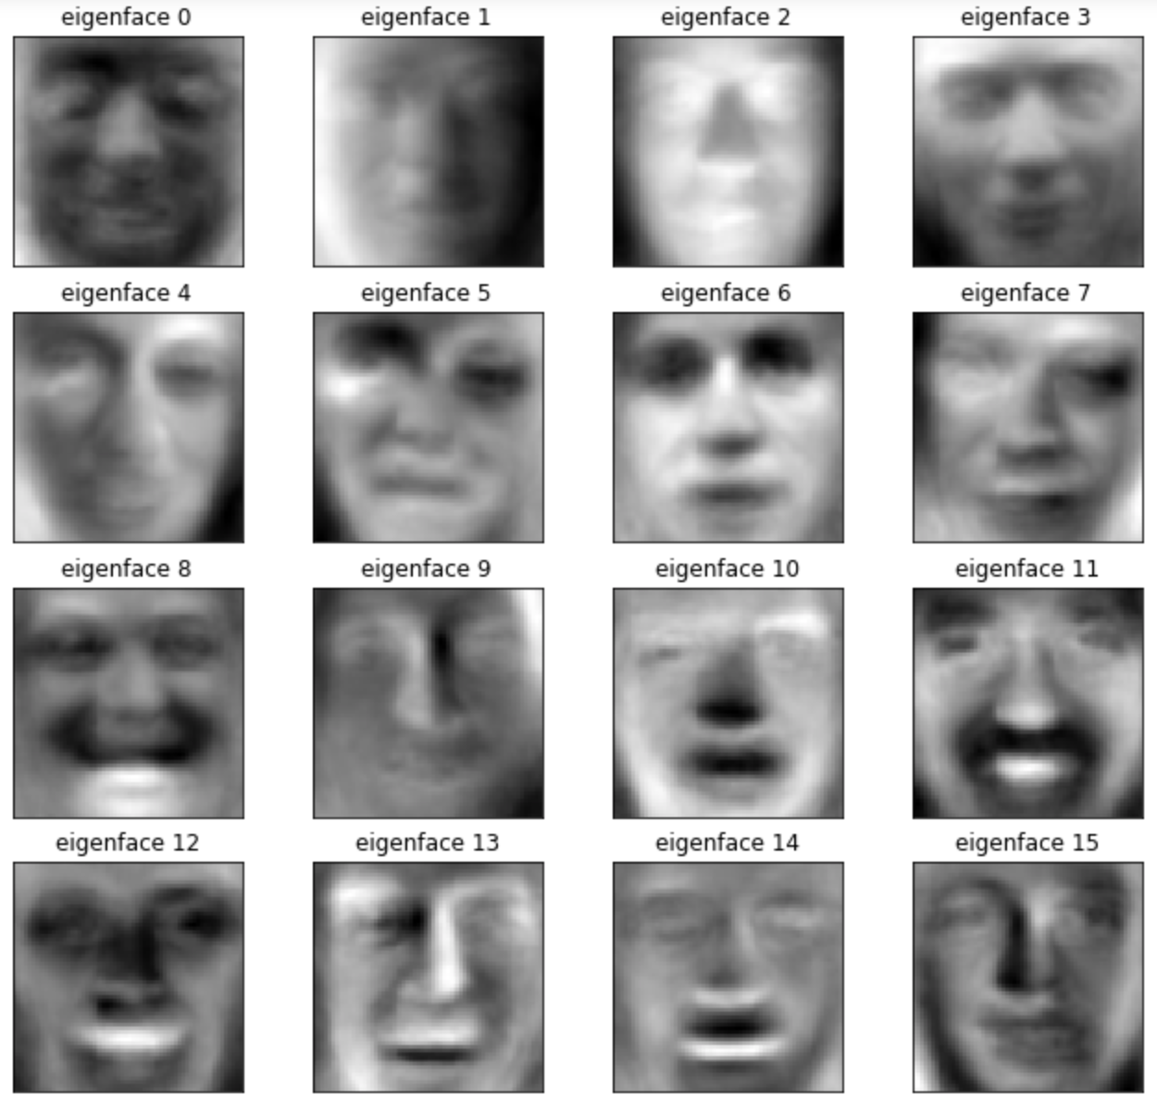
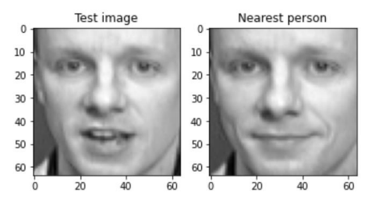
Eigenfaces: Modular Description

Slide 9



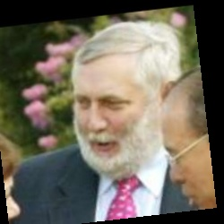
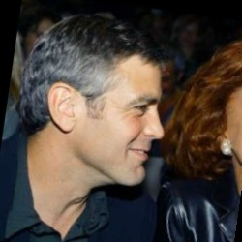
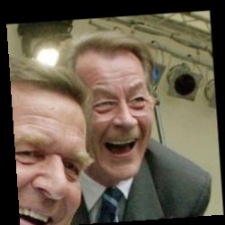

Eigenfaces: Testing
Datasets:
Olivetti (97% accuracy) (40 classes)
LFW (Bad accuracy ~15%) (1473 classes)
Our own images

Slide 10
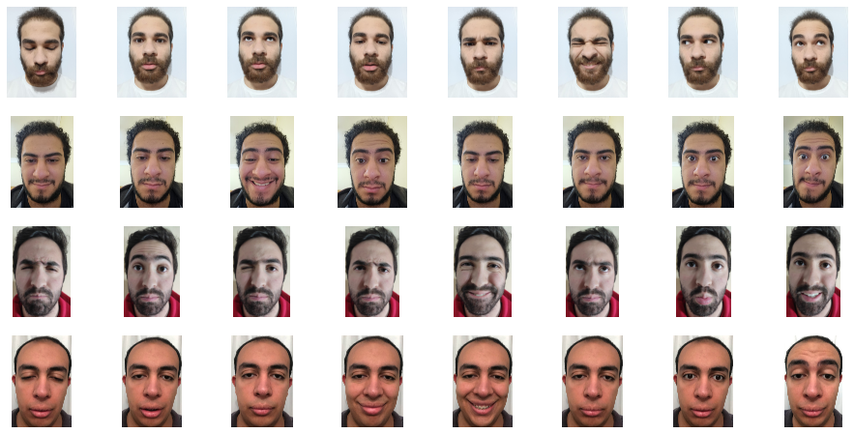
Eigenfaces: Testing

Slide 11
Eigenfaces: Limitations
The Eigenfaces algorithm does not try to extract certain features from the images that would make the difference between one face and the other.
Rather, it assumes that the faces distribution over the whole image space is not random. Based on this assumption, the algorithm aims to calculate the Eigenvectors (Eigenfaces) that best describe the distribution of face images over the images space.

