Slide 1
QA Bootcamp
By Ramzan Malik

Slide 3
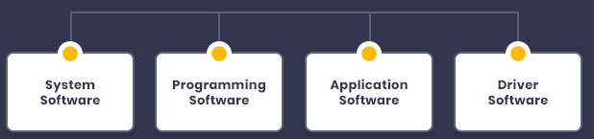
What is a Software?
Software is a set of instructions, data or programs used to operate computers and execute specific tasks. Opposite of hardware, which describes the physical aspects of a computer, software is a generic term used to refer to applications, scripts and programs that run on a device. Software can be thought of as the variable part of a computer, and hardware the invariable part.

Slide 4
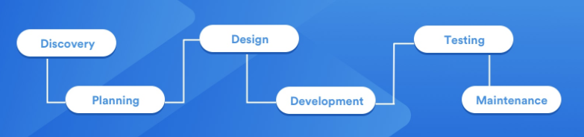
What is a Software development?
Software development is the process of conceiving, specifying, designing, programming, documenting, testing, and bug fixing involved in creating and maintaining applications, frameworks, or other software components. Software development is a process of writing and maintaining the source code, but in a broader sense, it includes all that is involved between the conception of the desired software through to the final manifestation of the software, sometimes in a planned and structured process.

Slide 5
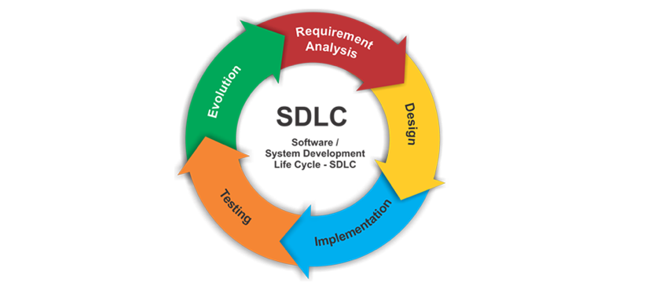
Software Development Process
While development team work on implementation, SQA Eng. works on test case development, test planning.
In this phase SQA Eng. executes test cases. Create bug reports for failed test cases. Re-testing & Regression.

Slide 6
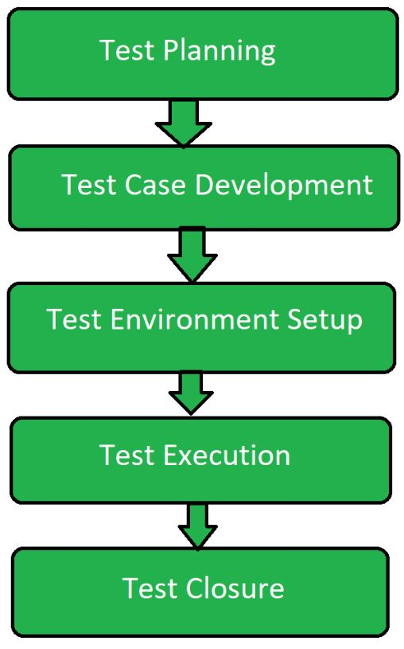
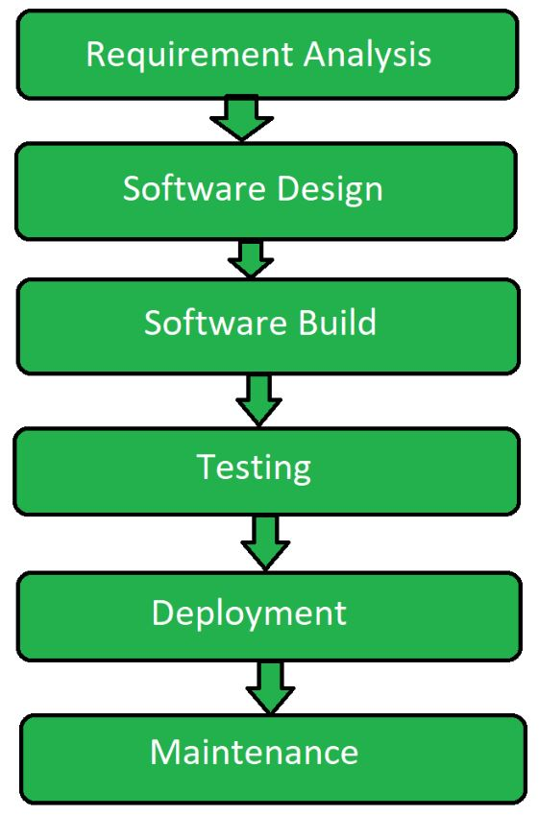
Software Development Life Cycle (SDLC)
Software Testing Life Cycle (STLC)

Slide 7
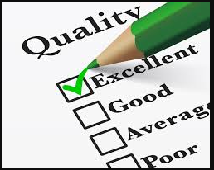
What is Quality?

Slide 8
What is Quality?
Quality is doing the right things right! How good or bad something is! Quality is conformance to requirements.

Slide 9

What is Quality?
Quality is degree of customer satisfaction.
Concept of Quality start with identification of customers quality requirements and must only end when finished product/service is placed in hand of the customer who remain Satisfied throughout the relationship.

Slide 10

What is Assurance?
Assurance is nothing but a positive declaration on a product or service, which gives confidence. It is certainty of a product or a service, which it will work well. It provides a guarantee that the product will work without any problems as per the expectations or requirements.

Slide 11
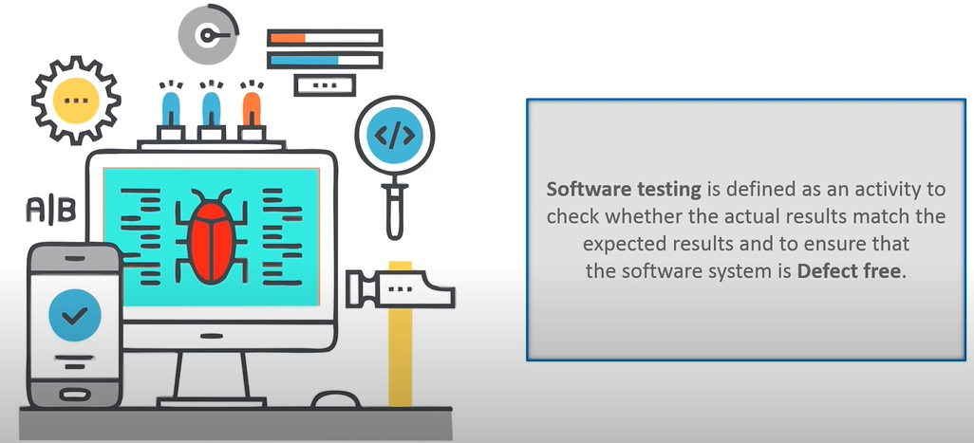
Software Testing / Quality Assurance?

Slide 12

Quality Assurance - Doing the Right Things:
Proactive Approach:
QA is primarily a proactive approach to quality management. It focuses on preventing defects and quality issues before they occur in the software development process.
QA activities are initiated at the beginning of the project and continue throughout its lifecycle.
Process-Oriented:
QA is process-oriented and involves defining, implementing, and continually improving processes, standards, and best practices.
It aims to create a framework within which high-quality products can be consistently produced.
Preventive Measures:
QA involves identifying potential issues, risks, and bottlenecks in the development process and taking measures to address them before they lead to defects.
It often includes activities like process audits, process design, and training to enhance the skills of team members.
Focus on Continuous Improvement:
QA promotes a culture of continuous improvement, where feedback from previous projects is used to refine processes and prevent recurring issues.
It aims to optimize the development process for efficiency and effectiveness.

Slide 13
Quality Control (QC) - Doing the Things Right:
Reactive Approach:
QC is primarily a reactive approach to quality management. It focuses on identifying and correcting defects and quality issues after they have occurred in the software product.
QC activities typically occur during or after the development phase.
Product-Oriented:
QC is product-oriented and involves activities like testing, code reviews, inspections, and dynamic analysis to assess the quality of the software product itself.
Defect Identification:
QC activities are designed to identify and report defects, deviations from requirements, and issues in the software.
It includes activities like test execution, bug tracking, and defect management.
Validation and Verification:
QC includes the validation and verification of the software to ensure that it meets the specified requirements and quality standards.
It helps ensure that the end product aligns with user expectations.

Slide 14
Verification vs. Validation:
Verification ensures that the software is built correctly according to specifications. It involves activities like code reviews, static analysis, and unit testing.
Validation ensures that the right product is built to meet user needs. It includes activities like system testing, user acceptance testing, and requirements validation.
Example Scenario: You're developing an e-commerce website. Verification would involve checking that the code for processing payments adheres to coding standards and is free of syntax errors. Validation would involve testing the payment process to ensure it accurately processes payments and meets user expectations.

Slide 15
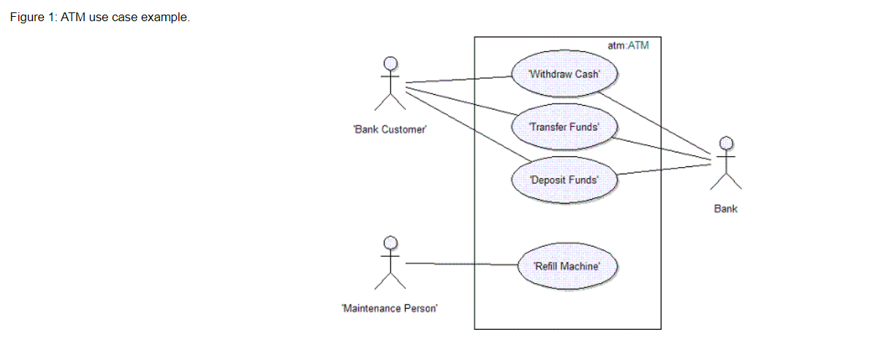
Use Cases, Test Cases, and Test Scenarios:
Use cases are detailed descriptions of how users interact with the software to accomplish specific tasks.

Slide 16
Properties of Use Cases
Name : Each use case should have a name that clearly describes the main goal of the use case. The name may have to be several words long to be understood. Typically the name is a verb phrase, for example: Withdraw Cash.
Note: No two use cases can have the same name.
Brief Description : The brief description of the use case should reflect its purpose.
Flow of Events – Contents: The flow of events should describe the interactions between the actor(s) and the system clearly enough for an outsider to easily understand. The flow of events should represent what the system does, not how the system is design to perform the required behavior.
Follow these guidelines for the contents of the flow of events:
Describe how the use case starts and ends.
Describe what data is exchanged between the actor and the use case.
Describe the flow of events, not only the functionality. To enforce this, start every action with "When the actor ... ".
Avoid vague terminology.
Detail the flow of events. Specify what happens when, for each action. Remember this text will be used to identify test cases.

Slide 17
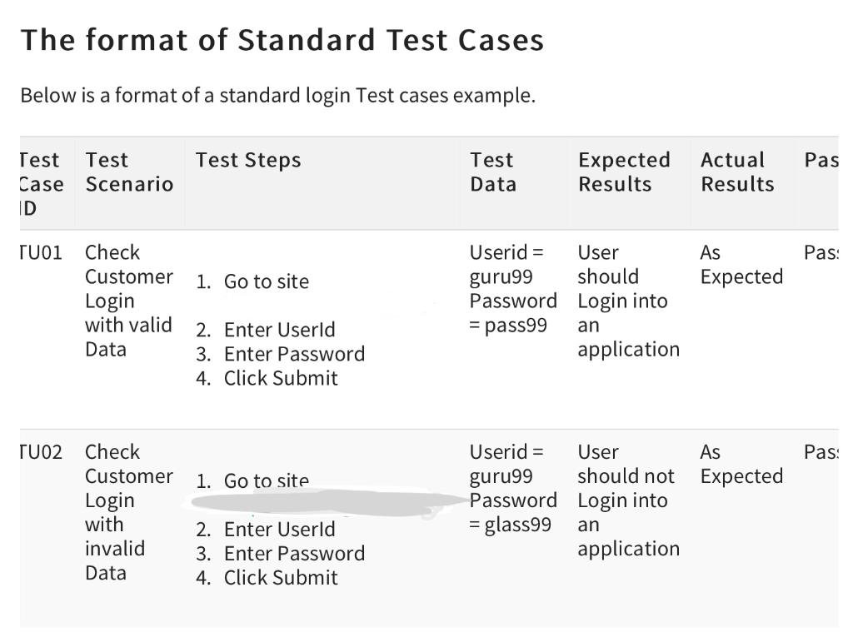
Test Cases
Test cases are specific sets of inputs, actions, and expected outcomes for testing a particular aspect of the software.
Example: You have to verify the age input field in signup form

Slide 18
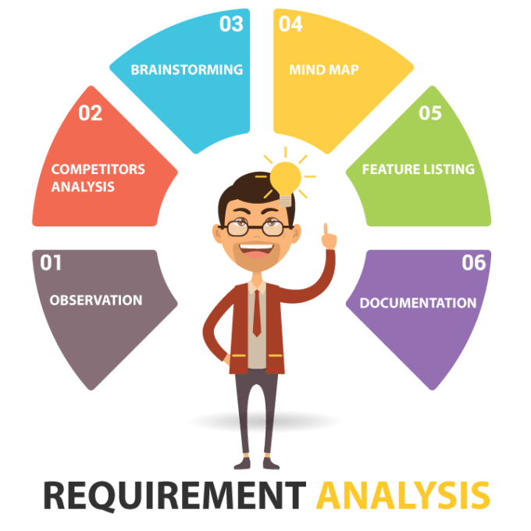
What is a Requirement Analysis?
Requirement Analysis, also known as Requirement Engineering, is the process of defining user expectations for a new software being built or modified. In software engineering, it is sometimes referred to loosely by names such as requirements gathering or requirements capturing.

Slide 19

Requirement Analysis in Software Industry?
Development team
Client/Product Manager
Skype, MS Teams, Slack, JoinMe, GoToMeeting, TeamViewer, Emailing (Outlook, Gmail)

Slide 20

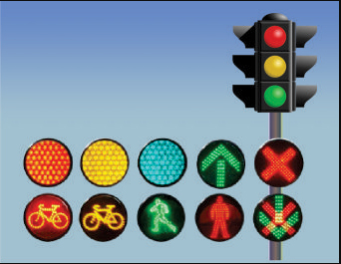
Types of Testing Used in Software Industry
Manual
Automation

Slide 21
Test Plan and Test Strategy
Test Plan outlines the scope, objectives, resources, and schedule for testing a project. It's a comprehensive document.
Test Strategy is a high-level plan that defines the overall approach to testing, including methodologies, tools, and resources.
Example : Let’s see practical documentation in detail

Slide 22
Static Testing:
Static Testing is a type of testing that reviews software documents and code without executing them. It helps find defects early in the process.
Early Detection: Static testing is conducted at the earliest stages of the SDLC, often starting with requirements and design documents. This early intervention helps identify issues before they become costly to fix in later stages of development.
Types of Artifacts: Static testing can be applied to various types of artifacts, including:
Requirements: Ensuring that requirements are clear, complete, and unambiguous.
Design Documents: Verifying that the design meets specified requirements and architectural guidelines.
Code: Identifying coding standards violations, logic errors, and potential bugs.
Test Cases: Reviewing test cases for completeness and coverage.

Slide 23
Working with Bugs:
Bug is a deviation from expected behavior in a software application.
Bug Reporting involves documenting defects with details such as steps to reproduce, severity, and priority.
JIRA is a popular project management and bug tracking tool.
Another example is Mentis used typically for bugs management

Slide 24
Bug Life Cycle/Severity and Priority:
Bug Life Cycle describes the various stages a bug goes through, from discovery to resolution.
Example: Document of bug reporting / Mentis Practical example
Severity indicates the impact of a bug on the system.
Priority determines the order in which bugs are fixed.

Slide 25
Bug Leakage and Bug Release:
Bug Leakage occurs when a bug is not identified during testing and makes its way into production.
- Bug Release is when a set of fixes for identified bugs is deployed to production.

Slide 26
Bug Triage:
Bug Triage is the process of prioritizing and categorizing bugs to determine which ones should be addressed first.
Purpose: The primary goal of bug triage is to efficiently allocate resources (developers, testers, etc.) to address identified issues based on their severity and impact on the project.

Slide 27
Difference between bug, Defect and Failure
1. Bug:
A bug is a broad term often used interchangeably with "defect" in informal language.
It represents a flaw or issue in the software that causes it to behave incorrectly or unexpectedly.
Bugs can encompass various types of problems, including coding errors, design flaws, or incorrect functionality.
Bugs are typically detected during the testing phase or by end-users.
Example of a Bug: Let's say you are testing a web application, and when you click the "Submit" button on a form, the application crashes and displays an error message. This behavior is a bug because it is not the expected or desired behavior.

Slide 28
Defect:
A defect is a specific type of issue or problem in the software that deviates from its requirements or specifications.
Defects are often identified through systematic testing processes, and they represent a failure to meet the defined criteria.
Defects can include issues such as incorrect calculations, missing features, or non-compliance with design specifications.
Example of a Defect: In a banking application, the interest calculation for a savings account is incorrect. According to the specifications, it should calculate interest monthly, but it is currently calculating it annually. This is a defect because it does not conform to the specified behavior.

Slide 29
Failure:
A failure occurs when the software behaves incorrectly or produces an undesirable outcome during actual usage by end-users or customers.
Failures are typically the result of one or more defects or bugs in the software.
Failures are observable issues that impact the user experience, leading to dissatisfaction or loss of functionality.
Example of a Failure: Imagine a mobile app for navigation that suddenly crashes while a user is using it to get directions, causing the app to close unexpectedly. This crash is a failure because it occurs during real-world use and disrupts the user's experience.

Slide 30
Black Box VS White Box Testing
Black Box Testing: Black box testing is a software testing method in which the internal structure, code, and implementation details of the system being tested are not known to the tester. Testers focus on testing the system's functionality, inputs, and outputs without knowledge of its internal workings.
White Box Testing: White box testing, also known as structural testing or glass box testing, is a software testing technique where the tester has access to the internal structure, code, and logic of the software application being tested. Testers design test cases based on the knowledge of the software's internal structure.

Slide 31
Functional Testing Vs Non-Functional Testing
Functional Testing: Functional testing is a type of black box testing that verifies whether a software application's functions and features work correctly according to specified requirements. It focuses on testing what the software does.
Non-Functional Testing: Non-functional testing, also known as performance testing, is a type of testing that assesses how well a software system performs non-functional requirements such as speed, scalability, security, and usability. It focuses on how the software performs.

Slide 32
Smoke Testing / Sanity Testing
Smoke Testing: Smoke testing is an initial testing process that checks whether the most crucial functions of a software application work correctly after a build or release. If the smoke test fails, further testing is halted until the critical issues are resolved.
Sanity Testing: Sanity testing is a subset of regression testing that checks specific areas or functionalities of a software application to ensure that recent changes or bug fixes did not introduce new issues. It is often used to quickly validate that the changes are working as expected.

Slide 33
Regression Testing / Re-testing
Regression Testing: Regression testing is a type of testing that ensures that new code changes or updates to a software application do not adversely affect existing functionality. It involves re-running previously executed test cases to verify that the software still functions correctly.
Re-testing: Re-testing is a specific type of testing that focuses on executing test cases related to a specific defect or issue that was found and fixed in the software. It checks whether the specific issue has been resolved.

Slide 34
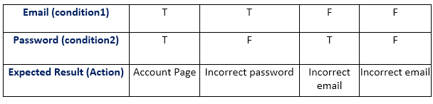
Decision Table Testing
Decision Table Testing: Decision table testing is a technique used to test combinations of inputs that can produce different outcomes in a software application. It involves creating a table that maps possible combinations of inputs to expected results.

Slide 35
Equivalence Partitioning / Boundary Value Analysis
Equivalence Partitioning: Equivalence partitioning is a black-box testing technique that divides the input space into partitions or classes. Test cases are selected from each partition to ensure comprehensive testing while avoiding redundant test cases.
Boundary Value Analysis : Boundary value analysis is a testing technique that focuses on test cases at the boundaries of input domains. It helps identify issues that may occur at the edge values of input ranges.

Slide 36
White Box Testing / Unit Testing
White Box Testing: White box testing is a testing method that examines the internal structure and logic of a software application. Testers design test cases based on their knowledge of the code to ensure that all code paths are tested.
Unit Testing: Unit testing is a type of white box testing that focuses on testing individual units or components of a software application, such as functions or methods, in isolation.

Slide 37
Alpha vs. Beta Testing
Alpha Testing: Alpha testing is the initial testing phase where a software application is tested internally by the development team or a select group of testers. It is typically conducted before beta testing and helps identify major issues.
Beta Testing: Beta testing is the second phase of testing where a software application is released to a limited group of external users. It aims to gather feedback and identify any issues in a real-world environment.

Slide 38
Alpha Testing:
Purpose: Alpha testing is the first phase of testing conducted on a software application, typically performed by the internal development team or a group of selected testers. Its primary purpose is to identify and resolve issues within the software before it is released to a wider audience.
Platform: Alpha testing is usually conducted on a controlled and isolated environment. It often takes place in-house, within the development organization's premises. The software is tested in a controlled and monitored setting, which may not necessarily resemble the real-world conditions in which the software will eventually be used.
Performed By: Alpha testing is performed by the software development team or a group of dedicated testers who have a deep understanding of the software's design and functionality. These testers can include developers, quality assurance (QA) engineers, or a specialized alpha testing team.
Characteristics: Alpha testing focuses on identifying major issues, functional defects, and usability problems. It involves testing various aspects of the software, including functionality, stability, and performance. Feedback gathered during alpha testing is used to make improvements and fixes.

Slide 39
Beta Testing:
Purpose: Beta testing is the second phase of testing, following alpha testing. It is conducted on a larger scale, involving external users who are not part of the development team. The primary purpose of beta testing is to gather real-world user feedback, uncover usability issues, and identify potential problems in diverse environments.
Platform: Beta testing is typically performed on a more diverse and widespread platform. The software is released to a limited number of external users who install and use it on their own devices, representing the actual environment in which the software will be used.
Performed By: Beta testing involves external users or a selected group of customers who have volunteered or been invited to participate. These users come from various backgrounds and may use the software in different ways.
Characteristics: Beta testing focuses on gathering feedback on the software's usability, user experience, and real-world performance. It aims to uncover issues that may not have been apparent during alpha testing, including compatibility problems with different hardware configurations, operating systems, or usage patterns.

Slide 40
Integration Testing
Integration Testing: Integration testing is a testing method that assesses how different components or modules of a software application work together. It verifies that integrated components interact as expected.

Slide 41
Stubs and Drivers in Integration Testing
"Stubs" and "Drivers" are terms often used in the context of integration testing, especially when discussing the top-down and bottom-up approaches to integration testing. These terms are used to describe the components or modules that are temporarily introduced to facilitate the testing of other components or modules.

Slide 42
Stubs and Drivers continue…
Subs (Subsystems): In integration testing, a "sub" or "subsystem" is a module or component that is under development or not yet completed. To test a component that depends on these incomplete or missing modules, placeholder "subs" are created. These subs simulate the behavior of the actual modules by providing the necessary input and producing expected output. Subs are used when the real modules are not available or ready for testing.
Drivers: Drivers are also used in integration testing, but they serve a different purpose. A "driver" is a module or component that interacts with the component being tested. It provides input to the component being tested and stimulates its behavior. Drivers are typically used to test a component when its dependent components are not yet developed or integrated. Drivers help ensure that the component being tested functions correctly when connected to other components.

Slide 43
Latent Defect
A latent defect is a type of defect or flaw that is present in a product or system but remains hidden or dormant for a certain period of time.
These defects are not immediately apparent or detectable during the initial inspection or testing.
Latent defects may become apparent only after a certain period of use, environmental conditions change, or specific circumstances occur that trigger their manifestation.
They can be problematic because they often lead to unexpected failures or issues long after the product has been delivered or the process has been implemented.
Latent defects can be challenging to detect and address proactively, making them a concern for quality assurance and warranty management.

Slide 44
Masked Defect
A masked defect is a defect that is hidden or overshadowed by another defect or issue that is more obvious or easier to detect.
In the presence of a more prominent defect, a masked defect may go unnoticed because the focus is on addressing the primary issue.
Masked defects can sometimes be revealed when the primary defect is corrected, and the masked defect becomes the new focus of attention.
Identifying masked defects requires thorough and systematic inspection and testing to ensure that secondary or less apparent issues are not overlooked.
These defects can be especially problematic because addressing the primary defect alone may not completely resolve the underlying quality issue.

Slide 45
Defect Rejection Ratio
The Defect Reject Ratio, also known as the Defect Rejection Rate, measures the proportion of identified defects or issues that are rejected by the testing team or quality control process during the testing phase.
It is typically expressed as a percentage and is calculated using the following formula:
Defect Reject Ratio (%) = (Number of Rejected Defects / Total Number of Identified Defects) x 100
A high Defect Reject Ratio indicates that many of the defects identified during testing are considered valid and require fixing by the development team. This could indicate that the initial testing process is stringent and rejects issues effectively.
Conversely, a low Defect Reject Ratio may suggest that the testing process is not thorough enough, allowing many issues to pass through to the next phases, such as production, where they can become more costly to fix.

Slide 46
Defect Leakage Ratio
The Defect Leakage Ratio, also known as the Defect Escape Rate, measures the proportion of defects that were not detected during the testing phase and have subsequently made their way into the production environment or have been reported by customers after the software release.
It is also expressed as a percentage and is calculated using the following formula:
Defect Leakage Ratio (%) = (Number of Defects Escaped to Production / Total Number of Defects Identified) x 100
A high Defect Leakage Ratio indicates that a significant number of defects have escaped detection during testing, leading to post-release issues and customer complaints.
A low Defect Leakage Ratio suggests that the testing process is effective in identifying and preventing defects from reaching the production environment, leading to higher software quality and customer satisfaction.

Slide 47
Mutation Testing
Mutation testing is a technique to identify if a set of test data or test case is useful by intentionally introducing various code changes (bugs) and retesting with original test data/ cases to determine if the bugs are detected.
def factorial(n): def factorial(n):
if n == 0: if n == 0:
return 1 return 1
else: else:
return n * factorial(n-1) return n + factorial(n-1)

Slide 48
Common risk that leads to project failure
The common risk that leads to a project failure are
Not having enough human resource
Testing Environment may not be set up properly
Limited Budget
Time Limitations

Slide 49
Data - Driven Testing
Data-Driven Testing is a testing technique in which test cases are designed to test the same functionality with multiple sets of test data. It aims to verify that the application behaves correctly under different input conditions. This approach helps in testing a wide range of scenarios efficiently.
Imagine you are testing the login functionality of an HR portal.
Test Case 1:
Username: user1
Password: pass123
Expected Result: Successful login
Test Case 2:
Username: user2
Password: invalidpass
Expected Result: Failed login with an error message

Slide 50
Behavior - Driven Testing:
Behavior-Driven Testing is an approach that focuses on defining and testing the desired behavior of the software from a user's perspective. It emphasizes collaboration between developers, testers, and non-technical stakeholders to define and understand the application's behavior through natural language specifications.
This approach encourages clear communication between team members and helps ensure that the software meets the specified requirements and user expectations.

Slide 51
public class LoginSteps {
private WebDriver driver;
@Before
public void setUp() {
// Set up WebDriver (Assuming ChromeDriver is used)
System.setProperty("webdriver.chrome.driver", "path_to_chromedriver.exe");
driver = new ChromeDriver();
}
@Given("the user is on the HR portal login page")
public void user_is_on_hr_portal_login_page() {
driver.get("https://hrportal.example.com/login");
}
@When("the user enters valid credentials (username: user1, password: pass123)")
public void user_enters_valid_credentials() {
WebElement usernameField = driver.findElement(By.id("username"));
WebElement passwordField = driver.findElement(By.id("password"));
WebElement loginButton = driver.findElement(By.id("loginButton"));
usernameField.sendKeys("user1");
passwordField.sendKeys("pass123");
loginButton.click();
}

Slide 52
It’s time to do some practical ! Stay Tuned ! ! !

Slide 53
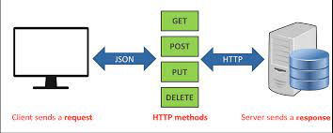
Learning API’s and Postman Tool

Slide 54
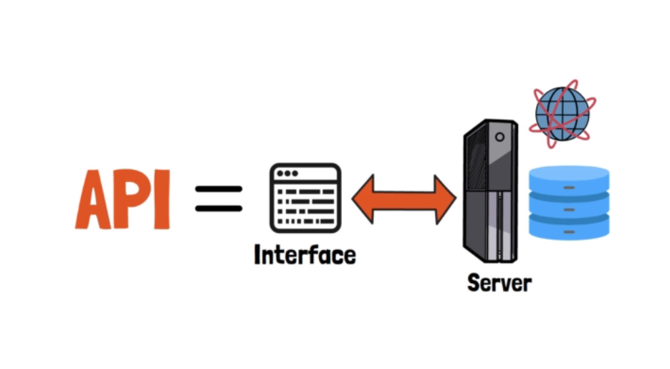
Introduction to API
An API (Application Programming Interface) is a set of rules and protocols that allows different software applications to communicate with each other.
Importance: APIs enable data exchange and functionality sharing between applications, making them a critical component of modern software development.

Slide 55
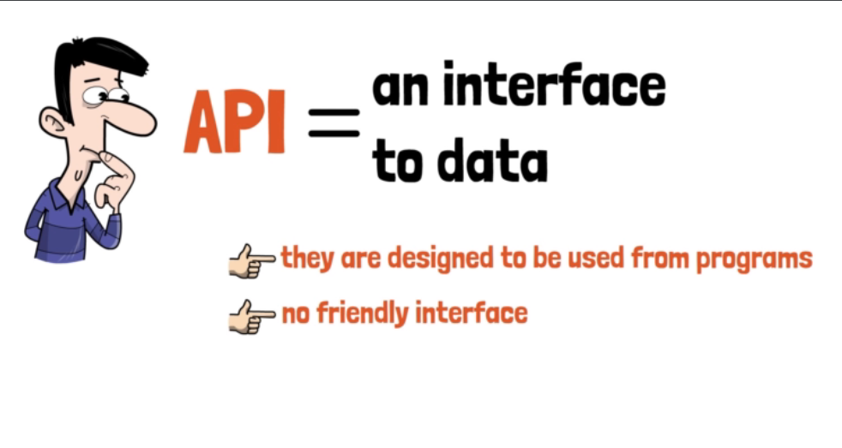

Slide 56
API Testing
Explanation: API (Application Programming Interface) testing involves testing the functionality, performance, and security of an API, which allows software components to communicate and interact with each other.
Example: Imagine testing the functionality of a weather forecasting API. You send a request to the API with specific parameters, and it responds with weather data, which you can verify against expected outcomes.

Slide 57
Web Services
Explanation: Web services are software components that use standardized protocols for communication and data exchange over the internet. They allow different systems to interact with each other, regardless of the technologies they use.
Example: Amazon Web Services (AWS) provides a range of web services for cloud computing, including services for storage, compute, and machine learning. These services can be accessed and integrated into various applications.

Slide 58
API’s vs Web Services
Definition: An API is a set of rules and protocols that allows different software applications or components to communicate and interact with each other. It defines the methods and data formats that applications can use to request and exchange information.
Scope: APIs can be broader in scope and not limited to web services. They can encompass a wide range of functionalities, including libraries, operating system functions, and more.
Usage: APIs can be used for various purposes, including accessing hardware features, interacting with databases, utilizing third-party libraries, and more. They are not limited to web-based communication.
Communication: APIs can use various communication methods, including but not limited to HTTP (for web-based APIs), libraries, command-line interfaces, and more.
Definition: Web services are a specific type of API that use standard web protocols (such as HTTP) for communication. They are a subset of APIs that focus on enabling communication over the internet or a network.
Scope: Web services are typically associated with web-based communication and data exchange. They are used for creating standardized interfaces for web applications to interact with each other.
Usage: Web services are commonly used for building distributed applications, enabling data sharing between different systems, creating public APIs for web and mobile applications, and facilitating integration between various software components.
Communication: Web services specifically use web protocols like HTTP, SOAP, REST, or others to enable communication between applications over the internet.

Slide 59
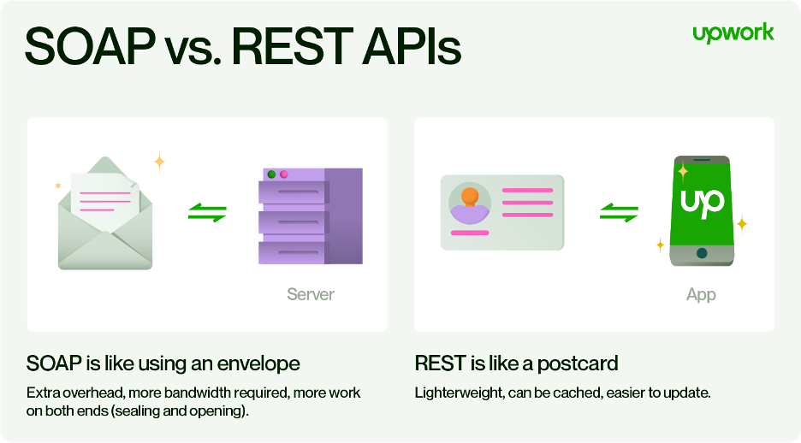
SOAP vs REST

Slide 60
SOAP vs REST
Explanation: SOAP (Simple Object Access Protocol) and REST (Representational State Transfer) are two common architectural styles for designing web services. SOAP uses XML for message formatting and relies on strict standards, while REST is more lightweight and relies on HTTP methods.
Example: SOAP is often used in enterprise applications and might be seen in a financial application that communicates with a central server using XML messages. REST, on the other hand, is commonly used in web APIs, such as the Twitter API, where you use HTTP methods like GET, POST, PUT, and DELETE to interact with resources.

Slide 61
SOAP Example
Explanation: In a SOAP request, data is packaged in an XML format, and it typically includes a specific envelope structure and strict standards for message format. A SOAP response follows a similar structure.
Example: To retrieve weather data through a SOAP service, you might send a request with a predefined XML envelope containing the necessary parameters. The response would be another XML document with the requested weather information.

Slide 62
REST Example
Explanation: RESTful APIs use standard HTTP methods (GET, POST, PUT, DELETE) to perform actions on resources, which are typically represented in JSON or XML format. It's flexible and relies on stateless communication.
Example: To access information about countries from a RESTful API, you would send a GET request to a URL like https://api.example.com/countries. The response would be a JSON or XML document containing the country data.

Slide 63
XML vs JSON syntax example
XML <employees>
<employee>
<firstName>John</firstName>
<lastName>Doe</lastName>
</employee>
<employee>
<firstName>Anna</firstName>
<lastName>Smith</lastName>
</employee>
<employee>
<firstName>Peter</firstName>
<lastName>Jones</lastName>
</employee>
</employees>
JSON
{
"employees":[
{"firstName":"John", "lastName":"Doe"}, {"firstName":"Anna", "lastName":"Smith"}, {"firstName":"Peter", "lastName":"Jones"}
]
}

Slide 64
HTTP Requests
Explanation: HTTP (Hypertext Transfer Protocol) is the foundation of data communication on the World Wide Web. HTTP requests are actions initiated by a client (e.g., a web browser or an application) to retrieve or send data to a server.
Example: When you open a web page in your browser, it sends an HTTP GET request to the server to retrieve the page's content. Other common HTTP request methods include POST (for submitting data), PUT (for updating data), and DELETE (for removing data).

Slide 65
HTTP vs HTTPS:
HTTP (Hypertext Transfer Protocol) and HTTPS (Hypertext Transfer Protocol Secure) are protocols used for communication between a client (such as a web browser) and a server (where a website or web service is hosted).
HTTP is not secure, as data transferred between the client and server is in plain text and can be intercepted by malicious actors. HTTPS, on the other hand, encrypts the data, making it secure.

Slide 66
HTTP Status Codes
Explanation: HTTP status codes are three-digit numbers returned by a server to indicate the outcome of an HTTP request. They provide information about the success or failure of a request and help in diagnosing and resolving issues.
Example: When you access a website, you might receive an HTTP 200 status code, indicating a successful request. If you encounter a "404 Not Found" error, it means the requested resource couldn't be located.

Slide 67
Introduction to Postman
Collections:
A collection in Postman is a group or folder where you can organize and store a set of related API requests. It allows you to group requests together for better organization and management. You can create and name collections to categorize your API endpoints, making it easier to find and work with them.
Headers:
Headers are part of an HTTP request or response and contain metadata about the request or response. In Postman, you can add headers to your requests to specify additional information such as the content type, authorization details, or custom parameters. Headers are crucial for configuring the behavior of the API request or response.

Slide 68
Introduction to Postman
3. Tokens:
Tokens typically refer to authentication tokens or API keys that are used to authorize access to an API. Postman allows you to include these tokens in your requests as headers, query parameters, or in the request body, depending on the API's authentication requirements.
4. Body:
The body of an HTTP request or response contains the data being sent or received. In Postman, when making POST or PUT requests, you can define the request body to send data to the API. The body can be in different formats, such as JSON, XML, form data, or raw text, depending on the API's requirements.

Slide 69
Request Headers
Request headers are a part of the HTTP request sent from a client (e.g., a web browser or an API testing tool like Postman) to a server. They provide information about the request itself and help the server understand how to process it. Here are some common request headers:
User-Agent: Identifies the client making the request, such as the web browser type or user agent string.
Accept: Specifies the type of response the client can handle (e.g., JSON, XML, HTML).
Authorization: Contains authentication credentials, often in the form of a token or API key, to access restricted resources.
Content-Type: Specifies the format of the data being sent in the request body (e.g., JSON, XML, form data).
Host: Indicates the domain or IP address of the server to which the client is sending the request.
Cookie: Contains client-specific data or session information used by the server to maintain state.
Cache-Control: Directs caching behavior for both the client and intermediary caches (e.g., "no-cache" to bypass caching).
If-Modified-Since: Used to check if a resource has been modified since a certain date and time.

Slide 70
Response Headers
Response headers are part of the HTTP response sent by the server to the client. They provide additional information about the response and how it should be handled by the client. Here are some common response headers:
Content-Type: Specifies the format of the data in the response body (e.g., JSON, XML, HTML).
Status Code: Indicates the outcome of the request (e.g., 200 OK, 404 Not Found, 500 Internal Server Error).
Server: Reveals information about the server software that handled the request.
Date: Shows the date and time when the response was generated.
Cache-Control: Specifies caching directives for the response, telling the client and intermediary caches how to handle the response data.
Content-Length: Indicates the size of the response body in bytes.
Location: Used in redirection responses (e.g., 301 Moved Permanently) to indicate the new location to which the client should redirect.
WWW-Authenticate: Used when a server requires authentication. It informs the client which authentication method to use.

Slide 71
Response
The response in Postman represents the data and information returned by the API after making a request. It includes the response body, which contains the actual data sent by the server, as well as response headers and status codes. Postman makes it easy to view and analyze the response data and headers, helping you verify that the API is working as expected.

Slide 72
Learning Agile

Slide 73
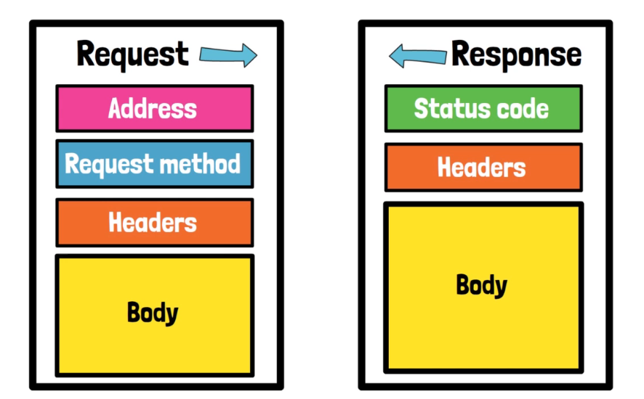

Slide 74
Introduction to Agile and Agile Manifesto:
The Agile Manifesto was created in 2001 by a group of software development experts who gathered in Snowbird, Utah, to discuss lightweight development methods. The result of their discussions was a set of values and principles that prioritize individuals and interactions, working software, customer collaboration, and responding to change over processes and tools. The Agile Manifesto consists of four key values and 12 principles:

Slide 75
Values of the Agile Manifesto:
Individuals and Interactions over Processes and Tools:
Emphasizes the importance of people working together and effective communication over relying solely on tools or rigid processes
Working Software over Comprehensive Documentation:
Prioritizes delivering functional software that meets user needs over extensive documentation that may become outdated.
Customer Collaboration over Contract Negotiation:
Encourages collaboration with customers and stakeholders throughout the development process rather than rigidly adhering to contractual agreements.
Responding to Change over Following a Plan:
Acknowledges that change is inevitable, and the ability to adapt to changing requirements is crucial for project success.

Slide 76
Principles of the Agile Manifesto:
Our highest priority is to satisfy the customer through early and continuous delivery of valuable software.
Welcome changing requirements, even late in development. Agile processes harness change for the customer's competitive advantage.
Deliver working software frequently, with a preference for shorter timescales.
Business people and developers must work together daily throughout the project.
Build projects around motivated individuals. Give them the environment and support they need, and trust them to get the job done.
The most efficient and effective method of conveying information to and within a development team is face-to-face conversation.
Working software is the primary measure of progress.
Agile processes promote sustainable development. The sponsors, developers, and users should be able to maintain a constant pace indefinitely.
Continuous attention to technical excellence and good design enhances agility.
Simplicity--the art of maximizing the amount of work not done--is essential.
The best architectures, requirements, and designs emerge from self-organizing teams.
At regular intervals, the team reflects on how to become more effective, then tunes and adjusts its behavior accordingly.

Slide 77
Introduction to Agile Project Management:
Agile project management is an iterative and flexible approach to managing projects, emphasizing collaboration, adaptability, and customer feedback. It aims to deliver value to customers continuously.
Scrum:
Scrum is an Agile framework that organizes work into time-boxed iterations called sprints. It emphasizes teamwork, accountability, and iterative progress.

Slide 78
Sprint:
A sprint is a fixed time period, typically 2-4 weeks, during which a Scrum team works on a set of prioritized tasks. At the end of each sprint, a potentially shippable product increment is delivered.
Backlog:
The product backlog is a prioritized list of features, enhancements, or user stories that need to be developed. It serves as the source of work for the development team.

Slide 79
User Story:
A user story is a simple, concise description of a feature or functionality from an end-user's perspective. It typically follows the format: "As a [user], I want [feature] so that [benefit]."
In Agile project management, teams use these terms and concepts to plan, prioritize, and track work in a collaborative and iterative manner. JIRA, a widely used project management and issue tracking tool, provides features and workflows to support Agile methodologies like Scrum, enabling teams to manage their sprints, backlogs, epics, user stories, and various issue types effectively.

Slide 80
Learning Agile – The Miscellaneous Concepts
Definition of Done (DoD):
Explanation: The Definition of Done is a clear and agreed-upon set of criteria that a product increment, user story, or task must meet to be considered "Done." It ensures that work is completed to a certain quality standard.
The DoD varies from team to team and can include criteria such as code review, testing, documentation, and integration.
Having a well-defined DoD helps prevent misunderstandings and ensures that everyone on the team understands the expectations for completion.
The DoD is reviewed and updated regularly to reflect evolving quality standards.

Slide 81
Velocity
Explanation: Velocity is a metric used in Agile to measure a team's capacity for work in a sprint. It represents the number of user story points or other units of work completed in a single sprint.
Velocity is calculated by summing up the story points of all completed user stories at the end of a sprint.
It is used for sprint planning and helps the team determine how much work they can commit to in future sprints.
Velocity can vary from sprint to sprint, and teams should not use it for performance evaluation but rather for planning and improving their estimation accuracy.

Slide 82
Burndown Charts:
Explanation: A burndown chart is a visual representation of work remaining (usually in story points or hours) over the course of a sprint. It helps the team track progress and identify potential issues.
The horizontal axis represents time (days of the sprint), while the vertical axis represents work remaining.
A burndown chart starts with a baseline (e.g., the number of story points committed to in the sprint).
As the team completes work, the line on the chart should ideally trend downward toward zero by the end of the sprint.
Burndown charts help teams identify if they are on track to complete the sprint's commitment or if they need to adjust their work plan.

Slide 83
Burn Up Charts:
Burn-Up Charts are visual representations used in Agile project management to track and communicate progress toward a project's goals and objectives over time. These charts provide a clear view of work completed (scope delivered) and how it relates to the total scope defined for a project, release, or iteration. Burn-Up Charts are particularly useful for Agile teams, Product Owners, and stakeholders to understand the progress and manage expectations effectively.
Here's how a Burn-Up Chart works and its key components:
X-Axis (Horizontal): Time is typically represented on the X-axis, which can be divided into days, weeks, or sprints, depending on the project's cadence.
Y-Axis (Vertical): The Y-axis represents the amount of work completed or points achieved. It is often measured in units like story points, work items, or some other metric that reflects the scope of the project.

Slide 84
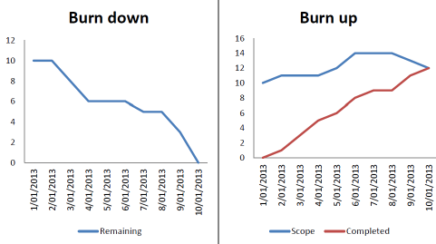

Slide 85
Scrum Ceremonies
Scrum ceremonies are predefined events or meetings in the Scrum framework that provide structure to the Agile development process. These ceremonies help teams collaborate, inspect and adapt their work, and keep stakeholders informed about the project's progress.
There are four primary Scrum ceremonies:

Slide 86
Sprint Planning:
Purpose: Sprint Planning initiates the sprint by selecting the work to be accomplished during the sprint.
Participants: Scrum Team (Product Owner, Scrum Master, Development Team).
Agenda: The Product Owner presents the top-priority items from the Product Backlog, and the Development Team collaborates to select which items they can commit to completing during the sprint. They also define the sprint goal.

Slide 87
Daily Scrum (Daily Standup):
Purpose: Daily Scrum is a daily synchronization meeting where the team discusses progress, plans for the day, and identifies impediments.
Participants: Scrum Team (Development Team, Scrum Master, Product Owner may attend as an observer).
Format: Each team member answers three questions: What did I do yesterday? What will I do today? Are there any impediments?

Slide 88
Sprint Review:
Purpose: Sprint Review is held at the end of the sprint to demonstrate the completed work and gather feedback from stakeholders.
Participants: Scrum Team and stakeholders (e.g., customers, users, management).
Format: The Development Team showcases the Increment (potentially shippable product increment), and stakeholders provide feedback. It also involves a review of the sprint goal.

Slide 89
Sprint Retrospective:
Purpose: Sprint Retrospective is an opportunity for the Scrum Team to reflect on the sprint, identify improvements, and plan for changes in their processes.
Participants: Scrum Team (Development Team, Scrum Master, Product Owner may attend as an observer).
Format: The team discusses what went well, what could be improved, and creates actionable items for process enhancement in the next sprint.

Slide 90
Additionally, some teams may use the following optional ceremonies to enhance collaboration and alignment
Backlog Refinement (Grooming):
Purpose: Backlog Refinement involves reviewing and preparing items in the Product Backlog for future sprints.
Participants: Scrum Team, with a focus on the Product Owner and Development Team.
Agenda: The team discusses, clarifies, and estimates backlog items, ensuring they are well-defined and ready for sprint planning.

Slide 91
Release Planning:
Purpose: Release Planning occurs at the beginning of a project or before a large release, focusing on high-level goals, timelines, and scope.
Participants: Scrum Team, stakeholders, and sometimes external parties.
Agenda: The team defines the overall project vision, identifies key features, and creates a release plan that aligns with business goals.
Product Backlog Refinement:
Purpose: Product Backlog Refinement is an ongoing activity that involves continually grooming and refining the Product Backlog to ensure it is ready for sprint planning.
Participants: Primarily the Product Owner and the Development Team.
Agenda: The Product Owner works on prioritization, clarification, and decomposing backlog items to make them actionable for development.

