Slide 1
Software Testing
QA Course - Batch 1
Prepared by Muhammad Shariq Naeem

Slide 2
Contents
1 | Introduction to SQA | What is SQA?
 |  | Importance of SQA
 |  | Role of SQA
 |  | Principles of Software Testing
 |  | Differences between QA vs. QC vs. Teste
2 | Software Development Lifecycle | SDLC Phases
 |  | SDLC Models
 |  | STLC Phases
3 | Types of Testing | Functional and its sub types
 |  | Non-Functional Testing and its sub types
4 | Testing methods | Black, White, Gray Testing
5 | Testing levels | Unit, Integration, System
6 | Test design, techniques, Execution | Writing Test Cases
 |  | Test Case Design Techniques
 |  | Test Execution Process
7 | Defect Management / Bug Life Cycle | Stages of a defect (new, assigned, fixed, closed, etc.)
 |  | Severity and priority of defects
 |  | Tools for Defect Management
8 | Career Guidance in SQA | Demo interviews for SQA position
 |  | SQA Career Paths
 |  | Building a QA Portfolio
 |  | Certifications in QA

Slide 3
Introduction to SQA
What is SQA?
Software Quality Assurance (SQA) is the practice of monitoring all software engineering processes, activities, and methods used in a project to ensure proper quality of the software and conformance against the defined standards.
Software quality assurance ensures that the software meets the specified quality standards and requirements. This results in software that is more reliable, efficient, and user-friendly
Notes:
Consider talking about:
Defects and failures
Input combinations and preconditions
Economics
Roles

Slide 4
Introduction to SQA
Importance of SQA
It assures that your software product meets quality standards. Since SQA is one of the pillars of successful SDLC, it involves continuous improvement & monitoring so that it can detect and prevent bugs and errors on time. Having a product passed through software QA means the application is ready for public use.
In April 2015, Bloomberg terminal in London crashed due to software glitch affected more than 300,000 traders on financial markets. It forced the government to postpone a 3bn pound debt sale.
Nissan cars recalled over 1 million cars from the market due to software failure in the airbag sensory detectors. There has been reported two accident due to this software failure.
Starbucks was forced to close about 60 percent of stores in the U.S and Canada due to software failure in its POS system. At one point, the store served coffee for free as they were unable to process the transaction.
China Airlines Airbus A300 crashed due to a software bug on April 26, 1994, killing 264 innocents live.
In April of 1999, a software bug caused the failure of a $1.2 billion military satellite launch, the costliest accident in history
In May of 1996, a software bug caused the bank accounts of 823 customers of a major U.S. bank to be credited with 920 million US dollars.
Notes:
Consider talking about:
Defects and failures
Input combinations and preconditions
Economics
Roles

Slide 5
Introduction to SQA
Role of SQA
Aspect | Quality Assurance (QA) | Quality Control (QC) | Testing
Definition | A process-oriented approach focused on preventing defects by improving the development processes. | A product-oriented approach focused on identifying defects in the finished product through inspection. | The execution of code or system to find defects and ensure functionality meets requirements.
Goal | To ensure that the development and maintenance processes are followed to deliver quality products. | To verify that the product meets specified quality standards by identifying defects after production. | To verify that the product works as intended and to find any existing defects.
Focus | Process-driven – improving and optimizing processes to avoid errors. | Product-driven – ensuring that the final product meets the required quality standards. | Execution-driven – executing the product to find defects or bugs.
Notes:
Consider talking about:
Defects and failures
Input combinations and preconditions
Economics
Roles

Slide 6
Introduction to SQA
Role of SQA
Aspect | Quality Assurance (QA) | Quality Control (QC) | Testing
When | Before the development process (preventive activity). | After product development (inspection activity). | Throughout the development cycle, especially during and after the build.
Responsibility | Everyone involved in the development process (managers, developers, etc.). | Dedicated QC team or inspectors. | Testers or QA team.
Examples | - Defining and enforcing processes - Process audits - Training teams on best practices | - Product inspection - Defect identification - Verification of corrections | - Manual or automated test execution - Functional and non-functional testing
Notes:
Consider talking about:
Defects and failures
Input combinations and preconditions
Economics
Roles

Slide 7
Introduction to SQA
Principles of Software Testing 1) Exhaustive testing is not possible(E-commerce website filters) 2) Defect Clustering(Banking app: testers often find that most defects are concentrated in certain areas, such as transaction processing. Due to the complexity) 3) Pesticide Paradox(following same pattern) 4) Testing shows the presence of defects(Testers cannot guarantee the absence of all defects) 5) Absence of Error – fallacy(navigation app: most of the time its not working offline) 6) Early Testing(paper-work, Imagination, finding complex scenarios) 7) Testing is context dependent(banking, app, e-commerce app, gaming app, etc)

Slide 8
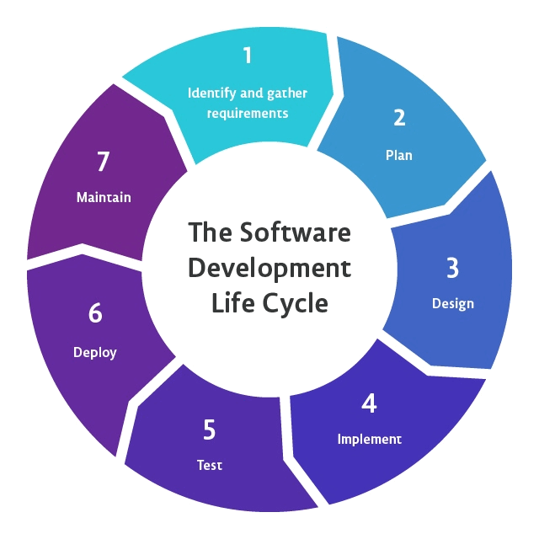
Software Development Lifecycle (SDLC)
Requirement Gathering
Planning
Design/Prototyping
Implement/Development
Testing
Deploy
Maintenance
Notes:
Consider talking about:
Static, dynamic and passive testing
Exploratory approach
The "box" approach

Slide 9
Software Development Lifecycle (SDLC) AS QA
Requirement Gathering
Activities: Analyze business and functional requirements, Identify ambiguities
Deliverables: Requirement Traceability Matrix (RTM)
Planning
Activities: Develop the overall test plan, identify test resources, timelines, and scope, Risk assessment
Deliverables: Test Strategy/Plan, Test Estimations, Risk Mitigation Plan
Notes:
Consider talking about:
Unit testing
Integration testing
System testing
Operational acceptance testing

Slide 10
Software Development Lifecycle (SDLC) AS QA
Design/Prototyping
Activities: Review design documents, Identify test scenarios based on design
Deliverables: Test Scenarios, Test Cases based on high-level design and requirements
Implement/Development
Activities: QA begins creating detailed test cases, Define test environment, and prepare test data
Deliverables: - Detailed Test Cases, Test Data
Notes:
Consider talking about:
Unit testing
Integration testing
System testing
Operational acceptance testing

Slide 11
Software Development Lifecycle (SDLC) AS QA
Testing
Activities: Execute test cases (manual/automated), Perform different types of testing
Deliverables: Test Execution Report, Defect Logs, Test Summary Report
Deployment
Activities: Conduct smoke testing, Verify that the system is stable and functioning in the production environment
Deliverables: Smoke Test Results, Go/No-Go Decision
Notes:
Consider talking about:
Unit testing
Integration testing
System testing
Operational acceptance testing

Slide 12
Software Development Lifecycle (SDLC) AS QA
Maintenance
Activities: Perform regression testing for patches and updates, Monitor system for issues post-deployment
Deliverables: Post-Production Test Reports, Regression Test Results
Notes:
Consider talking about:
Unit testing
Integration testing
System testing
Operational acceptance testing

Slide 13
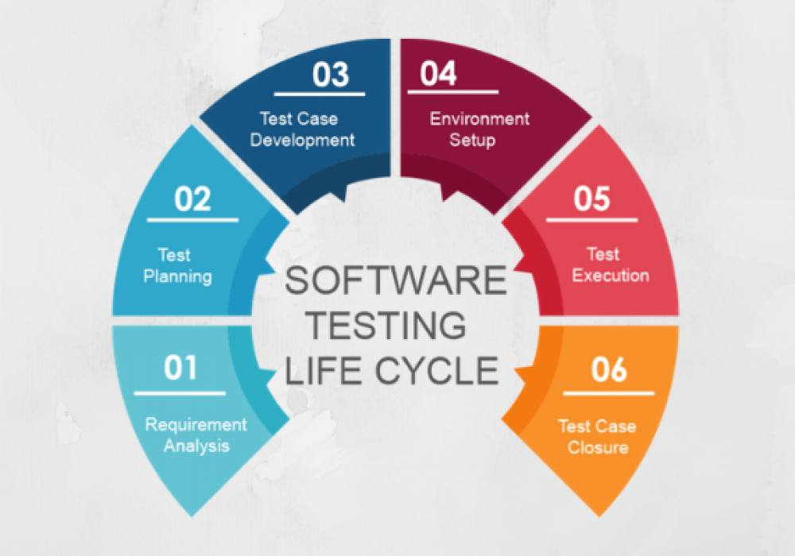
Software Testing Lifecycle (STLC)
Requirement Analysis
Test Planning
Test Case Development
Environment Setup
Test Execution
Test Cycle Closure
Notes:
Consider talking about:
Static, dynamic and passive testing
Exploratory approach
The "box" approach

Slide 14
Software Testing Lifecycle (STLC)
STLC Phase | Key Objective | Deliverables
Requirement Analysis | Understand testing requirements | Requirements Traceability Matrix
Test Planning | Plan and organize testing activities | Test Plan, Effort Estimation
Test Case Development | Design detailed test cases and prepare data | Test Cases, Test Data
Test Environment Setup | Set up the necessary testing environment | Test Environment, Smoke Test Results
Test Execution | Execute test cases and report defects | Test Execution Report, Defect Logs
Test Cycle Closure | Finalize testing and report results | Test Summary Report, Metrics
Summary of STLC Phases
Notes:
Consider talking about:
Unit testing
Integration testing
System testing
Operational acceptance testing

Slide 15
SDLC Models
Waterfall Model
V-shaped Model
Incremental Model
Spiral Model
Agile Model
Notes:
Consider talking about:
Traditional waterfall development model
Agile or XP development model
A sample testing cycle

Slide 16
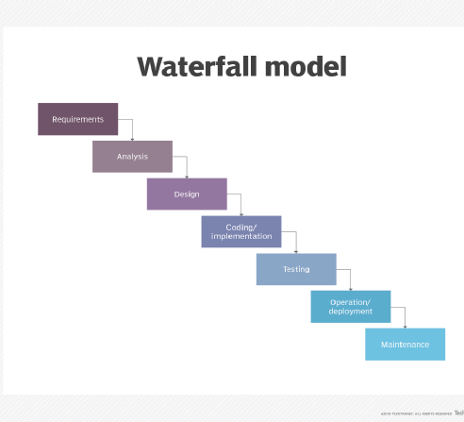
Waterfall Model
The waterfall model is a sequential software development process in which development is seen as flowing steadily downwards (like a waterfall) through the phases of requirements gathering, analysis, design, implementation, testing (validation), and maintenance
Notes:
Consider talking about:
Installation testing
Compatibility testing
Smoke and sanity testing
Regression testing
Acceptance testing
Alpha testing
Beta testing
Functional vs non-functional testing
Continuous testing
Destructive testing

Slide 17
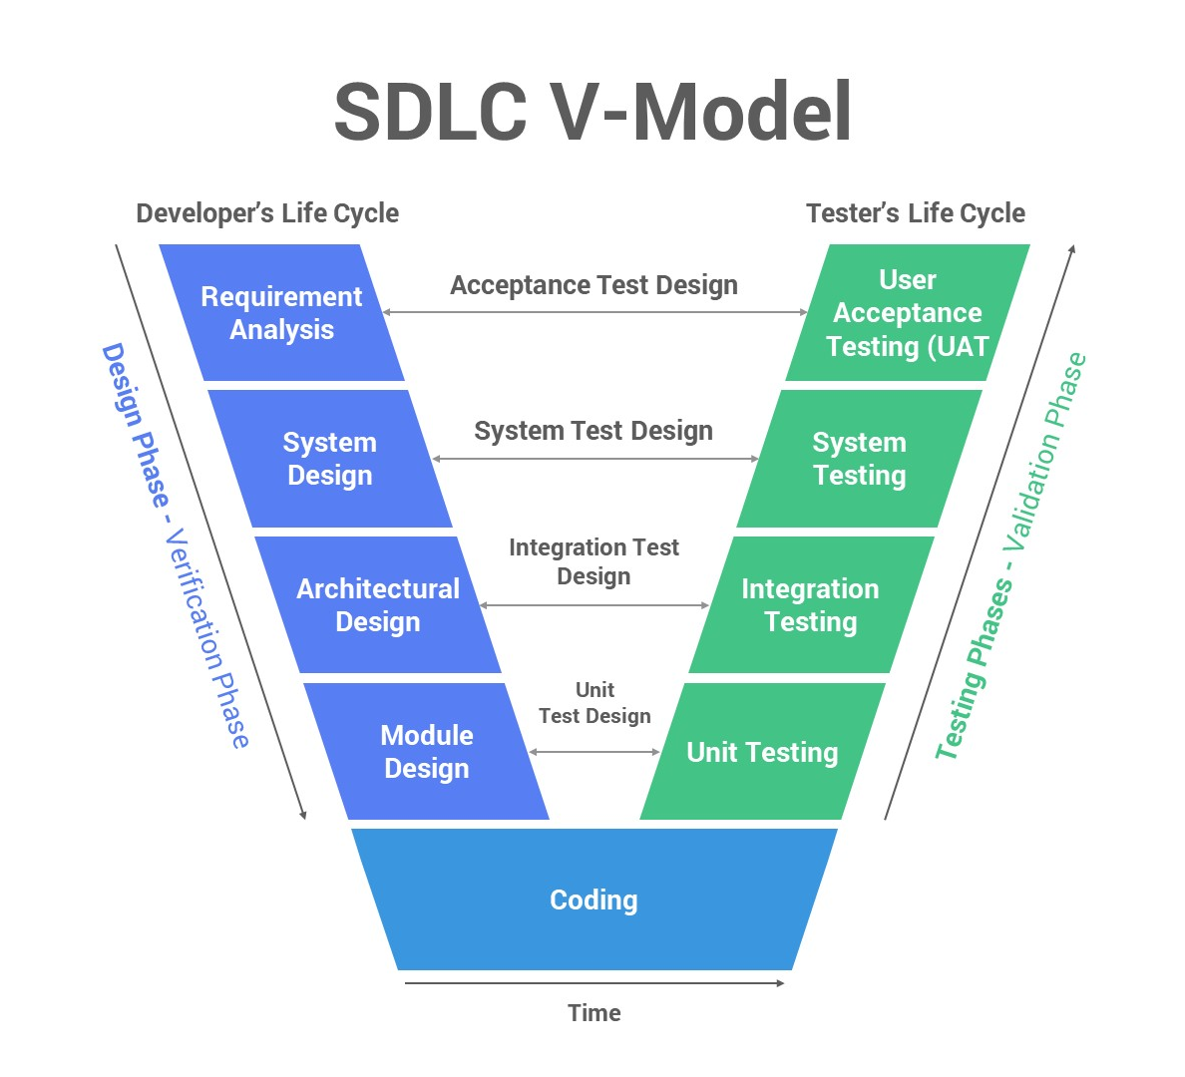
V-Shaped Model
Also known as the Verification and Validation Model, it is a sequential model that goes through each required phase of software development, from planning to coding to testing. The main advantage of the V-Model is that it provides a clear and concise roadmap for each stage of development, making it easy to track progress and ensure quality control.
Notes:
Consider talking about:
Installation testing
Compatibility testing
Smoke and sanity testing
Regression testing
Acceptance testing
Alpha testing
Beta testing
Functional vs non-functional testing
Continuous testing
Destructive testing

Slide 18
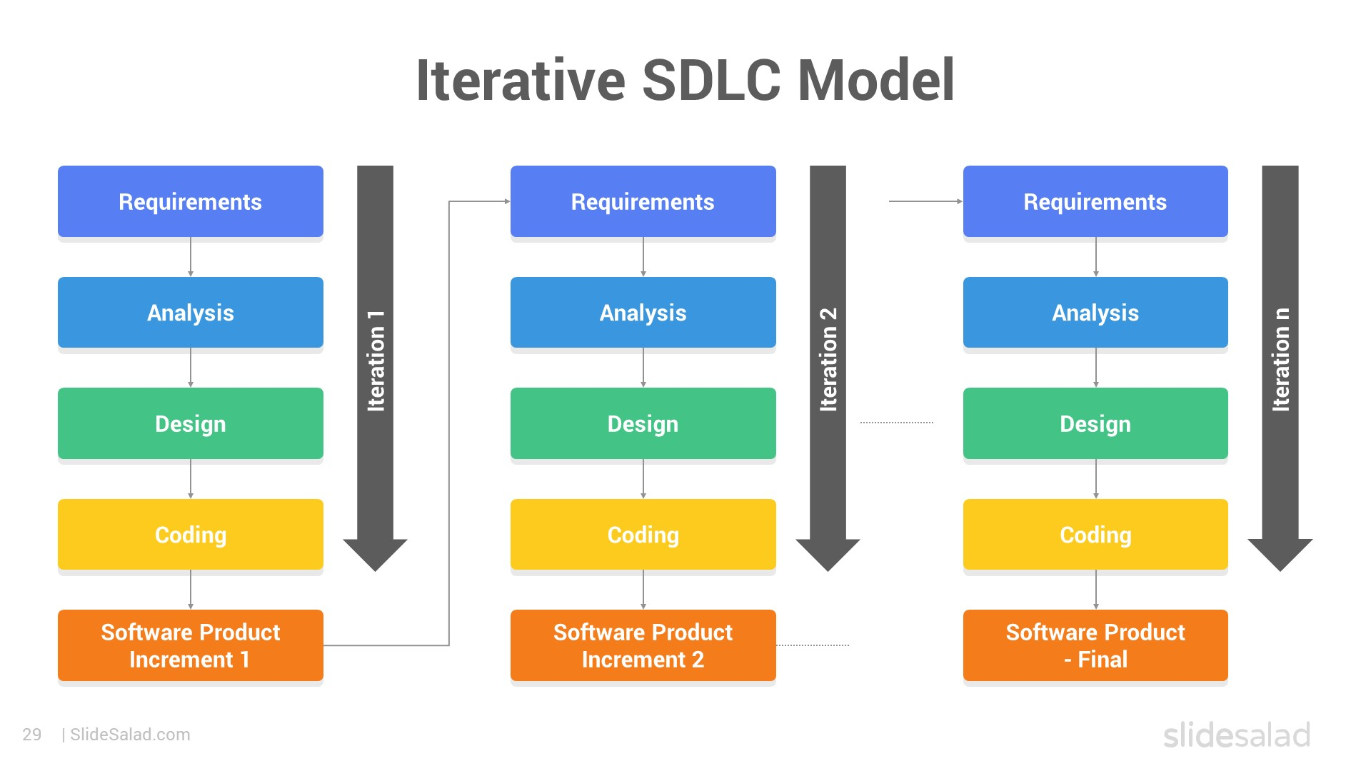
Iterative Model
The iterative SDLC Model is a software development process that combines the best aspects of the waterfall and agile models. The result is a process that is more flexible and responsive to change than the traditional waterfall model but which still provides the discipline and structure necessary to complete large-scale projects successfully.
Notes:
Consider talking about:
Installation testing
Compatibility testing
Smoke and sanity testing
Regression testing
Acceptance testing
Alpha testing
Beta testing
Functional vs non-functional testing
Continuous testing
Destructive testing

Slide 19
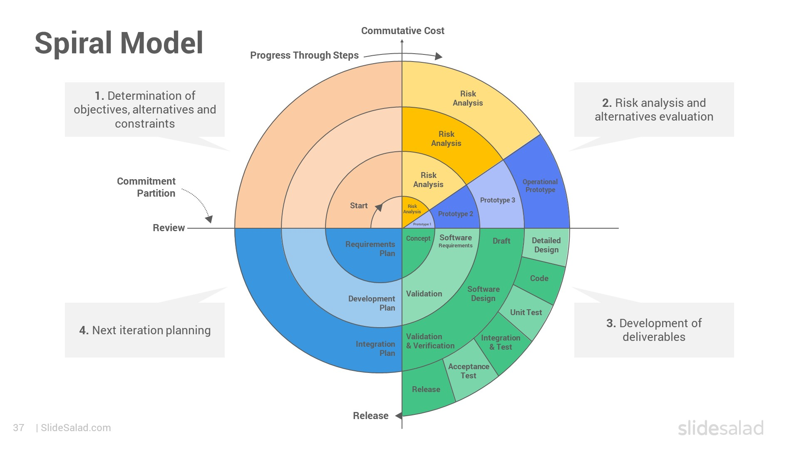
Spiral Model
The spiral model is a risk-driven process model generator for software projects.
You can adapt the process to the unique risks of your project.
You can deliver your project in small increments, allowing for changes and refinements along the way.
You can track progress and management through each stage of development.
Notes:
Consider talking about:
Installation testing
Compatibility testing
Smoke and sanity testing
Regression testing
Acceptance testing
Alpha testing
Beta testing
Functional vs non-functional testing
Continuous testing
Destructive testing

Slide 20
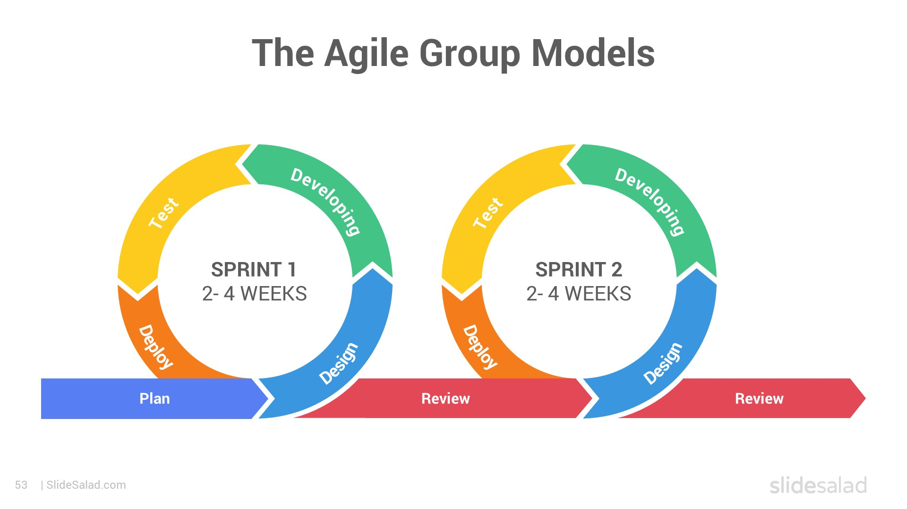
Agile Model
The Agile models are iterative and incremental software development models that emphasize flexibility and customer collaboration.
The Agile models include Extreme Programming (XP), Scrum, and Lean Software Development.
The Agile models have helped organizations improve their software development processes by increasing transparency and communication, decreasing bureaucracy, and improving project management.
Notes:
Consider talking about:
Installation testing
Compatibility testing
Smoke and sanity testing
Regression testing
Acceptance testing
Alpha testing
Beta testing
Functional vs non-functional testing
Continuous testing
Destructive testing

Slide 21
Comparison of SDLC Models
Model | Best For | Key Feature | Drawbacks
Waterfall | Projects with stable requirements | Linear, simple to manage | Not flexible to changes
V-Model | Projects needing verification at each stage | Testing integrated into each phase | Same as Waterfall, rigid structure
Iterative | Large projects with evolving needs | Repeated cycles of improvement | Can lead to scope creep
Spiral | High-risk projects with uncertainty | Risk management and iterative | Can be expensive, complex
Agile | Projects with frequent requirement changes | Flexibility and collaboration | Requires continuous stakeholder involvement
Notes:
Consider talking about:
Testing tools

Slide 22
Types of software testing
Functional Testing
Functional testing verifies that each software function operates according to the specified requirements. It tests the behavior of the software against the functional specifications.
Purpose: To ensure that the software behaves as expected.
Focus: Testing user interactions, features, and business logic.
Types of Functional Testing:
Smoke Testing
Sanity Testing
Regression Testing
Retesting
Notes:
Consider talking about:
Hierarchy of testing difficulty

Slide 23
Types of software testing
Non-Functional Testing
Non-functional testing evaluates aspects of the software that are not related to specific behaviors or functionalities. It focuses on non-functional attributes such as performance, usability, and security.
Purpose: To ensure the software's performance, reliability, and quality.
Focus: Testing system attributes that affect user experience.
Types of Non-Functional Testing:
Performance Testing
Usability Testing
Compatibility Testing
Security Testing … etc
Notes:
Consider talking about:
Hierarchy of testing difficulty

Slide 24
Key Differences Between Functional and Non-Functional Testing
Aspect | Functional Testing | Non-Functional Testing
Objective | Verify that the software functions as expected | Assess software's performance and quality attributes
Focus | Features, functionality, and business logic | Performance, usability, security, and other attributes
Types of Testing | Smoke, Sanity, Regression, etc | Performance, Usability, Security, Compatibility
Testing Basis | Requirements and specifications | Quality standards, expectations, and benchmarks
Examples | Testing login, form submissions, calculations | Testing load times, handling of high traffic, security
Tools Used | Selenium, QTP, TestComplete | JMeter, LoadRunner, OWASP ZAP
Output | Ensures functionalities work as expected | Ensures the software meets performance requirements

Slide 25
Functional Testing
Smoke Testing is a preliminary test to check whether the basic functionalities of an application are working correctly. It is also known as "Build Verification Testing.”
Sanity Testing is a narrow regression test that focuses on specific functionalities of an application. It ensures that a small section of the application works as expected after minor changes or bug fixes.
Regression Testing involves re-running functional and non-functional tests to ensure that previously developed and tested software still works after changes (e.g., new features, enhancements, bug fixes).
Retesting is a process of testing a specific defect after it has been fixed to verify that the issue is resolved.

Slide 26
Key Differences Between Smoke, Sanity, Regression, and Retesting
Aspect | Smoke Testing | Sanity Testing | Regression Testing | Retesting
Purpose | To verify if the build is stable | To verify specific functionality or bug | To ensure new changes do not affect existing features | To check if specific defects are fixed
Coverage | High-level, basic functionalities | Narrow, focused on particular functions | Broad, including all affected and unaffected areas | Limited to defect-specific test cases
Execution Time | Quick, takes a short amount of time | Quick, focuses only on recent changes | Takes longer, as it covers the entire application | Varies, depending on the complexity of the defect
When Performed | After a new build is released | After minor changes or bug fixes | After new features, enhancements, or major bug fixes | After a defect fix
Automation Possibility | Can be automated | Generally manual | Can be automated | Generally manual
Example | Checking if the app launches successfully | Verifying the specific bug fix | Testing all functionalities after a new module is added | Checking the functionality of a fixed button

Slide 27
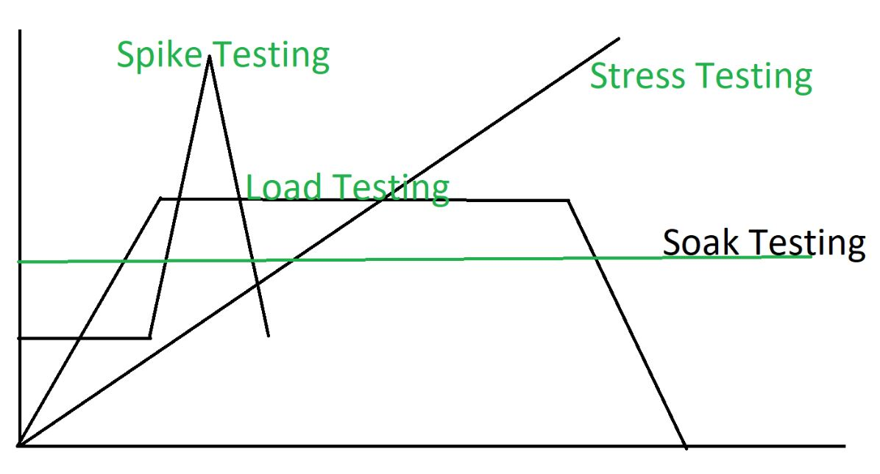
Non-Functional Testing
Performance Testing: To evaluate the system's responsiveness, stability, and speed under different load conditions.
Load Testing: Tests the system's behavior under expected load to identify any performance bottlenecks.
Stress Testing: Puts the system under extreme conditions(Greater than expected load) to assess its stability and error-handling capabilities.
Spike Testing: Tests the system's response to a sudden, sharp increase in load
Soak/Endurance Testing: Checks the system's performance over a prolonged period to detect memory leaks or degradation.

Slide 28
Non-Functional Testing
Usability Testing: To evaluate how user-friendly and intuitive the application is for end-users.
Compatibility Testing: To ensure that the application works as intended across different devices, operating systems, browsers, and hardware configurations.
Security Testing: To identify vulnerabilities and weaknesses in the software to prevent unauthorized access, data breaches, and other security threats.
Accessibility Testing: To ensure the software is usable for people with disabilities, such as those with visual or hearing impairments.

Slide 29

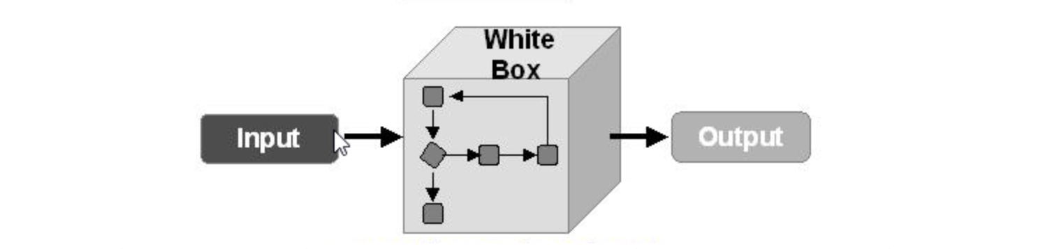
Testing Methods
Black Box Testing is done without knowledge of the system's internal code, structure, or implementation.
White Box Testing is performed with full knowledge of the internal code, structure, and implementation of the system.
Grey Box Testing is a combination of Black Box and White Box Testing; the tester has limited knowledge of the internal code.

Slide 30
Key Differences Between Black Box, White Box, and Grey Box Testing Methods
Methods | Description | Tester’s Knowledge | Focus | Example
Black Box Testing | Testing is done without any knowledge of the internal code, structure, or implementation of the system. | Tester only knows the input and expected output but does not know how the system processes the input. | Functional requirements and external behavior of the application. | Testing a login form by entering valid and invalid user credentials.
White Box Testing | Testing is performed with full knowledge of the internal code, structure, and implementation of the system. | Tester has access to the code and is aware of the internal workings and logic. | Code structure, internal paths, and flow of logic. | Testing individual functions, loops, or statements in a program (e.g., unit testing).
Grey Box Testing | A combination of Black Box and White Box Testing; the tester has limited knowledge of the internal code. | Tester has some understanding of the internal code and uses that knowledge to design better test cases. | Functional behavior and some aspects of internal implementation. | Testing a web application by understanding how the database interacts with the front end.

Slide 31
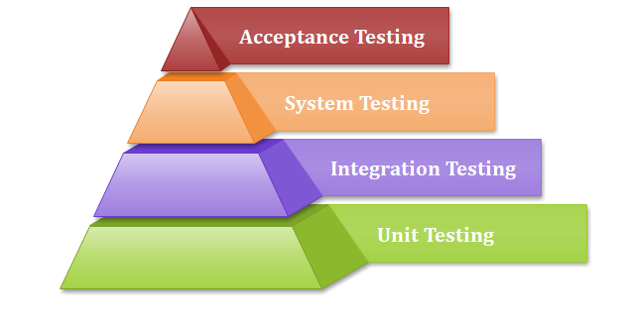
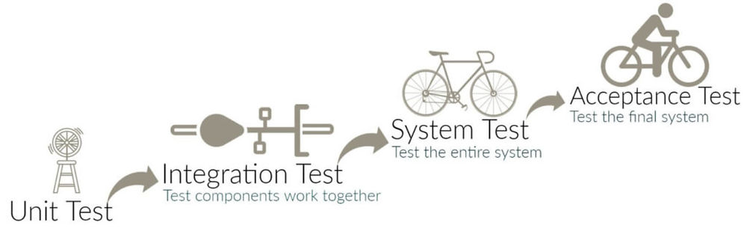
Testing LEVELS
EXAMPLES
Unit Testing: Testing individual components or functions of the software in isolation.
Integration Testing: Testing the interactions and data flow between integrated units or modules.
System Testing: Testing the entire system to ensure that it is working as per the expectations
Acceptance Testing: Testing is conducted to determine if the system meets the business requirements and is ready for the end-users.

Slide 32
Key Differences Between Unit, Integration, System, and Acceptance Testing
Testing Level | Description | Purpose | Scope | Example
Unit Testing | Testing individual components or functions of the software in isolation. | To ensure that each unit of code works as expected. | Narrow - focuses on a single function or module. | Testing a function that calculates the sum of two numbers.
Integration Testing | Testing the interactions and data flow between integrated units or modules. | To verify that components work together as expected. | Medium - covers integrated modules. | Testing an API that interacts with a database to ensure data is stored correctly.
System Testing | Testing the entire system as a whole to ensure that it meets the specified requirements. | To validate the end-to-end functionality of the complete system. | Broad - covers the entire application. | Testing an e-commerce website’s complete purchase workflow, from product search to payment.
Acceptance Testing | Testing conducted to determine if the system meets the business requirements and is ready for release to end-users. | To validate the system's compliance with business requirements. | Wide - involves testing real-world scenarios. | Running user acceptance tests to ensure that a new feature works as expected for end-users.

Slide 33
Test design, techniques, Execution
Test Scenarios are high-level descriptions of what needs to be tested. They represent a specific functionality or feature and help guide the testing process.
Example: For a login feature, test scenarios might include:
Successful Login: User enters valid credentials and gains access.
Invalid Password: User enters a valid username but an invalid password.
Username Not Found: User tries to log in with a username that doesn't exist.
Password Recovery: User requests a password reset.
Notes:
Consider talking about:
Software verification and validation
Software quality assurance

Slide 34
Test design, techniques, Execution
Test Cases are detailed, step-by-step instructions for testing a specific aspect of a scenario. They include all the necessary information to execute the test and verify the results.
Structure: A typical test case includes:
Test Case ID: Unique identifier.
Test Case Description: What the test case will verify.
Preconditions: Any setup or prerequisites needed before executing the test.
Test Steps: Detailed actions to perform.
Expected Result: What the outcome should be.
Actual Result: What happened during testing (filled after execution).
Status: Pass/Fail based on the comparison of expected and actual results.
Notes:
Consider talking about:
Software verification and validation
Software quality assurance

Slide 35
Test design, techniques, Execution
Example: For the scenario "Successful Login," a corresponding test case might look like this:
Test Case ID: TC001
Test Case Description: Verify user can successfully log in with valid credentials.
Preconditions: User is on the login page and has a registered account.
Test Steps:
Enter a valid username in the username field.
Enter a valid password in the password field.
Click the "Login" button.
Expected Result: User is redirected to the dashboard/homepage.
Actual Result: (To be filled during testing)
Status: (Pass/Fail)
Notes:
Consider talking about:
Software verification and validation
Software quality assurance

Slide 36
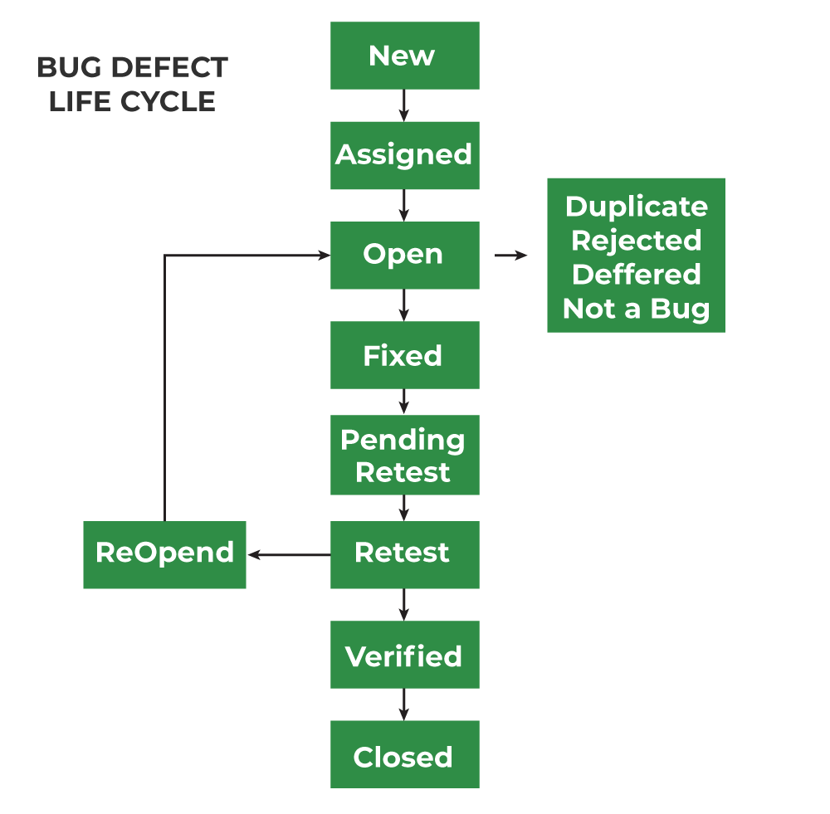
Bug🐞 Lifecycle

Slide 37
Bug🐞 Lifecycle
Phase | Description
1. New | A bug is identified and reported. It is in the "New" state until it is reviewed.
2. Assigned | The bug is assigned to a developer or team for further investigation.
3. Open | The developer starts analyzing and working on fixing the bug.
4. Fixed | The developer has made changes to fix the bug, and it is now marked as "Fixed."
5. Pending Retest | The fix is deployed to a test environment, and the bug is ready for retesting.
6. Retesting | The QA team retests the bug to verify the fix.
7. Verified | If the bug is no longer reproducible, it is marked as "Verified."
8. Closed | The bug is confirmed as resolved and closed after verification.
Optional: Reopen | If the bug persists or resurfaces, it is reopened and goes through the cycle again.
Optional: Deferred | The bug is postponed due to low priority or other reasons, to be fixed later.
Optional: Rejected | The bug is not valid or cannot be reproduced, and is marked as "Rejected."

Slide 38
Bug Lifecycle
Report the Bug with the Following Details:
Title/Summary: A brief and clear title summarizing the issue (e.g., "Login page fails for valid credentials").
Description: A detailed explanation of the issue.
Steps to Reproduce: A step-by-step guide on how to reproduce the issue.
Expected Result: What the application should do if working correctly.
Actual Result: What actually happened when the issue occurred.
Severity and Priority: Assign the bug's impact level (e.g., critical, high, medium, low).
Environment Details: Specify the operating system, browser, device, or app version.
Screenshots/Videos: Attach visual evidence to help developers understand the problem.
Logs: Include console or error logs, if applicable.

