Slide 1
FCODEX SOLUTION
Data Base

Slide 2
Table of content
Introduction
ER Diagram
Normalization
Report
In this section we give the details introduction
Of the our project.
In this section we make a ER diagram of our project
In this section we explain the normalization and structure database
This is the most important part or out presentation it includes
Queries
Output

Slide 3
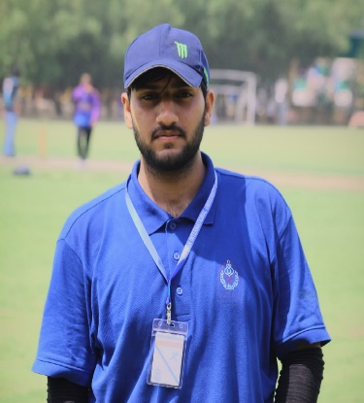





Group member
Ahmed mujtaba
Mustafa khan
26617
27015
Muhammad yousaf
27014
Notes:
Photo by Yucel Moran on Unsplash
Photo by sean Kong on Unsplash
Photo by Caique Silva on Unsplash

Slide 4
Introduction
In this project we make the database of a software house. As we know that we have employees in software house also they work on some project so we need to maintain the record of the employees and the record of the project in which they are working.
Also maintain the record of their salary and the record of the teams in a software house.

Slide 5
ER diagram
We make this diagram on draw.io software

Slide 6
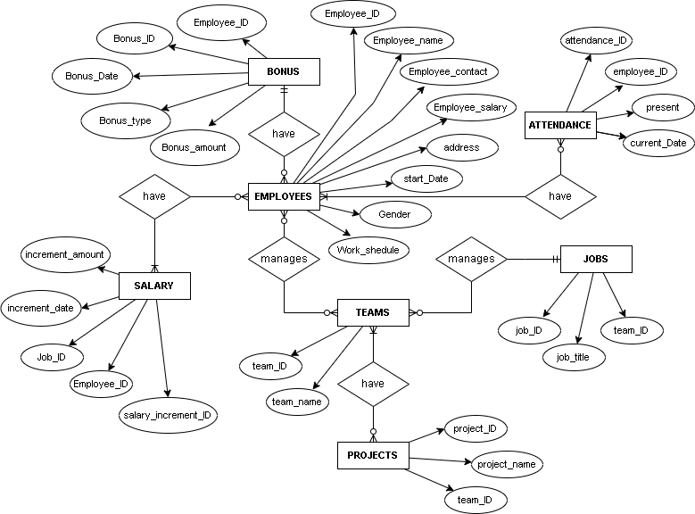

Slide 7
Normalization
First normal form
Third normal form
Second normal form
We achieved the first normal form from by keeping the data scalar.
Coming to second normal form we tried to make the relationships depends on the primary key.
On third normal form for , we make sure that all the dependencies are only on the primary key of the tables.
Now the this database is structure database

Slide 8
Report
In this section we have two parts
Queries
Out put

Slide 9
QUERY 1
SELECT employees.employee_id, employees.employee_name , attendance.attendance, attendance.current_date
FROM employees
inner JOIN attendance
ON employees.attendance_id=attendance.attendance_id
order by employee_id

Slide 10
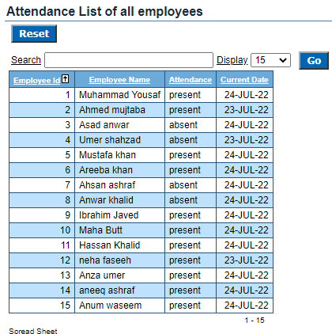
Out put

Slide 11
QUERY 2
SELECT employees.employee_id as ID, employees.employee_name as Name, jobs.job_title as "job description" ,team.team_name "team member"
FROM employees
inner join jobs
on employees.job_id=jobs.job_id
inner join team
on team.team_id=jobs.team_id
order by employee_id

Slide 12
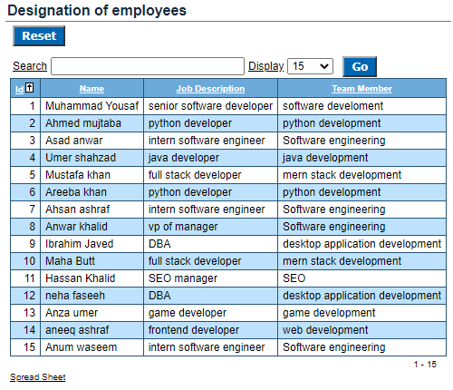
Out put

Slide 13
QUERY 3
SELECT employees.employee_id as ID, employees.employee_name as Name,employees.employee_salary "actual salary", bonus.bonus_amount+employees.employee_salary "with bonus" ,bonus_type
FROM employees
inner join bonus
on employees.bonus_id=bonus.bonus_id
order by employee_id

Slide 14
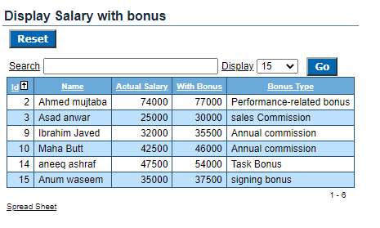
Out put

Slide 15
QUERY 4
SELECT employees.employee_id as ID, employees.employee_name as name ,employees.employee_salary+(employees.employee_salary*(5/100)) Salary, employees.start_date "Date of Join"
FROM employees
where start_date<('1-jan-22')

Slide 16
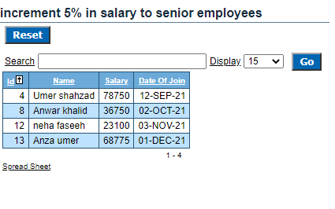
Out put

Slide 17
QUERY 5
select team.team_id, team.team_name,project.project_name,project.project_start_date,project.project_end_date
from team
inner join project
on team.team_id=project.team_id
AND project_end_date<('24-jul-22')
order by team_id

Slide 18
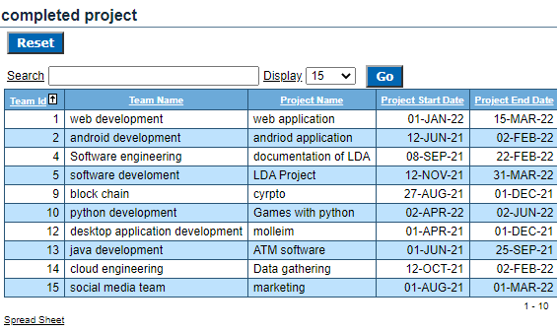
Out put

Slide 19
QUERY 6
SELECT employees.employee_id ID,employees.employee_name ||' is team member of '||team.team_name "Employees with team" ,project.project_name "Project",project.project_start_date"Date of start",project.project_end_date"Date of end"
FROM employees
inner join project
on employees.project_id=project.project_id
inner join team
on team.team_id=project.team_id
order by employee_id

Slide 20
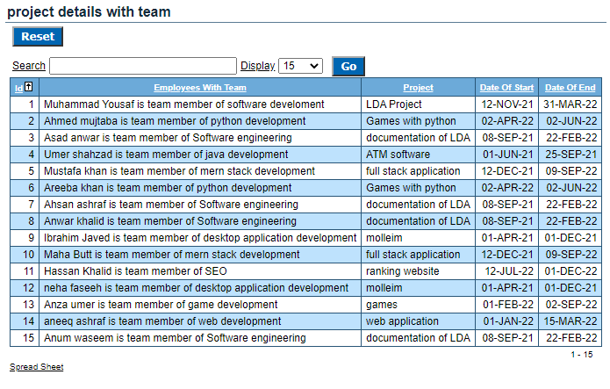
Out put

Slide 21
QUERY 7
select employees.employee_id ID, employees.employee_name Name,employees.gender, project.project_name "working on project",jobs.job_title"Designation",team.team_name"Member of team",project.project_start_date"Project start date",project.project_end_date"Project end date"
from employees
inner join project
on employees.project_id=project.project_id AND gender='female'
join team
on employees.team_id=team.team_id
join jobs
on employees.job_id=jobs.job_id AND jobs.job_title='DBA'
order by employee_id

Slide 22
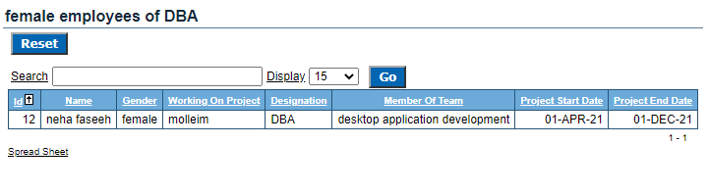
Out put

Slide 23
QUERY 8
select attendance.employee_id"ID" ,employees.employee_name "Name",attendance.attendance,attendance.current_date"Date of absent",team.team_name"Team"
from attendance,employees,team
where
employees.attendance_id=attendance.employee_id AND
employees.team_id=team.team_id AND
attendance.attendance='absent'
AND attendance.current_date=('24-jul-22');

Slide 24
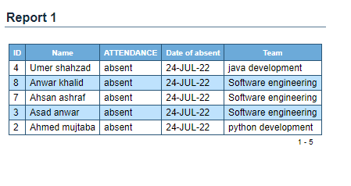
Out put

Slide 25
Thank you

