Slide 1
Information Security Project
Steganography
Audio Steganography using LSB algorithm the
Embedding and Extracting process
Title Page
Tell all bout encoding and decoding
Project name, member names
LSB Algorithm
What is steganography
Tell the all bout algorithm
Tell the history and why we use it.

Slide 2
Title Page
Audio Steganography
Steganography is a means of concealing secret information within an ordinary, non-secret document or other media to avoid detection
Ahmed Mujtaba 26617 Muhammad Yousaf 27014

Slide 3
Steganography
Steganography is the technique of hiding data within an ordinary, non-secret file or message to avoid detection Greek words stegnos, which means “hidden,” and graph, which means “to write.” Hence, “hidden writing.” Similar to cryptography but it is different.
Earlier kings used these methods, and now hackers and cyber experts use these methods.
Confidentiality
Not Revealing Information

Slide 4
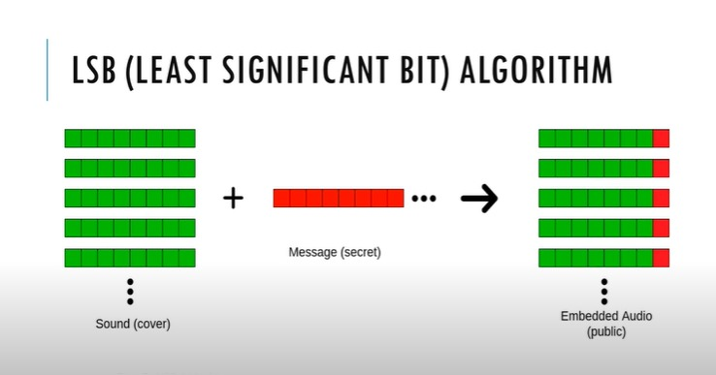
Least Significant Bit

Slide 5
Embedding Process
Replace LSB of the Data with secrete message
Input Audio
Separate Header and Data
Stegno Audio

Slide 6
Extracting Process
1
2
3
4
5
Separate Header and Data
Store the LSB of Data
Binary to ASCII
Extracted Text
Stegno Audio

Slide 7
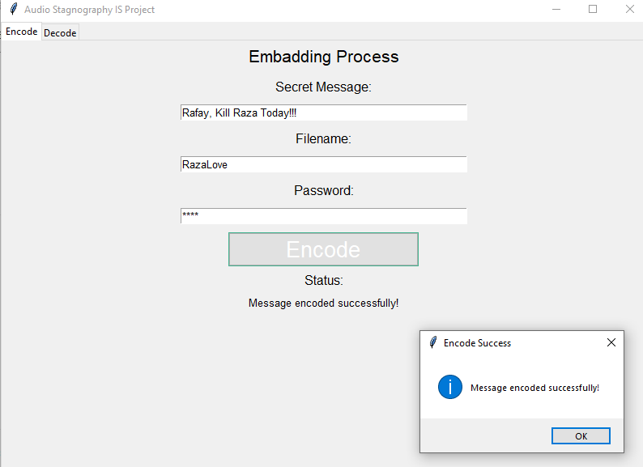

Slide 8
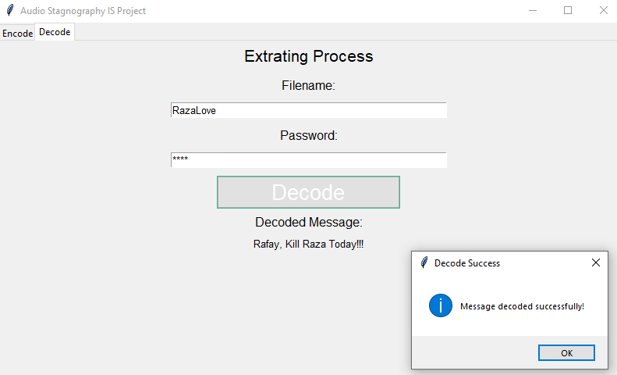

Slide 9
Questions?

