Slide 1
CE-408 · CLOUD COMPUTING · 8TH SEMESTER
Auto-Scaling E-Commerce Backend
with Chaos Engineering
A resilient, self-healing microservices backend on AWS, proven under load and deliberate failure.
PROJECT TEAM
Ahmed Musharaf (2022067)
Abdullah Saeed (2022329)
Abdullah Zafar (2022328)
INSTRUCTOR
Miss Safia Baloch
LIVE DEMO
S3-hosted GIKI Mart storefront

Slide 2
MOTIVATION
02 / 10
The Problem & Our Objectives
THE PROBLEM
CHAOS ENGINEERING
▪ Cloud apps fail in unpredictable ways: tasks die, dependencies slow down, traffic spikes without warning.
▪ Most teams only discover these weak points during a real outage, in front of real users.
▪ Resilience cannot be assumed. It has to be engineered and measured.
▪ Definition. Deliberately injecting failure into a system to expose weaknesses before they cause outages.
▪ Inspiration. AWS Architecture Blog: Chaos Engineering in the Cloud.
▪ Our approach. Two repeatable experiments: killing a live task, and injecting latency into one service.
▪ Goal. Zero user-visible 5xx errors, even while the system is actively failing.
OUR OBJECTIVES
▪ Build a 3-service e-commerce backend on AWS Fargate.
▪ Make it auto-scale on demand and self-heal on failure.
▪ Prove resilience with controlled chaos experiments.

Slide 3
DESIGN
03 / 10
System Architecture
▪ Single entry point. An Application Load Balancer routes every request by path.
▪ Path-based routing. /catalog/*, /cart/* and /orders/* each hit their own service.
▪ Independent services. Three Fargate services, each owning its own data store.
▪ Async fulfilment. Orders drop a message on SQS for downstream processing.
REQUEST FLOW
Browser
Customer device
↓
S3 Storefront
Static GIKI Mart site
↓
Application Load Balancer
Path-based routing
SERVICE MAPPING
↓
Fargate × 3
Catalog · Cart · Orders
Service
Compute
Data store
Catalog
Fargate
RDS Postgres
↓
RDS · DynamoDB · SQS
Per-service data layer
Cart
Fargate
DynamoDB
Orders
Fargate
RDS Postgres + SQS

Slide 4
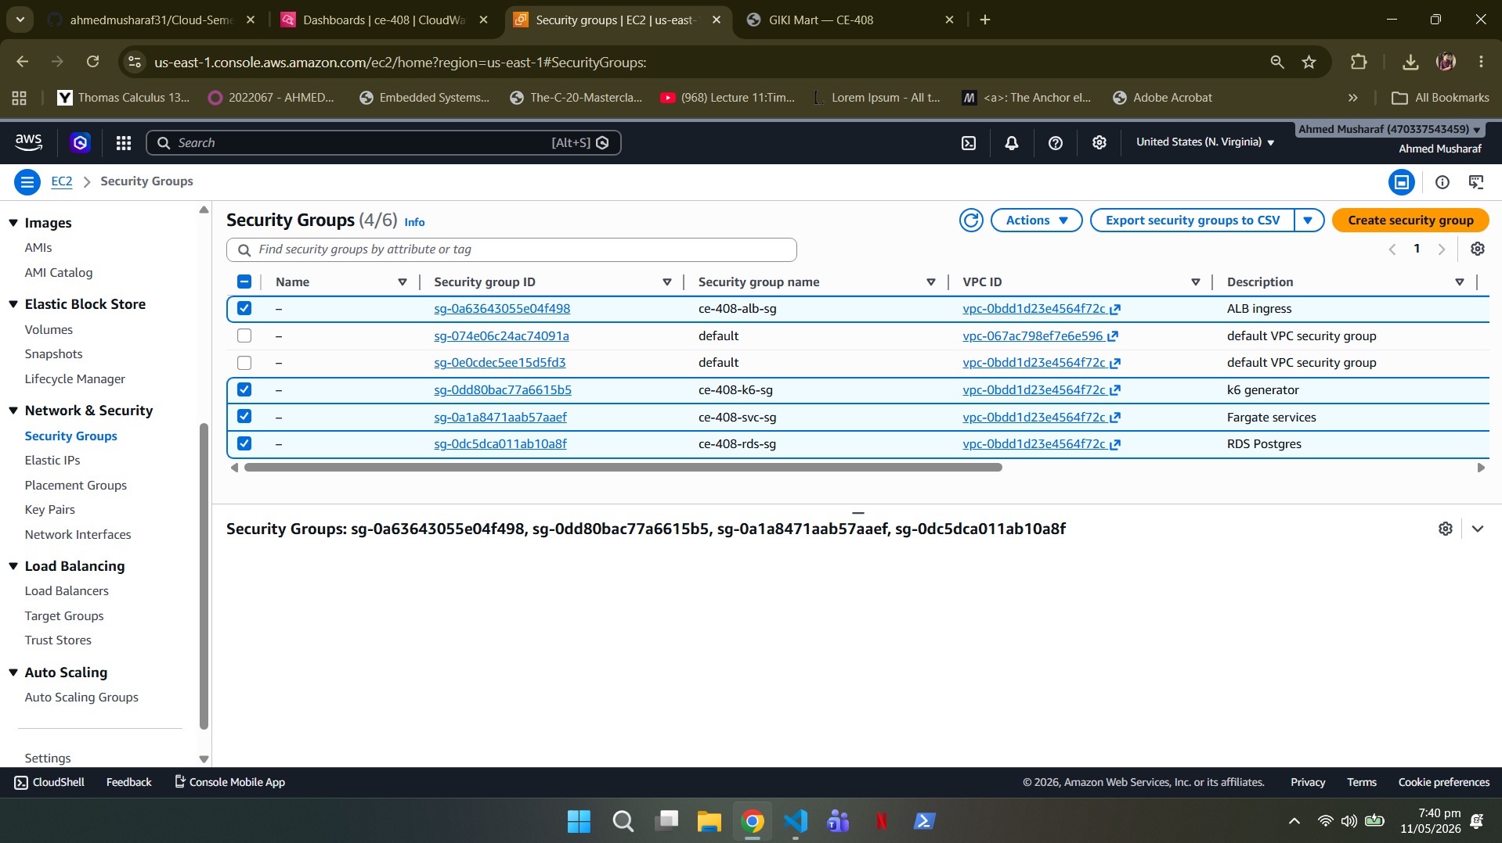
FOUNDATION
04 / 10
AWS Infrastructure & Networking
▪ VPC. 10.0.0.0/16 across 2 Availability Zones: 2 public and 2 private subnets.
▪ Isolation. Services and databases sit in private subnets; only the ALB is public-facing.
▪ Security groups. Four tiered SGs: ALB, services, RDS and the k6 load generator: each allowing only what it must.
▪ Compute. ECS Fargate cluster, 0.25 vCPU / 0.5 GB per task, pulled from ECR.
▪ Single NAT gateway. One NAT in a single AZ keeps egress working while controlling cost.
Tiered security groups in the AWS console: ALB, VPC, services and RDS.

Slide 5
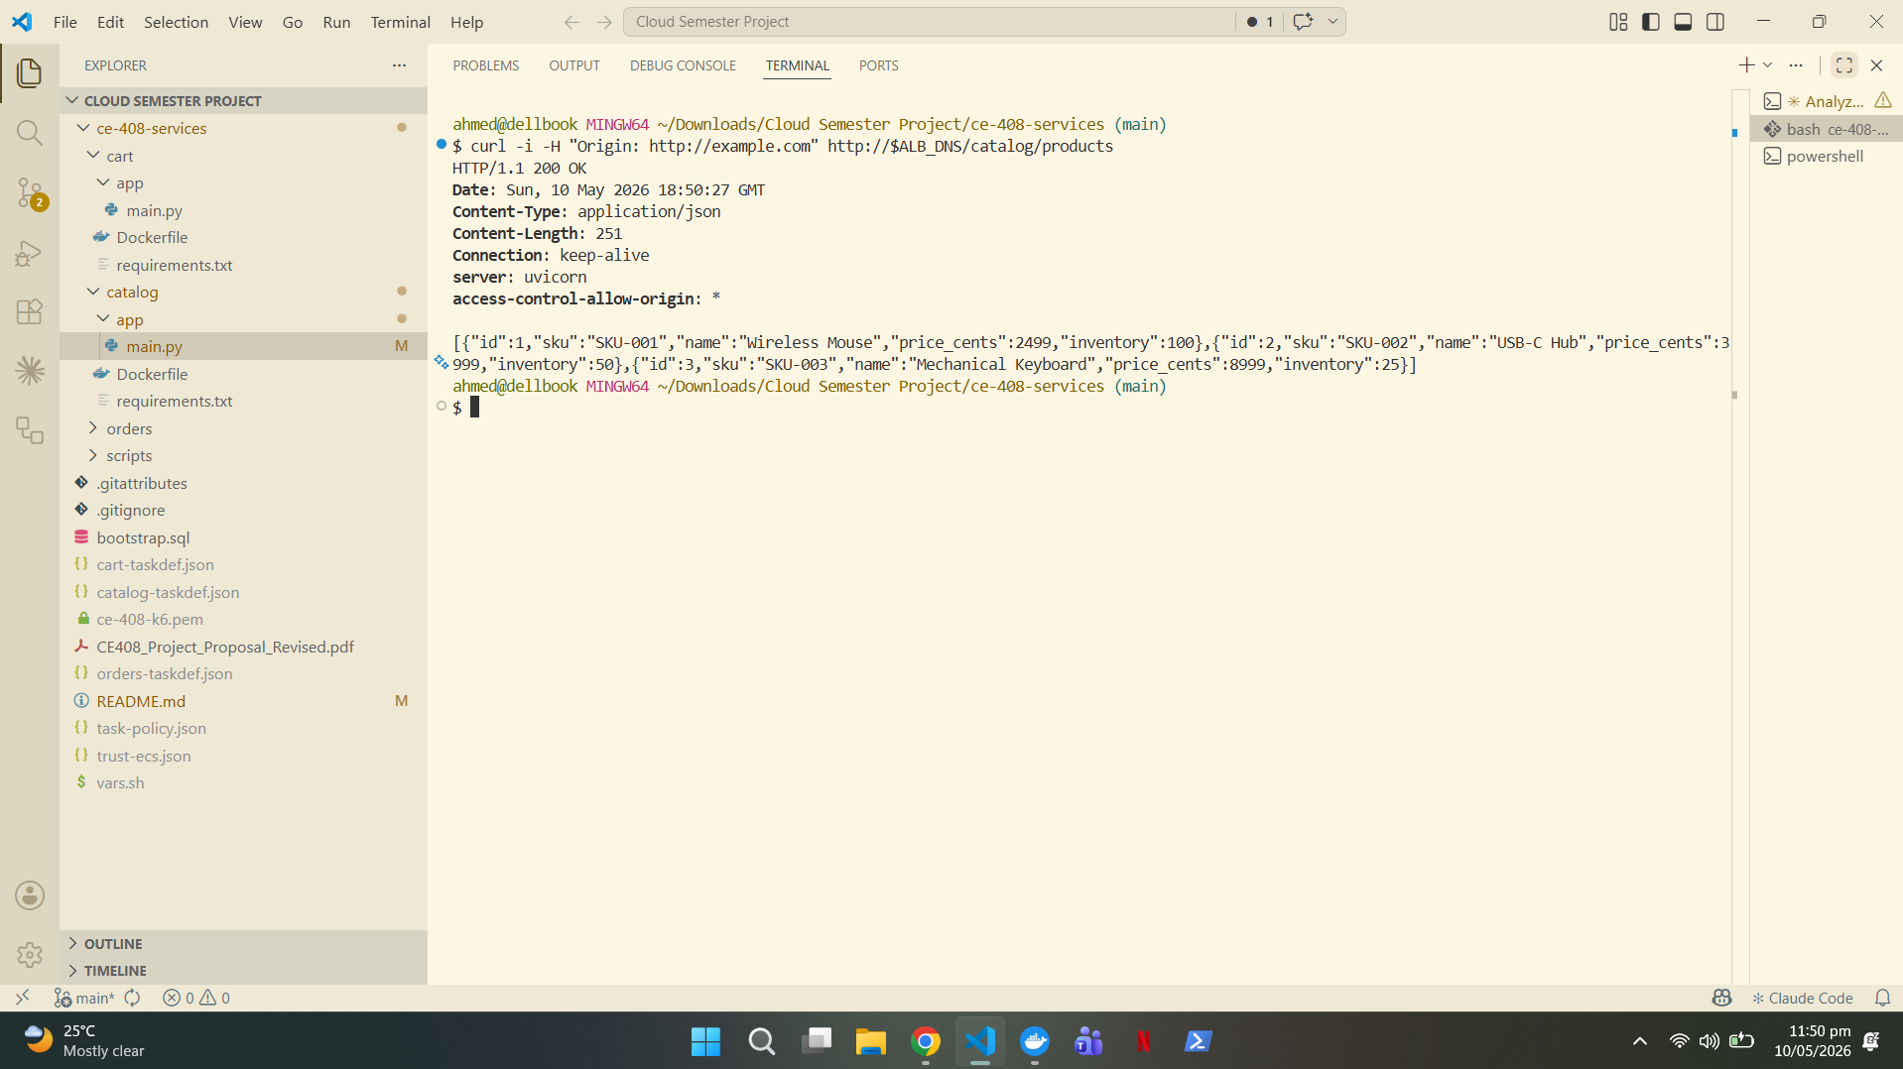
IMPLEMENTATION
05 / 10
Microservices & API Contract
▪ Catalog. Serves the product list and per-SKU lookups from RDS Postgres.
▪ Cart. Stores each session's bag as a nested item map in DynamoDB.
▪ Orders. Prices and persists orders, then queues them on SQS for fulfilment.
KEY ENDPOINTS
▪ GET /catalog/products
▪ GET / POST /cart/sessions/{userId}/items
▪ POST /orders → { orderId, total_cents, status }
Live response from GET /catalog/products through the ALB.

Slide 6
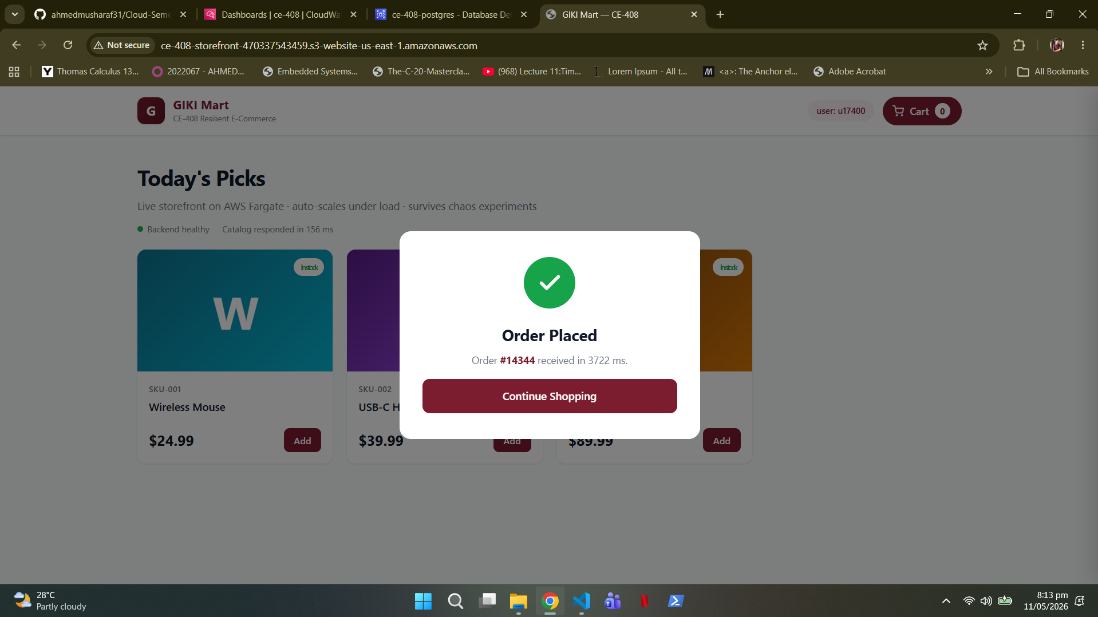
FRONTEND
06 / 10
The GIKI Mart Storefront
▪ Hosted on S3. A static storefront served as an S3 website — no servers to manage.
▪ Talks to the ALB. The page calls the live backend with fetch(), exercising all three services.
▪ Full shopping flow. Browse the catalog, add to cart, and place an order end to end.
▪ Deploy-time config. An __ALB_DNS__ placeholder is swapped for the live load balancer DNS at deploy.
▪ Proof it works. Orders placed from the browser are accepted, priced and queued in milliseconds.
An order placed from the storefront: accepted and queued in 3722 ms.

Slide 7
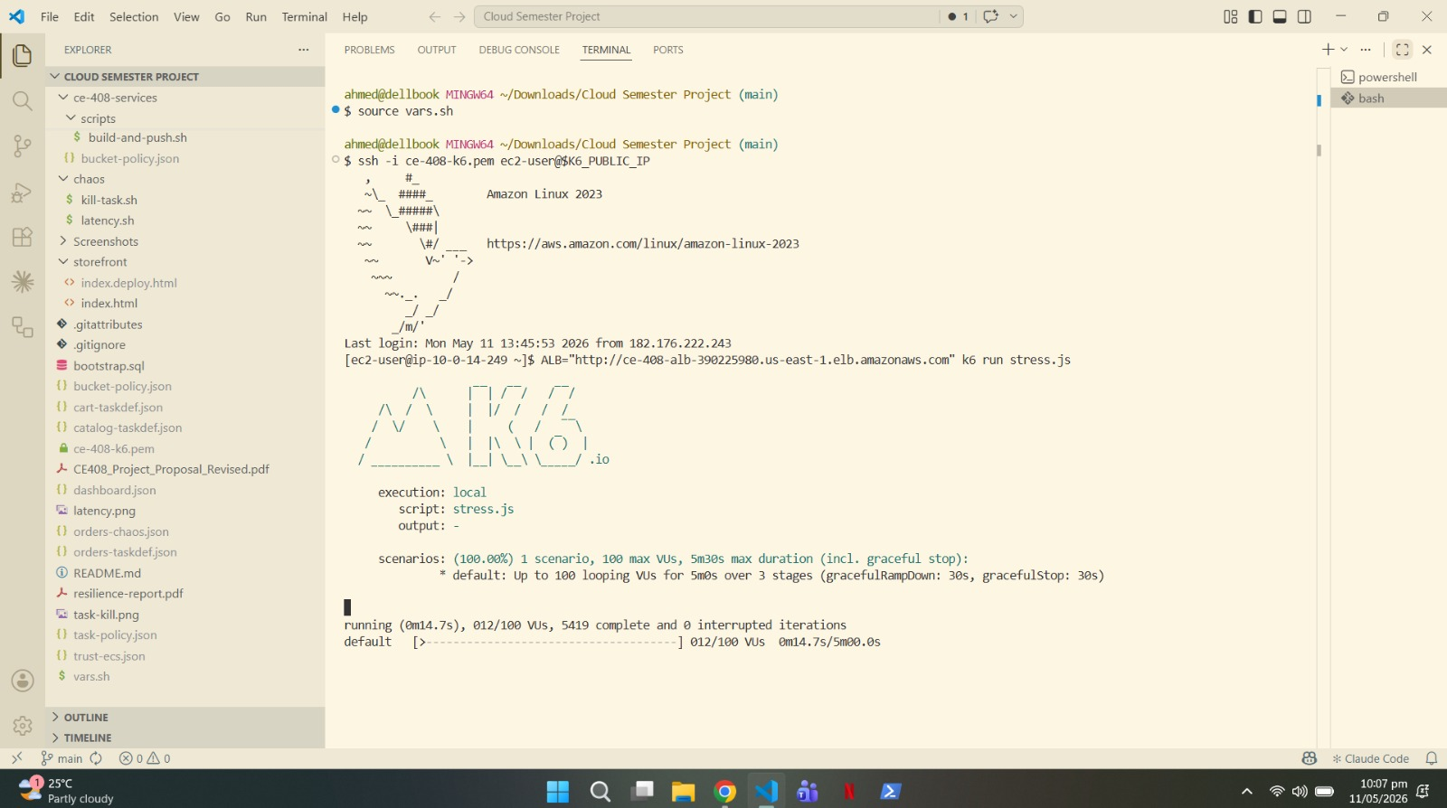
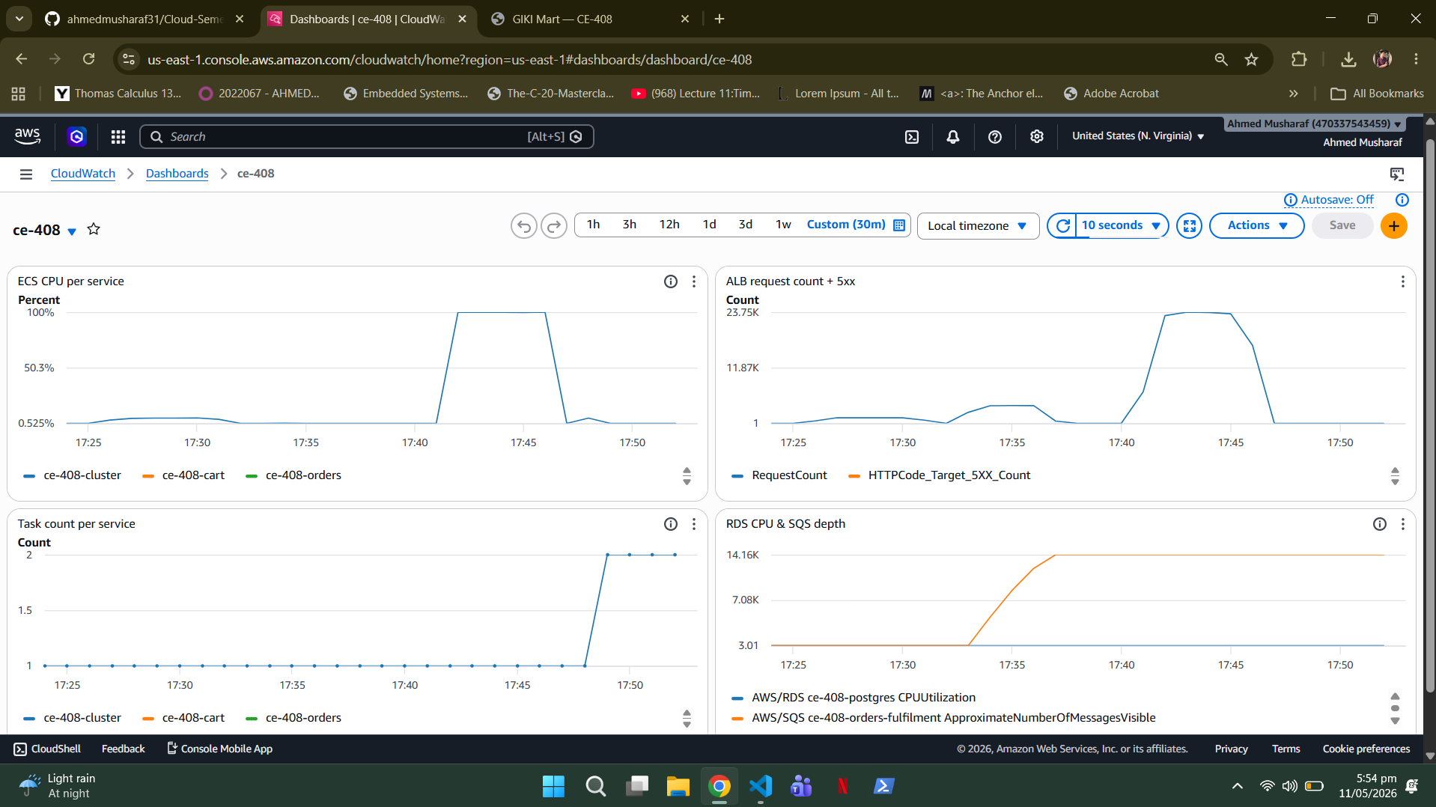
RESILIENCE · PART 1
07 / 10
Load Testing & Auto-Scaling
▪ Load generator. A dedicated k6 EC2 instance drives traffic at the ALB.
▪ Baseline. 20 virtual users for 5 minutes establishes a healthy baseline.
▪ Stress. A catalog-heavy stress test pushes CPU past the 60% scaling threshold.
▪ Auto-scaling. ECS provisions extra tasks automatically; ~6–9 minutes end to end by design, to avoid thrashing on brief spikes.
▪ Result. The service absorbs the spike and scales back down once it passes.
k6 load run (top) and the CloudWatch dashboard showing the CPU spike and scaling response (bottom).

Slide 8
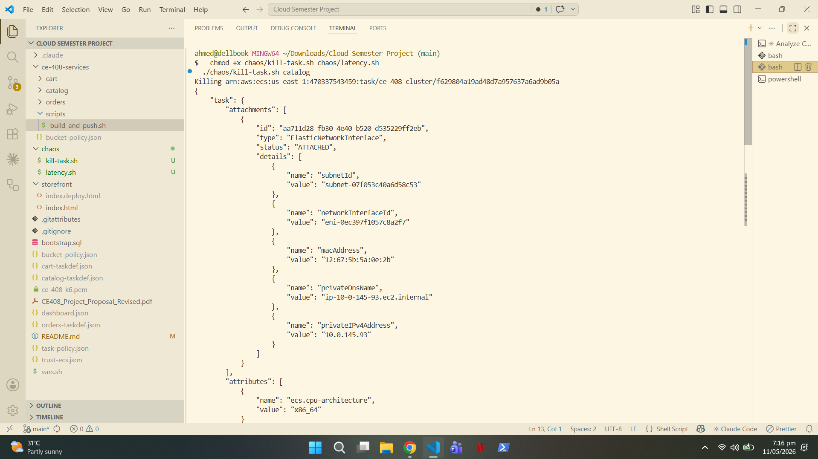
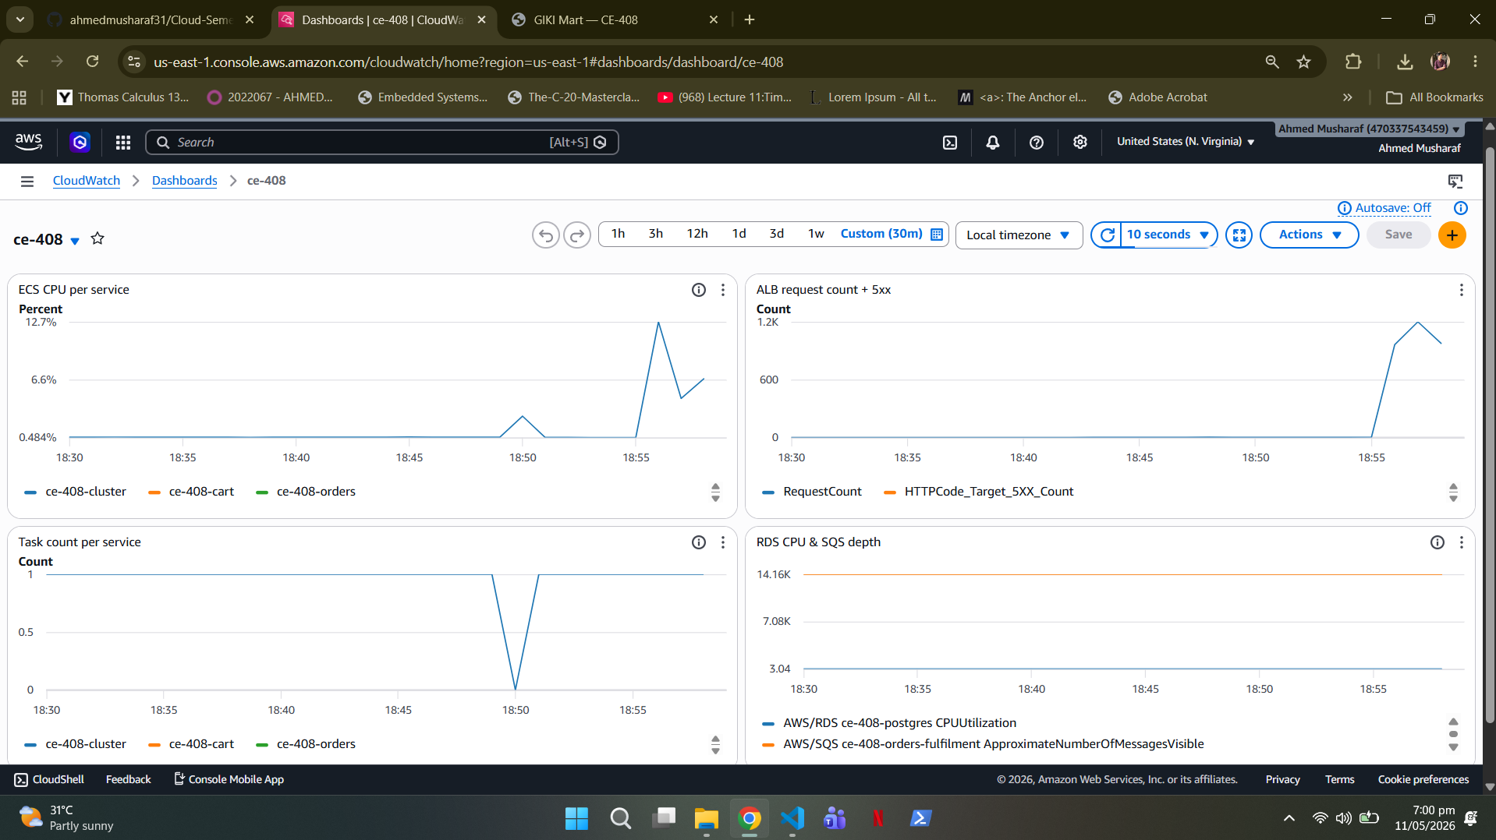
RESILIENCE · PART 2
08 / 10
Chaos Experiment 1 — Task Termination
▪ The experiment. chaos/kill-task.sh forcibly terminates a live Catalog task.
▪ Hypothesis. The ALB drains the dead target and ECS restores the task within ~90 seconds.
▪ What happened. Task count dropped, then recovered automatically in about 2 minutes.
▪ User impact. Zero 5xx errors throughout — healthy tasks absorbed every request.
▪ Takeaway. The system self-heals from an instance failure with no human intervention.
kill-task.sh terminating a task (top); CloudWatch task count recovering with no 5xx errors (bottom).

Slide 9
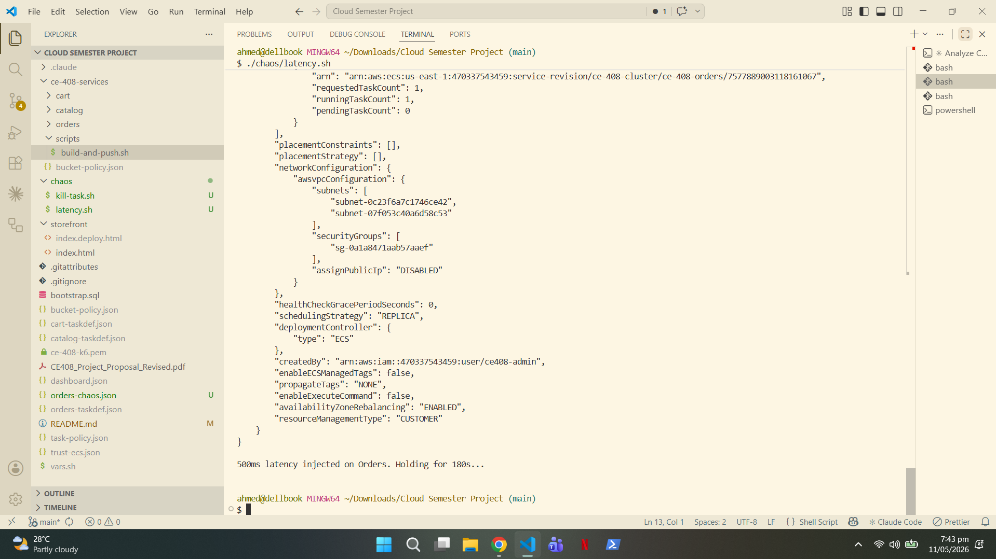
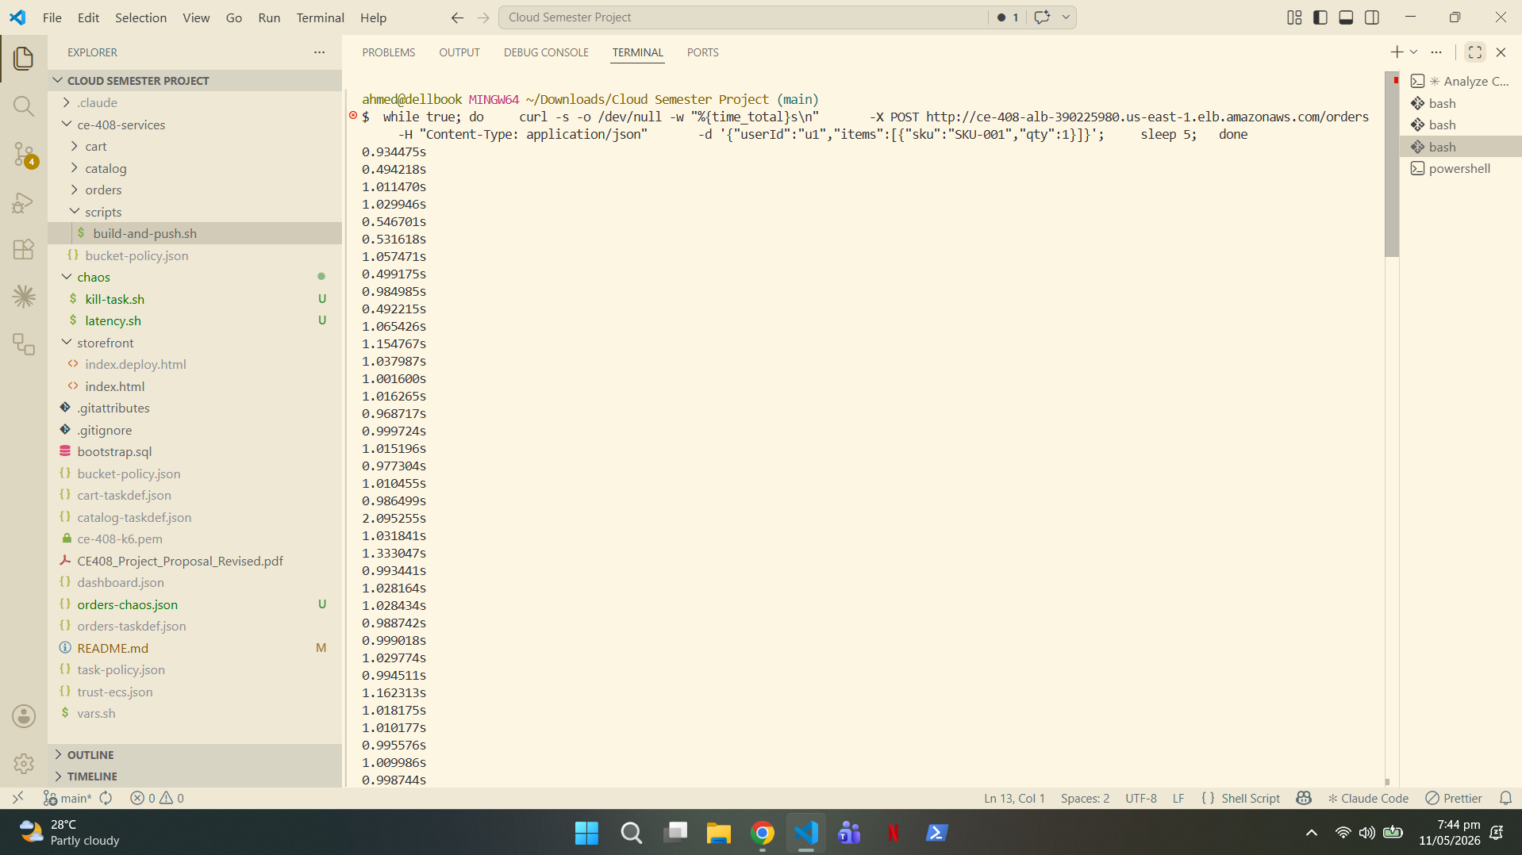
RESILIENCE · PART 3
09 / 10
Chaos Experiment 2 — Latency Injection
▪ The experiment. chaos/latency.sh injects 500 ms of delay into the Orders service via an env-var rollout.
▪ Hypothesis. Orders' p95 latency climbs sharply while Cart and Catalog stay untouched.
▪ What happened. Orders slowed as expected; the other two services were completely unaffected.
▪ Fault isolation. Because each service scales and runs independently, the slowdown never spread.
▪ Takeaway. A degraded dependency stays contained: it does not become a system-wide outage.
The impact stays isolated to one service during latency injection.
(upto 11x reduced)

Slide 10
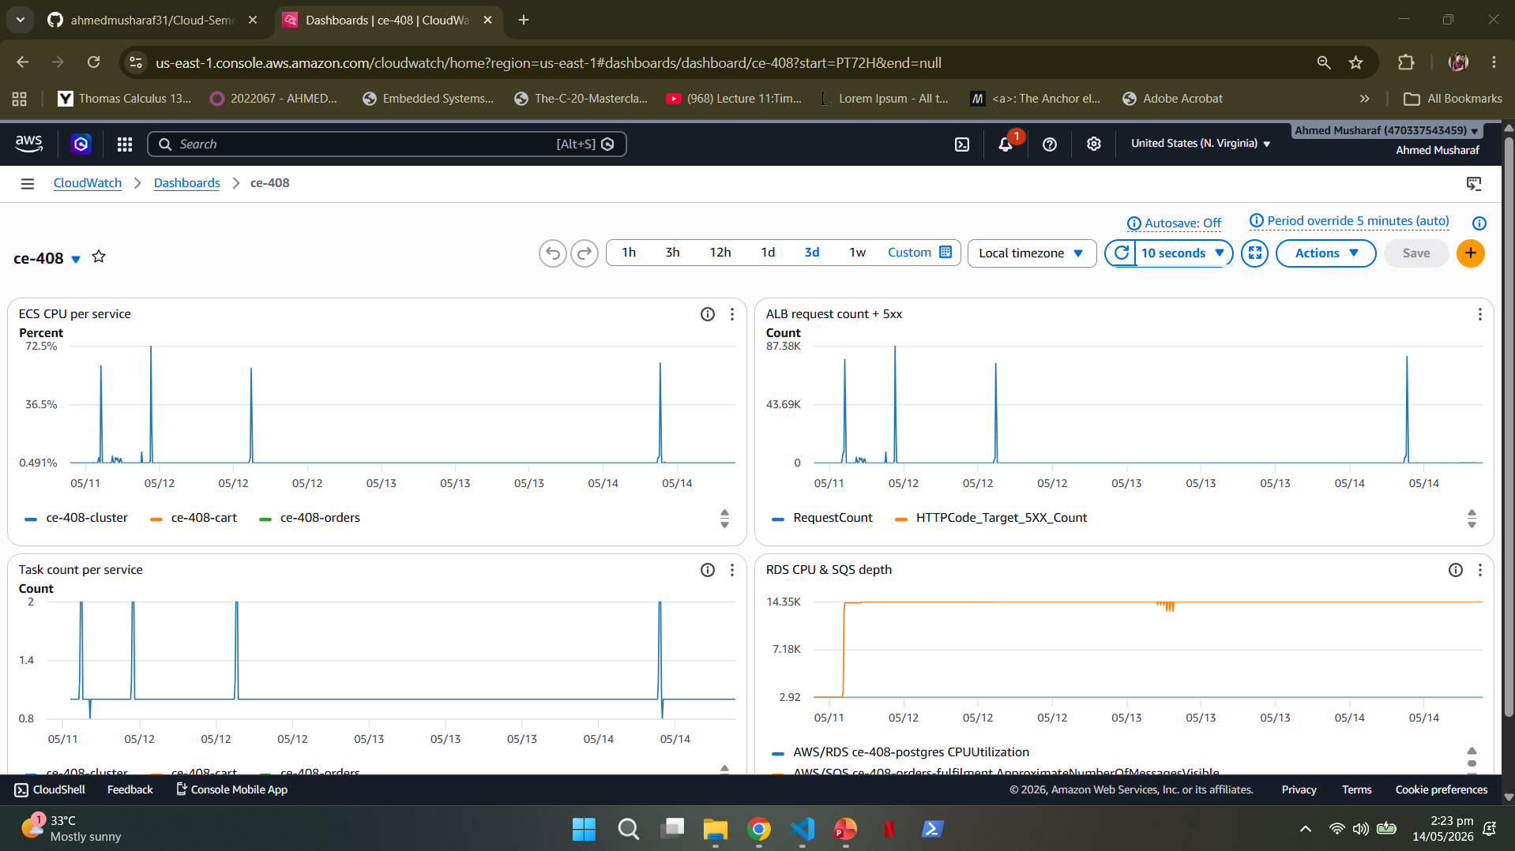
OUTCOME
10 / 10
Observability, Results & Conclusion
▪ Observability. A 4-widget CloudWatch dashboard plus 3 alarms cover CPU, 5xx, task count and queue depth.
▪ Monitored live. Every load and chaos test was watched on this dashboard in real time.
KEY RESULTS
~14 ms
0%
CONCLUSION
Baseline p95 latency
5xx errors under chaos
We built a microservices backend that auto-scales under load and self-heals under failure: and proved it with measured chaos experiments that produced zero user-visible errors.
~2 min
3 / 3
Task-kill recovery
CloudWatch alarms wired

