Slide 1
OM
GIKAFE
Cafeteria Operations Study
Forecasting · Inventory · Queueing Analysis at the Peak Lunch Hour
GROUP MEMBERS
Ahmed Musharaf — Reg# 2022067
Umar Mushtaq Mughal — Reg# 2022602
MS-492
OPERATIONS
MANAGEMENT
INSTRUCTOR Dr. Muhammad Suhaib
TEXTBOOK Heizer & Render — Operations Management, 12e
INSTITUTE GIK Institute of Engineering Sciences & Technology · Spring 2026

Slide 2
01 · PROBLEM DEFINITION
Why GIKAFE, why now?
THE PROBLEM
SYSTEM BOUNDARY
GIKAFE serves ~500 students during the 12:00–14:00 lunch window on a single main counter. Visible 6–8 person queues form at the peak, food items occasionally run short before 14:00, and there is no formal demand-forecasting or inventory policy in place.
Location: GIKAFE main counter only
Window: 12:00–14:00 (peak lunch)
Scope: 16 menu items, 1 service line
Excluded: Kitchen prep, breakfast, dinner
WHY IT MATTERS
Long waits cut into student study/class time
Stockouts on popular items hurt service level
No data-driven ordering = overstock or waste
511
51
3
Friday
customers
Timed
observations
Observation
days
MS-492 Operations Management · GIKAFE Cafeteria Analysis
2 / 11

Slide 3
02 · METHODOLOGY
Three OM tools, one integrated study
Grounded in Heizer & Render — Operations Management (12e). Tools chosen because they map directly to the three pain points we observed: demand variability, no order policy, and peak-hour congestion.
01
Ch. 4
02
Ch. 12
03
Ch. D
FORECASTING
INVENTORY
QUEUEING
Demand Forecasting
ABC · EOQ · ROP
M/M/1 Analysis
SMA · WMA · Exponential Smoothing to predict daily demand for the top 5 items. Compared via MAPE to pick the best method.
Classify 16 items by annual value, then size optimal order quantities and reorder points for Class-A high-value items.
Model the main counter as a single-server queue. Use λ, μ, ρ to diagnose stability and waiting times at the 12:00–14:00 peak.
OUTPUT Forecast for Day 11 (Mon 11-May)
OUTPUT Order policy for Class-A items
OUTPUT Server utilisation & wait time
MS-492 Operations Management · GIKAFE Cafeteria Analysis
3 / 11

Slide 4
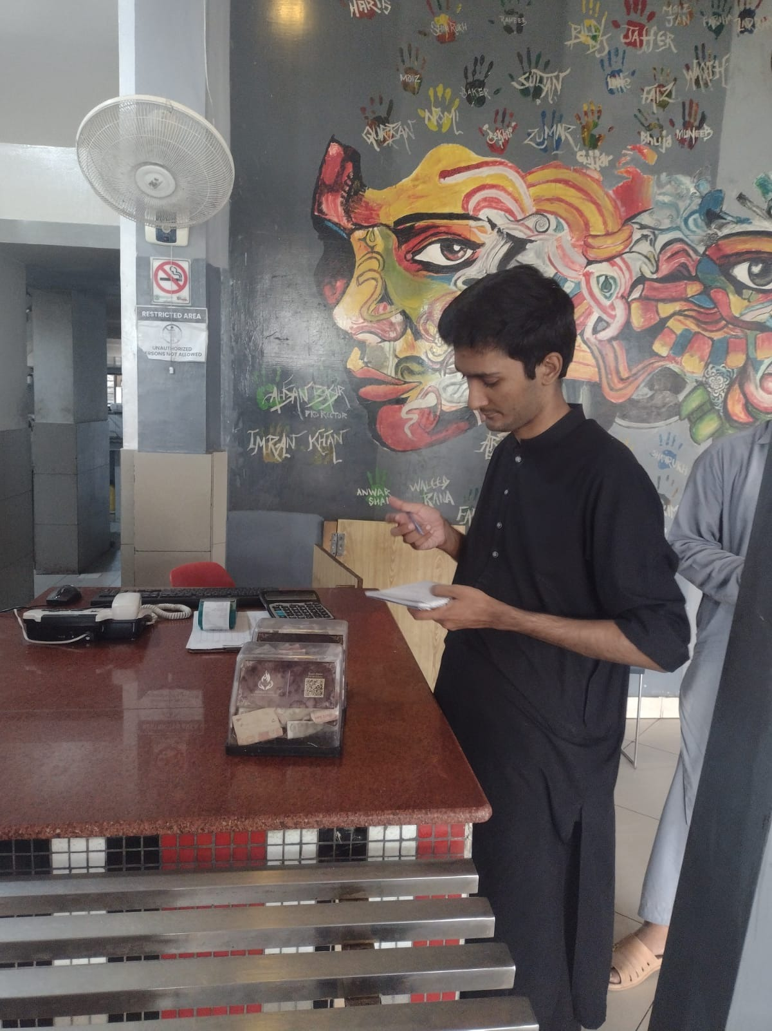
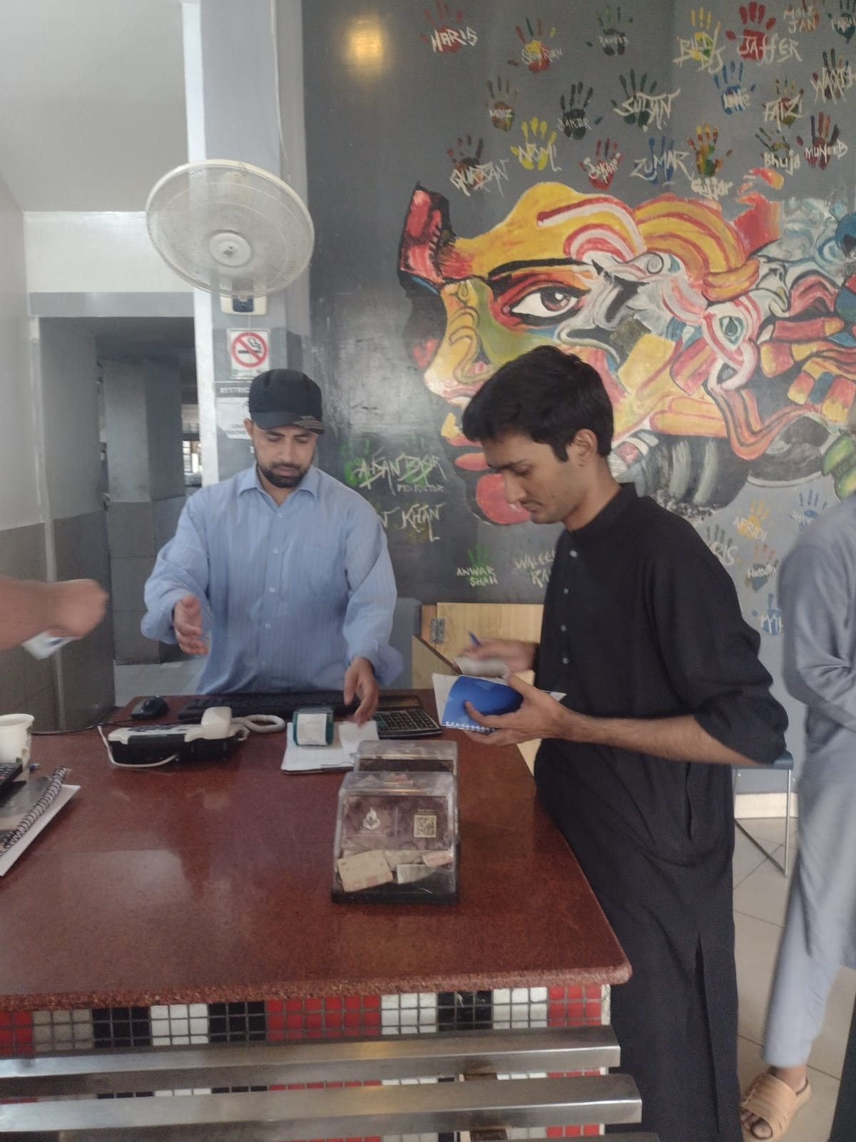
03 · DATA COLLECTION
On-site observation at the GIKAFE counter ;)
HOW WE COLLECTED
Two observers, three shifts
Observer 1
Stopwatch — timed arrivals & service durations live
Observer 2
Notebook — logged item-by-item tally + queue length
Cross-check
End-of-day totals validated with GIKAFE supervisor
Window 12:00–14:00 · Fri/Sat/Sun · 51 records
On-site at GIKAFE counter — coordinating with the supervisor & timing customer flow
MS-492 Operations Management · GIKAFE Cafeteria Analysis
4 / 11

Slide 5
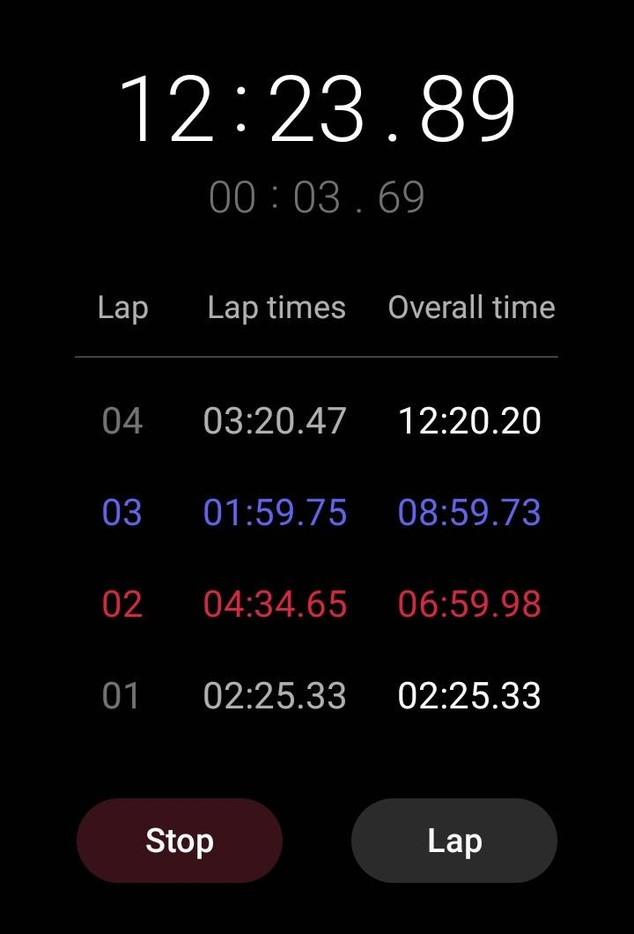
04 · DATA VALIDATION
Stopwatch readings match the observation log
The lap times captured on a phone stopwatch align with the first arrivals recorded in Sheet 3 of our workbook — confirming the raw data is real and consistent.
STOPWATCH ➜ EXCEL LOG
First 5 Friday arrivals
# | Stopwatch (cumulative) | Excel Arrival | Match
1 | 00:00.00 | 12:00:00 | ✓
2 | 02:25.33 | 12:02:25 | ✓
3 | 06:59.98 | 12:07:00 | ✓
4 | 08:59.73 | 12:08:59 | ✓
5 | 12:20.20 | 12:12:20 | ✓
NOTE Lap times shown as cumulative duration on the stopwatch; arrival timestamps in Excel start from 12:00:00.
MS-492 Operations Management · GIKAFE Cafeteria Analysis
5 / 11

Slide 6
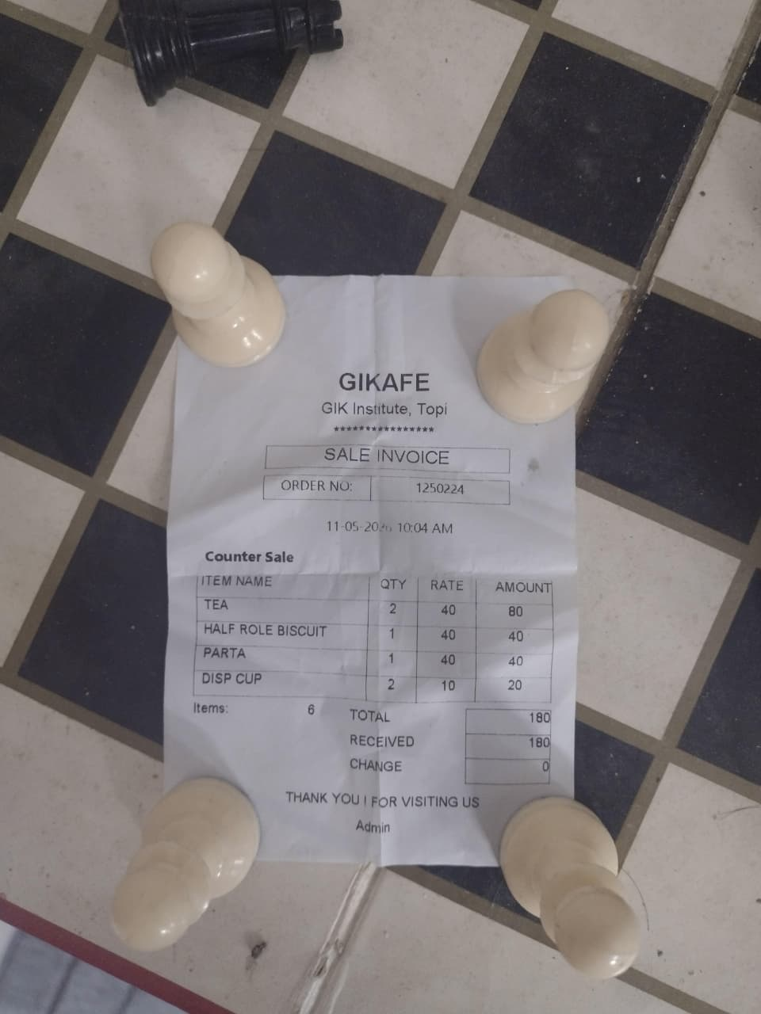
04 · DATA VALIDATION
Proof of presence — Mon 11-May
GIKAFE sale invoice dated 11-05-2026 — confirms we were on-site collecting the Monday actuals used to validate our forecasts.
WHY THIS RECEIPT MATTERS
Forecast actuals were observed, not borrowed
Date stamp
11-05-2026 · Order #1250224 — GIKAFE, GIK Institute, Topi
What it confirms
The team was physically present at GIKAFE on Monday 11-May. The Day-11 actuals used in the forecast comparison are numbers passed on by the supervisor.
Why it matters for MAPE
MAPE is only meaningful if the “actual” column is real. Self-observed actuals close the loop on the SMA / WMA / ES comparison shown on the next forecasting slide.
GIKAFE sale invoice — Mon 11-May-2026, 10:04 AM
MS-492 Operations Management · GIKAFE Cafeteria Analysis
6 / 11

Slide 7
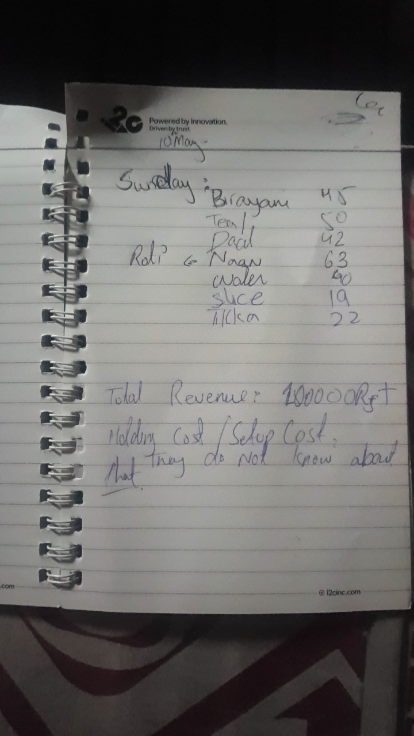
05 · RAW FIELD DATA
Sunday 10 May — peak lunch tally
WHAT WE RECORDED
Top items + a hidden cost
Item | Sun Units | Unit Price
Naan | 63 | Rs. 20
Tea / Chai | 50 | Rs. 60
Chicken Biryani | 45 | Rs. 200
Daal Chawal | 42 | Rs. 150
Mineral Water | 40 | Rs. 70
Slice Juice | 19 | Rs. 50
Chicken Tikka | 22 | Rs. 220
HIDDEN COST
15%
of unit price assumed
as annual holding cost
Refrigeration · spoilage · storage
MANAGEMENT BLIND-SPOT
Sunday revenue ≈ Rs. 100,000. GIKAFE is run by GIK administration (low overhead), so 15% is a realistic holding-cost rate — but management does not formally track holding or setup costs.
Field notebook · Sunday 12:00–14:00
MS-492 Operations Management · GIKAFE Cafeteria Analysis
7 / 11

Slide 8
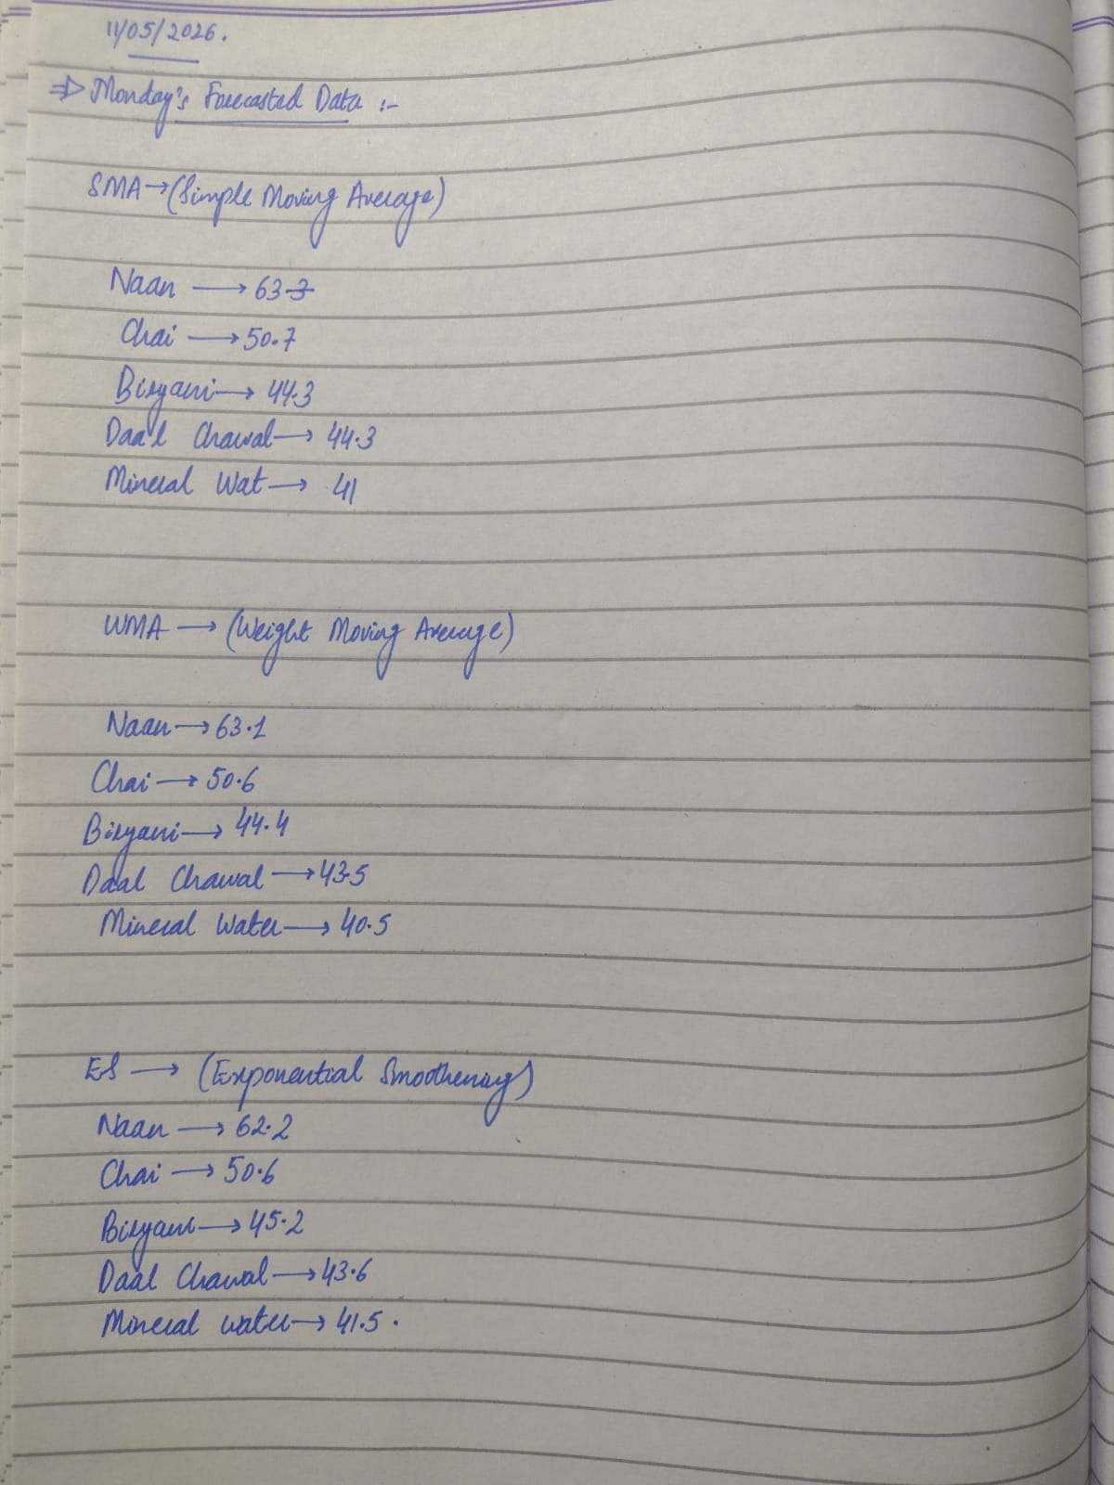
06 · FORECASTING RESULTS
Monday 11-May forecast — SMA · WMA · ES
Three methods applied to 10 days of historical demand. Method-by-method comparison with MAPE — WMA wins on lowest average error.
BEST METHOD
AVG WMA MAPE
MONDAY HEADLINE
WMA
1.5%
63 · 51
Lowest avg MAPE — adopted for daily ordering
Across all 5 top-volume items
Naan & Chai units — feed inventory layer
Hand-worked forecasts vs. self-observed Mon 11-May actuals
MS-492 Operations Management · GIKAFE Cafeteria Analysis
8 / 11

Slide 9
07 · INVENTORY ANALYSIS
ABC classification → EOQ → Reorder Point
ABC CLASSIFICATION
EOQ + ROP · TOP CLASS-A ITEMS
16 items by annual value
Optimal order quantity & reorder trigger
Item | D (units) | EOQ | ROP | Orders/yr
Chicken Biryani | 13,876 | 481 | 66 | 28.8
Chicken Karhai + Rice | 9,286 | 273 | 45 | 34.0
Daal Chawal | 13,876 | 430 | 66 | 32.3
Chicken Tikka | 7,616 | 319 | 36 | 23.9
Chicken Burger | 5,321 | 206 | 26 | 25.8
Tea / Chai | 15,859 | 531 | 76 | 29.9
FORMULAS USED
EOQ = √(2DS / H) ROP = (d̄ × L) + SS
Lead time L = 1 day · H = 15% × price · SS = 0.5 × d̄ · 313 working days/yr
A Tight weekly control · B Bi-weekly review · C Monthly / on-demand
MS-492 Operations Management · GIKAFE Cafeteria Analysis
9 / 11

Slide 10
08 · QUEUEING ANALYSIS
M/M/1 model at the main counter
Single counter, FIFO discipline, Poisson arrivals, exponential service — the textbook M/M/1 setup.
λ (arrival rate)
μ (service rate)
Servers
Sample size
0.142
1.034
1
51
cust/min
cust/min
main counter
observations
PERFORMANCE METRICS
DIAGNOSIS
Sample rate → Full peak
ρ > 1 at peak
Metric | Sample (λ=0.14) | Full Peak (λ=4.06)
ρ utilisation | 0.137 (14%) | 3.92 ⚠
Lq in queue | 0.022 | ∞
Wq wait (sec) | 9 | ∞
W total (sec) | 67 | ∞
Stability | STABLE | UNSTABLE
Why?
Full-peak λ = 4.06 cust/min
μ = 1.03 cust/min
ρ = λ/μ = 3.92 → UNSTABLE
→ Single server cannot keep up with peak arrival rate — explains the 6–8 person queues we observed.
MS-492 Operations Management · GIKAFE Cafeteria Analysis
10 / 11

Slide 11
09 · RECOMMENDATION
To stabilise the system, restore ρ < 1
Three implementable levers — pulled together they bring server utilisation back below 1 and reduce average wait.
01
02
03
INCREASE μ
DECREASE λ
TEST OFF-PEAK
Boost service rate
Smooth the arrival rate
Validate during off-peak
Add a second server or a dedicated Tea/Naan batch station during 12:00–14:00. Pre-pack Class-A items.
Stagger class break timings or push pre-orders via QR menu. Spread arrivals across a wider window.
Run pilot during 11:30 or 13:30 windows where natural λ is lower — confirm μ improvements before scaling.
IMPACT ~60% wait reduction (M/M/2)
IMPACT Flattens peak demand spike
IMPACT Low-risk implementation path
TAKEAWAY Use WMA forecasts for daily orders · Trigger reorders at ROP for Class-A items · Add a 2nd server at peak — together these move ρ back below 1 and stabilise the system.
Thank you · Questions ?

