Slide 1
Lecture 6
Visualization
in
Computer Graphics

Slide 2
Contents
6.1 Visualization
6.2 Computer Graphics Primer
6.3 Color concepts
6.4 Simulation of light behavior in 3D

Slide 3
6.1 Visualization
It is a method of computing in computer graphics for the transformation of Data into pictures or images:
Transforms the symbolic into the visual
Allows researchers/ engineers/ physicians/ scientists/users to observe their simulations and computations
Allows financial analysts/ marketing specialists/business professionals/ network analysts/ users to survey and explore large data collections efficiently
Offers a method of seeing the unseen
Enriches the process of (scientific/ engineering/medical/ commercial) discovery and fosters profound and sometimes unexpected insight

Slide 4
Visualization-contn
Visualization is a group of techniques for creating images, diagrams, or animations to communicate a message.
Visualization through visual imagery has been an effective way to communicate both abstract and concrete ideas since the dawn of man.
Examples from history include cave paintings, Egyptian hieroglyphs, Greek geometry, and Leonardo da Vinci's revolutionary methods of technical drawing for engineering and scientific purposes.

Slide 5
Visualization-contn
Visualization today has ever-expanding applications in science, education, engineering (e.g. product visualization), interactive multimedia, medicine , etc.
Typical of a visualization application is the field of computer graphics.
The invention of computer graphics may be the most important development in visualization since the invention of central perspective . The development of animation also helped advance visualization.

Slide 6
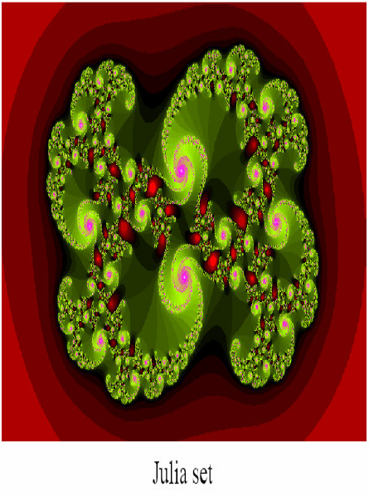
Why do we need Visualization?
A picture is worth more than a thousand words – Chinese proverb
1000 Words Picture
It looks like a swirl. There are smaller swirls at the edges. It has different shades of red at the outside, and is mostly green at the inside. The smaller swirls have purple high lights.The green has also different shades. Each small swirl is composed of even smaller ones. The swirls go clockwise. Inside the object, there are also red highlights. Those have different shades of red also. The green shades vary in a fan, while the purple ones are more unicolor. The green shades get darker towards the outside of the fan......

Slide 7
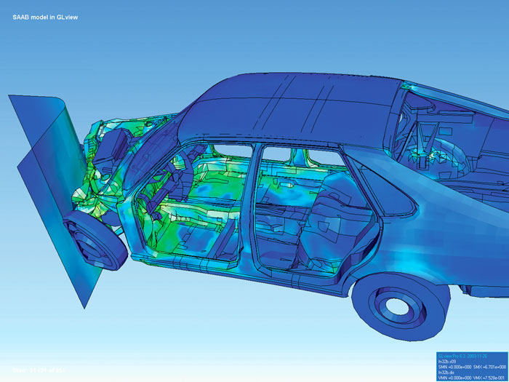
Visualization of how a car deforms in a asymmetrical crash using finite element analysis.

Slide 8
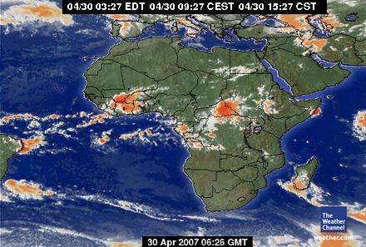

Visualization examples
  Weather maps
  Computer entertainment
  Medical applications

Slide 9
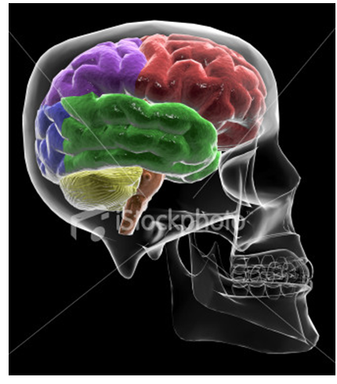
Skull & Brain Visualization

Slide 10
Relations with other fields
Visualization employs these largely independent
but convergent fields:
Computer graphics
Image processing and pattern recognition
Computer vision
Computer Aided design
User interface studies
Signal processing

Slide 11
Types of Visualization
Scientific Visualization
Educational Visualization
Information Visualization
Knowledge Visualization
Product Visualization
Visual communication
Visual analysis

Slide 12
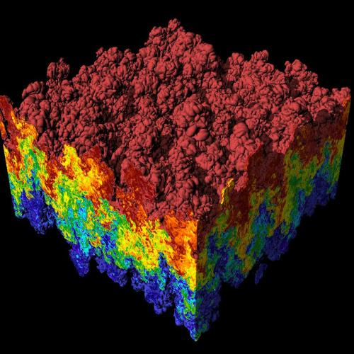
A scientific visualization of an extremely large simulation of a Raleigh-Taylor instability caused by two mixing fluids

Slide 13
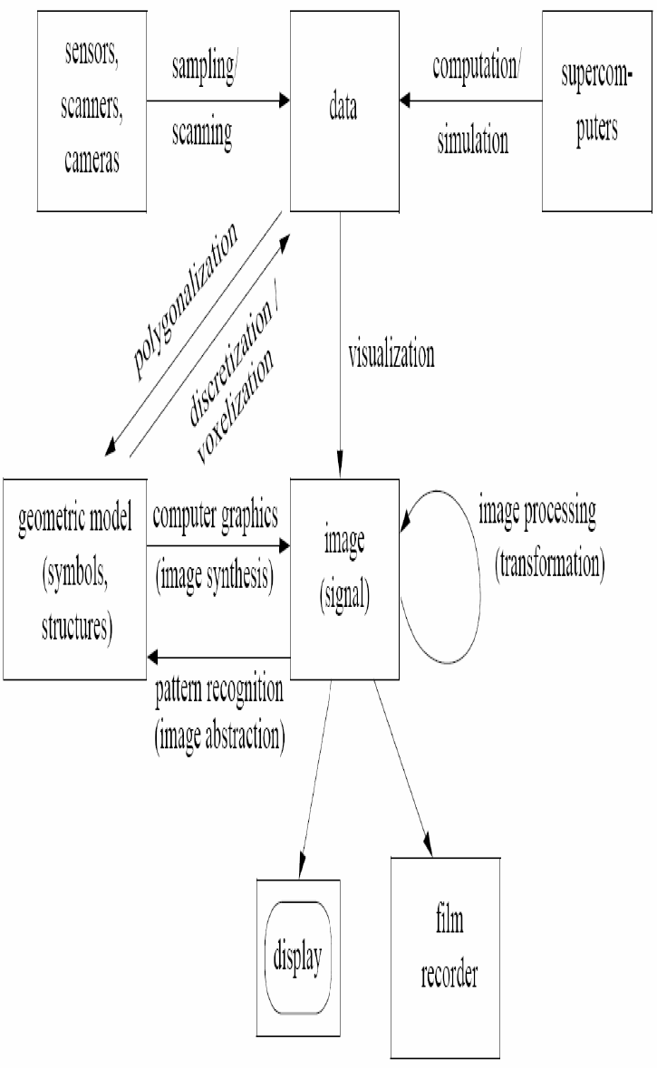
Visualization & Data

Slide 14
Visualization Techniques
Constructing isosurfaces ( perfect image from group of cross sections images)
direct volume rendering
Streamlines, streaklines, and pathlines
table, matrix
charts (pie chart, bar chart, histogram, function graph, scatter plot)
graphs (tree diagram, network diagram, flowchart, existential graph)
Maps
parallel coordinates - a visualization technique aimed at multidimensional data
treemap - a visualization technique aimed at hierarchical data
Venn diagram
Euler diagram
Chernoff face
Hyperbolic trees
brushing and linking

Slide 15
Visualization Tools
Models and frameworks for building visualizations include:
the data flow models popularized by systems such as AVS, IRIS Explorer, and Visualization Toolkit (VTK)
data state models in spreadsheet systems such as the Spreadsheet for Visualization and Spreadsheet for Images

Slide 16

VTK (The Visualization Toolkit) is a software system for 3D Computer Graphics and Visualization. VTk includes a textbook published by Prentice-Hall, a C++ class library, and a Tcl implementation based on the class library

Slide 17
Imaging, Computer graphics & Visualization
Imaging: (image processing)
  The study of 2D pictures by transformation (rotate, scale & shear) & extracting information
Computer graphics:
creating images using computer either 2D or 3D.
Visualization:
Viewing data as images to gain information

Slide 18
Imaging, Computer graphics & Visualization-contn
Visualization can be greatly enhanced through the use of 3D computer graphics
  computer graphics are our tool in visualization
In order to do effective visualization we need:
  to know basic concepts of computer graphics
  a computer graphics architecture (VTK)
  in general , toolkit is a set of tools especially for a specific type of work, kept in a special box or bag

Slide 19
6.2 Computer Graphics Primer
Visualization is the process that transforms data into a set of graphical primitives.
Methods of computer graphics are then used to convert these primitives into pictures or animation. This is called Rendering.
How light and physical objects interact to form what we see?
A common 3D technique is “ray-tracing or ray casting”:
It simulate the interaction of light with objects by following the path of each light ray backwards (from eye to object).

Slide 20
Rendering Definition
is the process of generating an image from a model, by means of computer programs.
The model is a description of three-dimensional objects in a strictly defined language or data structure. It would contain geometry, viewpoint, texture, lighting, and shading information.
The image is a digital image or raster graphics image.
The term may be by analogy with an "artist's rendering" of a scene.
'Rendering' is also used to describe the process of calculating effects in a video editing file to produce final video output.

Slide 21

Visualization & Computer Graphics & Rendering
Graphics primitives
Visualization
Rendering
Date
Picture or animation

Slide 22
Rendering Concepts
Image order: draw one pixel at a time sequentially. Ray-tracing is image order (time consuming)
Object order: rendering one object at a time (faster operation).
Surface rendering: viewing its surfaces & their interactions with light.
Volume rendering: viewing its surfaces & its internal structures.

Slide 23
Rendering Process
The primary components of the rendering process:
  Sources of light
  Objects to be rendered (actors)
  Camera
  All together form a scene.
  A renderer is a carefully engineered program, based on a selective mixture of disciplines :
  light physics
  visual perception
  Mathematics
  software development.

Slide 24
6.3 Color Concepts
If white light (from sun or white bulb) passes through prism, it spread up in spectrum of colors; which is called the visible spectrum of light.
These are the frequencies of the electromagnetic spectrum (“ light”) that we can see with the naked eye.
Visible electromagnetic spectrum contains wavelength range 400-700 nm.
Each color is composed of different intensities of these wavelengths.
The human eye has three types of receptors R,G & B.

Slide 25
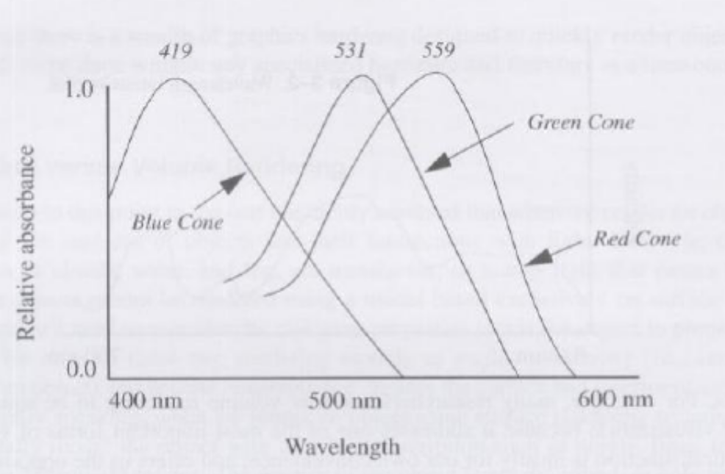
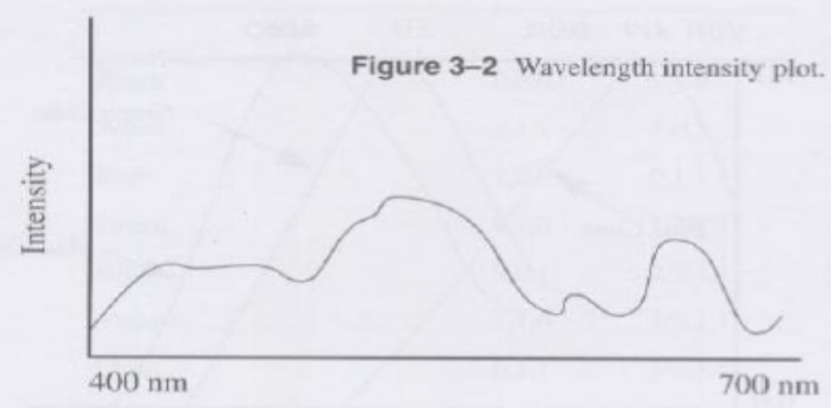
Color Concepts-contn

Slide 26
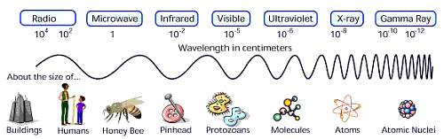
The Electromagnetic Spectrum
It is the measure of photons ( smallest unit of light quantity), traveling at the speed of light, carrying some type of energy
Its speed is measured in terms of wavelength and frequency:
speed = length * frequency = length / period

Slide 27
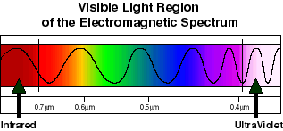
Visible Light
Occurs in a small part of the EM spectrum, near the middle
Wavelengths are 400nm to 700nm long(after the ultraviolet and before the infrared)

Slide 28
Color Models
Additive Color Model
Subtractive Color Model

Slide 29
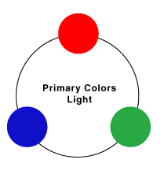
Additive Color Model
Used by computers
When light energy is added, a color appears brighter
Different visible light wavelengths can be combined to create new colors
The Additive Color Model uses Red, Green and Blue (RGB) as Additive Primaries

Slide 30
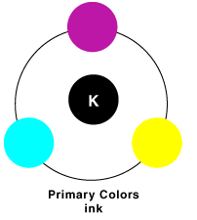
Subtractive Color Model
Used in the print media
When more color is added, a color appears darker
Ink or paint can be thought of a filter that filters out all colors except the color being perceived, which is reflected
The Subtractive Color Model uses Cyan, Yellow Magenta, and Black ( CYMK ) as Subtractive Primaries

Slide 31
Colors Description Systems
Two systems are used to describe colors:
  RGB can be considered as a 3D system with coordinates R,G&B.
  HSV represents color based on their hue, saturation & value.
  Hue: A specific location on the visible spectrum , which is; the dominant wavelength of the color.
    Saturation: Specifies the amount (intensity) of a color , which indicates; how much hue is mixed in color
Value: Represents brightness . Adding WHITE to a color produces a TINT( light color ). Adding BLACK to a color produces a SHADE.

Slide 32
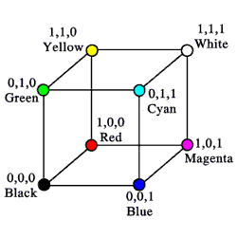
RGB Color Space (Color Cube)
Define colors with (R, G, B) amounts of red, green, and blue

Slide 33
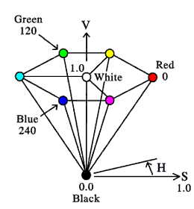
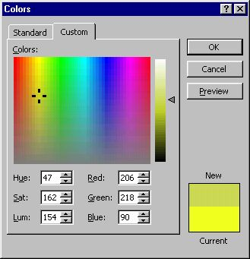
Hue, Saturation & Value (HSV)
Saturation (intensity)
Value ( brightness)
Hue (location)

Slide 34
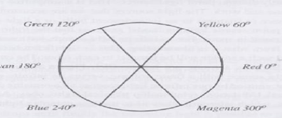
The Color Wheel
A common way to map color is to use the Color Wheel
All hues are depicted as an angle on the wheel (0° represents RED and 360° represents VIOLET)
Saturation is represented as a percentage
Value is represented as a percentage
RED, YELLOW and BLUE are the color wheels primary colors

Slide 35
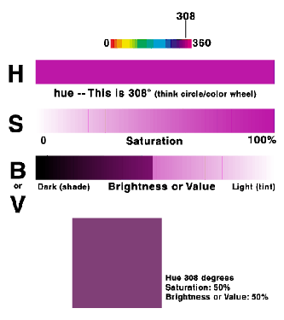
Representing a Color

Slide 36
Programming a Color
Digital Color is normally represented as a numeric constant in triplet format, representing RGB values
In many graphic programs RGB values are represented as a percentage (0%-100%) or as an integer (0-255)
On the web, color triplets are often represented using hexadecimal numbers
51 = 3x16+ 3
RGB | 0 | 51 | 102 | 153 | 204 | 255
PERC | 0% | 20% | 40% | 60% | 80% | 100%
HEX | 00 | 33 | 66 | 99 | CC | FF

Slide 37
Calculating hexadecimal colors
Each color will have numerical values for the amounts of Red, Green and Blue that make it up. These numbers will range from 0 to 255 for each of the three. All you have to do is divide this number by 16.
Given RGB values, where all three are 0-255 (0, 0, 0 being black and 255, 255, 255 being white), use the equation:
R/16 = x + y/16
G/16 = x' + y'/16
B/16 = x" + y"/16
This will give you a whole number, 0-15, for x, and a remainder, y, represented as a whole number, 0-15, over 16. This will give you:
COLOR="# ^{x y x' y' x" y"} "

Slide 38
Calculating hexadecimal colors-contn
For example:
with RGB values of 80, 6, 143,
80/16 = 5 + 0/16
6/16 = 0 + 6/16
143/16 = 8 + 15/16
translating this to hexadecimal, where our 10-15 become A-F, you get: #50068F
Also, with an RGB of 182, 0, 35, you would get:
182/16 = 11 + 6/16
0/16 = 0 + 0/16
35/16 = 2 + 3/16
# B60023

Slide 39
hexadecimal colors to their RGB values
All you need to do is multiply by 16 again. Simply take the first number of the pair (there are three pairs, one each for Red, Green and Blue), multiply it by 16, then add the second number of the pair:
Using the first pair of the above example #B60023, multiply B, or 11, by 16 to get 176, then add 6 to give 182
Multiply 0, by 16 to get 0, then add 0 to give 0
Multiply 2, by 16 to get 32, then add 3 to give 35
So RGB values are 182,0,35

Slide 40
Common Hex Colors
RED (Hex: #FF0000)
GREEN (Hex: #00FF00)
BLUE (Hex: #0000FF)
WHITE (Hex: #FFFFFF)
BLACK (Hex: #000000)
MAGENTA (Hex: #FF00FF)
CYAN (Hex: #00CCFF)
GRAY (Hex: #808080)
You can Visit: http://www.allfreebackgrounds.com/backgrounds/backs/webcolor_pop.htm

Slide 41
Assignment #8
(a) Justify the following :
WHITE (Hex: #FFFFFF) , given that it has 255,255,255 values in RGB system
BLACK (Hex: #000000), given that it has 0,0,0 values in RGB system
(b) Compute the RGB values for the white and black colors, given that they have Hex #FFFFFF and #000000 respectively

Slide 42
*******************************

Slide 43
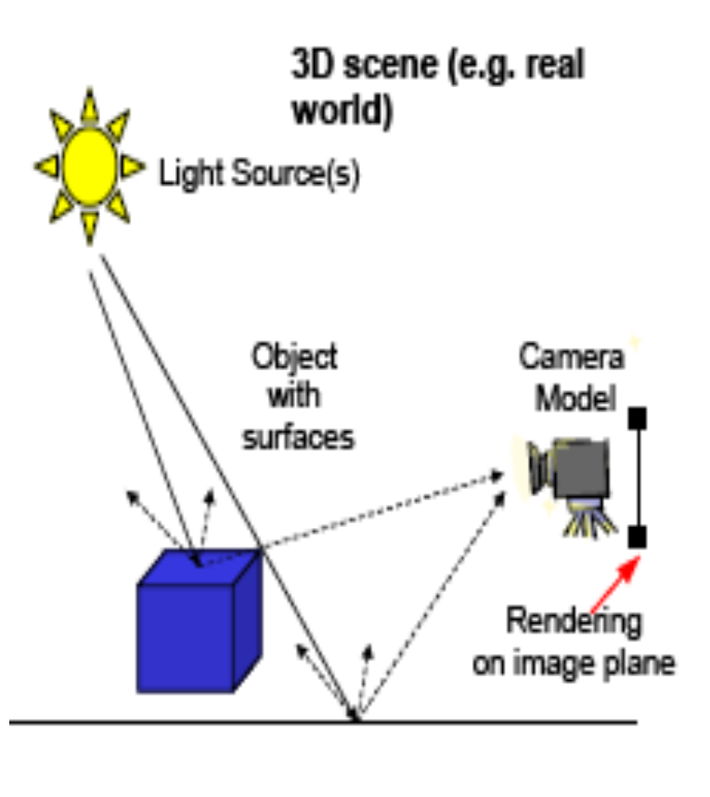
6.4 Simulation of light behavior in 3D ( light effects)
Effective simulation require to model:
  object representation (geometry)
  object illumination (lighting) by light source( sun for example)
  camera model (vision)
    world to image plane projection
    rendering: converting
    graphical data into an image

Slide 44
Lighting Models
  If we’re attempting to create a realistic image, we need to simulate the lighting of the surfaces in the scene.
  We have different lighting models:
  Ambient ( background )
    Normal reflections only
  Lambert/ Diffuse ( shadows )
    Angle between surface normal and light
  Phong / Specular ( brilliant spots)
    Surface normal, light, and viewpoint

Slide 45
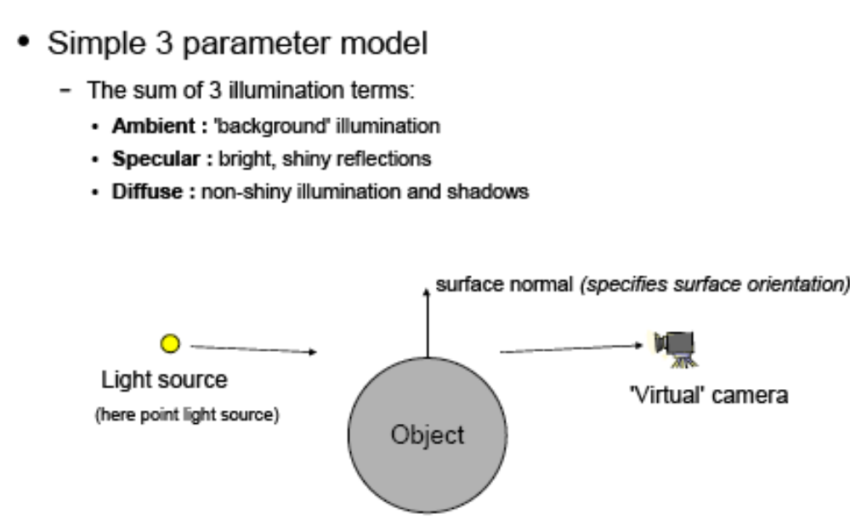
Light interaction with surfaces

Slide 46
6.4.1 Ambient light
( Background illumination )
Ambient light is light that, after millions, billions or even more numbers of reflections; is equally distributed in space.
So the objects will be evenly lit from all sides based on this environmental background.
Note that ambient light is also present in shadows due to the large amount of reflections! The surface attribute here is just that objects reflect light.

Slide 47
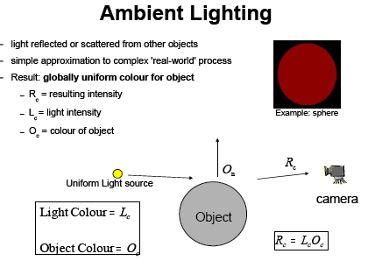
Intensity of the resulting color intensity ( R_{c} )depends on the source light intensity (L_{c} )and the color of the object (O_{c} ),which indicates the differentiation between background and object

Slide 48
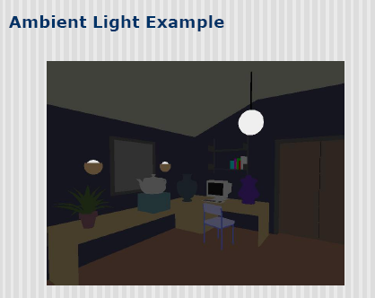
Lamp object and its background

Slide 49
6.4.2 Lambert/Diffuse light
( non shinny illumination & shadows )
Diffuse light is a direction-dependent type of light that, on collision with an object, is equally distributed in all directions.
The amount of reflected light-rays that reach our eyes is proportional to the cosine of the angle between the direction vector of the light-rays and the normal vector of a surface.
Diffuse lights represent diffuse surfaces, surfaces that are not bright and a little rough on a very small scale.

Slide 50
The Physics of Reflection
Ideal diffuse reflection
  An ideal diffuse reflector, at the microscopic level, is a very rough surface
  Because of these microscopic variations, an incoming ray of light is equally likely to be reflected in any direction over the hemisphere:

Slide 51
Lambert’s Cosine Law
Ideal diffuse surfaces reflect according to Lambert’s cosine law:
  “The energy reflected by a small portion of a surface from a light source in a given direction is proportional to the cosine of the angle between that direction and the surface normal “
These are often called Lambertian surfaces
Note that the reflected intensity is independent of the viewing direction, but does depend on the surface orientation with regard to the light source

Slide 52
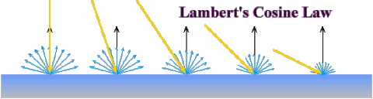
Lambert’s Law

Slide 53
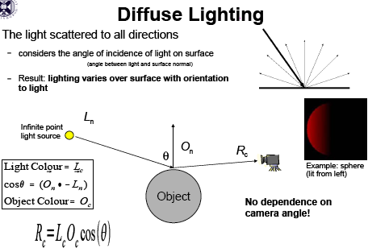

Slide 54
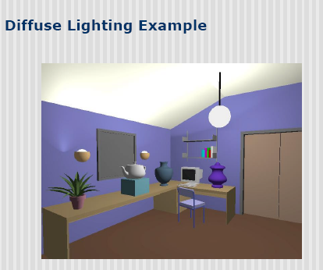

Slide 55
6.4.3 Specular light (brilliant spots)
Specular light is also directional and it is used to simulate the bright shiny spots ( specular highlights ) on objects when looking at them from specific angles.
These shiny spots are pretty much the reflection of the light source itself on the object.
All light sources can emit ambient, diffuse and specular light.
Also, the above lighting types are statistical methods; so we can deduce mixed lighting model

Slide 56
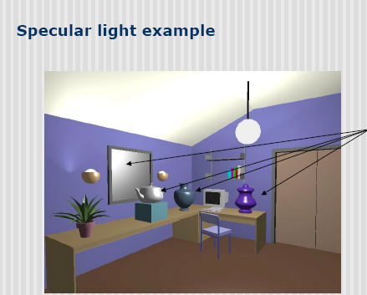

Slide 57
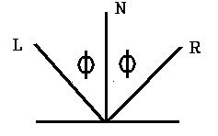
Specular light-contn
Specular reflection is when the reflection is stronger in one viewing direction, i.e., there is a bright spot, called a specular highlight.
This is readily apparent on shiny surfaces.
For an ideal reflector, such as a mirror, the angle of incidence equals the angle of specular reflection, as shown below.

Slide 58
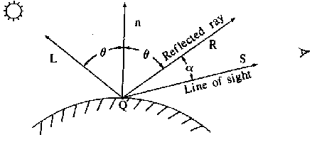
Specular light-contn
So if R is the direction of specular reflection and V is the direction of the viewer (located at the View Reference Point or VRP), then for an ideal reflector, the specular reflection is visible only when V and R coincide.
For real objects (not perfect reflectors) the specular reflectance can be seen even if V and R don't coincide, i.e., it is visible over a range of a values (or a cone of values).
The shinier the surface, the smaller the f range for specular visibility. So a specular reflectance model must have maximum intensity at R, with an intensity which decreases as f(α).

Slide 59
6.4.4 Phong Model
Phong Model (by Phong Bui- Tuong )
Phong shading model refers to a set of techniques in 3D computer graphics.
Phong shading combines a model for the reflection of light from surfaces with a compatible method of estimating pixel colors using interpolation of surface normals across rasterized polygons.
Phong reflection is an empirical model of local illumination( based on observations not measures ).
It describes the way a surface is lit as a combination of the diffuse lighting of rough surfaces with the specular reflection of shiny surfaces.

Slide 60
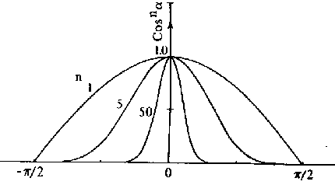
Phong Model -contn
Phong empirical model is not based on physics, but physical observation. Phong observed that for very shiny surfaces the specular highlight was small and the intensity fell off rapidly, while for duller surfaces it was larger and fell off more slowly.
He decided to let the reflected intensity be a function of (cos α)^{n} with n >= 200 for a shiny surface and n small for a dull surface. For a perfect reflector n equals infinity, and for a piece of cardboard n equals 0 or 1.
In the diagram below we can see how the function (cos α)^{n} behaves for different values of n.

Slide 61
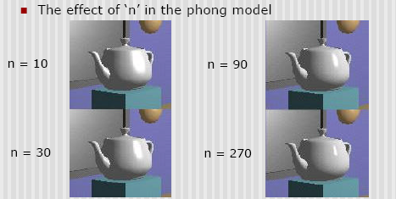

Slide 62
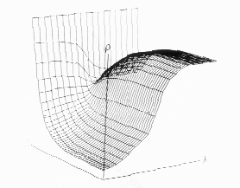
Phong Model -contn
Specular reflection is also a function of the light incidence angle θ. An example is glass which has almost no specular reflectance for θ = 0 degrees but a very high specular reflectance for θ > 80 degrees.
Some substances, such as copper, actually change color with change in the incidence angle, as shown in the following plot of the reflectance curve as a function of the incident angle for copper

Slide 63

Phong Model –contn
(illumination intensity model)
A full specular reflectance function is the Bi-directional Reflectance Distribution Function (BRDF).
For glass ,the BRDF at 0 degrees incidence equals 0 and for light incident at 90 degrees, it equals 1.
Since for many materials the BRDF is approximately constant, Phong called this term the specular coefficient ( k_{s} ) and assumed it was constant.
Then, since cos α = V·R , a complete illumination intensity model for reflection including diffuse reflection from ambient light and a point light source, and the Phong model for specular reflection is:
n

Slide 64
Phong Model –contn (illumination intensity model)
k_{s}: specular reflection constant, the ratio of reflection of the specular term of incoming light
k_{d}: diffuse reflection constant, the ratio of reflection of the diffuse term of incoming light (Lambertian reflectance)
k_{a}: ambient reflection constant, the ratio of reflection of the ambient term present in all points in the scene rendered
n: is a shininess constant for this material, which decides how "evenly" light is reflected from a shiny spot,
L the direction vector from the point on the surface toward each light source,
N the normal at this point of the surface,
R the direction that a perfectly reflected ray of light (represented as a vector) would take from this point of the surface,
V the direction towards the viewer (such as a virtual camera).
Then the shade value for each surface point Ip is calculated using the previous equation, which is the Phong reflection model

Slide 65
Phong Model –contn (illumination intensity model)
For color, there will be versions of the above equation for Red, Green, and Blue components.
The coefficient of specular reflection k_{s} is usually not the same as the coefficient of diffuse reflection k_{d} or the ambient reflection k_{a}.
The assumption is often made that the specular highlights are determined by the color of the light source, not the material, e.g., k_{s}^{R} = k_{s}^{G} = k_{s}^{B} = 1.0
This is true of plastic which is why many computer graphics images appear to be plastic

Slide 66
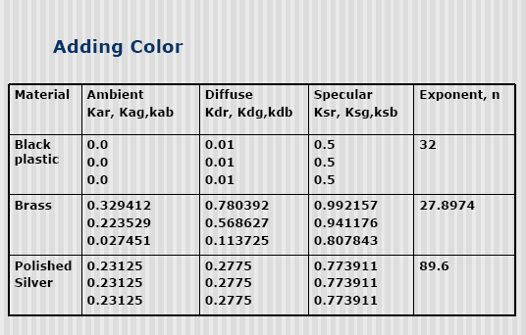

Slide 67
Assignment 9
Given that we have a brass (an alloy of copper and zinc) material object with shinny constant n =27.897, exposed to a single light source; with the following data :
L = ( 3 , 2 , 5 ) & N = ( 1 , 2 , 3 ) & V = ( 4 , 5 , 6 ) & R = ( 7 , 8 , 9 )
Compute:
shade value for each surface point I_{p} for Red
shade value for each surface point I_{p} for Green
shade value for each surface point I_{p} for Blue
Give your comment about the dominate shaded color
 | Object Reflection Constants |  |  | Object light intensity
 | K_{a} | K_{d} | K_{s} | i_{a} | i_{d} | i_{s}
Red | 0.3294 | 0.7803 | 0.9921 | 10 | 20 | 30
Green | 0.2235 | 0.5689 | 0.9411 | 40 | 50 | 60
Blue | 0.0274 | 0.1137 | 0.8078 | 70 | 80 | 90

