Slide 1
Pioneers of Digital Egypt Initiative
Under The Auspices of the Ministry Of Communications and Information Technology
Students name | Round Code | Recommend Track
Shaher Mohamed Gomaa Hassan | SHR1_ISS2_M1e | Cisco Network Administrator
Reem Adil Mohamed | SHR1_ISS2_M1e | Cisco Network Administrator
Hour Youssef AbulFutouh | SHR1_ISS2_M1e | Cisco Network Administrator
Mostafa Mohamed Abdel Samad | SHR1_ISS2_M1e | Cisco Network Administrator
Ahmed Nagy Fathey Glal | SHR1_ISS2_M1e | Cisco Network Administrator
Project Title:
Designing A Network Linking School Branches In Cairo And Alexandria
Under Supervision:
Eng. Sameh Kamal Elshamy
Company:
AST

Slide 2
Abstract
This project focuses on designing an efficient and secure network infrastructure to link school branches located in Cairo and Alexandria. The aim is to create a reliable communication
system that supports data transfer, resource sharing, and
centralized management across multiple locations. He proposed network would streamline administrative operations, enable real- time communication between branches, and support the integration of digital learning tools to enhance the educational experience for students and staff.

Slide 3
Introduction
In today's increasingly interconnected world, efficient and reliable communication between educational institutions is paramount. As schools expand across multiple cities, the need for a robust network infrastructure becomes critical to ensure seamless operations and enhance the quality of education. This project focuses on designing a secure and scalable network that links school branches in Cairo and Alexandria. The network will support a range of essential functions, from administrative operations to academic collaboration, enabling real-time data sharing, centralized resource management, and efficient communication between staff, students, and stakeholders. By implementing advanced technologies and adhering to best practices in network architecture, this solution aims to foster an environment where distance is no longer a barrier to educational excellence.

Slide 4




Components
7 Routers
33 Switches
7 Servers
20 Laptops
44 PCs
20 Access Points

Slide 5
Requirements
Cairo and Alex devices can connect to all except the database.
Control and policy can connect to all.
Active NAT protocol that Cairo and Alex can connect to the internet only by browsing and ping.
Active LAG / Ethernet channel to core switches.
Active DHCP and Port fast to all end devices.
Active PVST to all Uplink Switches.
Wireless AP can access all Laptops.
Redundancy Must exist in the core network Using HSRP.
The network and Security team can remotely access Cairo and Alex.

Slide 6


Connection
1- Shall we not build the Alexandria School network consisting of 15 switches, 20 computers, 10 laptops, and 10 Access point devices Then we put the address on it, and that is specific to the computer, but laptop devices are connected via wireless, then connect to the router (R5)
The IP of Alex branch is 192.168.2.0
Figure. [1]: DHCP Pool for Alex Network
2- Shall we not build the Cairo School network consisting of 15 switches, 20 computers, 10 laptops, and 10 Access point devices Then we put the address on it, and that is specific to the computer, but laptop devices are connected via wireless, then connect to the router (R0)
The IP of the Cairo branch is 192. 168.1.0
FigureError! No text of specified style in document.[2]: DHCP Pool for Cairo Network

Slide 7

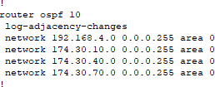
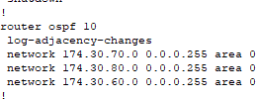
3- We connected all routers with each other’s by OSPF protocol
OSPF (Open Shortest Path First) is a link-state routing protocol used in IP
networks. It calculates the shortest path based on link cost, converges quickly, and supports large-scale networks by dividing them into areas.
Figure. [3]: OSPF protocol for Router 0
Figure. [4]: OSPF protocol for Router 1
Figure. [5]: OSPF protocol for Router 2

Slide 8

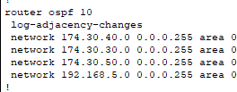
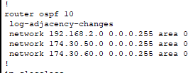
Figure. [6]: OSPF protocol for Router 3
Figure. [7]: OSPF protocol for Router 4
Figure. [8]: OSPF protocol for Router 5
4- R1 is responsible for the control and policy network connected to switch26
and 4 pc the IP of network 192.168.4.0
The first Pc is a system, the second pc is a network, the third pc is it, and the fourth pc is security
This network is very secure because this network allows access to all data.

Slide 9
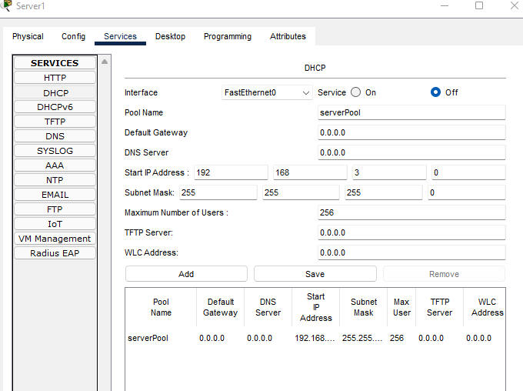
5-R2 is responsible for the server to the internet all network devices allow access to The Internet via a router 2 the ip of the network is 172.30.80.0 this network Allows all networks to reach it via IP to use the Internet.
5- R3, R4 is responsible for the database this network doesn’t allow any network to access it except the IT network by R1
R3 is responsible for the main database including one switch and three servers and R4 is responsible for the backup database including one switch and three servers
7- We used dynamic host configuration protocol version 4 (DHCPv4) is a protocol that allows network hosts to automatically receive an IP address allocation from a DHCP Server
Figure. [9]: DHCP4 protocol for server 1

Slide 10
6- We use access-list protocol (ACL) to permit or deny some network to another network like in the project used to permit the network to access the data server only and deny others.
Conclusion
In conclusion, establishing a reliable and secure network between two schools offers numerous advantages, including enhanced collaboration, shared resources, and improved communication. By leveraging modern networking, technologies such as fiber-optic connections, virtual private networks (VPNs), and cloud-based solutions, schools can ensure seamless data sharing, efficient resource management, and greater accessibility to educational tools.
Key considerations in this design include ensuring network security through firewalls and encryption, providing adequate bandwidth for handling peak loads, and implementing disaster recovery measures for uninterrupted learning. With these factors in place, the network will streamline operations and foster an enriched learning environment for both schools, paving the way for future growth and collaboration in education.

