Slide 2
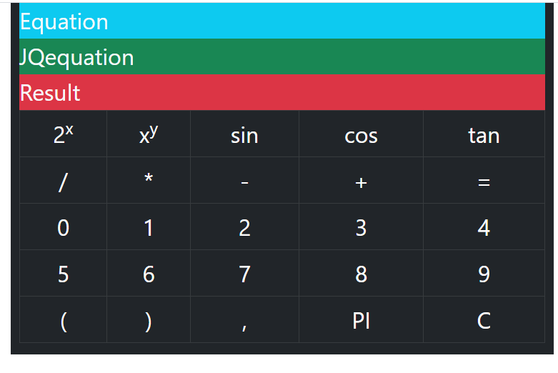

Slide 3
Create upper article
<main class="container " >
<section class="row ">
<article class="col-8 mx-auto bg-dark text-light fs-2" >
<div class="equation bg-info " style="height: 50px;">Equation</div>
<div class="JQequation bg-success " style="height: 50px;">JQequation</div>
<div class="result bg-danger" style="height:50px">Result</div>

Slide 4
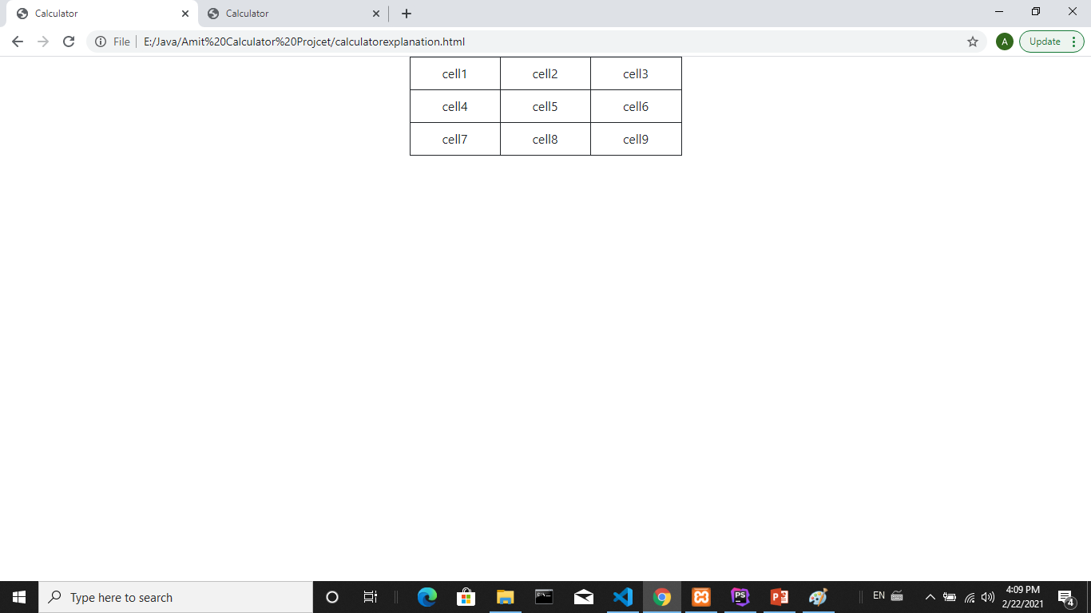

Slide 5
<table class="table table-bordered border-dark w-25 mx-auto">
<!--/////////////////first row//////////////////////////////////////-->
<tr>
<td>cell1</td>
<td>cell2</td>
<td>cell3</td>
</tr>
<!--/////////////////second row//////////////////////////////////////-->
<tr>
<td>cell4</td>
<td>cell5</td>
<td>cell6</td>
</tr>
<!--////////////////////third row//////////////////////////////////-->
<tr>
<td>cell7</td>
<td>cell8</td>
<td>cell9</td>
</tr>
<!--/////////////////////////////////////////////////////////////-->
</table>

Slide 6
Calculator Table code
<table class="table table-bordered fs-2 table-dark text-center" >
<table class="table table-bordered table-dark text-center" >
<!--first row-->
<tr>
<td >2<sup>x</sup></td>
<td >x<sup>y</sup></td>
<td >sin</td>
<td >cos</td>
<td>tan</td>
</tr>
<!--second Row-->
<tr>
<td >/</td>
<td >*</td>
<td >-</td>
<td >+</td>
<td class="execute" >=</td>
</tr>

Slide 7
<!--third row-->
<tr >
<td>0</td>
<td>1</td>
<td>2</td>
<td>3</td>
<td>4</td>
</tr>
<!--fourth row-->
<tr >
<td>5</td>
<td>6</td>
<td>7</td>
<td>8</td>
<td>9</td>
</tr>
<!—fifth row-->
<tr >
<td>(</td>
<td>)</td>
<td>,</td>
<td >PI</td>
<td class="clear">C</td>
</tr>
</table>
</article>
</section>
</main>

Slide 8
Jquery Built in Math Functions
Math.pow(2,y) :calculate 2 to the power y
Math.pow(x , y) :calculate x to the power y
Math.cos(x) : calculate cos(x);
Math.sin(x) : calculate sin(x)
Math.tan(x) :calculate tan(x)
Math.PI :returns pi

Slide 9
Simple calculation code
Html:
<div class="text-center">
<input class="jqequation mt-5"><br>
<button class="calculatejqequation mt-5">calculate equation</button>
</div>
jquery:
<script>
$(document).ready(function(){
//click calculatejqequation button
$(".calculatejqequation").click(function(){
// get the value (the text) of the input
var jqequation=$('.equation').val();
//alert the mathematical value of jqequation value
alert (eval (jqequation));
}) }) </script>

Slide 10
HTML Code explanation
1] create div which has “text-center” to align elements to center
2] create html input element of class=“jqequation”
where we write jquery function
has mt-5 (margin-top)
3] create button which calculate the equation when clicked
Has mt-5 (margin-top)

Slide 11
Jquery Code Explanation
When “caculatejqequation” button clicked:
1]Take the value in “JQequation” div store it in jqequation variable
2]Then alert(Mathematical Value of jqequation variable)

Slide 12
Add this code
Add button to calculate cos
Which adds to the “jqequation” input “Math.cos”
HTML:
<button class="cos" >cos</button>
jquery:
$(".cos").on("click",function(){
//get the value(text) from input save it in jqequation
var jqequation=$('.jqequation').val();
//Add "Math.cos(" to the input
$(".jqequation").val(jqequation + "Math.cos(");
})

Slide 13
Bootstrap and HTML design

Slide 14
Jquery code : click on general cell
///when you click the cell add text to Myequation div and equation div
$("tr td").on("click",function(){
var funcname=$(this).text();
switch ( funcname )
{
case '2x’ : funcname="pow(2"; jqfuncname="Math.pow(2";break;
case 'xy‘ : funcname="pow(“ ; jqfuncname="Math.pow(";break;
case 'sin': funcname="sin(“ ; jqfuncname="Math.sin(";break;
case 'cos': funcname="cos(“ ; jqfuncname="Math.cos(";break;
case 'tan': funcname="tan(“ ; jqfuncname="Math.tan(";break;
case '=‘ : funcname="“ ; jqfuncname="";break;
case "PI“ : funcname="PI“ ; jqfuncname="Math.PI“ ; break;
default:jqfuncname= funcname; break;
}
//Add the jquery function name to JQuery equation div text
$(".JQequation").text($(".JQequation").text()+jqfuncname);
// Add function name to the equation text div
$(".equation").text($(".equation").text()+funcname);
});

Slide 15
Jquery code : click on “=“ cell
$(".execute").on("click",function()
{
//get the text from Myequation div
var $result=($(".JQequation").text());
//get the mathematical value of $result
var $Mathresult = eval($result);
//display the result in result div
$('.result').text(($Mathresult));
});

Slide 16
Jquery code : click on “C“ cell
//when you click "C" button clear the equation and result and JQequation div’s
$(".clear").on("click",function(){
$(".equation").text("");
$(".JQequation").text("");
$(".result").text("");
})

Slide 17
Jquery code : cursor and hover
///Make cursor pointer on the cell
$("tr td").css ("cursor“ , "pointer");
///change color of the cell when hover
$("tr td").hover(function(){
$("tr td").css("background-color","#212529");
$(this).css("background-color","#444");
})

