Slide 1

DATA ENGINEERING PROJECT DEFENSE
FinTech Lakehouse
Batch + Incremental Data Engineering Pipeline
Medallion · Bronze→Silver→Gold
Kimball Star Schema
Local + Cloud Architecture
Presented by
Ahmed Nhmedo Amr Magdy Mohamed ElNoby Abdelrahman Hussien
FinTech digital payments & transfers analytics platform
Notes:
Good [morning/afternoon]. I'm Ahmed, and this is the FinTech Lakehouse — an end-to-end data engineering platform for digital payment and transfer transactions. The headline is that it does two things into one warehouse: a batch pipeline that initializes the full history, and an incremental Kafka pipeline that keeps it current. It follows the Medallion architecture and a Kimball star schema, it's fully built and verified locally, and it has a working Microsoft Fabric cloud companion. I'll walk through the problem, the architecture, the data model, both pipelines, the cloud build, and the Power BI dashboards.

Slide 2







PRESENTATION ROADMAP
Agenda
01
02
03
Problem & Solution
System Architecture
Data Model
Why a lakehouse — the business gap
Hybrid local design, two pipelines
Kimball star: 1 fact · 7 dimensions
04
05
06
Local Solution
Cloud Solution
Power BI Dashboard
Batch + incremental into SQL Server
Microsoft Fabric companion build
Volume, declines, FX, merchants
2
Notes:
Here's the path. I'll start with the business problem and the solution, then the system architecture. Then the data model — the Kimball star. The core of the project is the local solution: the batch pipeline and the incremental Kafka pipeline. After that, the Microsoft Fabric cloud companion, the Power BI dashboards, and the validation evidence. Each section is built to be explained in under a minute.

Slide 3




SECTION 01 — PROBLEM & SOLUTION
The Business Problem
A fintech company processes large volumes of digital payment and transfer transactions — but the raw operational data exists only as scattered CSV exports.
Scattered CSV exports
Slow & delayed insight
8 raw files, no conformed, trusted dataset to build on
Reporting on volume, FX and KPIs is reactive, not repeatable
Manual & error-prone
No way to absorb new data
Hand-joined spreadsheets with no referential integrity
No repeatable path to ingest new transactions as they arrive
3
Notes:
The starting point is messy. The company runs huge volumes of payments and transfers, but the data lives as scattered CSV exports — eight separate files. There's no trusted, conformed dataset, so any analysis of volume, decline reasons, FX activity, or merchant performance is slow, manual, and error-prone. And crucially, there's no repeatable way to absorb new transactions as they keep arriving. Those four gaps are exactly what the platform is designed to close.

Slide 4






SECTION 01 — PROBLEM & SOLUTION
My Solution: A FinTech Lakehouse
FROM → TO
What the platform supports
Scattered CSV exports no trust · no integrity · no refresh
Historical batch loading Full ~1.3M-row initial load of the warehouse
Incremental event ingestion New transactions stream in via Kafka
Trusted SQL Server warehouse Kimball star, FK-enforced, idempotent
Trusted FinTech Lakehouse
Conformed SQL Server star schema
Validated by dbt · consumed by Power BI
Refreshed by an event-driven stream
dbt validation & reporting 47 checks gate every load; reporting views
Power BI Desktop reporting KPI dashboards on the conformed model
Microsoft Fabric companion Same pattern re-expressed in the cloud
4
Notes:
The solution is a FinTech Lakehouse. The 'from-to' on the left is the whole story: we go from scattered CSVs with no trust to a single conformed, referentially-correct warehouse. On the right are the capabilities. The batch path establishes the warehouse with the full history; the incremental path keeps the fact table current as new events arrive. Both enforce the same data-quality and integrity rules, dbt validates the result, and Power BI consumes it. And the whole pattern is mirrored in a Microsoft Fabric cloud companion.

Slide 5
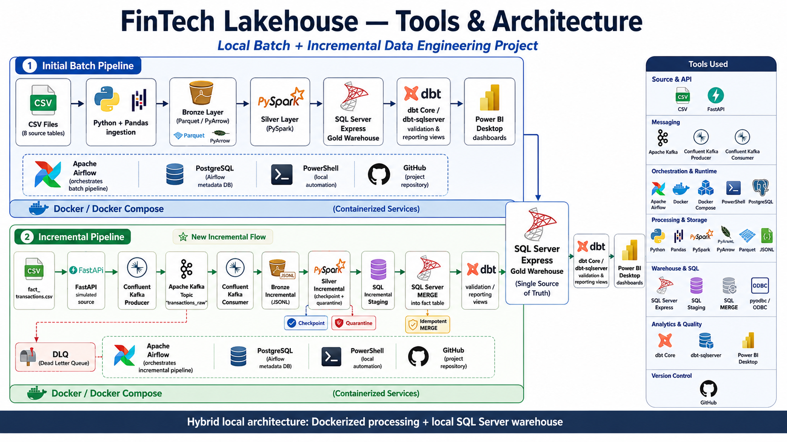
SECTION 02 — SYSTEM ARCHITECTURE
Hybrid Local Architecture
IMPLEMENTED · LOCAL
Dockerized processing + local SQL Server warehouse
① Batch Pipeline
CSV → Bronze → Silver → SQL Server → dbt → Power BI
Initializes the full star (7 dims + fact).
② Incremental Pipeline
FastAPI → Kafka → Bronze JSONL → Silver → SQL staging → MERGE → dbt
Upserts only new transactions.
Both pipelines converge on one SQL Server Express Gold warehouse (fintech_db · dbo.*).
5
Notes:
This is the full local architecture. Read it as two tracks that converge. The top track in blue is the batch pipeline: eight CSVs through Pandas to a Bronze parquet layer, PySpark for Silver, into SQL Server, validated by dbt, into Power BI. The bottom track in green is the incremental pipeline, which adds the event backbone — FastAPI, Kafka, a JSONL bronze, a Spark silver, then SQL staging and a MERGE. Both land in the same SQL Server Express gold warehouse, the single source of truth. The split is deliberate: lake processing runs in Docker, while the warehouse layer runs on the Windows host for trusted authentication.

Slide 6
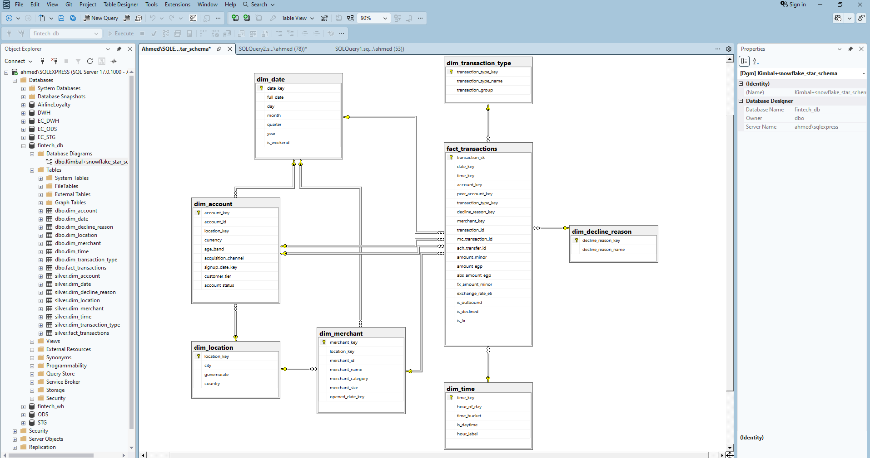
SECTION 03 — DATA MODEL
Kimball Star Schema
1 fact 7 dimensions
fact_transactions + dim_date, dim_time, dim_location, dim_account, dim_merchant, dim_transaction_type, dim_decline_reason
Keys
transaction_id business key (UNIQUE) transaction_sk IDENTITY surrogate 7 FKs fact → each dimension
Verified row counts
fact_transactions
1,000,000
dim_account
40,000
dim_merchant
1,200
dim_time
1,440
dim_date
731
dim_location · type · decline
19 · 13 · 8
6
Notes:
The gold layer is a Kimball star: one fact table, fact_transactions, surrounded by seven dimensions. The business key is transaction_id, which carries a unique index — that's the anchor for both the batch dedupe and the incremental MERGE. The surrogate key, transaction_sk, is an IDENTITY column. The fact connects to every dimension through foreign keys, and dim_account is role-playing — it serves both the account and the peer-account on a P2P transfer. The model is built to answer transaction analytics, decline analysis, FX, merchant performance, and customer behaviour. On the right are the actual verified row counts straight from the warehouse — a million facts.

Slide 7
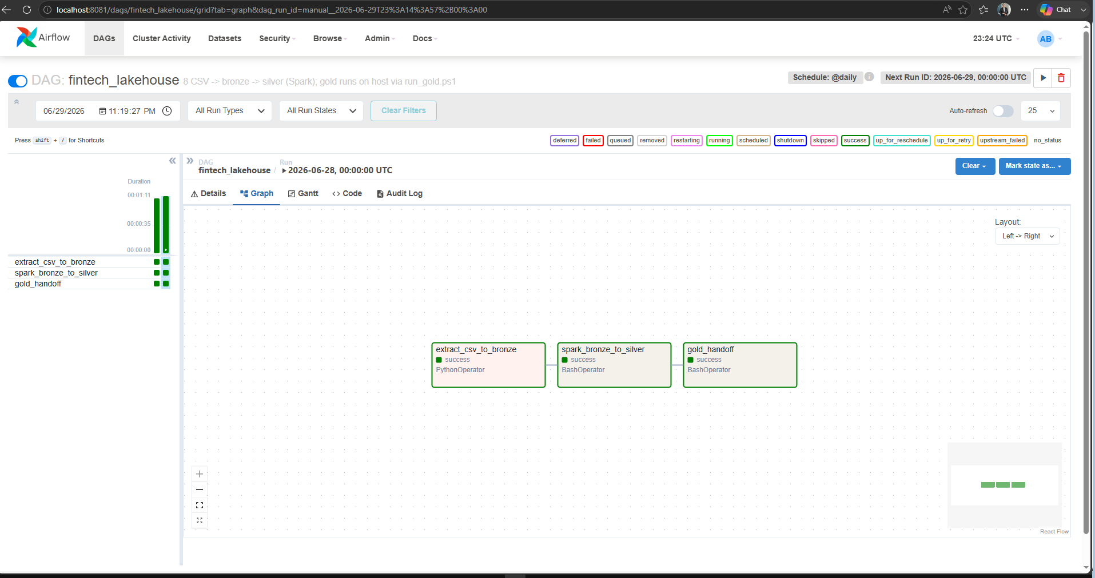
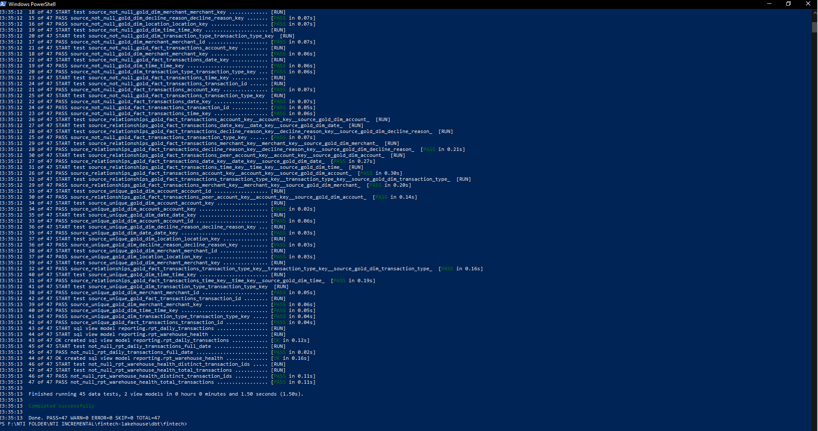
SECTION 04 — LOCAL SOLUTION
Initial Batch Pipeline
IMPLEMENTED · LOCAL
Medallion ETL — initializes the warehouse
8 CSV files
Pandas → Bronze
PySpark → Silver
SQL Server Gold
dbt validate
Power BI
Airflow DAG fintech_lakehouse — extract → spark → gold_handoff (all success)
dbt build — PASS=47 (45 data tests + 2 reporting views), 0 errors
Bronze preserves raw data
Silver cleans & conforms
Gold Kimball star schema
7
Notes:
The batch pipeline initializes the warehouse. Eight CSVs, roughly 1.3 million rows, flow through Pandas into a Bronze parquet layer, then PySpark conforms them into Silver — type casting, trimming, de-duplicating on the natural key. From there they load into the SQL Server gold star, and dbt validates. Orchestration is split: Airflow, running in Docker, owns the lake stages — you can see the three-task DAG all green — and PowerShell owns the warehouse stages, because that's where Windows authentication lives. The dbt build on the right is the quality gate: 47 checks pass, zero errors. Bronze preserves raw, Silver conforms, Gold is the star.

Slide 8


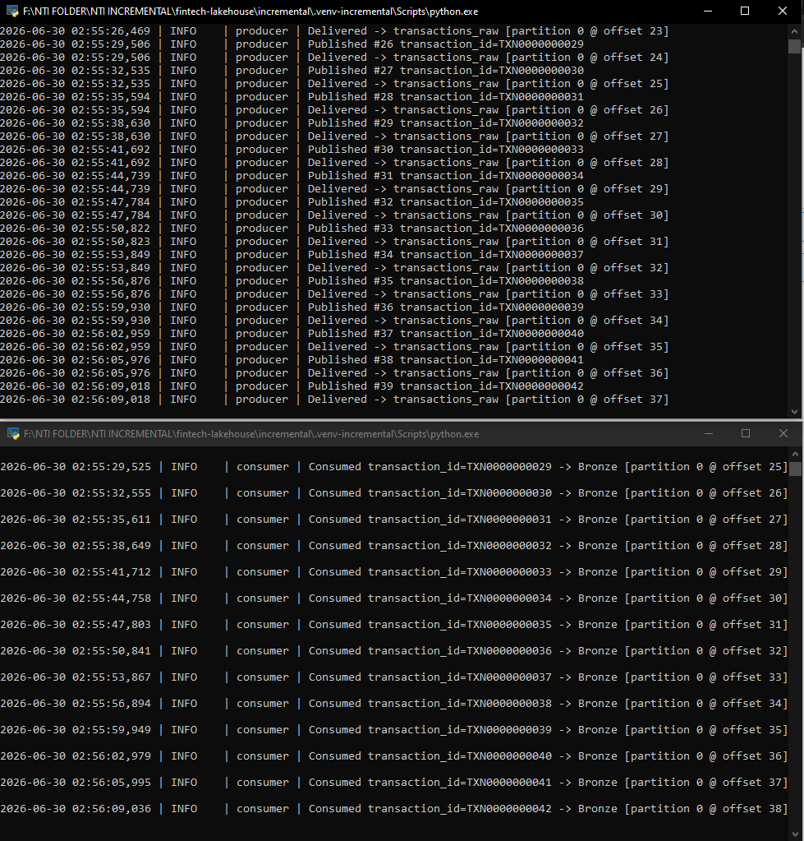
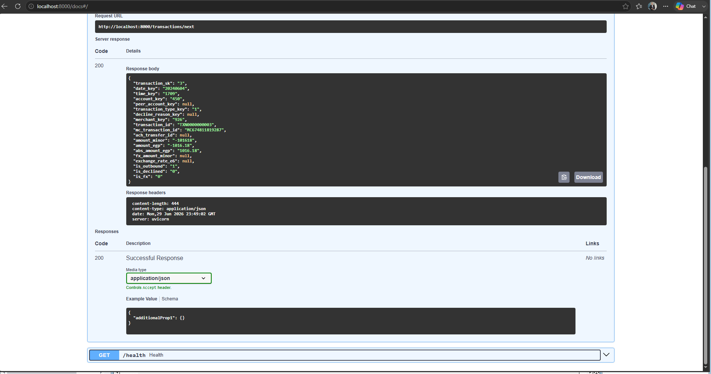
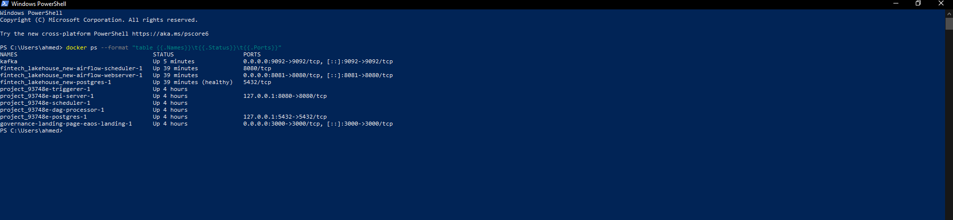
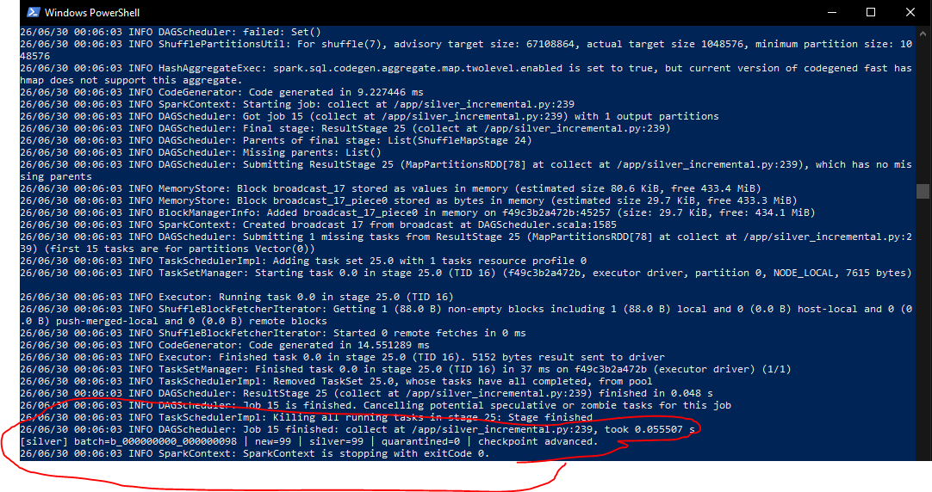
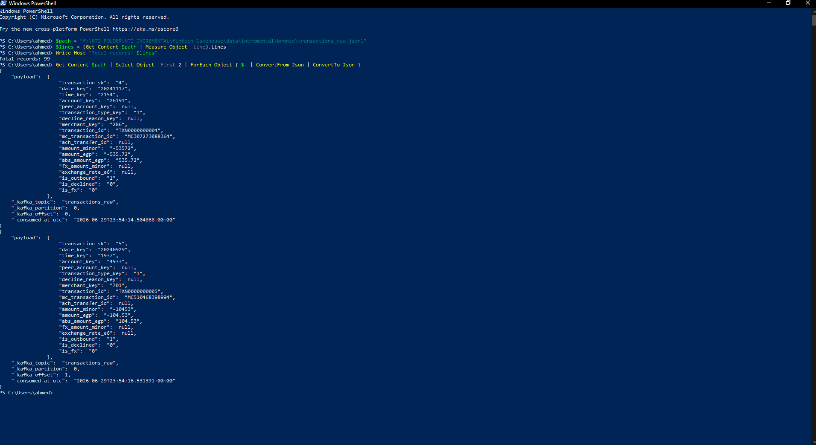

SECTION 04 — LOCAL SOLUTION
Incremental Kafka Pipeline
IMPLEMENTED · LOCAL
Event-driven — only new transactions; dimensions stay batch-loaded
fact CSV
FastAPI
Kafka Producer
topic transactions_raw
Consumer
Bronze JSONL
Silver Parquet
SQL staging
SQL MERGE
FastAPI /transactions/next
Kafka KRaft broker running (docker)
Silver micro-batch: new=99 · quarantined=0
Bronze JSONL — raw event + Kafka lineage
Producer → Consumer → Bronze JSONL (offset-tracked)
Only fact_transactions is streamed — dimensions stay batch-loaded; the idempotent SQL MERGE on transaction_id upserts only new or changed rows, never reloading history.
8
Notes:
This is the part I'm most proud of — the incremental pipeline. It simulates how a real bank receives a continuous feed. A FastAPI endpoint serves one transaction per request; a Confluent Kafka producer publishes to a KRaft topic — no ZooKeeper; a consumer writes each event to a Bronze JSONL with full Kafka lineage. PySpark then conforms a micro-batch into Silver, here ninety-nine new rows with zero quarantined. The key design choice: only the fact is streamed, because it's the only genuinely append-only, high-velocity table. Dimensions stay batch-loaded. And the load into the warehouse is an idempotent MERGE on transaction_id, so we upsert deltas instead of reloading a million rows.

Slide 9

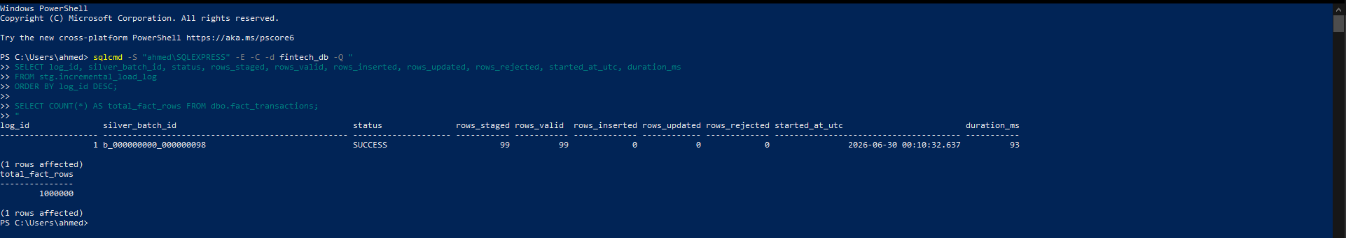
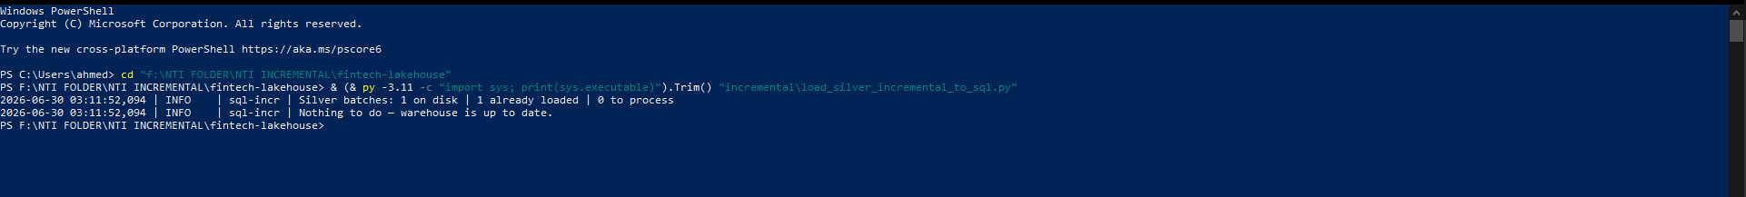
INCREMENTAL PIPELINE
Reliability & Data Quality
Kafka KRaft (no ZooKeeper) fewer moving parts, single-node quorum
At-least-once consumer write Bronze, then commit offset — crash replays
DLQ for poison messages unparseable events isolated, pipeline keeps flowing
Append-only Bronze JSONL immutable raw history, never mutated
Silver offset checkpoint Kafka offset = replay-safe watermark
Quarantine with _dq_reason invalid rows isolated, not dropped
SQL staging before MERGE validate & reject before touching the warehouse
Idempotent MERGE insert new, update changed, no-op identical replays
SQL audit / load log one row per batch; second SUCCESS impossible
dbt build = final gate post-MERGE check of keys, FKs, domains, sanity
Idempotent re-run — “warehouse is up to date”
Load log: SUCCESS · 99 staged / 99 valid / 0 rejected · fact = 1,000,000
9
Notes:
Because this is financial data, reliability is layered end to end. The consumer is at-least-once: it durably writes Bronze and only then commits the Kafka offset, so a crash replays rather than loses an event. Bad messages go to a dead-letter queue; bad rows are quarantined with a reason, never silently dropped. Silver checkpoints on the Kafka offset, which is a perfect replay-safe watermark. SQL staging validates and rejects before the MERGE, and the MERGE itself is idempotent on transaction_id — identical replays are no-ops. Every batch is logged, and dbt is the final gate. The two screenshots prove it: a re-run finds nothing to do, and the audit log shows a clean SUCCESS with the fact still at exactly one million.

Slide 10
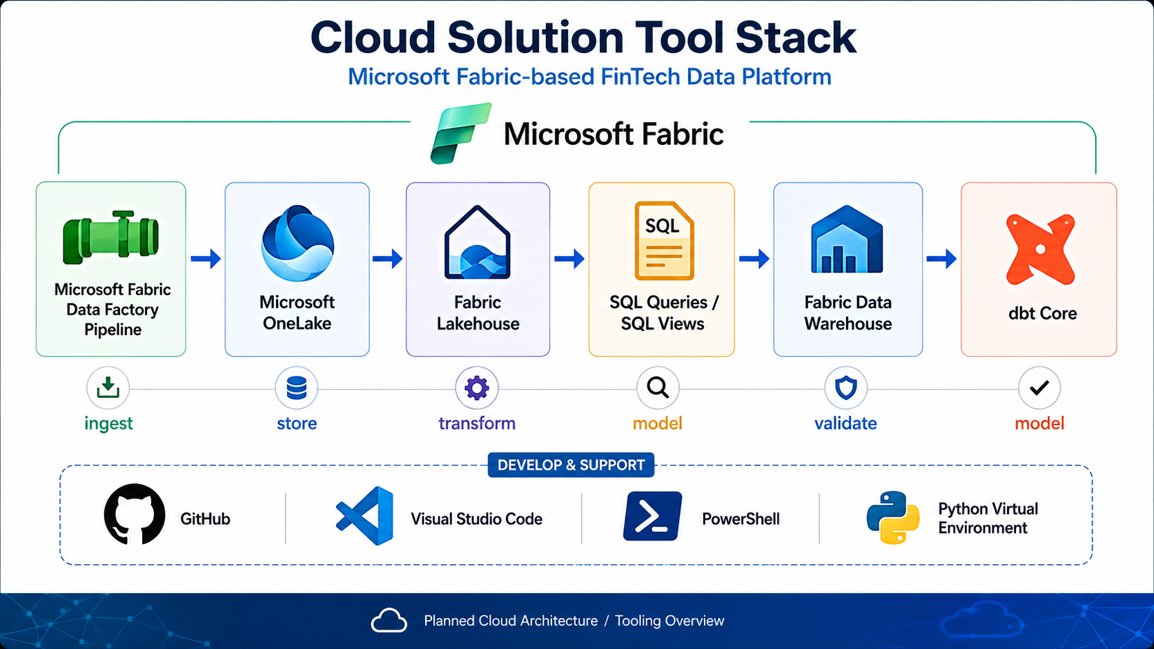
SECTION 05 — CLOUD SOLUTION
Microsoft Fabric Companion
DESIGN TARGET · MICROSOFT FABRIC
Same Medallion + Kimball pattern, re-expressed on Fabric
Target flow
1
Cloud CSV source raw transaction datasets
2
Data Factory pipeline parameterized · ForEach · Copy
3
OneLake Lakehouse — Bronze raw Delta + ingestion metadata
4
Silver SQL views cast · trim · dedupe · validate
5
Fabric Warehouse — Gold SQL views + dbt-fabric KPI marts
6
Power BI Desktop reporting target
Identity via Microsoft Entra ID · workspace roles · service principals (distinct from the local Windows-Auth model).
10
Notes:
The cloud companion re-expresses the exact same Medallion-plus-Kimball pattern on Microsoft Fabric. The tool stack on the left maps one-to-one to the local design: a Data Factory pipeline ingests, OneLake and a Fabric Lakehouse store the Bronze, Silver becomes conformed SQL views in the warehouse, and Gold is built with SQL plus dbt — here using the dbt-fabric adapter — feeding Power BI. The big architectural difference from local is identity: instead of Windows authentication, the cloud uses Microsoft Entra ID, workspace roles, and service principals. The original architecture document framed this as the target design; on the next slide I'll show it's actually deployed and running.

Slide 11

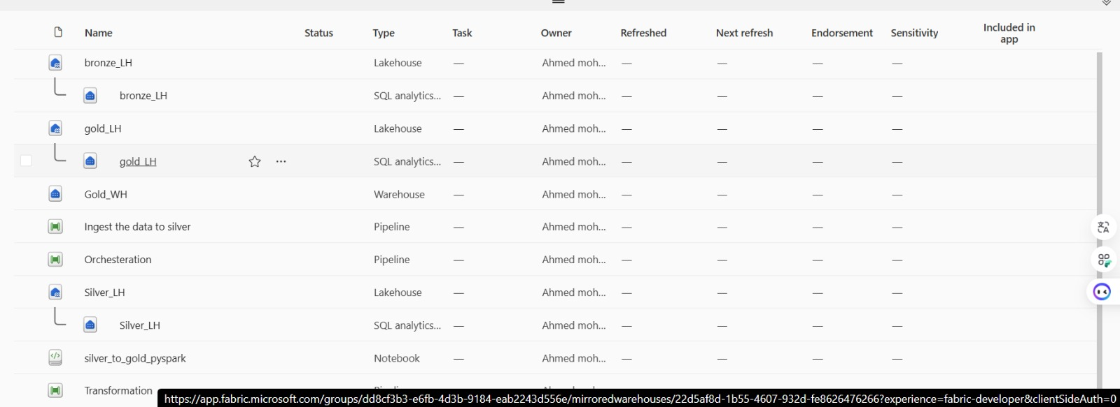
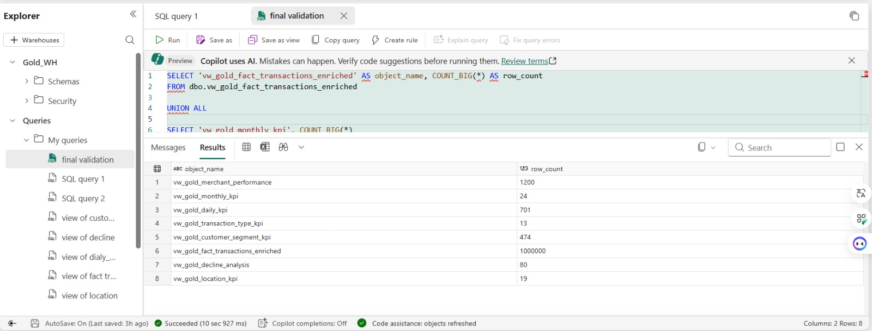
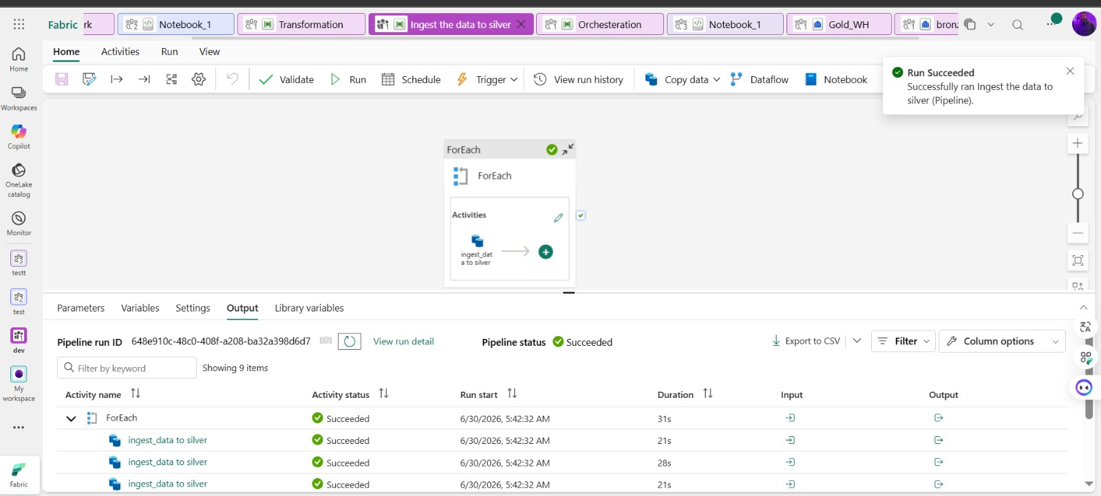
SECTION 05 — CLOUD SOLUTION
Fabric Build — Up & Running
BUILT & VALIDATED IN FABRIC
Data Factory pipeline “Ingest the data to silver” — Run Succeeded (ForEach, 9 items)
Fabric workspace items — bronze/silver/gold Lakehouses, Gold_WH, pipelines, notebook
Cloud Gold — verified
vw_gold_fact_transactions_enriched
1,000,000
vw_gold_merchant_performance
1,200
vw_gold_daily_kpi
701
vw_gold_customer_segment_kpi
474
decline_analysis · monthly · loc
80 · 24 · 19
Gold_WH validation query — vw_gold_fact_transactions_enriched = 1,000,000 rows
11
Notes:
And here's the proof the cloud build is real, not just a diagram. Top-left: the Fabric Data Factory pipeline 'Ingest the data to silver' ran successfully — a ForEach over the files, every activity green. Top-right: the deployed workspace, with Bronze, Silver and Gold lakehouses, the Gold warehouse, the orchestration and transformation pipelines, and the silver-to-gold notebook. And at the bottom, the validation query against the Fabric Gold warehouse: the enriched fact view returns exactly one million rows — matching the local warehouse — plus the KPI marts for merchants, daily, customer segments, declines and more. So the same data, the same counts, reproduced in the cloud.

Slide 12

ARCHITECTURE COMPARISON
Local vs Fabric Cloud
Area | Local Implementation | Fabric Cloud Build
Source | 8 CSV files; fact replayed via FastAPI | Cloud-hosted CSV datasets
Orchestration | Airflow (Docker) + PowerShell | Fabric Data Factory pipeline (ForEach)
Bronze | Parquet (batch) / JSONL (incremental) | Lakehouse / OneLake Delta tables
Silver | PySpark conformance to Parquet | Conformed SQL views in Warehouse
Gold | dbo.* star: full-reload + MERGE | Fabric Warehouse SQL views + dbt marts
Warehouse | SQL Server Express (fintech_db) | Fabric Warehouse (Gold_WH)
dbt | dbt-sqlserver (tests + views) | dbt-fabric (models, tests, docs)
Reporting | Power BI Desktop (Import) | Power BI Desktop
Authentication | Windows (Trusted) Auth — no secrets | Microsoft Entra ID · service principals
Monitoring | Exit codes · dbt · load log | Fabric monitoring + run history
12
Notes:
This table is the bridge between the two halves of the project. Every local component has a clean cloud counterpart, which is exactly why the migration path is realistic. Airflow-plus-PowerShell becomes a Data Factory pipeline. PySpark Silver becomes conformed SQL views. The SQL Server star becomes the Fabric warehouse. dbt-sqlserver swaps to dbt-fabric — often just changing the adapter type. Power BI stays Power BI. The one genuine re-architecture is authentication: local Windows Auth with no secrets becomes Entra ID with service principals. So the design isn't two unrelated systems — it's one pattern, two runtimes.

Slide 13
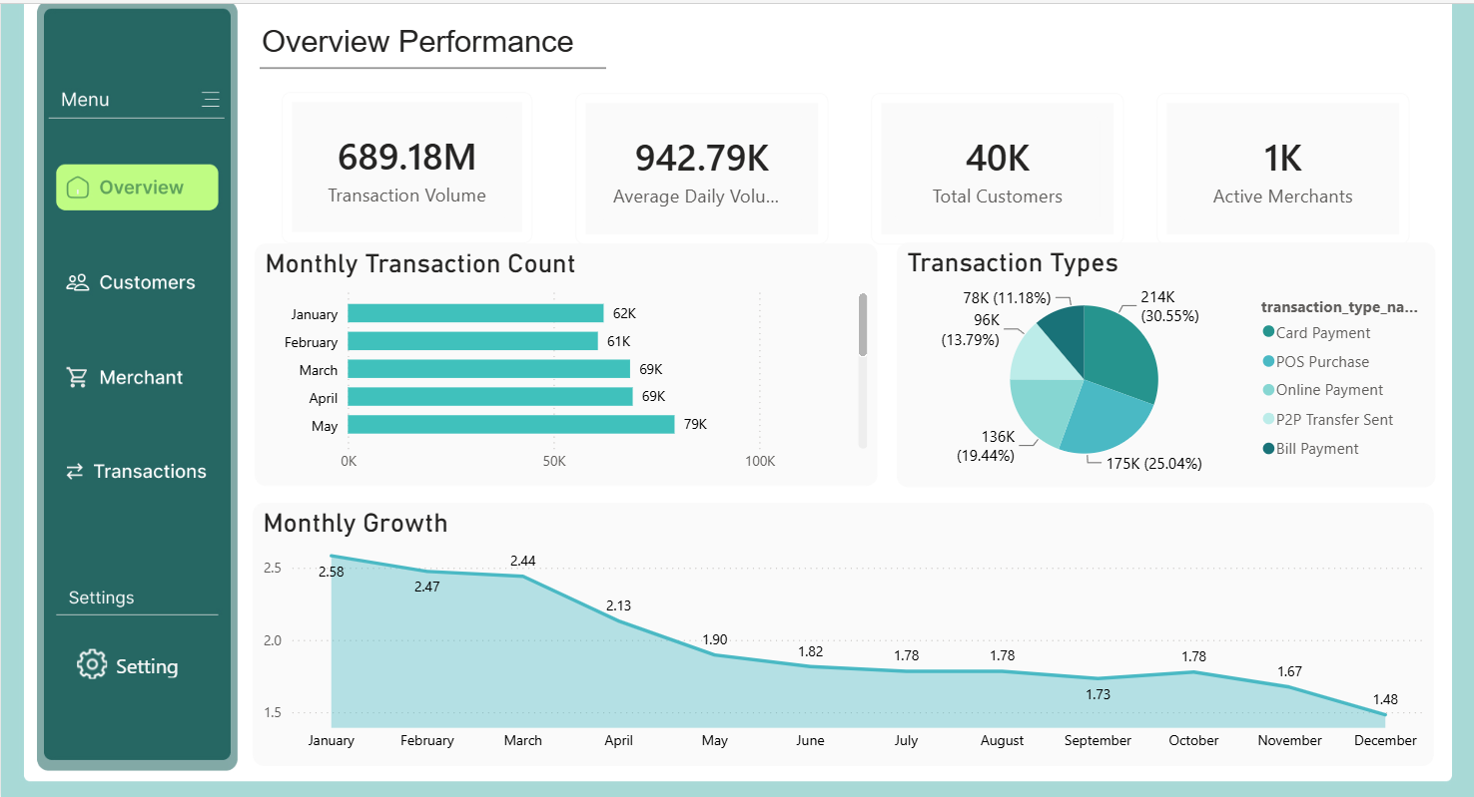
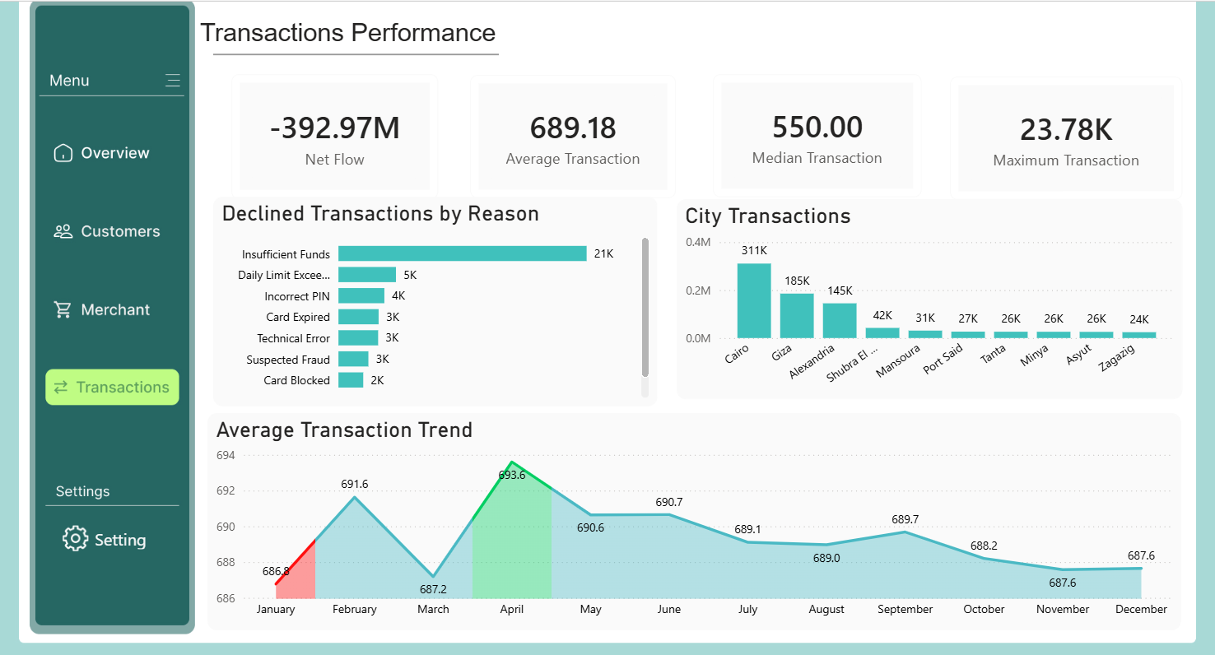

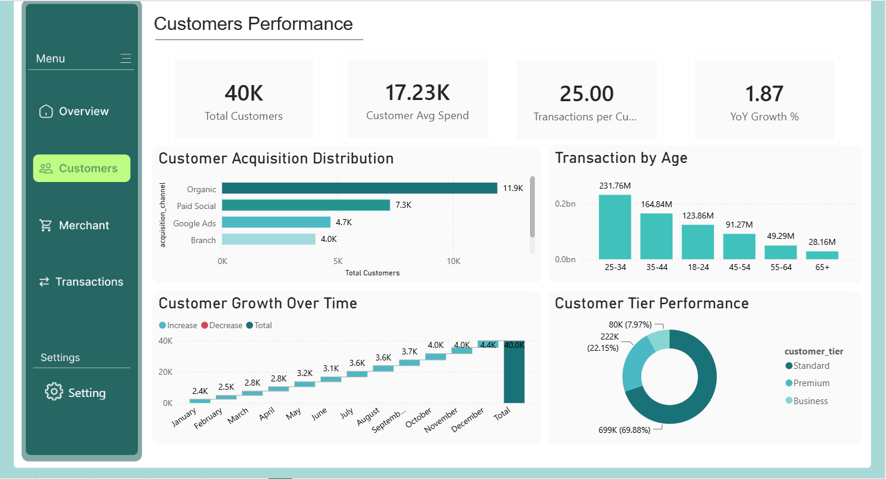
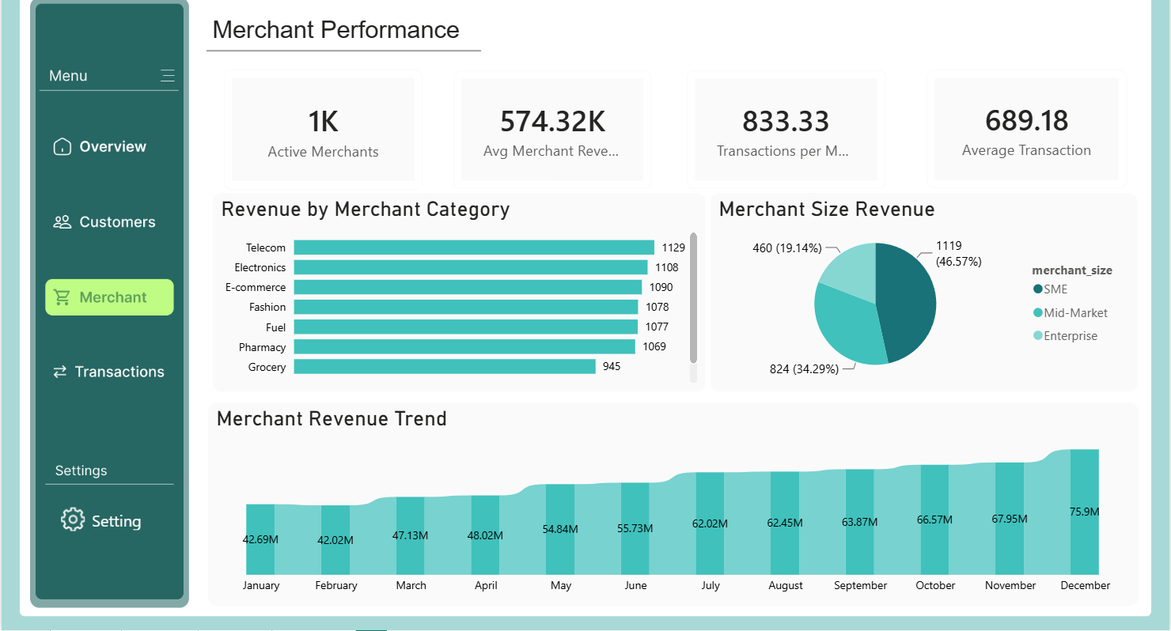


SECTION 06 — POWER BI DASHBOARD
Business Intelligence
Power BI Desktop · Import mode · Windows Auth — connected to the trusted warehouse / reporting views
Overview — 689.18M volume · 40K customers
Transactions — declines, FX, city & trend
Customers — tiers, acquisition, age, growth
Merchants — category, size mix, revenue trend
13
Notes:
Finally, the consumption layer. Power BI Desktop connects in Import mode over Windows Auth to the trusted warehouse and reporting views. There are four pages. Overview gives the headline KPIs — total transaction volume around 689 million EGP, forty thousand customers, the transaction-type mix. Transactions drills into decline reasons, FX, and city-level activity. Customers covers tiers, acquisition channels, age bands and growth. And Merchants shows category revenue, the SME-to-enterprise size mix, and the revenue trend. Because the source is frozen and deterministic, these numbers double as a benchmark — if a figure drifts, the model is stale or mis-connected.

Slide 14
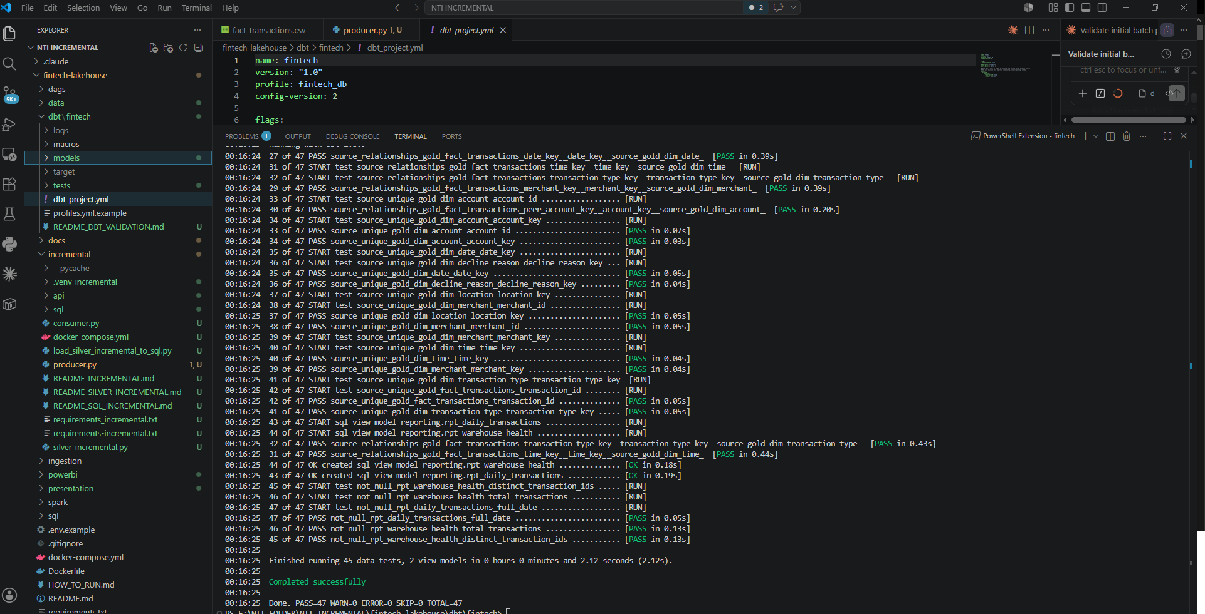
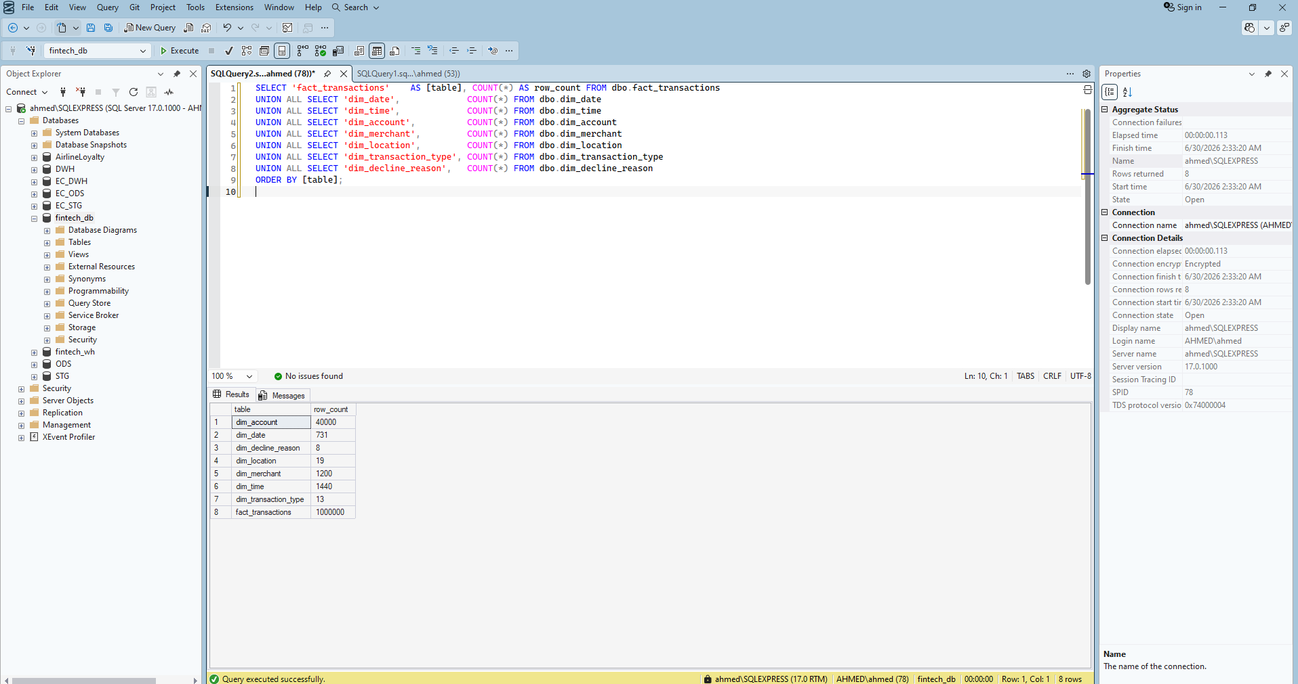
PROOF OF COMPLETION
Validation & Evidence
Completion checklist
Initial batch pipeline completed
Incremental Kafka pipeline completed
SQL MERGE validated (idempotent)
dbt build PASS = 47 · WARN/ERROR = 0
dbt build — Done. PASS=47 WARN=0 ERROR=0
No duplicate transaction_id
No orphan foreign keys
Reporting views created
Cloud Gold reproduces 1,000,000 rows
Warehouse row counts — fact_transactions = 1,000,000
14
Notes:
Pulling the evidence together. Both pipelines run end to end. The MERGE is proven idempotent. dbt build passes all forty-seven checks with zero warnings or errors — that single green result asserts uniqueness, intact foreign keys, valid domains, and sane measures all at once. There are no duplicate transaction_ids and no orphan keys. The reporting views are live, and the cloud Gold warehouse independently reproduces the same one million rows. So the correctness claim isn't a promise — it's checked by automated tests on every load, locally and in the cloud.

Slide 15

FINAL OUTCOME
A complete data engineering platform
Historical batch loading Full ~1.3M-row warehouse initialization
Incremental ingestion Event-driven Kafka stream, idempotent MERGE
Medallion architecture Bronze → Silver → Gold, both pipelines
Kimball dimensional model 1 fact · 7 conformed dimensions
SQL Server warehouse Trusted, FK-enforced single source of truth
dbt validation 47 automated checks gate every load
Power BI analytics Volume, declines, FX, merchants, customers
Microsoft Fabric evolution Same pattern, built & validated in the cloud
15
Notes:
To sum up the value delivered: this is a complete, working data engineering platform. It does historical batch loading and incremental event-driven ingestion. It implements the Medallion architecture and a Kimball dimensional model. It lands in a trusted SQL Server warehouse, validated by forty-seven automated dbt checks, and surfaced through Power BI analytics. And it has a real Microsoft Fabric evolution path that's already been built and validated. The design goal throughout was reproducibility and correctness — every KPI is traceable back through conformed, tested data.

Slide 16
Thank You
Questions?
Medallion
Kimball Star
Kafka Incremental
dbt · 47 checks
Power BI
Microsoft Fabric
FinTech Lakehouse · Batch + Incremental Data Engineering Pipeline · Ahmed Nhmedo
Notes:
That's the FinTech Lakehouse: a batch and incremental data engineering pipeline, built locally end to end and validated in Microsoft Fabric. Thank you — I'm happy to take questions, whether on the Kafka incremental design, the MERGE idempotency, the dbt testing, or the Fabric migration path.

