Slide 1
Get Fit Right
By: Ahmed, Edgar, Rameez, Zakee

Slide 2
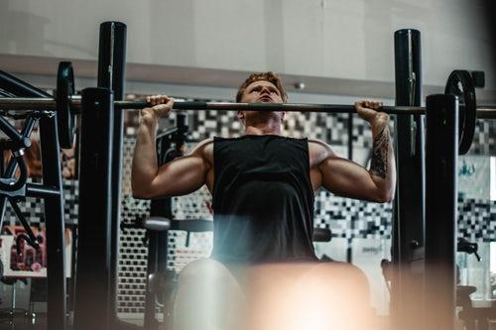
Overview
Our Idea - Get Fit Right
The need
Current Issues
The fix
Technology we are developing

Slide 3




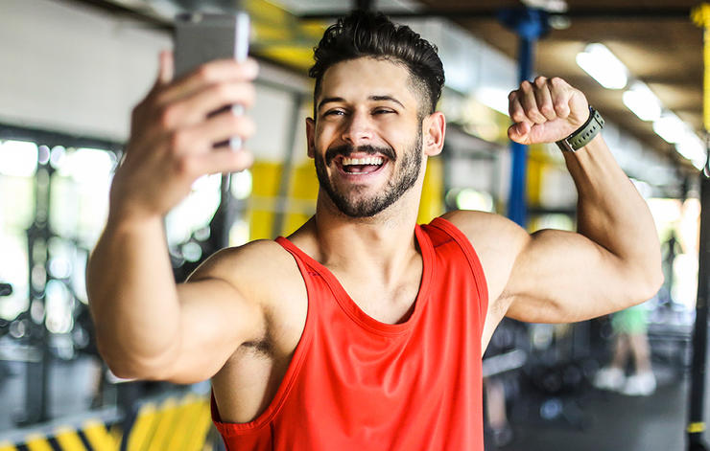
Client, Customers, Hands on Users
Client - Nike Inc.
Customers
Professional Sports Teams
Personal Trainers
Hands on Users
Professional Athletes
Gym Goers

Slide 4



Underlying Tech
Smartphone Camera
Motion tracking
Machine Learning
Instant feedback
Saving Data
Cloud

Slide 5
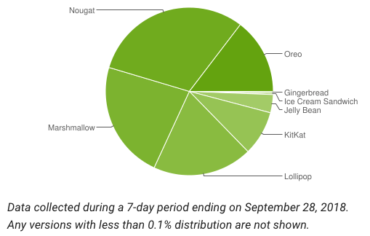
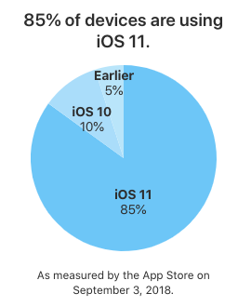


Supported Platforms

