Slide 1
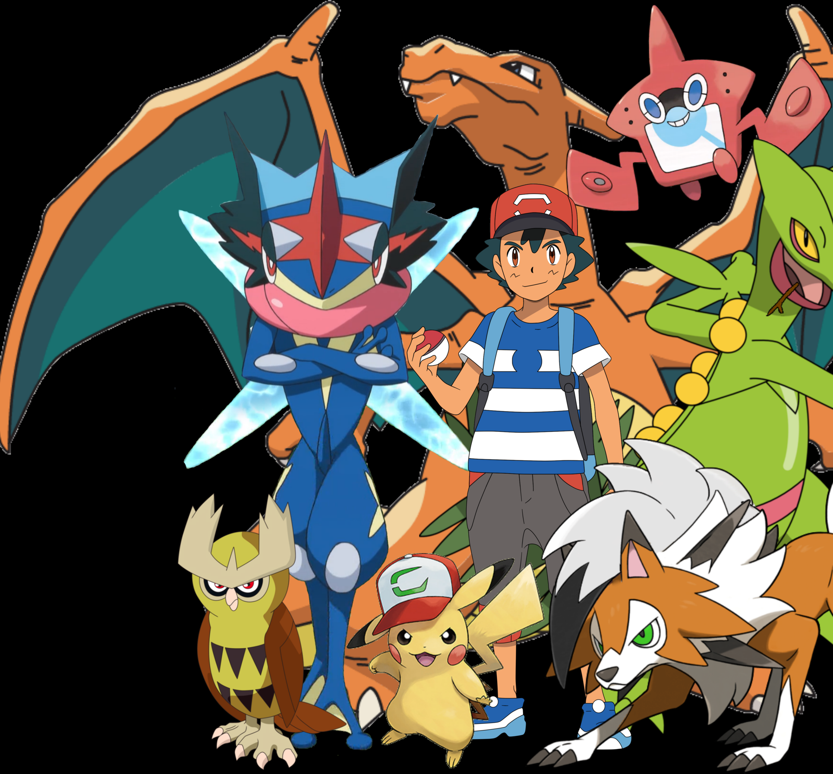
Pokémon Card Match Memory Game Team 15
Ahmed, Aaron, Adarsha, Josh
CPSC 233 – T04 – Dr. Nathaly Verwaal.

Slide 2
Project Description
Card match memory game.
The game generates random pairs of cards. The objective is to allow the interaction of two players taking turns flipping two cards. The cards selected must match to be eliminated from the field of play and a score would be earned. Throughout the alternation of each player, if a player consecutively matches two cards without fail, the player would gain bonus points for each consecutive match until they fail to match the card then the point system would reset back to granting 1 score per match. After all cards have been matched and eliminated from the field of play, the player with the highest number of points will win the game and the message “PLAYER (#), WINS!” is displayed. If both players achieve the same number of points, then the game would display “DRAW!” In the case that the player plays a match against a computer, if computer wins it would display “COMPUTER WINS!”

Slide 3
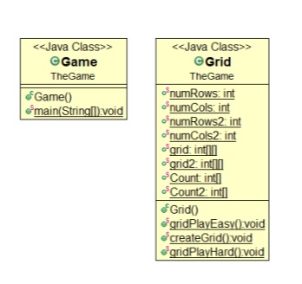
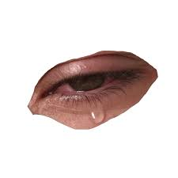
DEMO 1 Class Diagram 😒😢
Previously the game had two class diagram and contains a Game class and Grid class.
The class contains methods in the grid. The Game.java file contains the main string.
The grid class would extend the main Game class.

Slide 4
DEMO 2 Class Diagram 😃😎
Currently game has FIVE classes & the class diagram contains a Game class, Grid class, Multiplayer Class, Computer Class and GUI Class.
The class contains methods in the grid. The Game.java file contains the main string.
The Grid Class would be considered the SUPERCLASS.

Slide 5
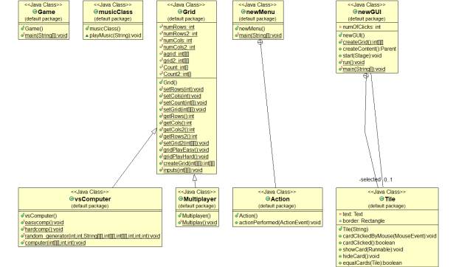
DEMO 2 Class Diagram 😃😎

Slide 6
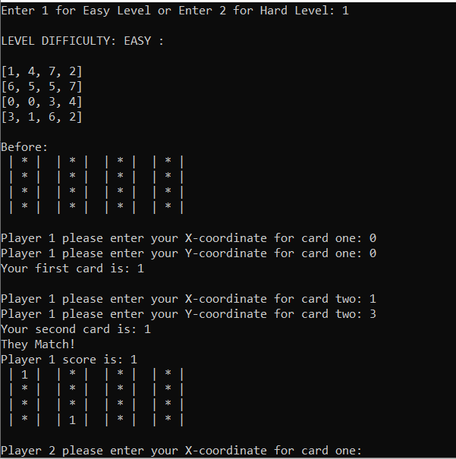
Text-Based Interface
The image portrays the text based interface allowing the user to enter their X coordinate and Y coordinate.
The starting point of the coordinate is (0,0) which is the top left corner of the screen.
The coordinate is (x,y) the incrementation of X would move the coordinate right and the incrementation of Y would move the coordinate down.

Slide 7
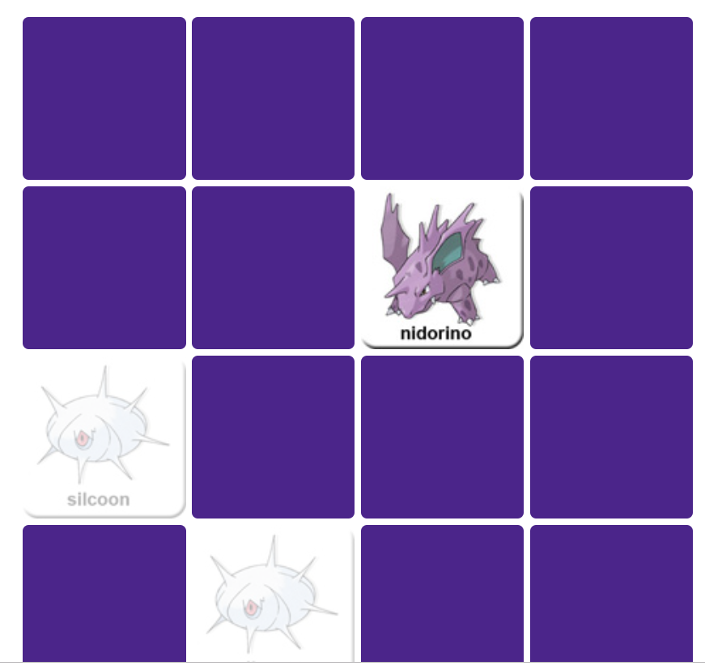
Graphical User Interface (EXPECTATIONS)
The graphical game portrayed is rather simple. The project our group will create will contain more advance features allowing user to play against computers and other users.
This is the graphical-user interface that would be portrayed in the final project minus some extra features that would soon be added in the game.
Animations and graphics will be implemented in the product.

Slide 8
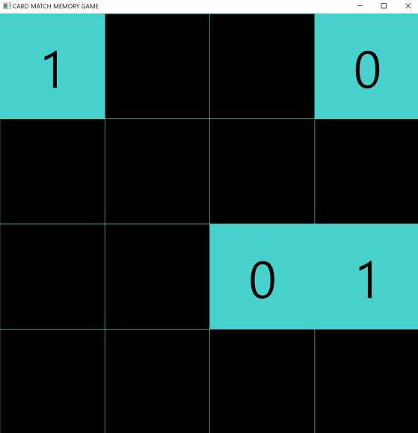
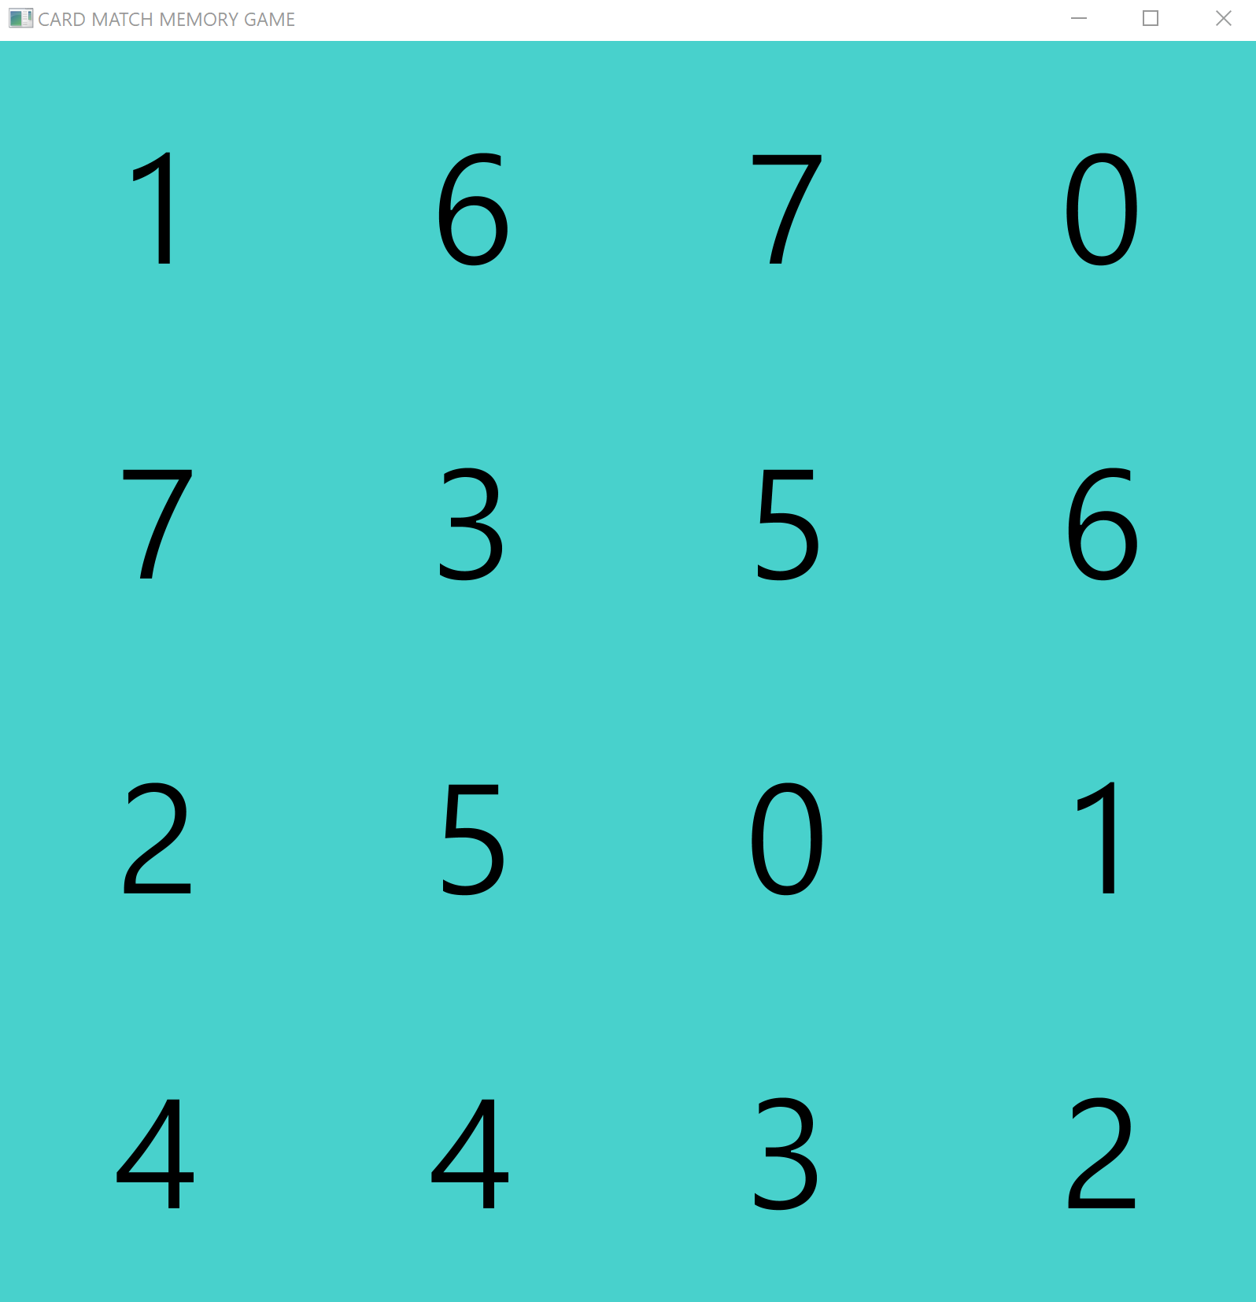
Graphical User Interface (REALITY)

Slide 9
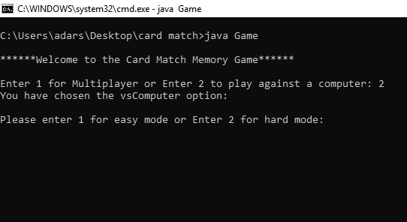
Difficulties 🛰
- You can select 2 modes Multiplayer and Computer and also 2 difficulties for each, easy and hard

Slide 10
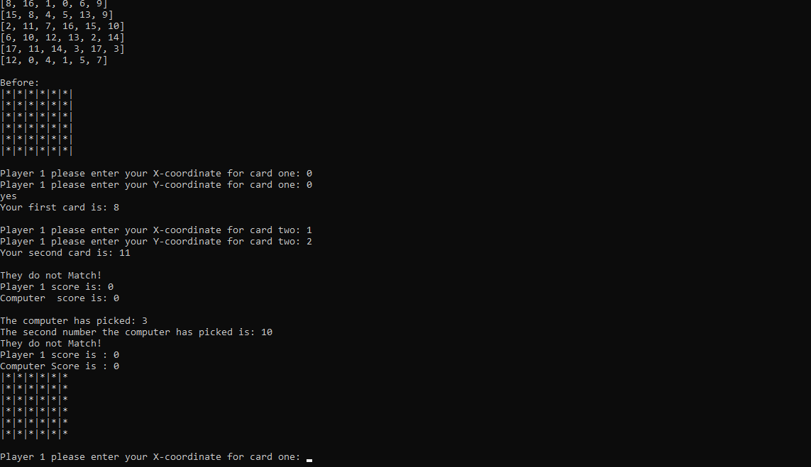
More features of computer
Each difficulty not only brings up a different grid size, but also higher probability for the computer to match the cards

Slide 11
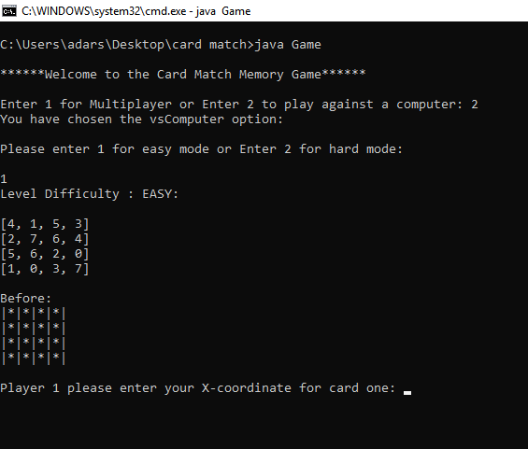
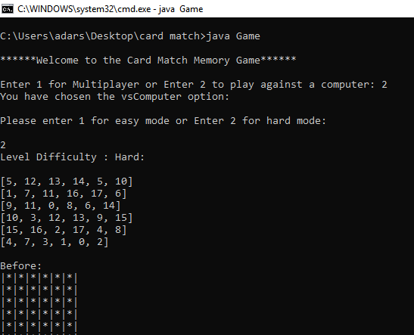
Smarter computer
Easy mode for computer presents a 4x4 grid with 50% probability of the computer getting the guess right
Hard mode contains a 6x6 array with a 75% probability of the computer's guess being correct

Slide 12

Addition of GUI
We have also added a single player interactive version of GUI

