Slide 1

Event Sourcing
Workshop
Gabriel Schenker, PhD, Principal Architect

Slide 2
This is not presentation…

Slide 3
You learn by doing…
“Theory is good
Practice is better”

Slide 4
Agenda
9:00am-9:20am Introduction
9:20am-12:00pm Pair programming
12:00pm-1:00pm Lunch
1:00pm-1:15pm Q & A
1:15pm-4:00pm Pair programming
4:00pm-4:10pm Wrap up
4:10pm-??? Coding with beer

Slide 5
Magic triangle
Client
ACK/NACK
DTOs
Command
Queries
Queries
Domain
Read Model
Events
Events
3
Event Store
Replay
2
1

Slide 6
Events of a single Task instance
n - TaskCompleted
⁞
3 - TaskAccepted
Event Store
2 - TaskPublished
1 - TaskScheduled

Slide 7

Commands
Exactly 1 target
Can be refused
Name is context
Name in imperative PublishTask, AssignTaskTarget, RejectTask, etc.
Minimal payload
Response: ACK/NACK

Slide 8

Events
0..n targets
Cannot be refused
Name is context
Name in past tense TaskPublished, TaskTargetAssigned, TaskRejected, etc.
Can be enriched
Cause state change
Are immutable

Slide 9
Commands
Queries
Web API
Web API
Domain
Light weight DAL
SQL
Server
Observers
Repository
Events
Dispatcher
Mongo
DB
Events
Async.
Event
Store
Elastic
Search
Read Model

Slide 10
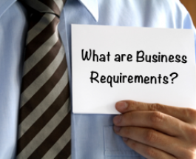
What?
Create an Animal Census System

Slide 11
Hints
Concentrate on the events
Play with read model
Use iteration zero

Slide 12

And now what?
Work in teams of 2-4
Teams interact
I’m here to help
Code on GitHub https://github.com/gnschenker/ES-workshop

