Slide 1



Bank Loan Default Risk Analysis
(Business part)
Team 8

Slide 2

Problem
Banks face significant financial losses due to loan defaults
Applications with no credit history or missing guarantees create high risks
Need for better risk assessment models to minimize default-related losses
Current lending strategies may not adequately identify high-risk applicants

Slide 3
Motivation
This study and its findings will help banking institutions:
Identify key risk factors in loan applications and improve lending strategies
enabling them to determine which areas require enhanced verification procedures
which customer segments deserve favorable terms
ultimately leading to reduced default rates and increased profitability through data-driven decision making.

Slide 4
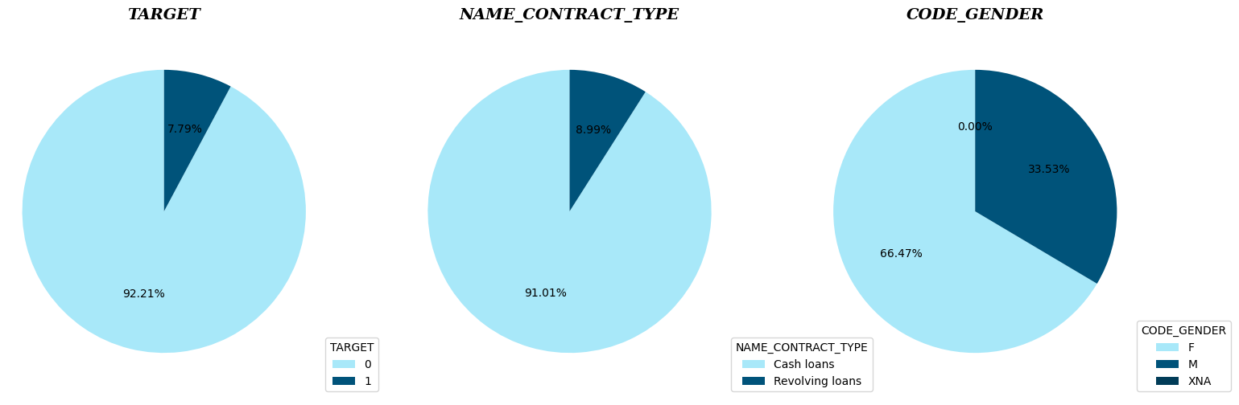
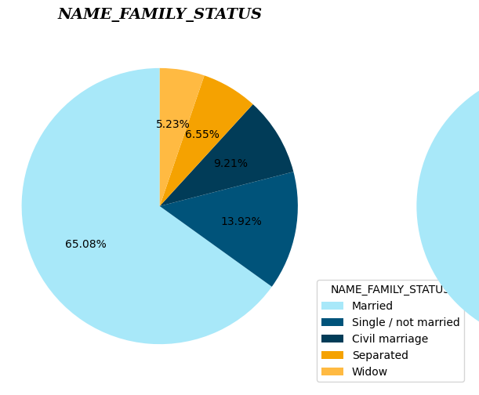
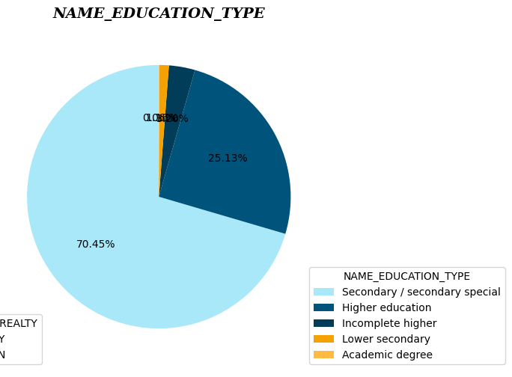
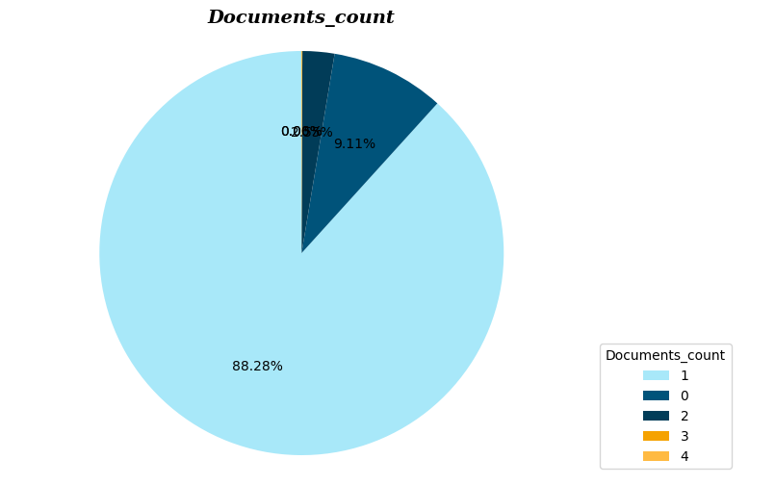
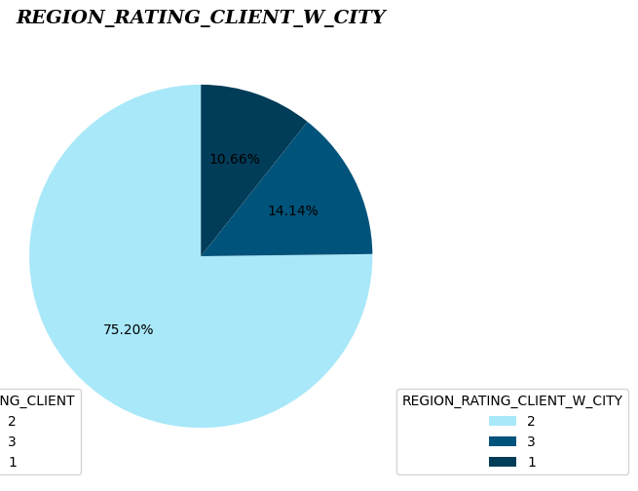
EDA (Univariate Analysis)

Slide 5
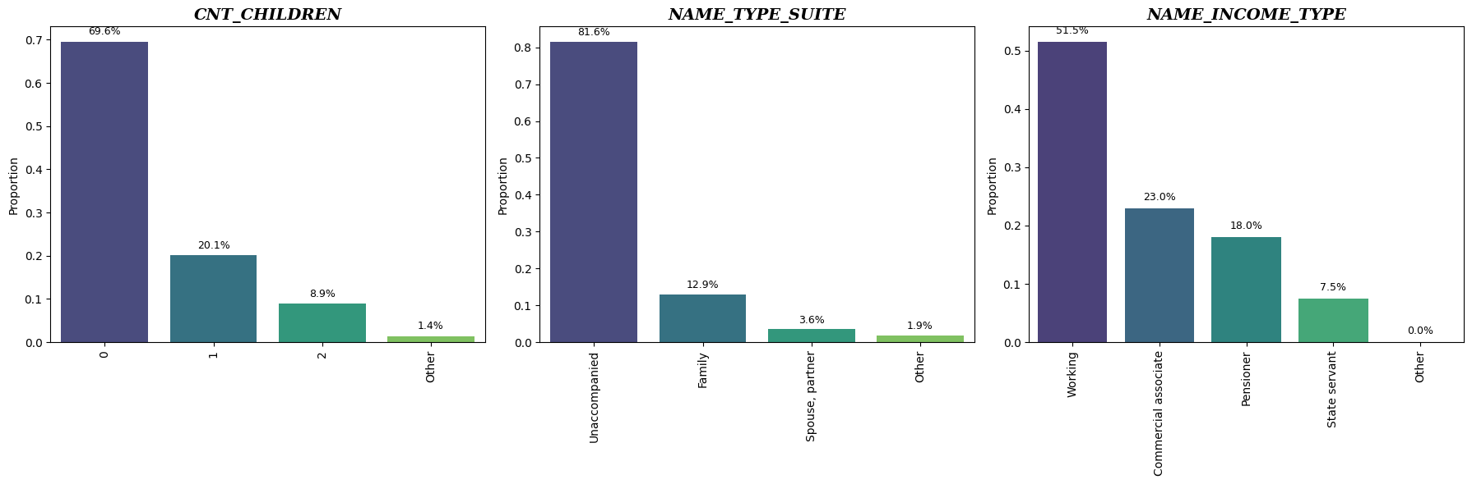
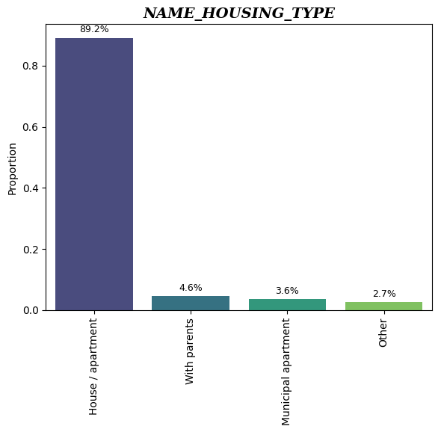
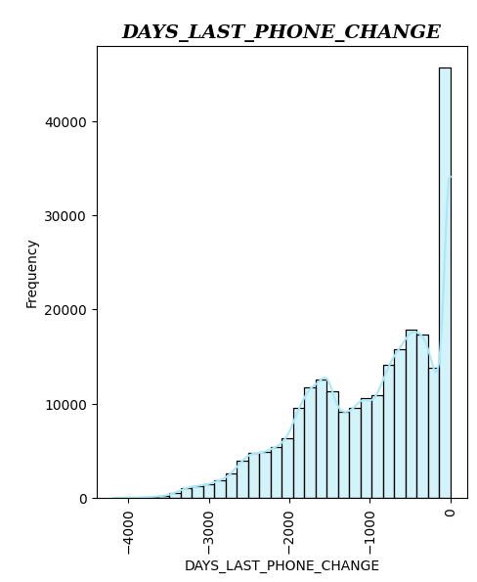
EDA (Univariate Analysis)

Slide 6
EDA (Univariate Analysis)
Insights:
Default Rate: About 7.79% of clients default on their loans.
Demographics: Majority are females (~66.5%), mostly married, own real estate, but don't own cars (~65–70%).
Region and Education: Most live in middle-rated regions and have secondary or higher education.
Loan and Documents: Cash loans dominate (~91%), and most clients deliver fewer than 2 documents.
Residence: Majority live in the same city where they work.
Family Status: About 70% of clients have no children, and most apply for loans alone.
Employment: Nearly half work in standard, fixed-income jobs.
Housing: Around 90% live in privately owned apartments or flats.
Most clients updated their phone records less than 125 days before applying for the loan.

Slide 7
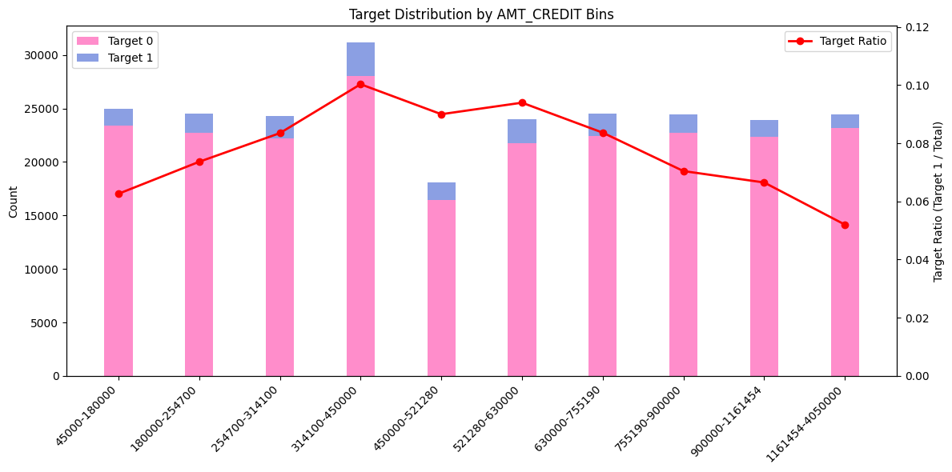
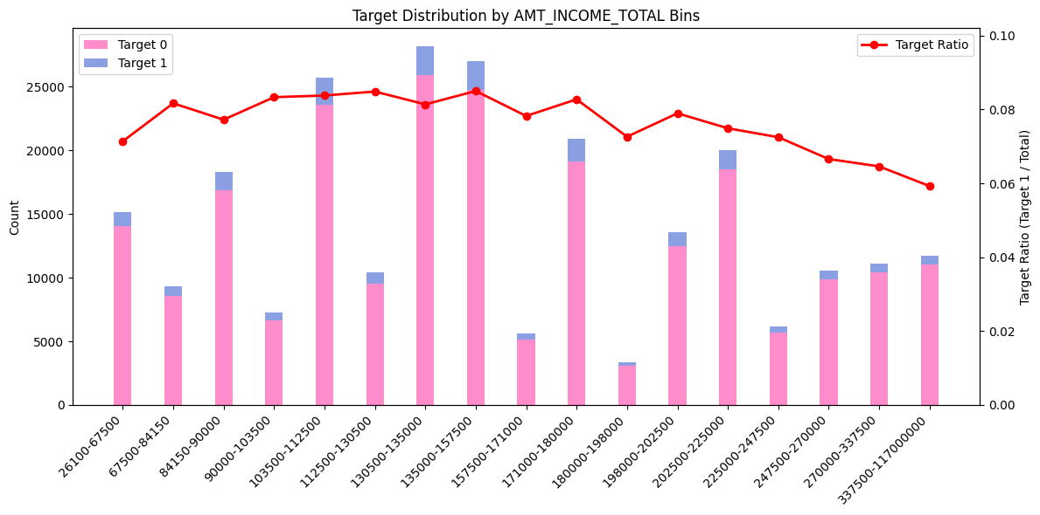
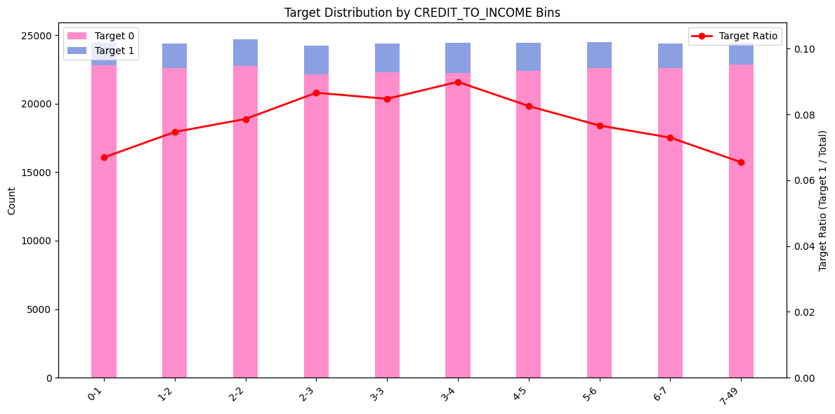
EDA (Bivariate Analysis)

Slide 8
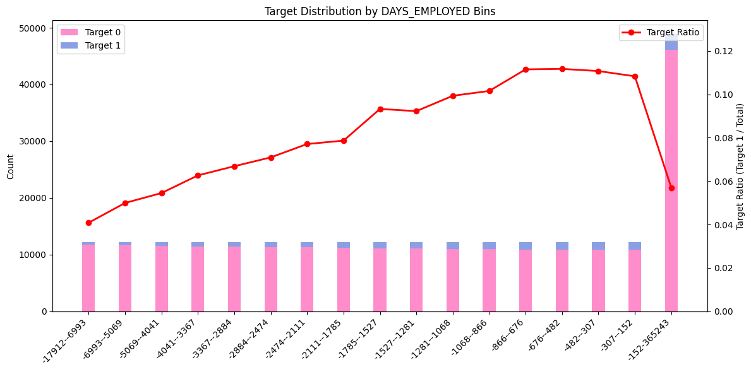
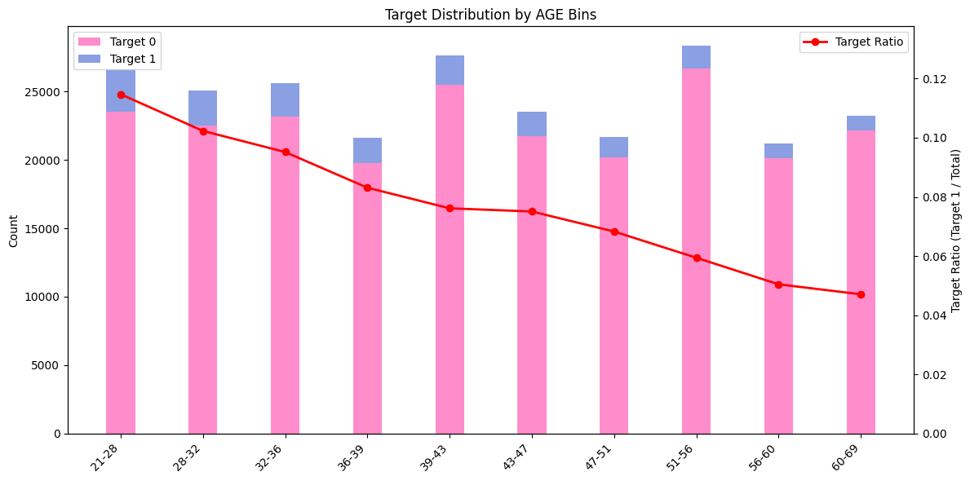
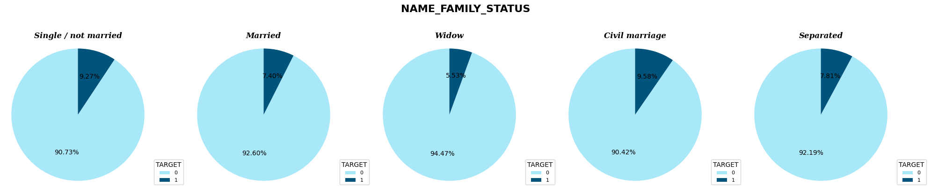
EDA (Bivariate Analysis)

Slide 9
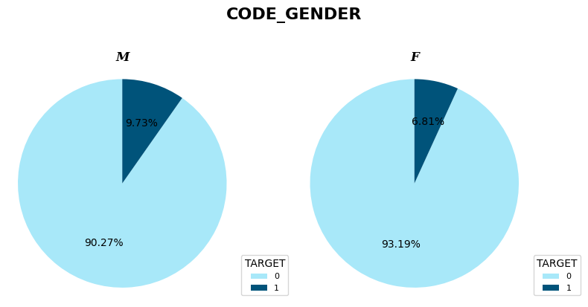
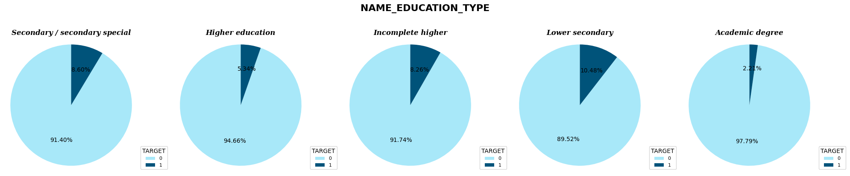
EDA (Bivariate Analysis)

Slide 10
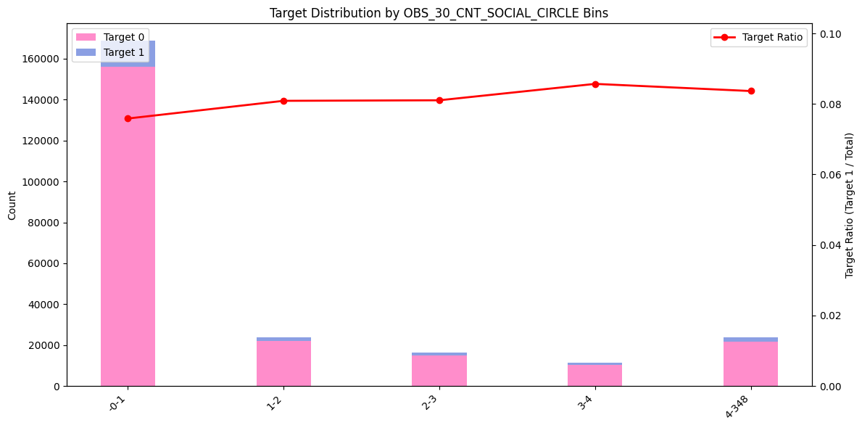
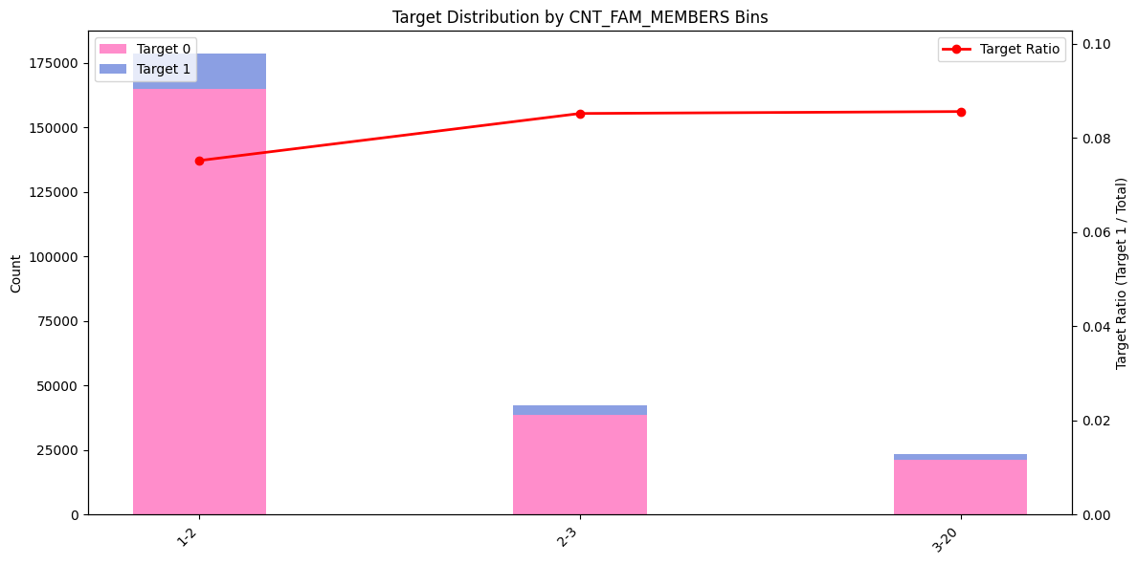
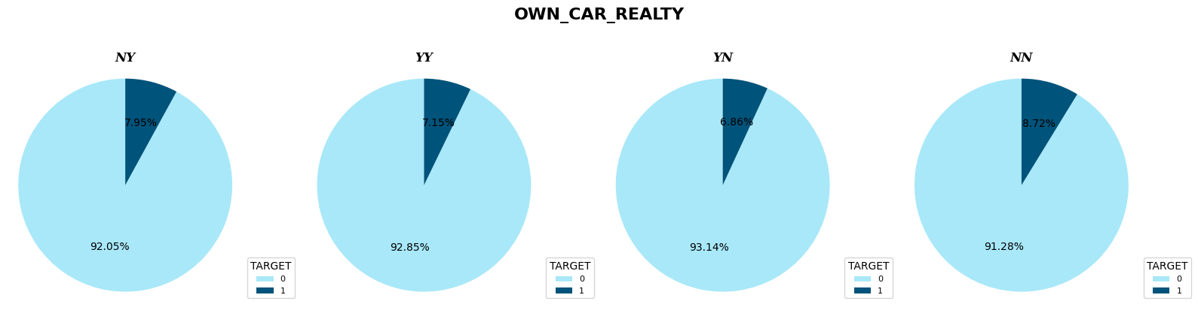
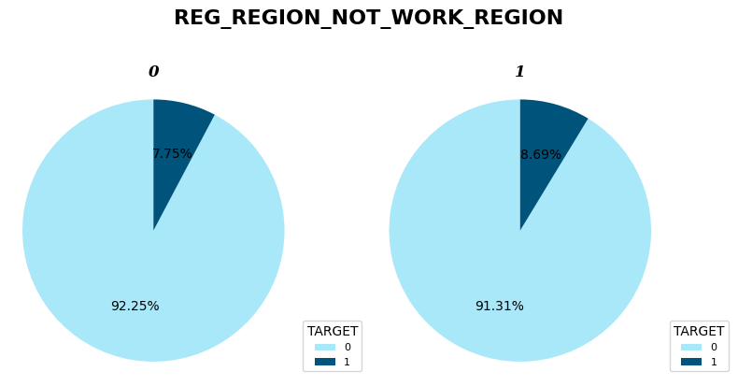
EDA (Bivariate Analysis)

Slide 11
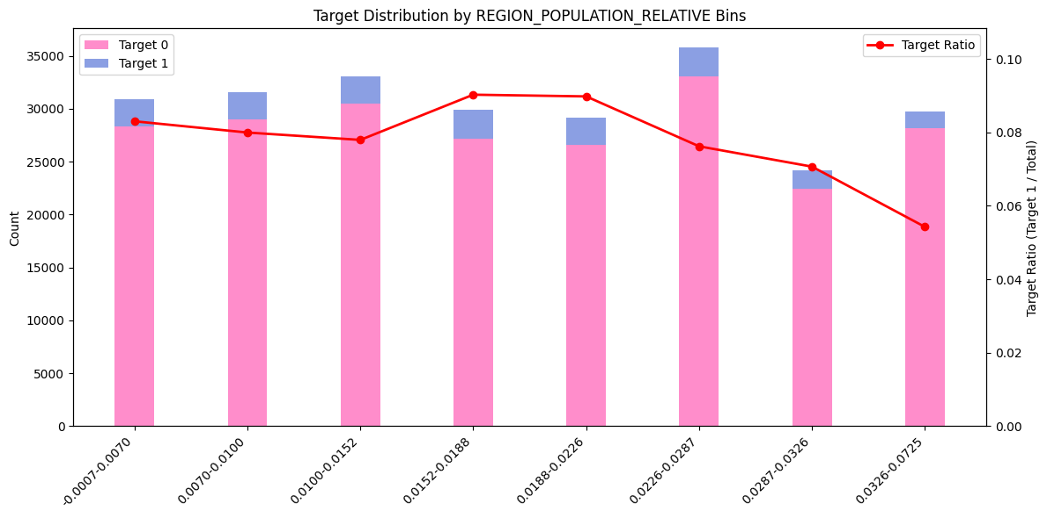
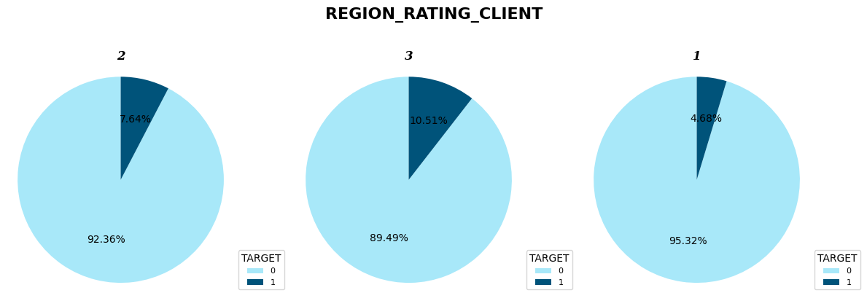
EDA (Bivariate Analysis)

Slide 12
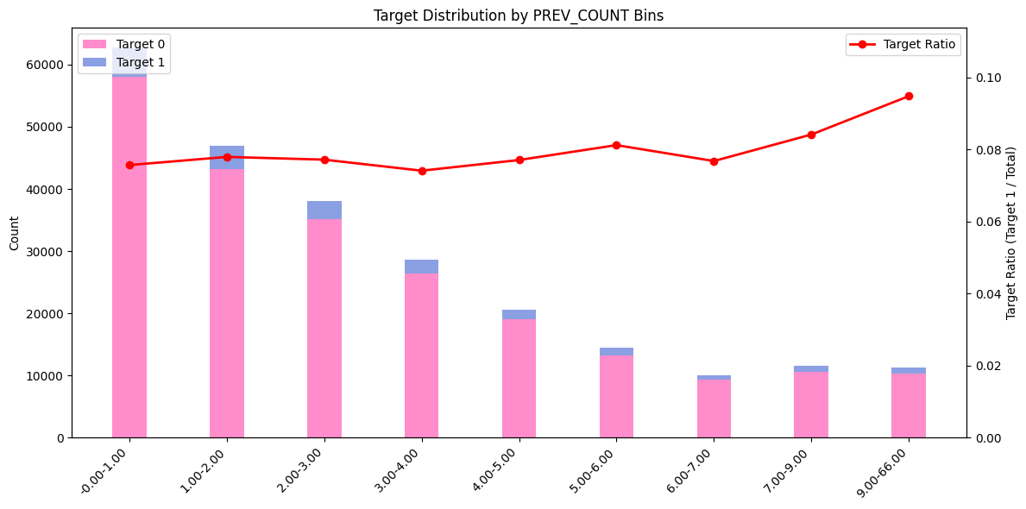
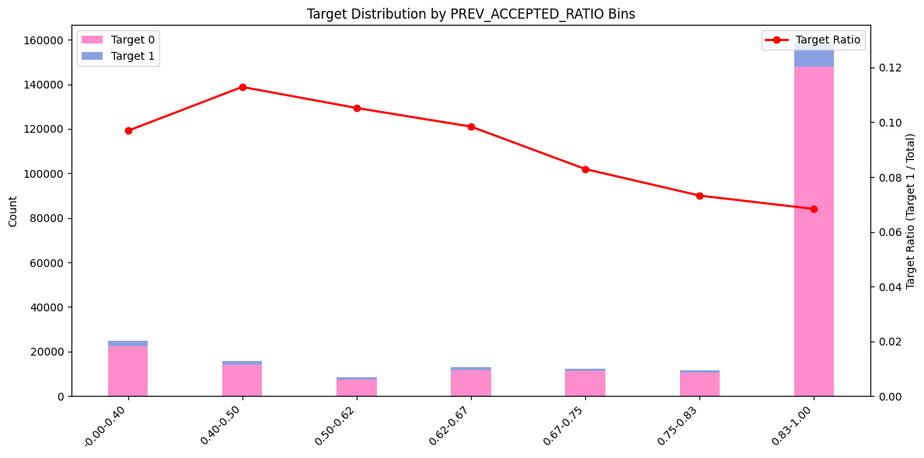
EDA (Bivariate Analysis)

Slide 13
EDA (Bivariate Analysis)
Insights:
Income Effect: As total income increases, default rates decrease.
Credit Amount vs Income: Borrowers asking for 2–5× their income show higher default rates.
Loan Amount Risk: Mid-sized loans (314,100–450,000) have the highest default risk (~10%).
Employment Duration: Shorter employment duration leads to higher default rates (~11%).
Gender: Men have a higher default rate (9.73%) compared to women (6.81%).
Marital Status: Widowed clients show the lowest risk (5.53%), while single/civil marriage clients have higher risks (~9.5%).
Education: Lower education levels are associated with higher default risk.
Age: Younger clients have higher default rates.
Social Defaults: Most clients (~85%) have 0–1 acquaintance with defaults; risk slightly increases with more social defaults.

Slide 14
EDA (Bivariate Analysis)
Insights:
10) Assets Ownership: Clients without a car or real estate face higher default risk.
11) Work vs Live Region: Clients living in a different region than they work have higher risk.
12) Region Rating: Clients from higher-rated regions (Rating 3) show higher default rates.
13) Population Size: Clients in higher population regions have lower default risk.
14) Previous Loan Behavior:
Having more previous loans increases risk.
A higher acceptance ratio reduces risk.
15) Current Loan Size vs History: Borrowers whose current loan is smaller than historical averages (<0.63) have a lower risk (~7%); beyond that, risk stabilizes.

Slide 15
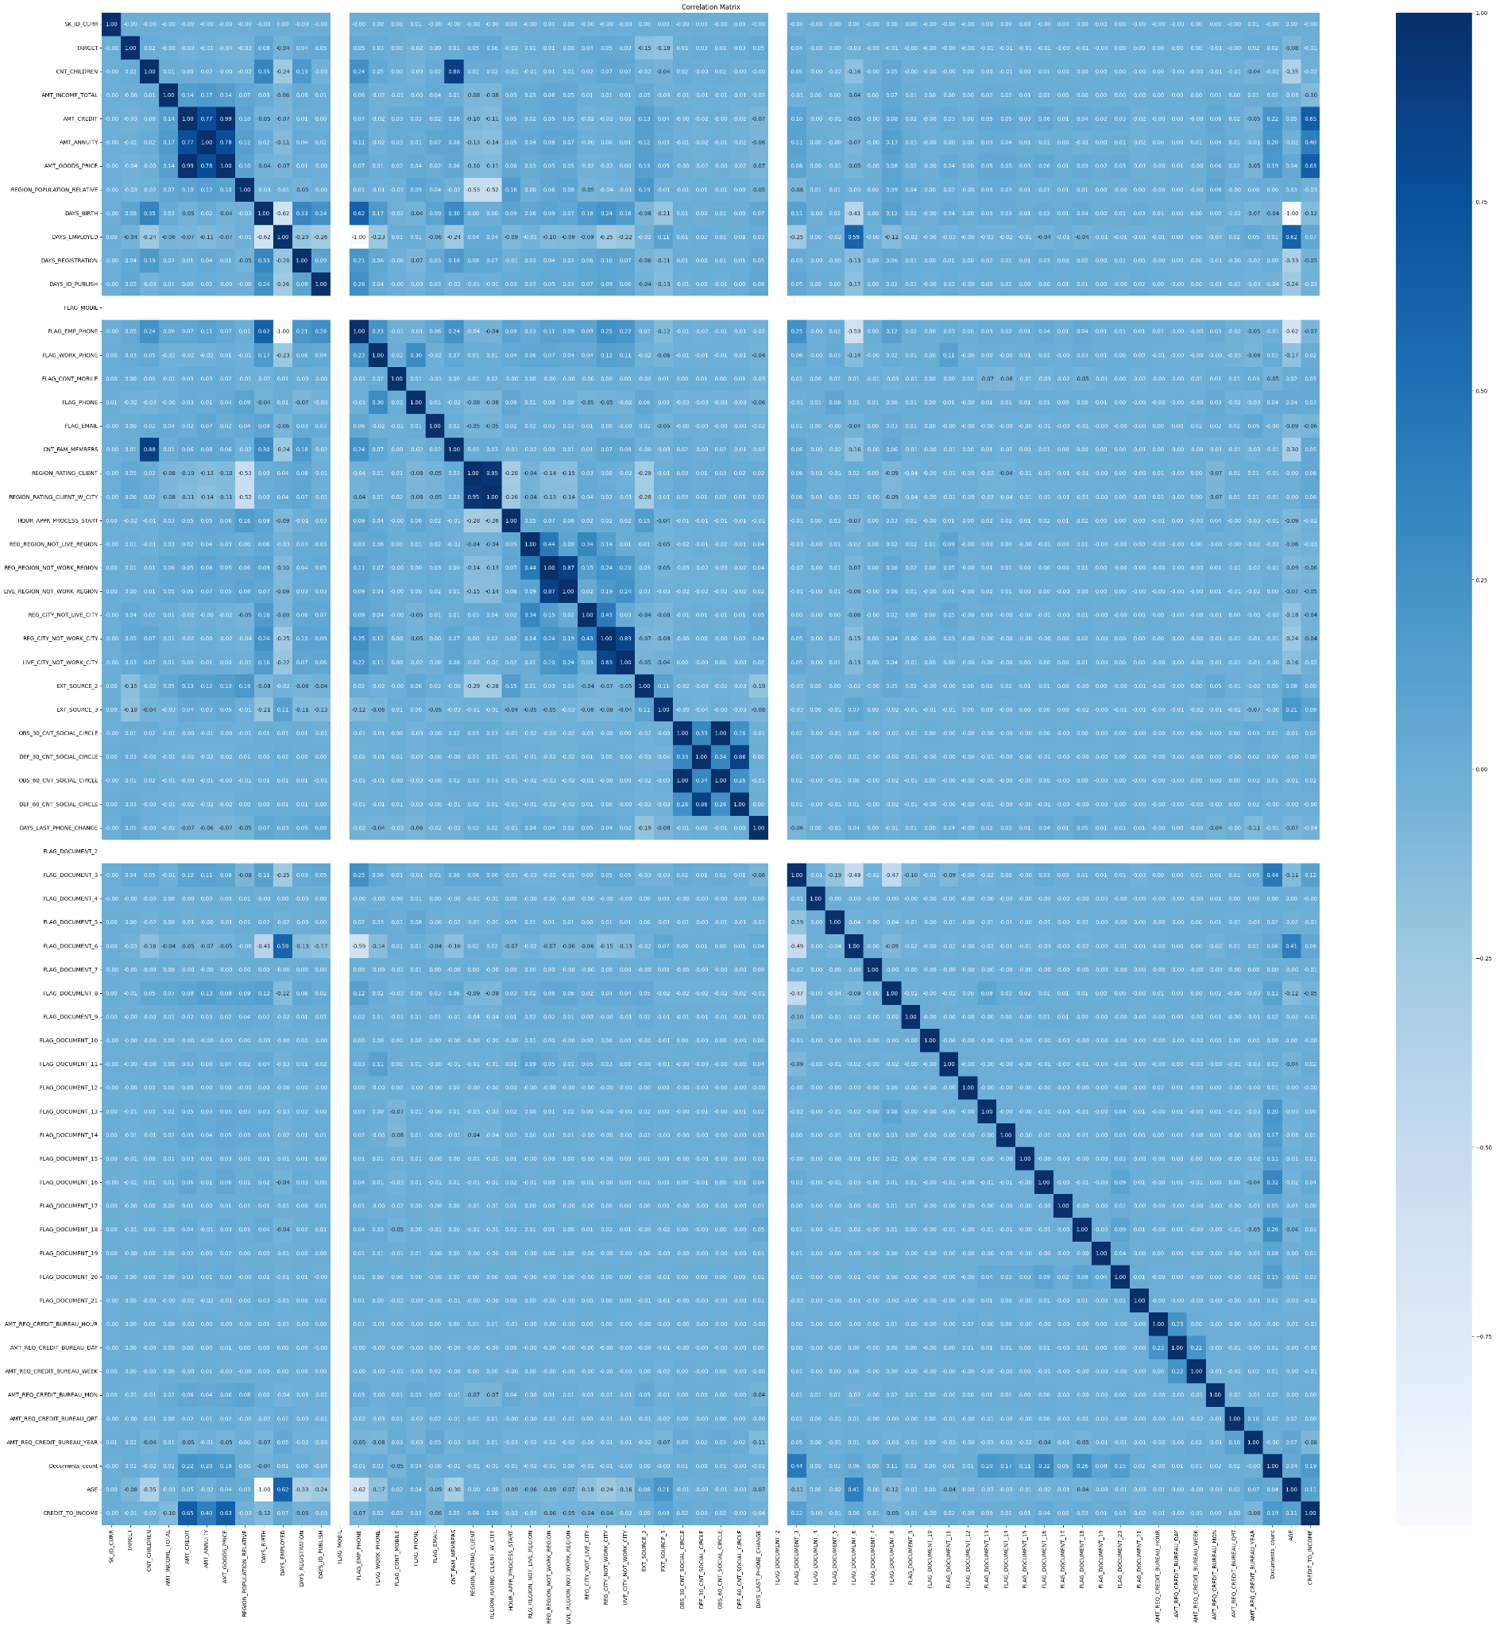
EDA (Multivariate Analysis)
For columns with high correlation, we can drop one of them to avoid redundancy and improve model performance.

Slide 16
Thank You

