Slide 1



Bank Loan Default Risk Analysis
(Technical part)
Team 8

Slide 2

Pipline
Process Curr Data
Process Prev Data
Merge Data
Encoding_Outliers_FeatureSelection
Clustering
Classification

Slide 3

1-Process Curr Data
processed_current_application.csv
application_data.csv
col with Threshold for null & row contains nulls
Notes:
307511 & 122
to
Shape after dropping cols: (307511, 72)
Shape after dropping rows: (244280, 72)

Slide 4
2-Process Prev Data
processed_previous_application.csv
previous_application.csv
1- col with Threshold for null & row contains nulls
2- Generate New Features using (prev_features.sh) file
Notes:
(1670214, 37)
after null threshold
(1670214, 26)
after row nulls
(1246320, 26)
after generating new features
(1246320, 33)
after only keeping the wanted row (duplicate droped)
(338857, 33)

Slide 5
3- Merge Data
processed_current_application.csv
merged_application.csv
processed_current_application.csv
Merge on SK_ID_CURR
Notes:
after merged
(232196 , 104)

Slide 6
4- Encoding_Outliers_FeatureSelection
encoded_merged_application
.csv
merged_application.csv
Encode the Features using (curr_application_features_encoding_methods.txt) file
Notes:
after encoding
83 features

Slide 7
4- Encoding_Outliers_FeatureSelection
df_no_outliers
.csv
encoded_merged_application
.csv
Remove outliers using Zscore
Notes:
Original rows: 232196
Rows after removing outliers: 157782

Slide 8
4- Encoding_Outliers_FeatureSelection
high corr features
(two files before and after )
&
featureSelected_encoded_merged_application.csv
&
df_no_outliers.csv
1- Split data (train_test)
2- Study High Correlated Features (MulCorr)
3 -Low Correlated Features with target
X_train.csv , y_train.csv
X_test.csv , y_test.csv
Notes:
featureSelected_encoded_merged_application.csv
after feature selection
(31619 , 64)

Slide 9
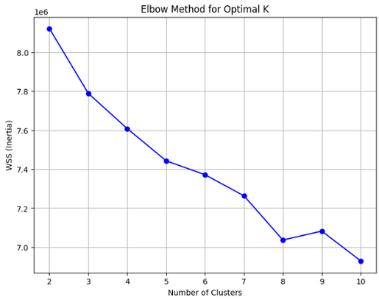
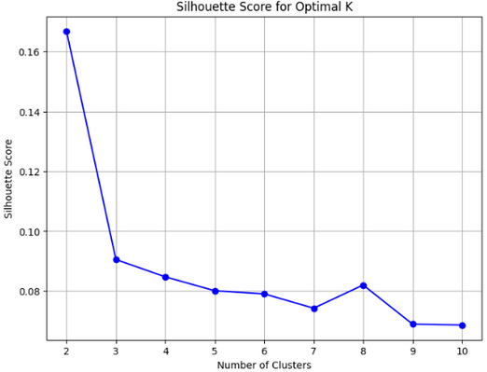
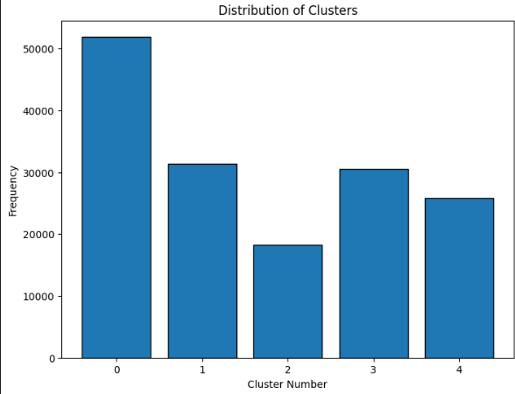
5- Clustering
choose 5 cluster to be
X_train.csv
X_test.csv
1- StandardScaler
2- choose best #clusters (WSS ,
Silhouette)
3 -Kmeans

Slide 10
6- Classification
Best Model
featureSelected_encoded_merged_application.csv
After CV parm’s tuning
1- Split with stratification
(biasedData)
2- TreeBased Models
3 -K-fold CV

Slide 11
Thank You

