Slide 1
Smart home
By:
Taqi Eldeen Moanes
Ahmed Othman
Hosam Mohamed
John salama

Slide 2
Introduction
Smart home that consists of GUI PC application and an embedded system based on ATmega32
User can monitor and control home devices including:
Lights (Based on LDR)
Fan (Based on LM35)
Door status (servo motor)
Electrical device (based on relay)

Slide 3
User can enter home password that is saved on EEPROM
LCD for interactions with the user
Lockdown mode if password entered 3 times wrong
User can change the password using the GUI

Slide 4
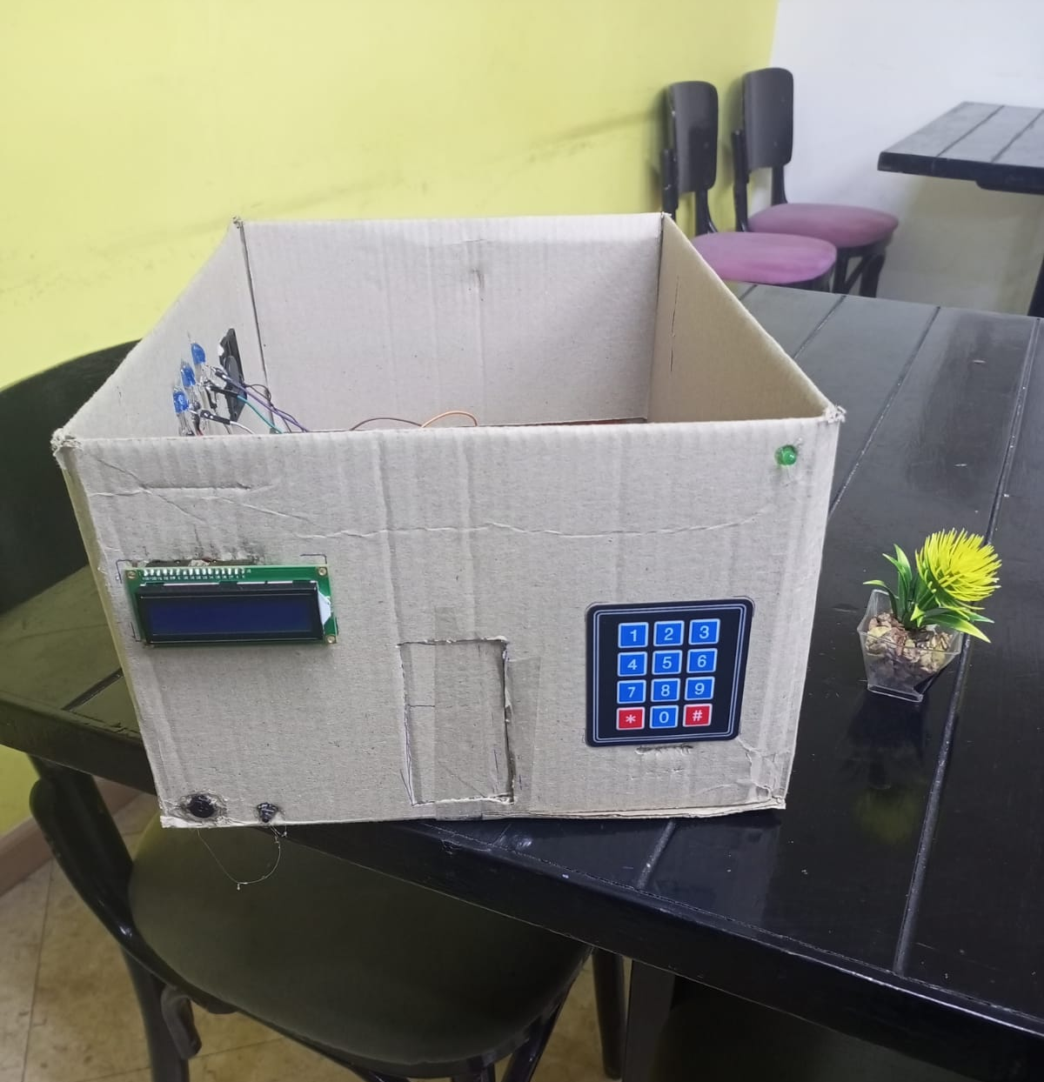
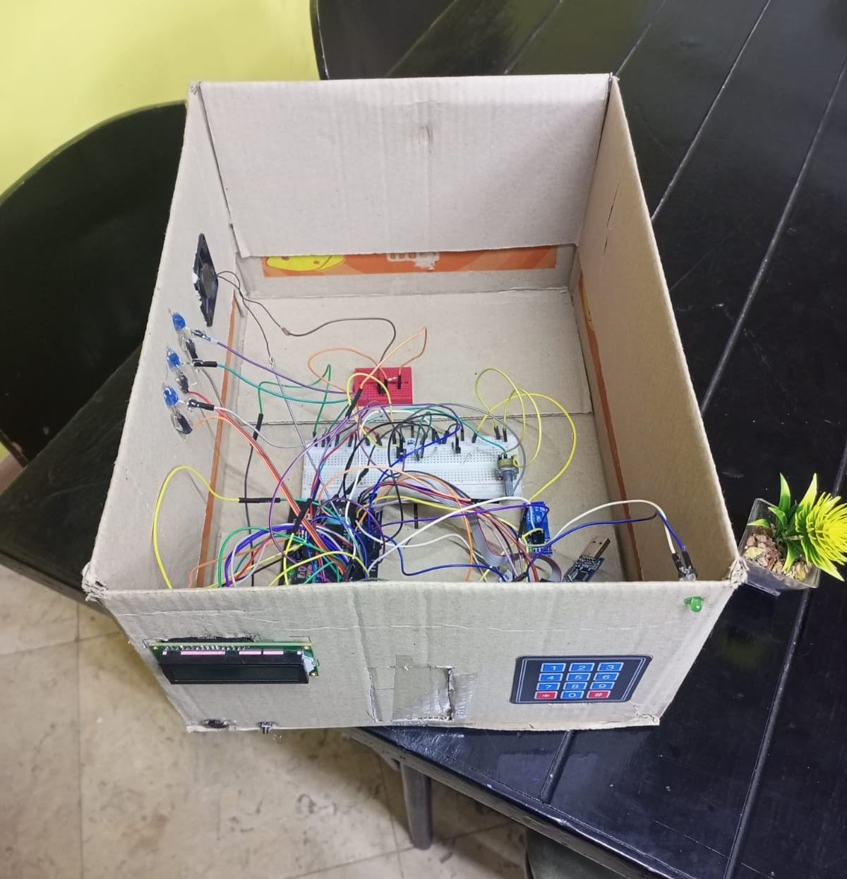

Slide 5
Embedded side, An overview
We used ATmega32 as the main controller for the system
HC-12 module for communication between PC and microcontroller
DC fan
LEDS for light simulation
Keypad for password entry
Internal EEPROM of ATmega32 is used for password saving
Buzzer for interaction with keypad and for alarm

Slide 6
Embedded side, an overview
Relay is used to simulate an electrical device control
Servo motor is used to simulate door lock
LDR for light sensing
LM35 for temperature sensing

Slide 7
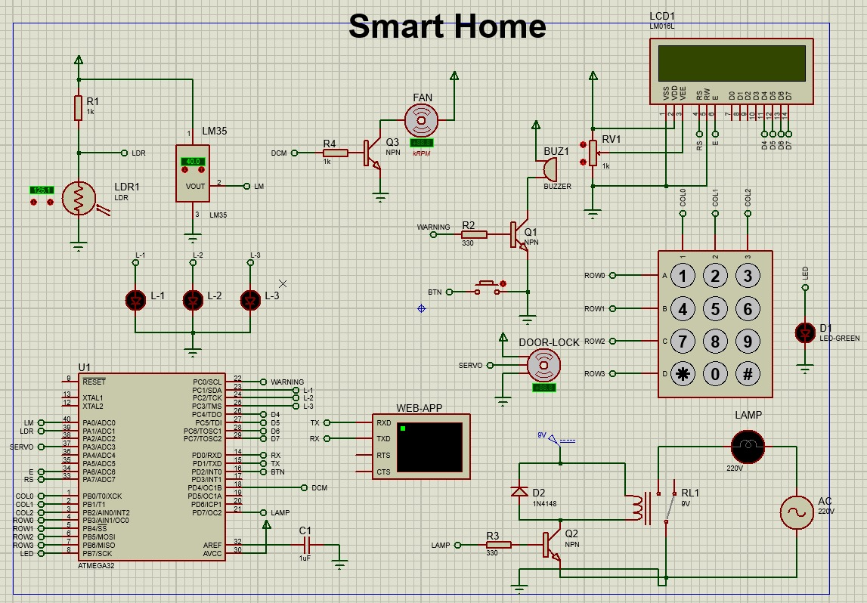

Slide 8
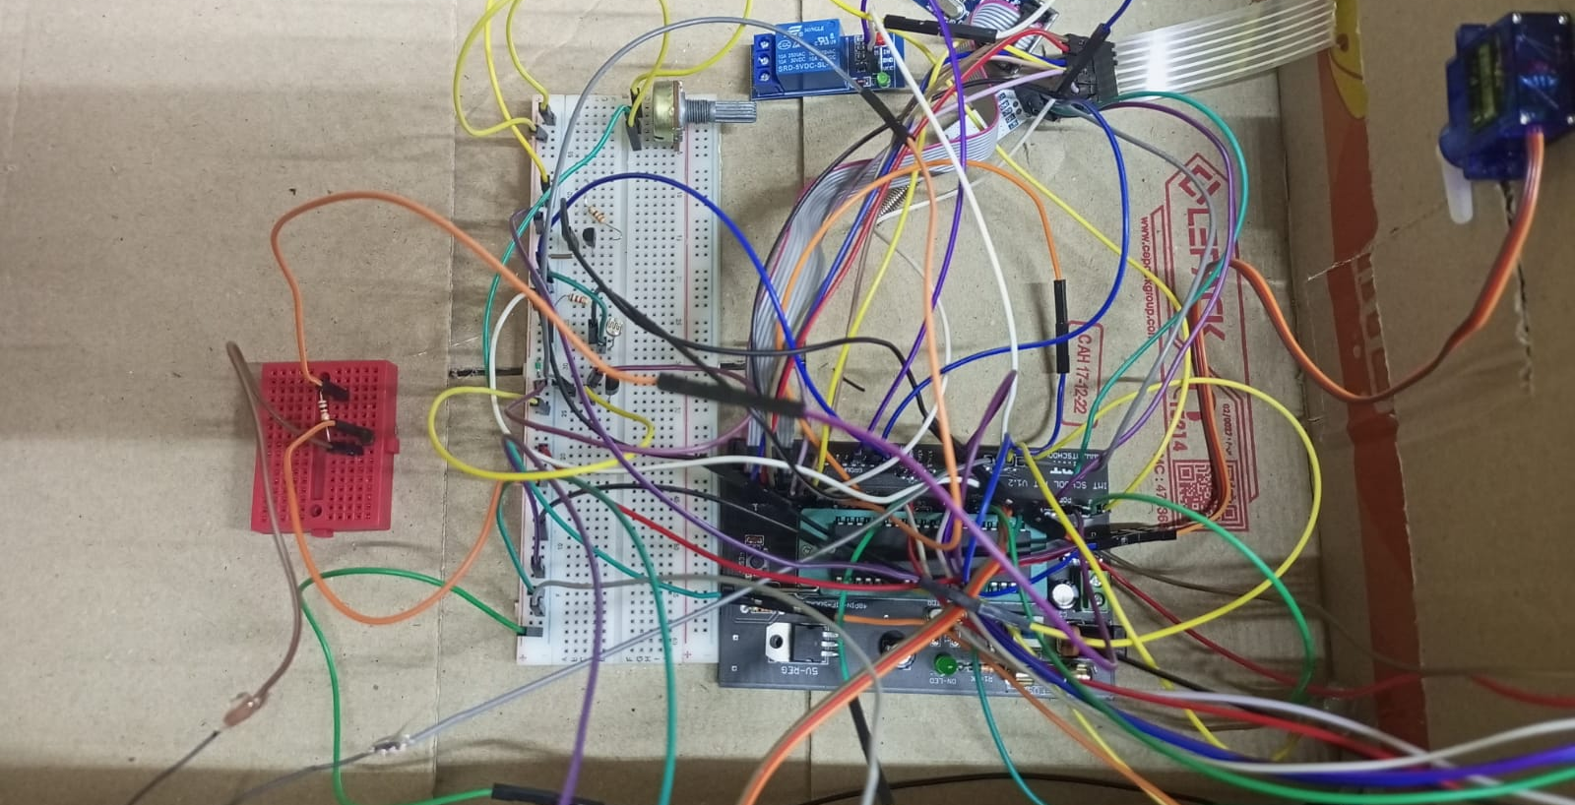

Slide 9
Embedded side, Drivers
MCAL :
ADC,
TIM 0, 1, 2
DIO
EEPROM
EXTI
GIE
UART

Slide 10
Embedded side, Drivers
HAL :
BUZZ
DCM
HC
HOME_LIGHT
KEYPAD
LCD
LDR
SERVO
TEMPS

Slide 11
Embedded side, Application
Implementation of frames for communications between GUI and Microcontroller to monitor the status and control
Timeout for keypad 8 seconds if no activity
LCD display interactions such as greeting and after entering it display the temperature and light intensity
Buzzer sound when pressing a key
Buzzer alarm if 3 attempts is made incorrectly

Slide 12
Embedded side, Application
Automatic light intensity control if enabled
Automatic fan control if enabled
TIM2 for servo control (on AND off)
TIM1 for PWM for fan
ADC for LM35 and LDR
UART for HC-12

Slide 13
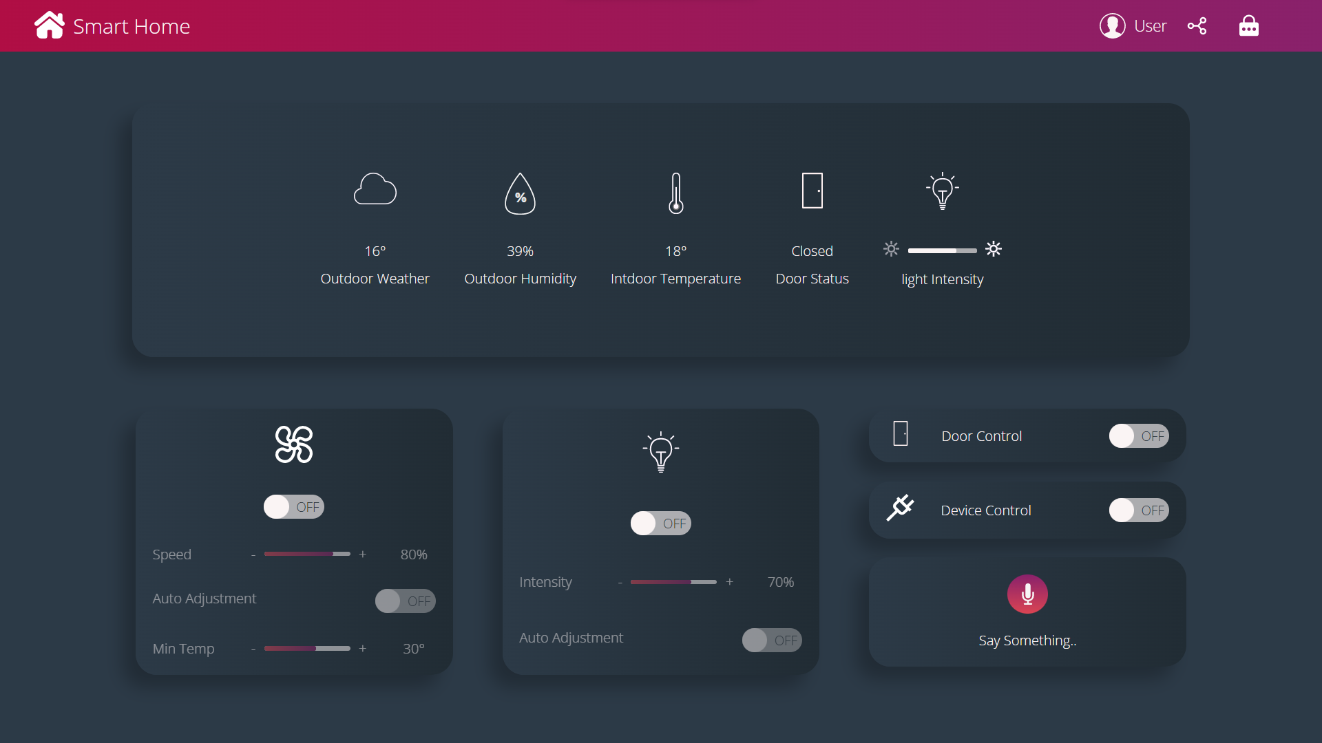
GUI side

Slide 14
GUI side
User can interact with the system using the GUI
User Can turn ON/OFF the lights and enable/disable automatic control
User Can turn ON/OFF the Fan and enable/disable automatic control
User Can change the password of the lock
User Can use voice commands
Can control the electrical device
Can monitor the temperature of the inside and see the outside humidity and weather

Slide 15
Thank you!

