Slide 1

Digital forensics project

Slide 2
Task 0
We selected the NIST CFReDS Forensics Image Test Image because it is a publicly available Windows forensic image containing user activity suitable for forensic investigation. Its limitation is that it is a training dataset, so the activity may be simulated.

Slide 3

Task 1
Dataset source: NIST CFReDS
Image name: 2020JimmyWilson.E01
Image format: E01
Tool used: FTK Imager
MD5: b267fb0cd94645425eee00258d3a9b58
SHA1: a1102c70a50768b588225fdcad6efa5d5d57341b
Verification result: Both MD5 and SHA1 hashes match

Slide 4
Task 2
Operating System:
The forensic image contains a Microsoft Windows operating system, as evidenced by the presence of the Windows directory and System32 system files.
User Accounts:
Multiple user accounts were identified on the system, including BillyBob, Fred Flintstone, James Russell, Jimmy Wilson, and Joe Nameless. This indicates a multi-user environment.

Slide 5
Task 2
Suspicious Files:
Executable files were identified within a “redist” directory located on the Desktop. These files appear to be redistributable installers (e.g., software dependencies). Although likely legitimate, their presence in a user-accessible location suggests user activity related to software installation and warrants further analysis.
A directory identified as “199165” was located within unallocated disk space, with a size of approximately 28 MB. The presence of structured data within unallocated space suggests that files or directories were previously deleted. The naming pattern and size indicate potential relevance, possibly associated with user activity or intentional removal of data
An internet shortcut file titled “how to hide money from the government Libertarian money.url” was identified within a user’s Favorites directory. This indicates that the user accessed and saved content related to concealing financial assets. While not inherently malicious, the nature of the content her investigation.

Slide 6
Task 2
Initial Hypothesis:
The examined system appears to be a multi-user Windows environment with evidence of user activity involving software installation and potential data handling. Executable files located in user-accessible directories suggest possible software execution or installation by users. Additionally, the presence of structured data within unallocated space indicates that files or directories may have been deleted, which could suggest attempts to remove or conceal information.
Furthermore, the identification of a browser bookmark related to hiding money from the government may indicate user interest in concealing financial activity. While these findings do not confirm malicious activity, they suggest the possibility of unauthorized or suspicious behavior and warrant further detailed forensic analysis.

Slide 7
Task 3
Autopsy Forensic Browser (v4.23.0) was used to analyze the provided disk image (2020JimmyWilson.E01). A new case was created, and the image was added as a data source using the “Disk Image or VM File” option. The time zone was set to (GMT+2:00) Africa/Cairo, and key ingest modules such as Recent Activity, File Type Identification, Extension Mismatch Detector, Keyword Search, Email Parser, and PhotoRec Carver were enabled. The ingest process was initiated to extract system artifacts, including user activity, deleted data, and other relevant forensic evidence.

Slide 8
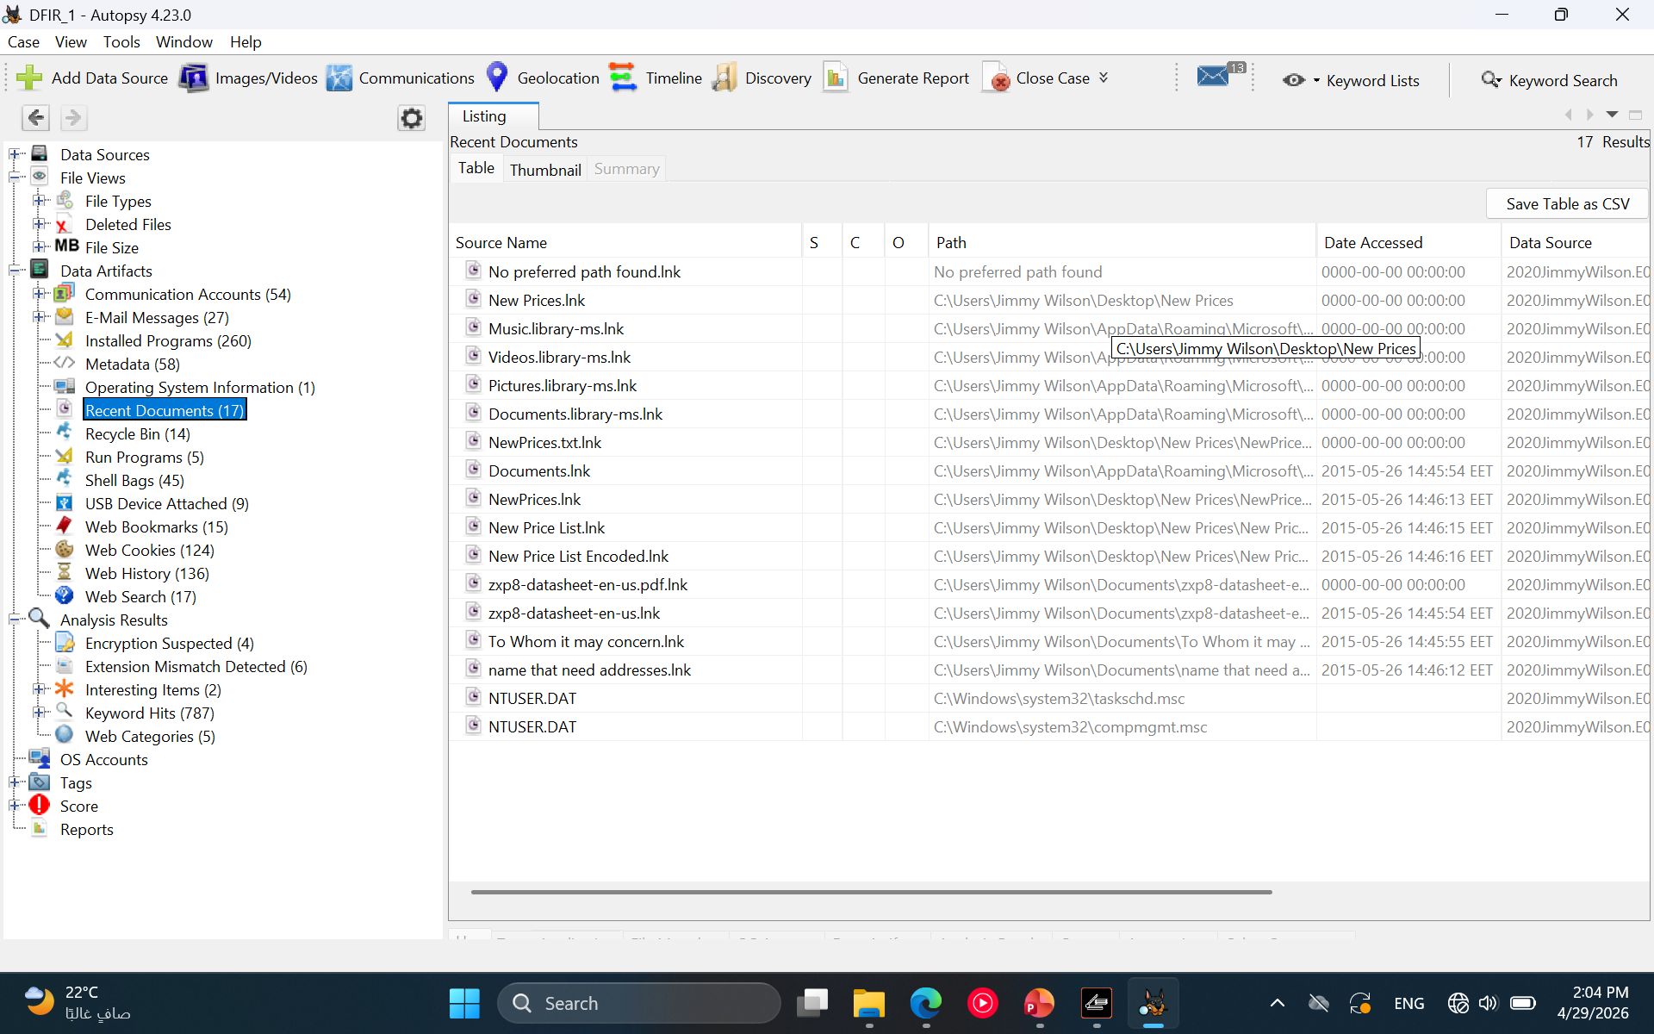
Task 3
.lnk files (shortcut files) were analyzed to identify recently accessed files and user activity. These shortcuts reveal the original file paths, allowing us to determine which files and locations the user interacted with. This helps reconstruct user behavior, even if the original files were moved or deleted.

Slide 9
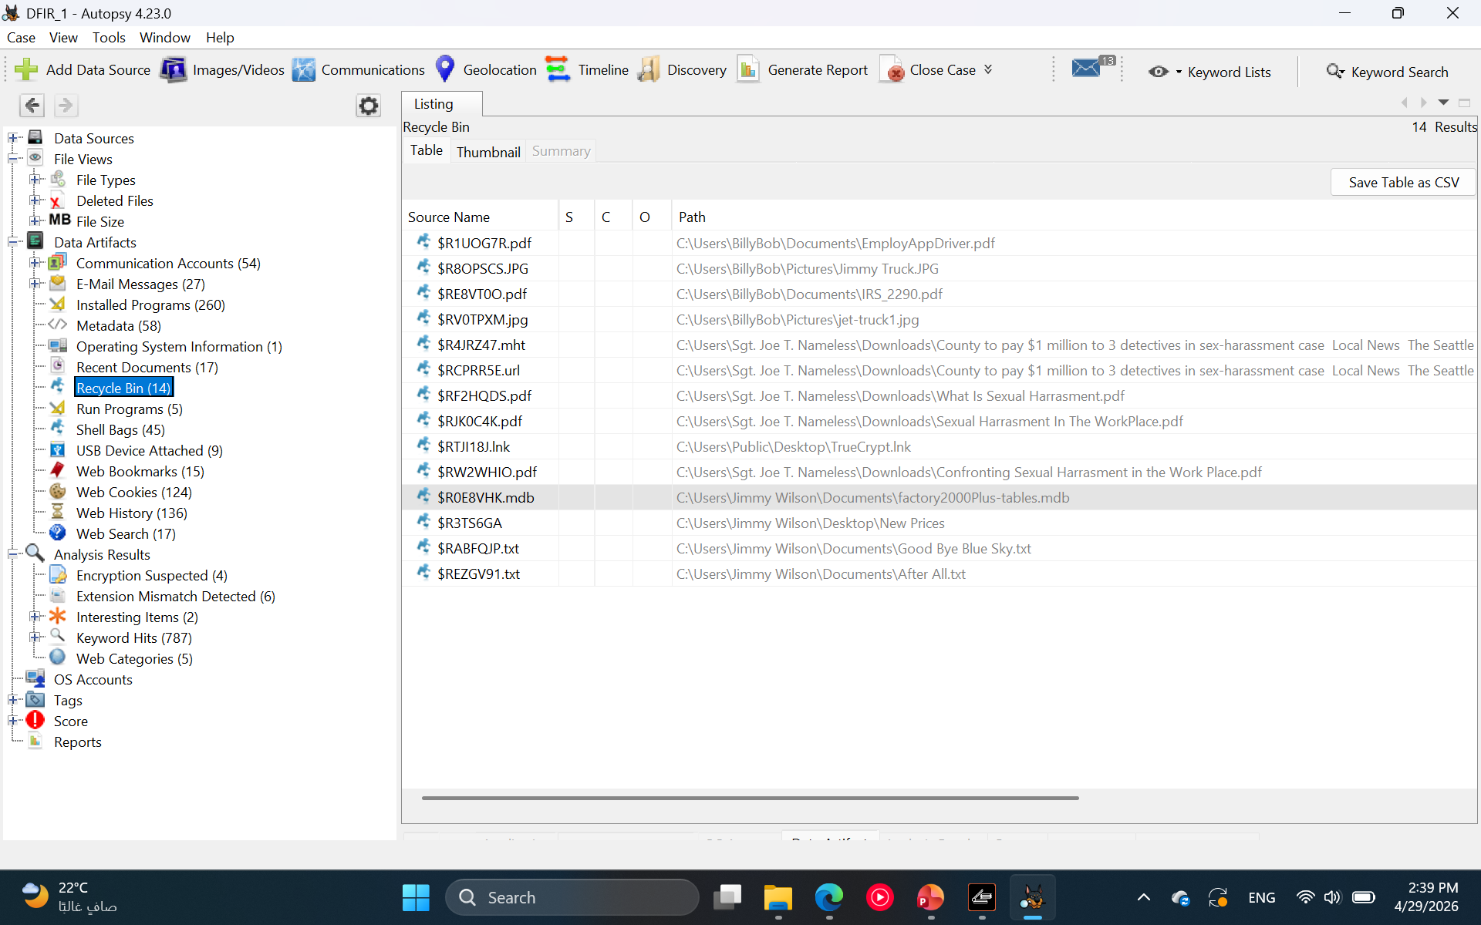
Task 3
Recycle Bin analysis identified deleted user files including a “New Prices” folder from the Desktop, a database file (.mdb), and text documents such as “After All.txt.” These files are associated with user activity and were removed after use, suggesting that the user attempted to delete potentially sensitive or relevant information, indicating possible concealment of activity.

Slide 10
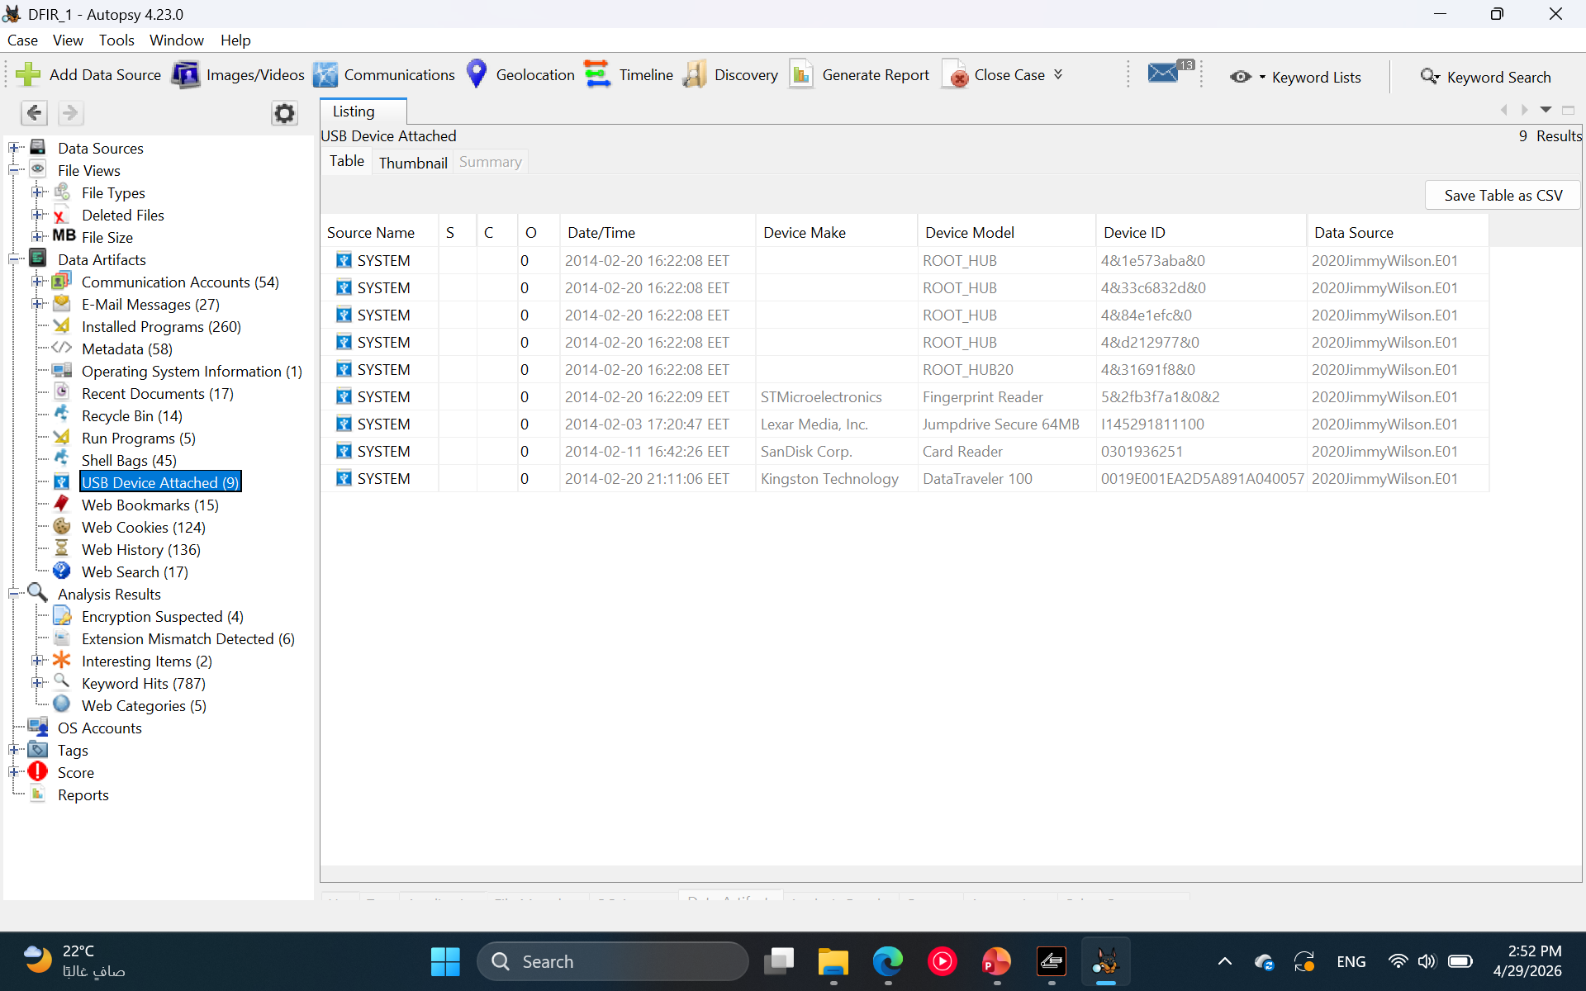
Task 3
USB device analysis identified the use of external storage devices, including a Kingston DataTraveler 100 and a Lexar JumpDrive. These devices were connected around the same time as key user activity and file deletions, suggesting potential data transfer or removal of files from the system using external media

Slide 11
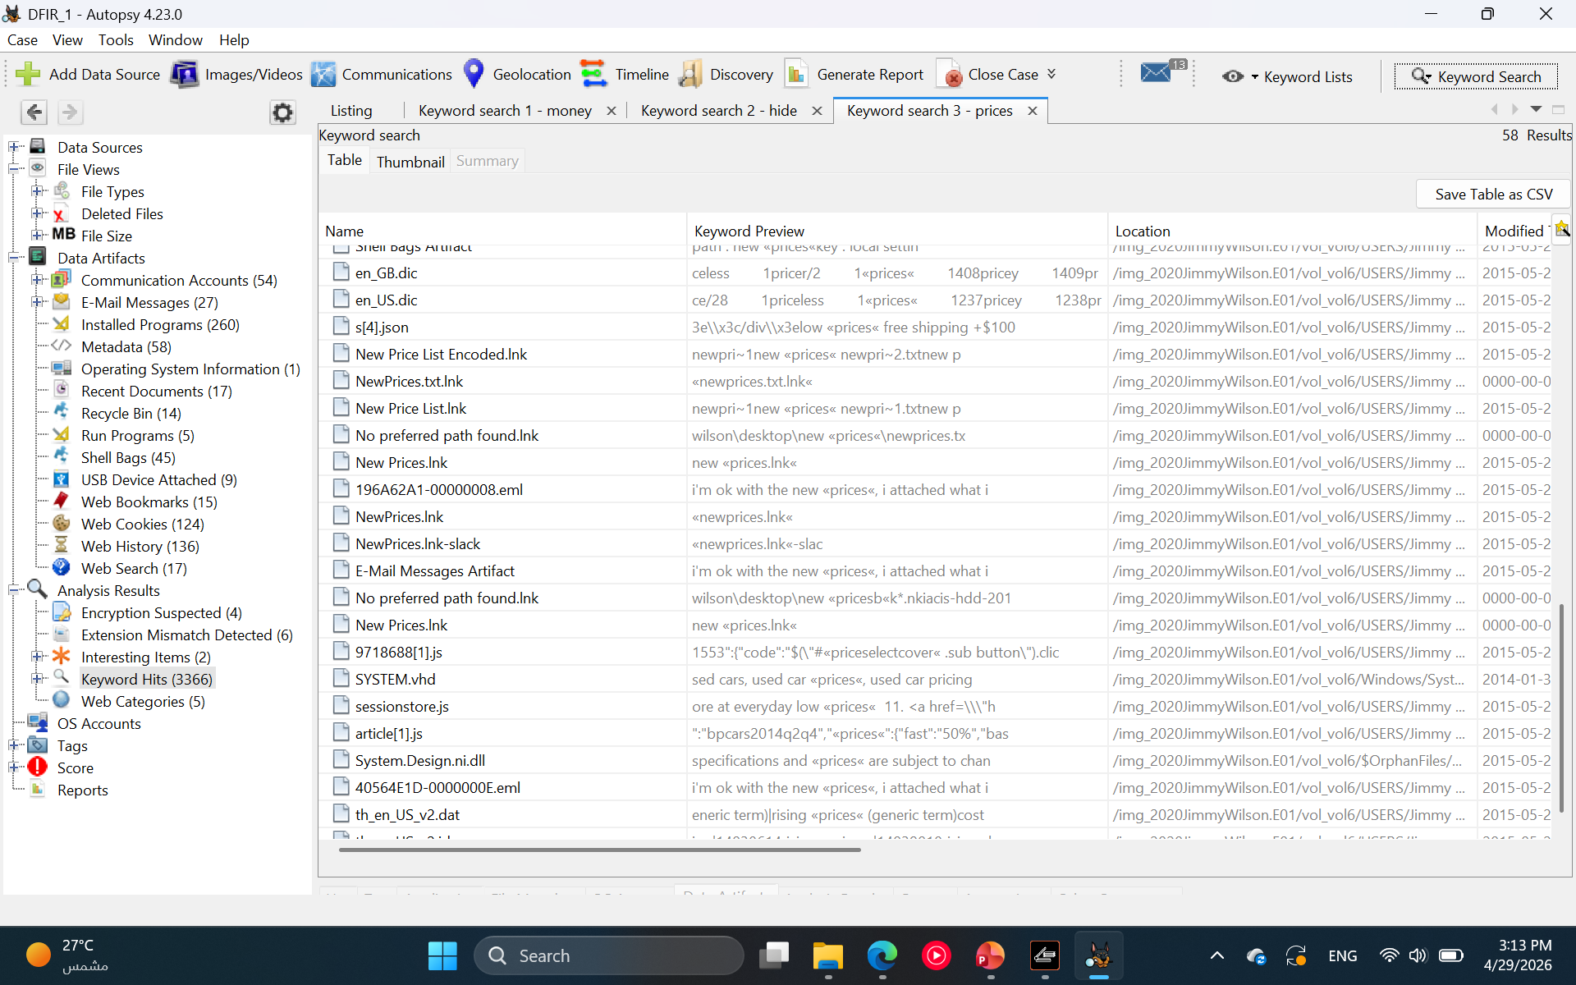
Task 3
Keyword searching: prices search
Keyword search results showed repeated references to “NewPrices.txt” and related shortcut files on the Desktop, indicating frequent access and possible modification of pricing data. This, combined with other findings, suggests potential involvement in financial activity or data handling

Slide 12
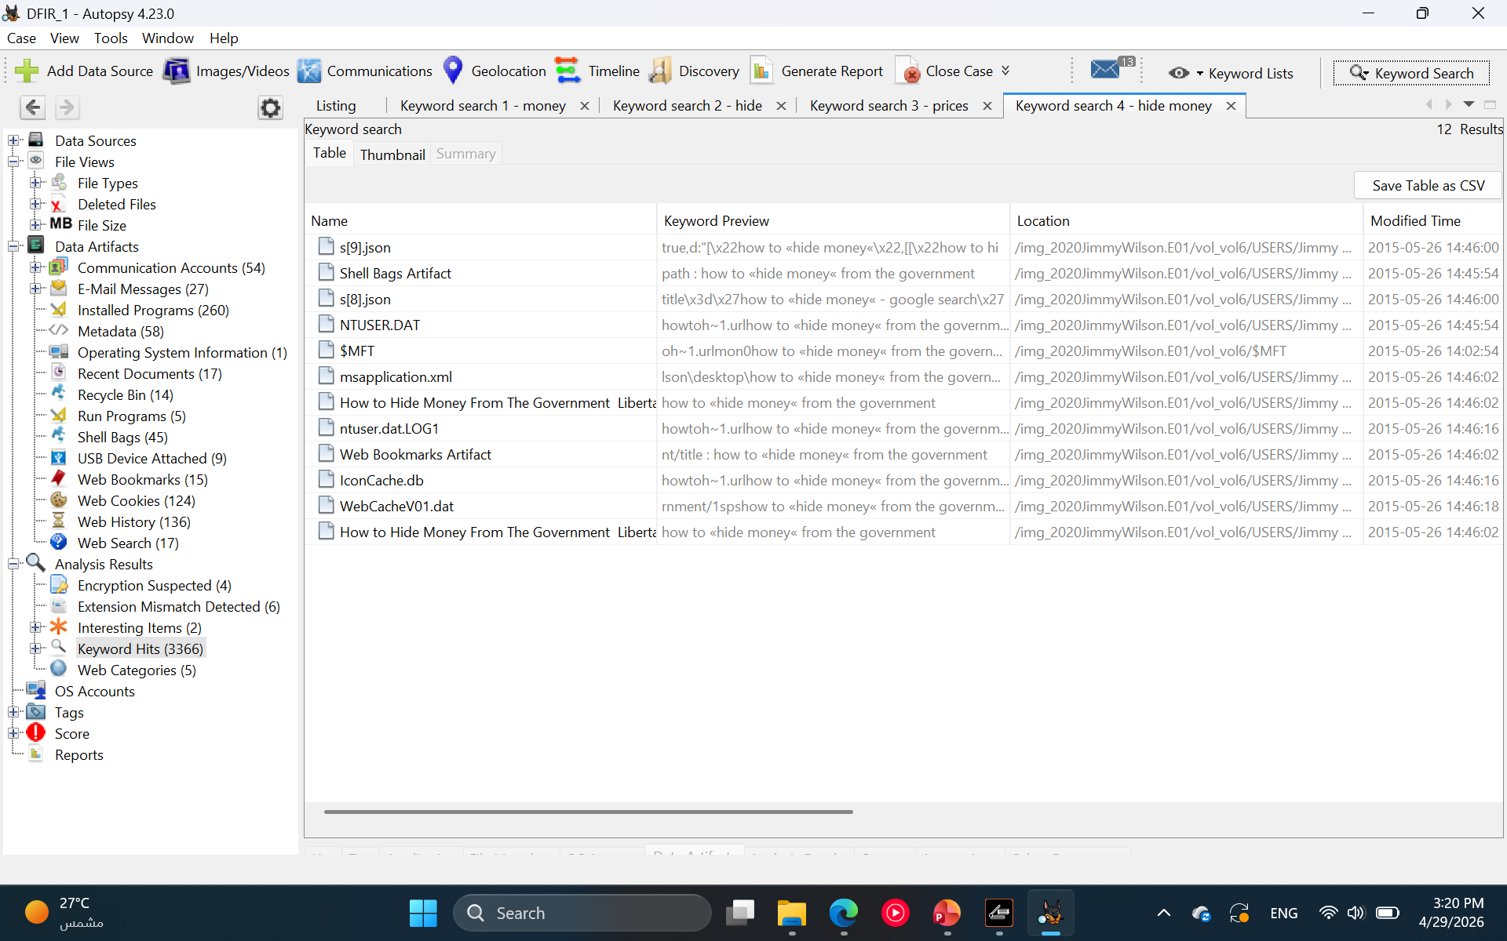
Task 3
Keyword searching: Hide money search
Keyword search for “hide money” identified web bookmarks, browser cache, and registry artifacts referencing content titled “How to Hide Money From the Government.” This indicates that the user actively searched for and accessed information related to concealing financial assets

Slide 13
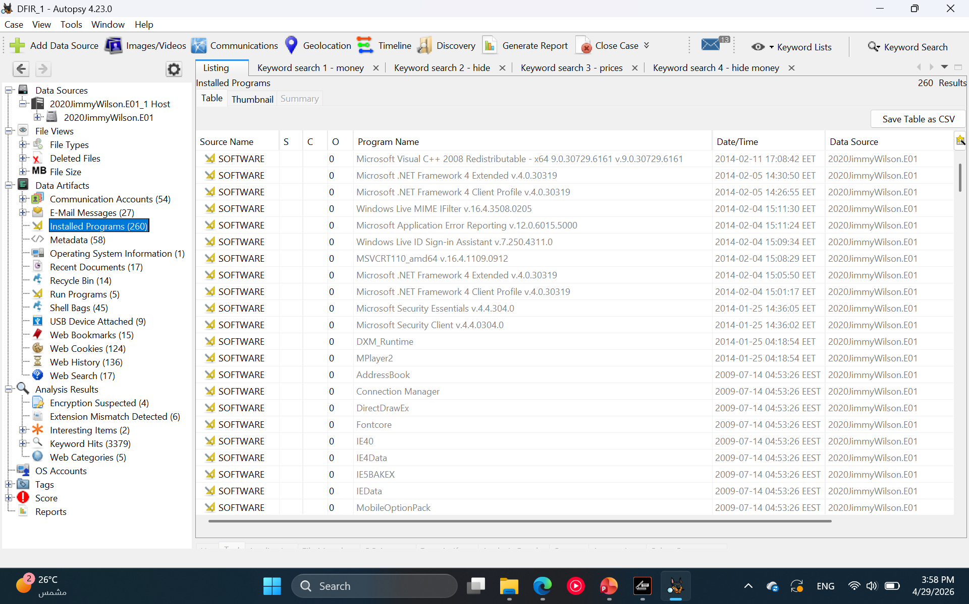
Task 4
Registry Run Keys analysis did not reveal any suspicious or unauthorized programs configured to execute at system startup. All identified entries were consistent with normal system behavior

Slide 14
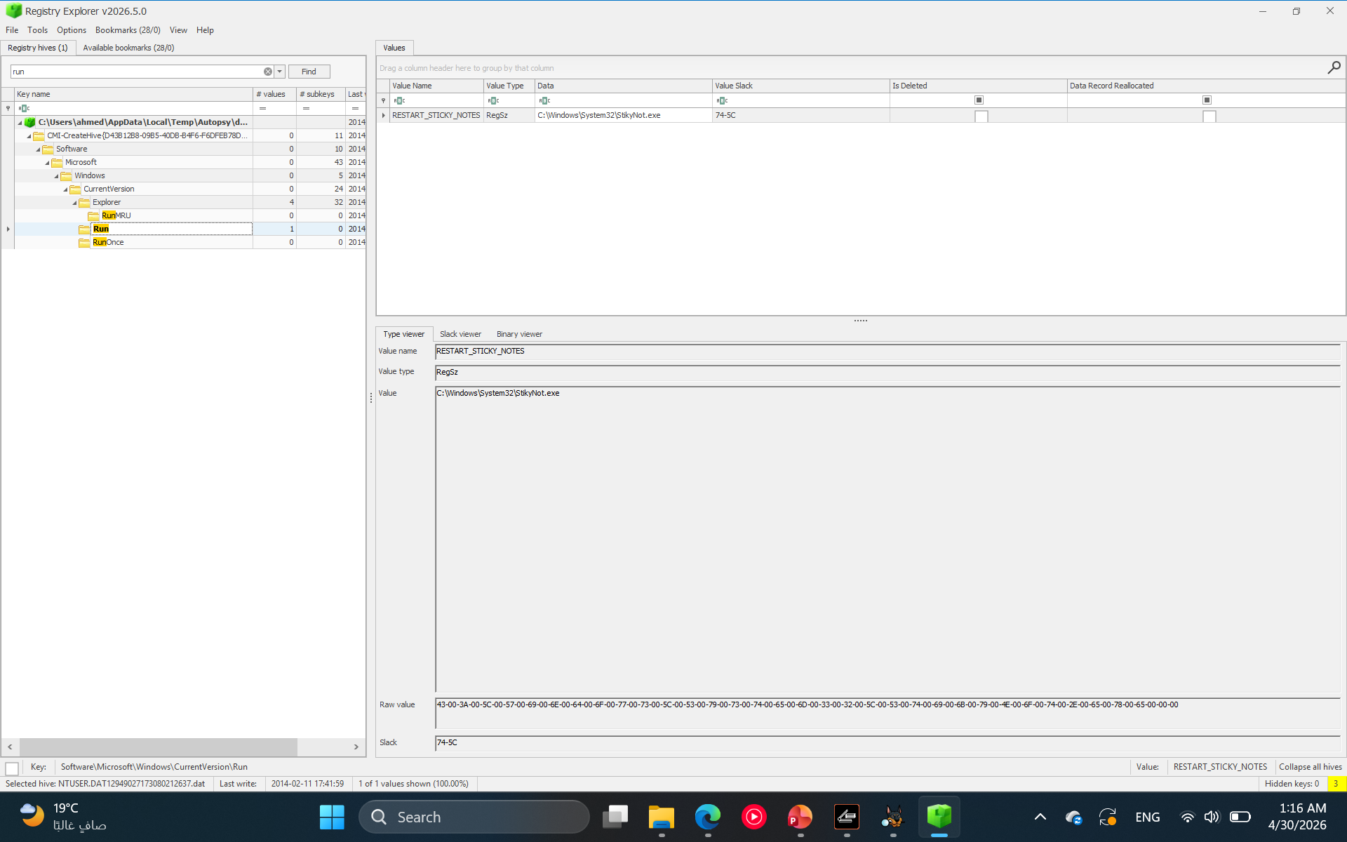
Task 4
Registry Run keys were successfully examined using Eric Zimmerman’s Registry Explorer under Software\Microsoft\Windows\CurrentVersion\Run and RunOnce. No suspicious or unauthorized entries were identified, indicating no evidence of persistence mechanisms configured to execute at user logon

Slide 15
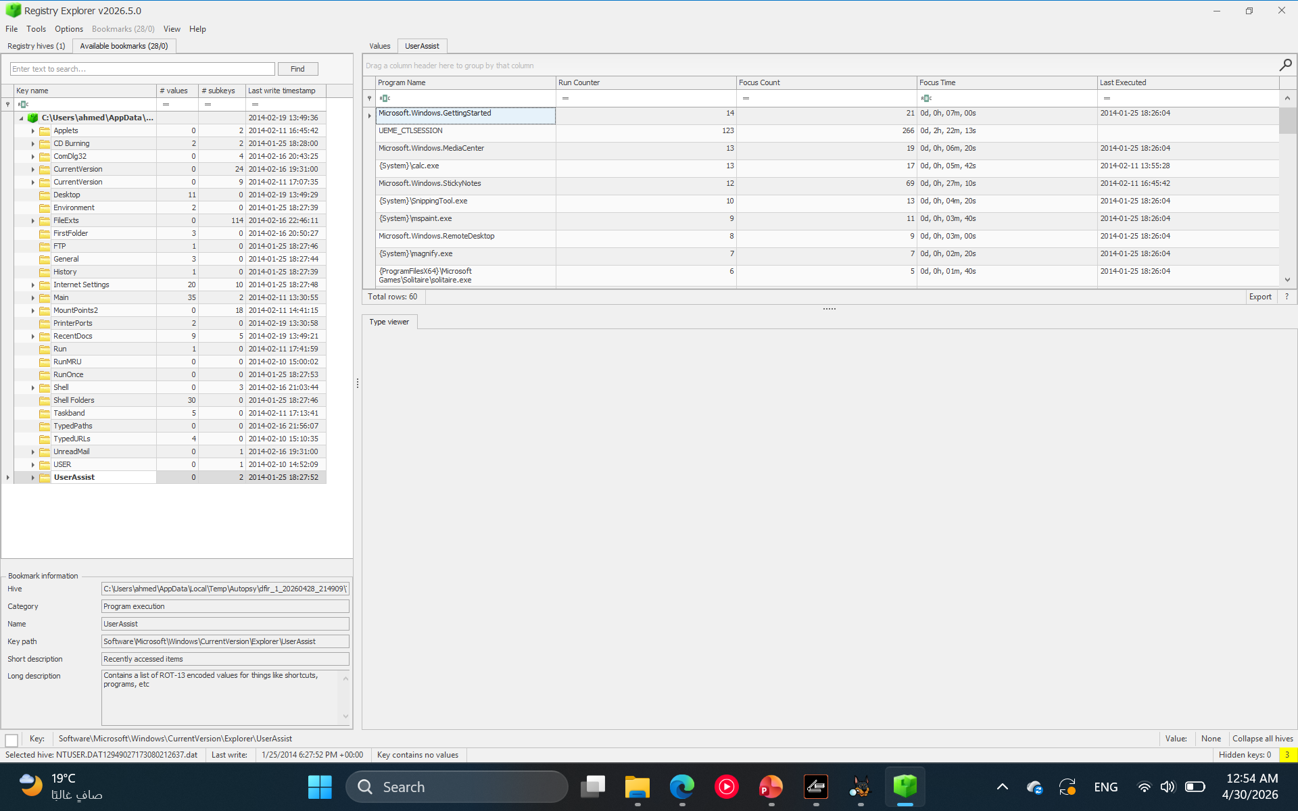
Task 4
Registry userassist
UserAssist registry entries were analyzed using Eric Zimmerman’s Registry Explorer to identify executed programs. The analysis revealed normal user activity, including applications such as Snipping Tool, Paint, Sticky Notes, and Media Center. Execution counts and timestamps indicate regular system usage, with no evidence of suspicious or malicious program execution

Slide 16
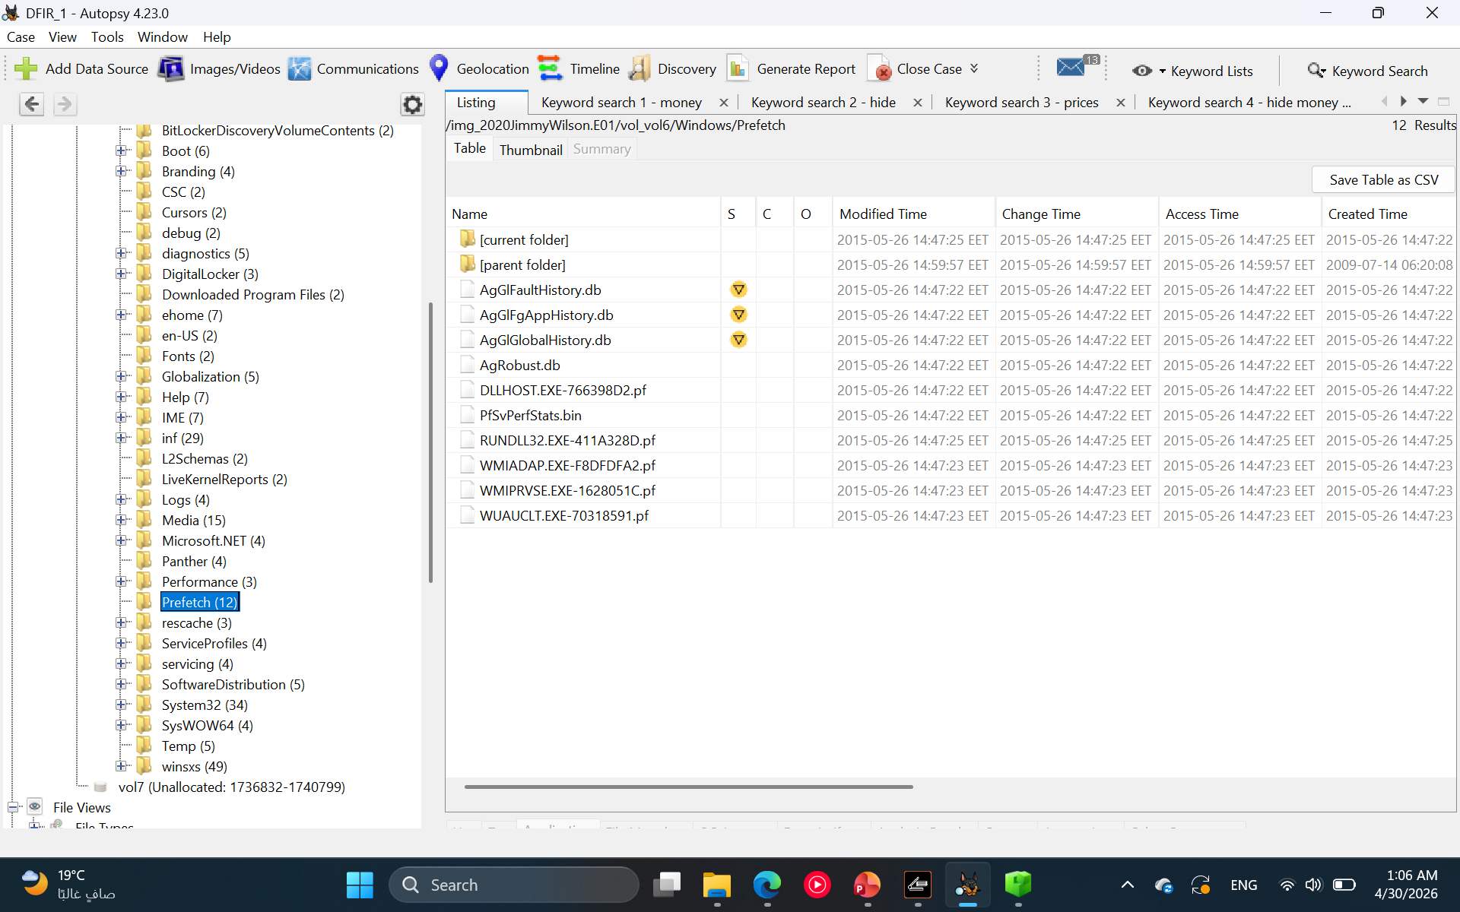
Task 4
Prefetch files:
Prefetch files were obtained from the Windows\Prefetch directory within the forensic image. The analysis revealed execution of system-related processes such as DLLHOST.EXE, RUNDLL32.EXE, WMIADAP.EXE, WMIPRVSE.EXE, and WUAUCLT.EXE. These entries indicate normal operating system activity, with no clear evidence of suspicious or user-driven program execution found in the Prefetch data

Slide 17
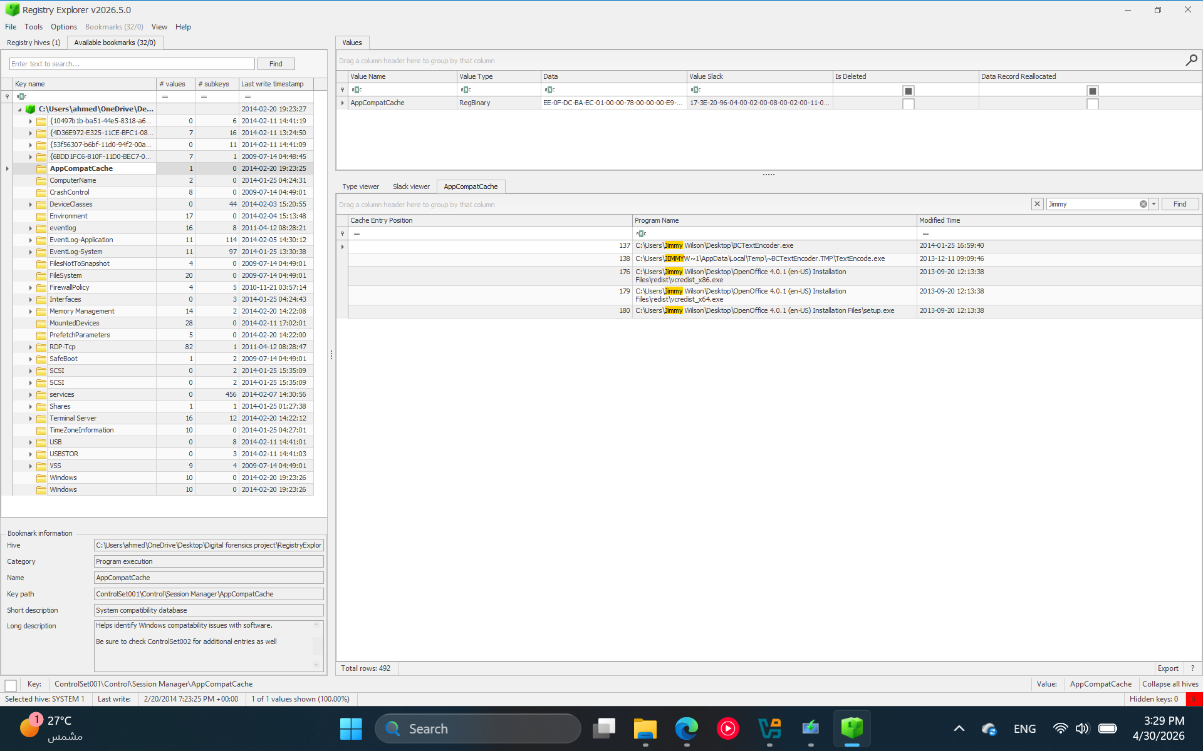
Task 4
Shimcache:JIMMY SEARCH
ShimCache/AppCompatCache analysis using Eric Zimmerman’s Registry Explorer identified BCTextEncoder.exe in Jimmy Wilson’s Desktop path. This is relevant because an encoded price list was also found in the user’s files, suggesting possible use of an encoding tool to obscure pricing-related data.

Slide 18
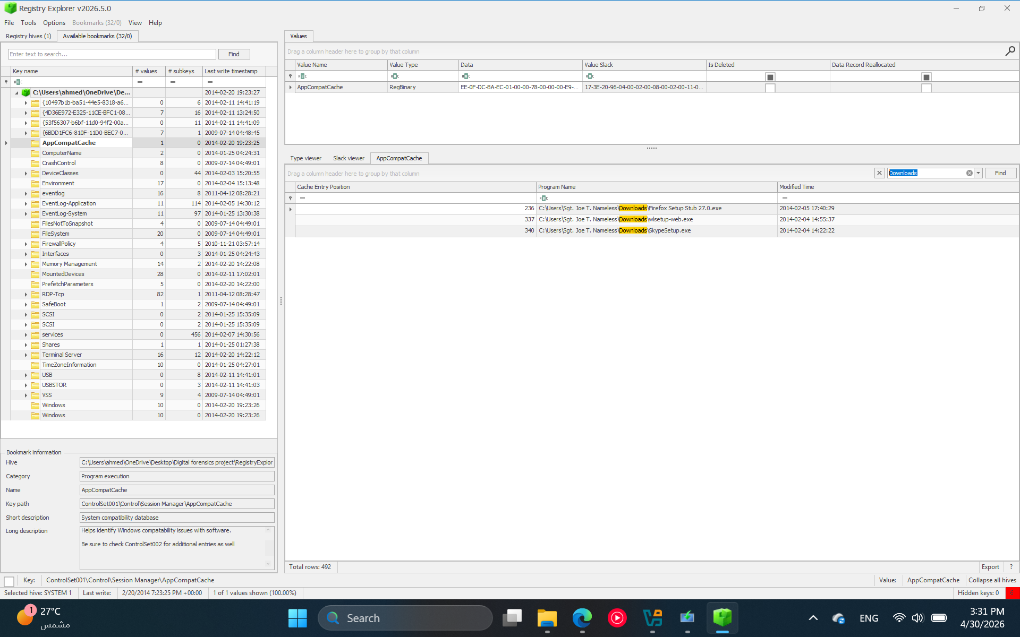
Task 4
Shimcache: downloads search
A search for Downloads within ShimCache identified installer files such as Firefox, Windows Live, and Skype setup executables under the Sgt. Joe T. Nameless user profile. These appear consistent with normal software installation activity and are not directly related to the main Jimmy Wilson findings.

Slide 19
Task 4
Amcache analysis was attempted by searching for Amcache.hve and manually checking the Windows\AppCompat\Programs directory. The Amcache.hve artifact was not present in the dataset, which limited executable metadata analysis through Amcache

Slide 20
Task 5
Velociraptor: Indicators of compromise
Velociraptor was used to search the mounted forensic image for known indicators of compromise. The search identified BCTextEncoder.exe in G:\USERS\Jimmy Wilson\Desktop\, confirming the presence of the encoding tool previously observed in ShimCache analysis. This supports the possibility that the tool was used to encode or obscure pricing-related data
Velociraptor found G:\USERS\Jimmy Wilson\Desktop\BCTextEncoder.exe
Vql query command: SELECT FullPath, Size, Mtime
FROM glob(globs="G:\\**\\BCTextEncoder.exe")

Slide 21
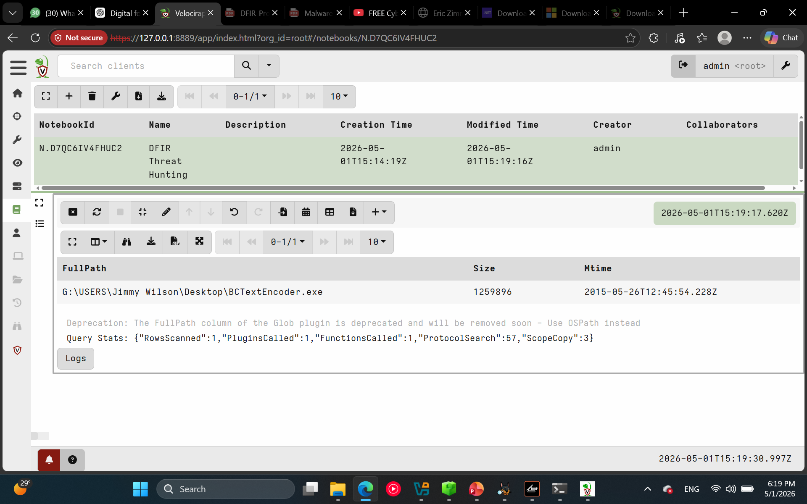
Task 5
Velociraptor: Indicators of compromise

Slide 22
Task 5
Velociraptor: Persistence mechansims
Velociraptor was used to examine Startup folder persistence locations in the mounted forensic image. The only item identified in Jimmy Wilson’s Startup folder was desktop.ini, which is a normal Windows configuration file. No suspicious executable, script, shortcut, or persistence mechanism was found in the Startup folder
Sql query command:SELECT FullPath, Size, Mtime
FROM glob(globs=[
"G:\\Users\\*\\AppData\\Roaming\\Microsoft\\Windows\\Start Menu\\Programs\\Startup\\*",
"G:\\ProgramData\\Microsoft\\Windows\\Start Menu\\Programs\\Startup\\*"
])
Velociraptor found:G:\USERS\Jimmy Wilson\AppData\Roaming\Microsoft\Windows\Start Menu\Programs\Startup\desktop.ini

Slide 23
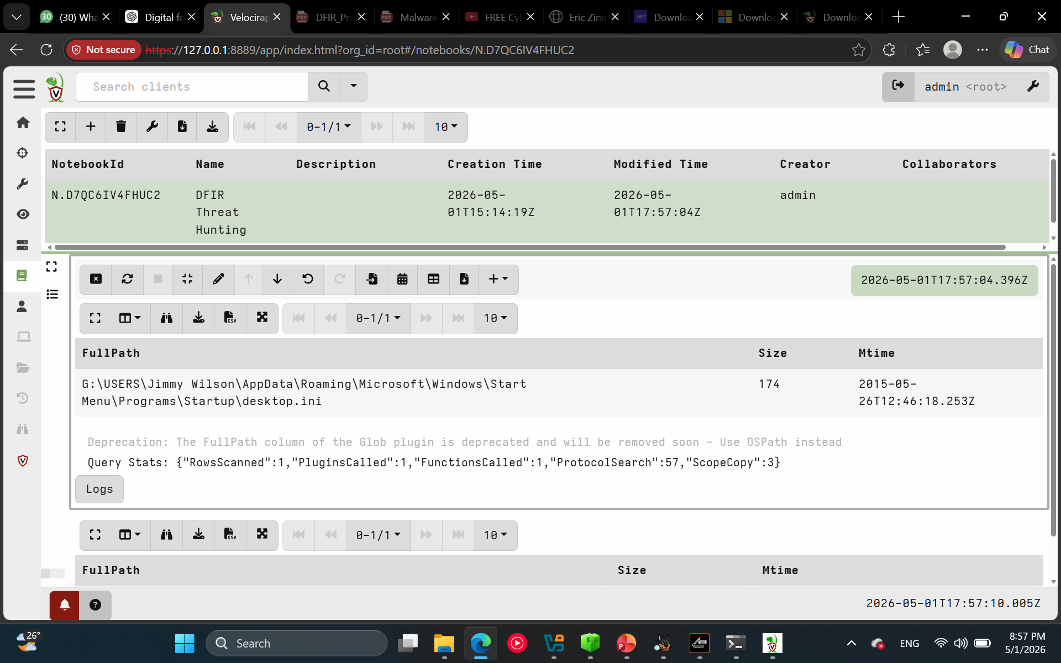
Task 5
Velociraptor:persistence mechanisms

Slide 24
Task 5
Velociraptor: suspicious files
Velociraptor was used to search Prefetch artifacts in the mounted forensic image for suspicious execution traces, including BCTextEncoder, cmd.exe, PowerShell, script interpreters, and rundll32.exe. The search identified RUNDLL32.EXE prefetch activity, which is a common Windows process and was not suspicious by itself. No clear malicious process execution trace was confirmed from Prefetch
Velociraptor found: G:\Windows\Prefetch\RUNDLL32.EXE-411A328D.pf
Vql query command: SELECT FullPath, Size, Mtime
FROM glob(globs=[
"G:\\Windows\\Prefetch\\*BCTextEncoder*.pf",
"G:\\Windows\\Prefetch\\*cmd*.pf",
"G:\\Windows\\Prefetch\\*powershell*.pf",
"G:\\Windows\\Prefetch\\*wscript*.pf",
"G:\\Windows\\Prefetch\\*cscript*.pf",
"G:\\Windows\\Prefetch\\*rundll32*.pf"
])

Slide 25
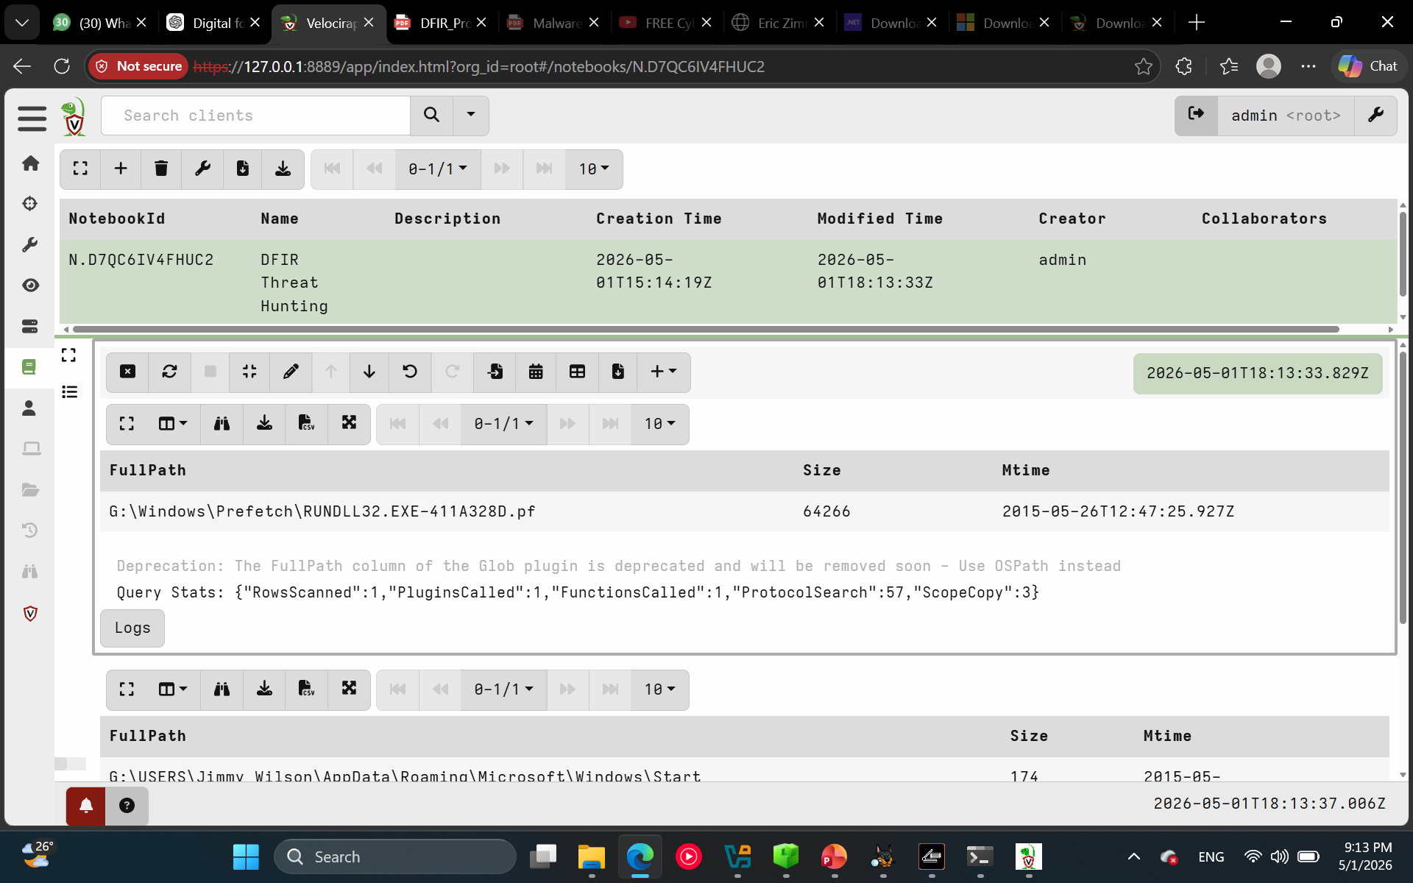
Task 5
Velociraptor: suspicious files

Slide 26
Task 6
The attack reconstruction suggests suspicious insider activity rather than a confirmed external malware compromise. Jimmy Wilson was identified as the main user of interest due to suspicious artifacts under his profile, including the New Prices folder, encoded pricing files, and BCTextEncoder.exe on the Desktop. Browser artifacts referencing “How to Hide Money From the Government” supported the hypothesis of financial concealment. ShimCache and Velociraptor both confirmed the presence of BCTextEncoder.exe, linking the encoding tool to the encoded price list evidence. Persistence checks through Run/RunOnce keys and Startup folders showed no suspicious auto-start mechanism, and Prefetch/UserAssist mostly showed normal system and user activity. Overall, the evidence points to possible concealment or obfuscation of pricing-related data, with no confirmed malware persistence or active malicious process identified.

Slide 27
Task 6
Stage | Reconstruction | Evidence
Initial Access | No confirmed external compromise. Activity appears to originate from local user behavior. | User profile artifacts under Jimmy Wilson, browser/bookmark/search evidence
Execution | BCTextEncoder.exe was present and likely relevant to encoding activity. | ShimCache entry + Velociraptor confirmation at G:\USERS\Jimmy Wilson\Desktop\BCTextEncoder.exe
Persistence | No clear persistence mechanism identified. | Run/RunOnce clean, Startup folder only had desktop.ini
User Actions | User interacted with pricing files and concealment-related content. | New Prices folder, encoded price list, “hide money” search/bookmark artifacts
Exfiltration | Possible but not proven. USB devices were attached, but no direct transfer evidence confirmed yet. | USB artifacts: Lexar, SanDisk, Kingston devices
Final Assessment | Suspicious insider concealment activity is more supported than malware compromise. | Multiple artifacts corroborate encoding/concealment hypothesis

Slide 28
Task 7
Date / Time | Event | Source / Artifact | Interpretation
2014-02-03 | Files related to sexual harassment/confronting topics were found deleted under Sgt. Joe T. Nameless Downloads. | Recycle Bin | Shows deletion activity from another user account, not directly tied to Jimmy Wilson.
2014-02-05 | TrueCrypt.lnk was found deleted from the Public Desktop. | Recycle Bin | Potentially relevant because TrueCrypt can relate to encrypted storage, but no direct link was confirmed.
2014-02-17 | factory2000Plus-tables.mdb was deleted from Jimmy Wilson’s Documents. | Recycle Bin | Deleted database file possibly related to structured/business data.
2014-02-17 | New Prices folder and related text files appeared in deleted/recycle bin evidence. | Recycle Bin | Indicates deletion or cleanup of pricing-related files.

Slide 29
Task 7
Date / Time | Event | Source / Artifact | Interpretation
2014-02-03 | Lexar JumpDrive Secure 64MB was attached. | USB artifacts | Confirms removable media usage on the system.
2014-02-20 | Kingston DataTraveler 100 was attached. | USB artifacts | Indicates use of external storage, which could support possible data movement.
2014-02-20 | SanDisk Card Reader was also identified in USB artifacts. | USB artifacts | Additional removable media device present.
2014-02-20 | USB activity occurred around the broader period of deleted/user file activity. | USB artifacts + Recycle Bin | Suggests possible data transfer path, but does not prove exfiltration.

Slide 30
Task 7
Date / Time | Event | Source / Artifact | Interpretation
2015-05-26 14:45 | New Price List.txt was identified in Jimmy Wilson’s New Prices folder. | File system / Autopsy | Shows pricing-related data under Jimmy Wilson’s profile.
2015-05-26 14:45 | New Price List Encoded.txt was identified. | File system / Autopsy | Shows an encoded version of the pricing data.
2015-05-26 14:45 | Browser/search artifacts referenced “How to Hide Money From the Government.” | Web artifacts / keyword search | Supports financial concealment intent.
2015-05-26 14:45 | BCTextEncoder.exe was identified on Jimmy Wilson’s Desktop. | ShimCache + Velociraptor | Encoding tool potentially linked to encoded price list evidence.

Slide 31
Task 7
Date / Time | Event | Source / Artifact | Interpretation
2015-05-26 14:46 | LNK/recent document artifacts referenced New Prices and pricing files. | Recent Documents / LNK files | Shows user interaction with pricing-related files.

Slide 32
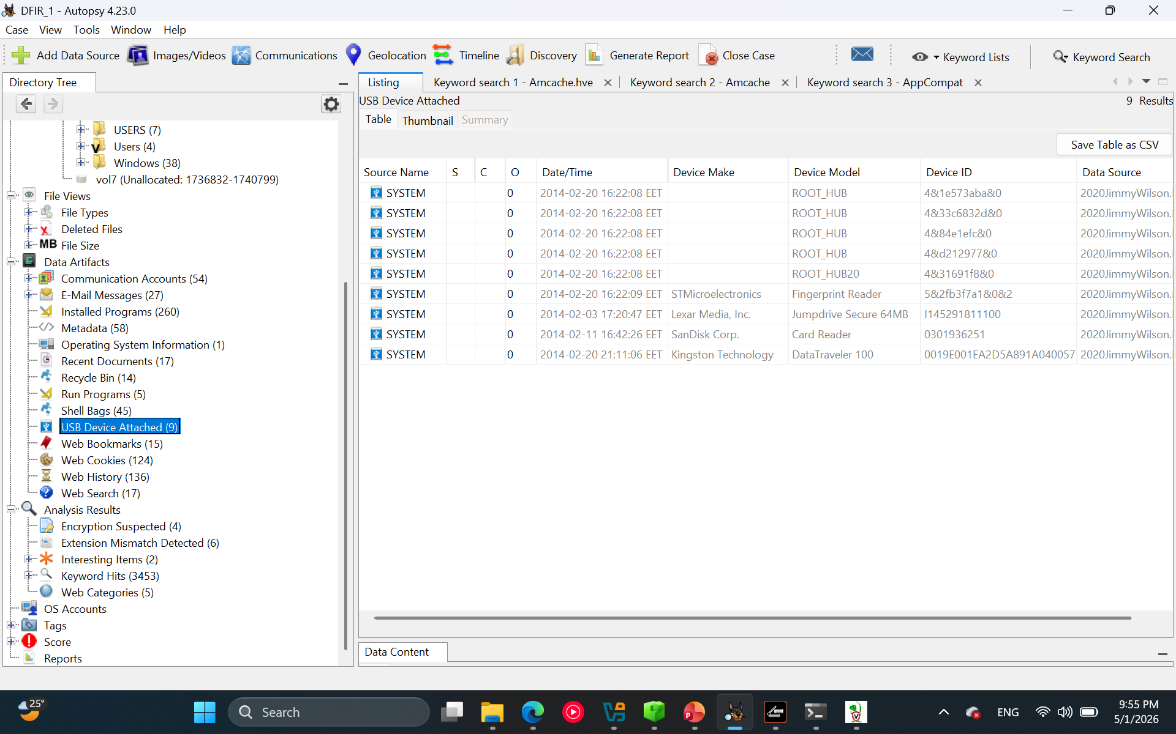
Task 8
Exfiltration was possible but not confirmed. USB devices were connected, pricing-related files existed, an encoded price list was found, and BCTextEncoder.exe may have been used to obscure data. However, no direct evidence of copying, uploading, or transferring files to an external destination was identified

