Slide 1

NVIC
Presented by : Ahmed Yassin
Senior I Electronics and Electrical Communications dep.
Embedded Committee Instructor
2023 / 2024

Slide 2
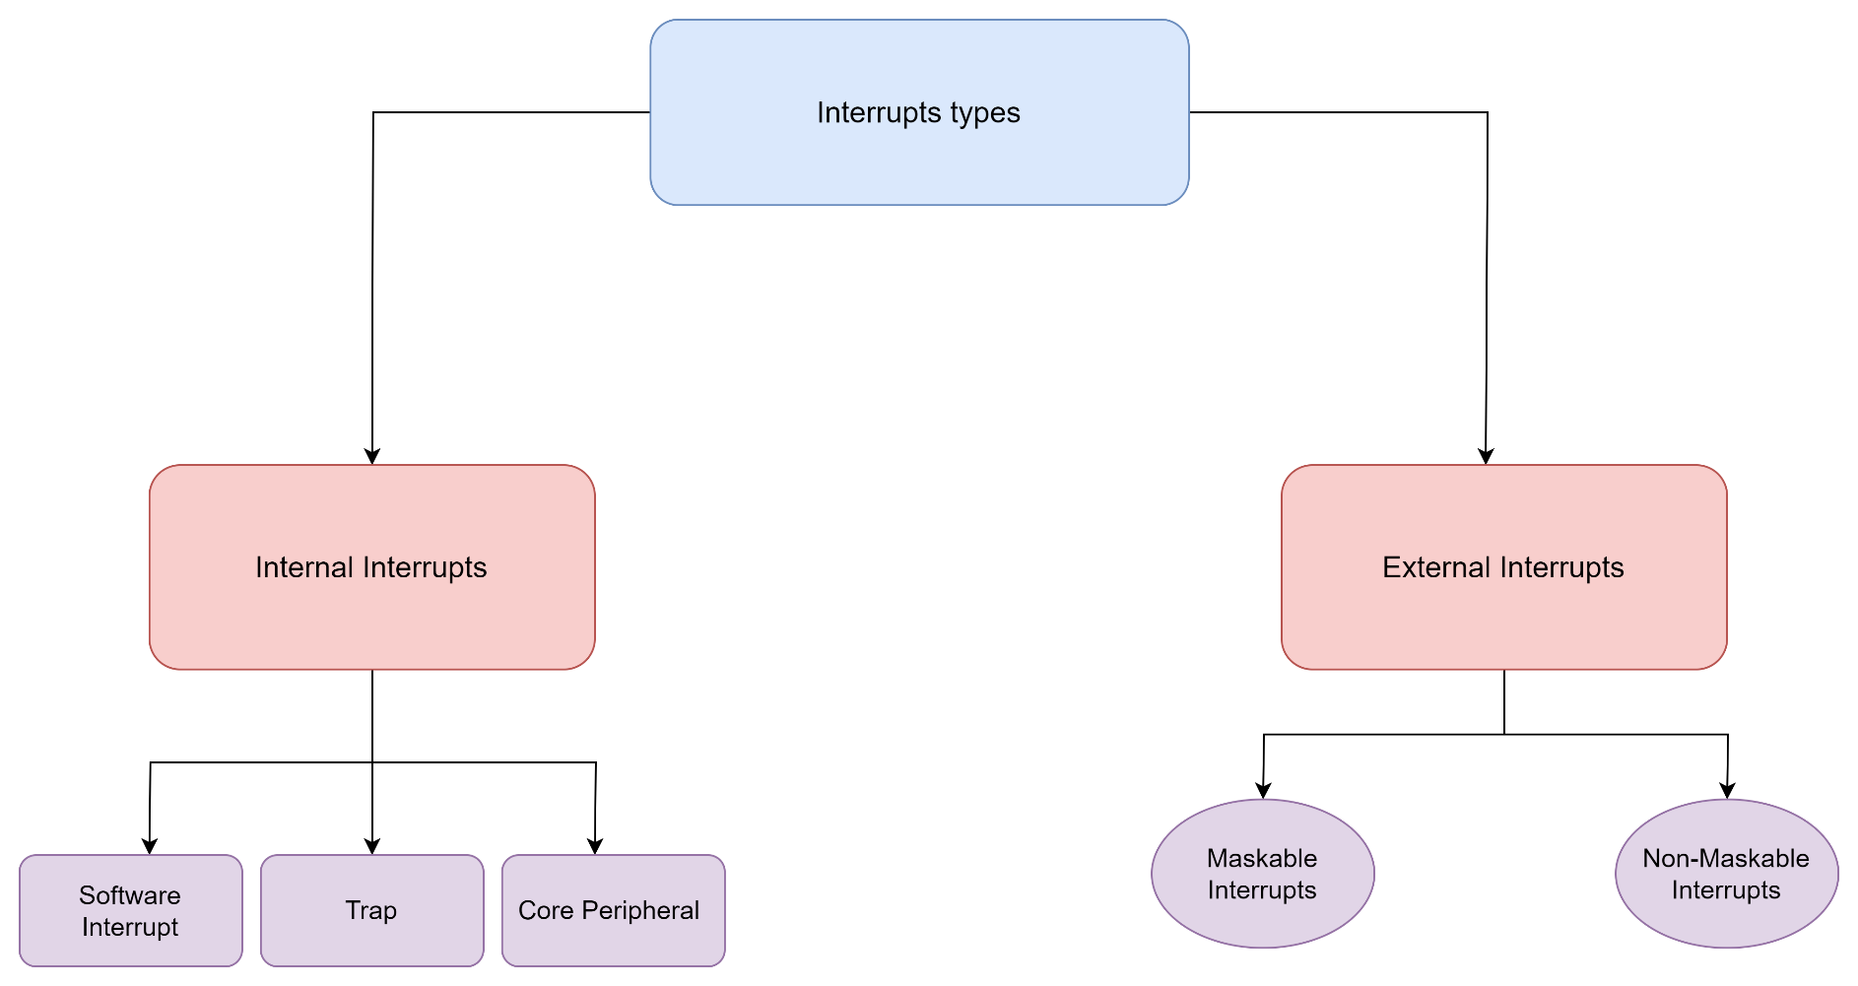

Revision on Interrupts
Interrupts Types

Slide 3
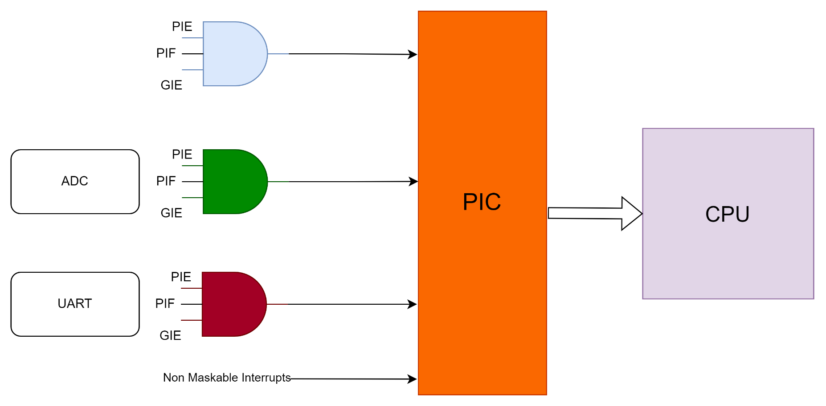
Revision on Interrupts
In AVR, We had 3 flags to fire an interrupt PIE, PIF, GIE.

Slide 4
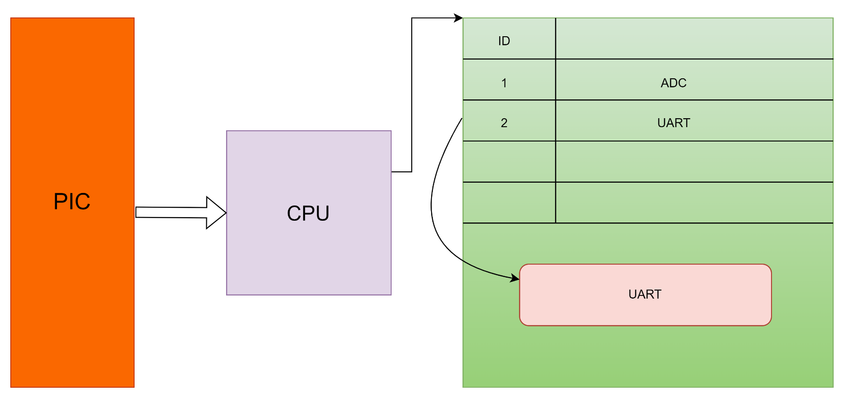
Revision on Interrupts
Processor jumps into Flash Vector Table Location (Fixed)
Vector Table contains pointer to functions into the ISR

Slide 5
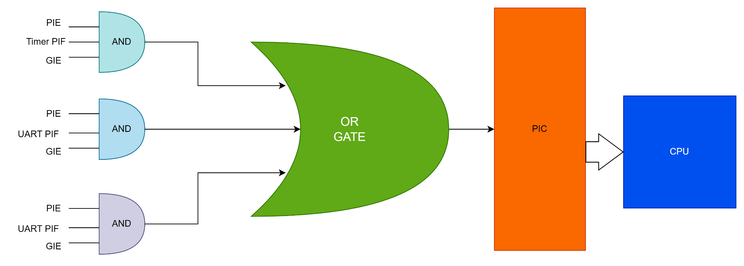
Revision on Interrupts
Flexible Priority used on PIC microcontrollers

Slide 6
Revision on Interrupts
Interrupt Lifecycle
Each exception has the following states:
Disabled
PIE disabled.
Inactive
PIF is not fired. The exception is not active nor pending.
Pending
PIE, PIF, GIE are enabled but another interrupt is served at current time. The exception is waiting to be serviced by the processor.
Active
All flags are enabled and no interrupt is served at current time. The exception is being serviced by the processor but has not completed.
Active and pending
The exception is being serviced by the processor and there is a pending exception from the same source.

Slide 7
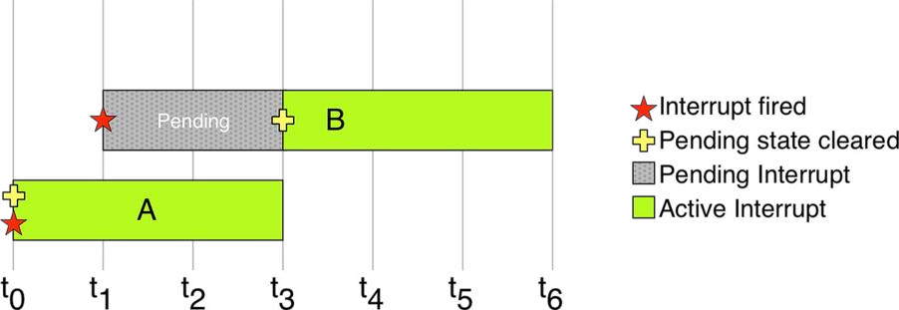
Revision on Interrupts
When an exception fires, it is marked as pending until the processor can serve it. If no other exception is currently being processed, it’s pending state is automatically cleared by the processor, then it starts get served.

Slide 8
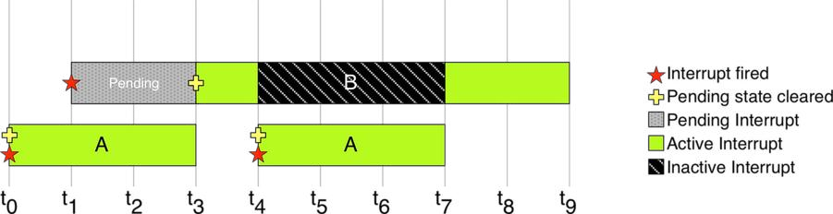
Revision on Interrupts
The lower priority ISR has to wait in pending state until no higher priority ISR is being processed. It can be put into inactive state when it is preempted by a higher priority ISR.

Slide 9
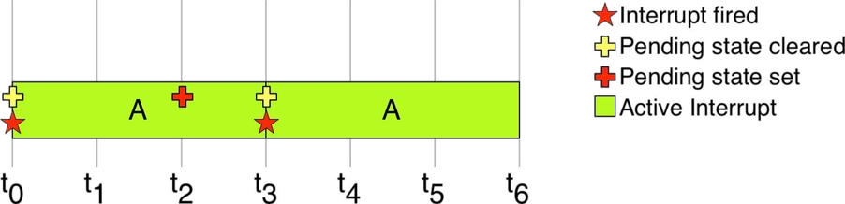
Revision on Interrupts
An exception can be forced to fire again during its execution, simply setting its pending bit again. However, the executing exception will complete before re-calling itself.
Self-nesting

Slide 10
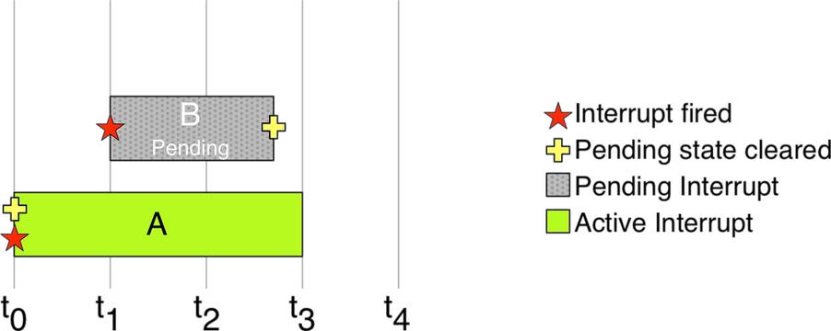
Revision on Interrupts
In the same way, the execution of an exception can be canceled clearing its pending bit while it is in pending state.

Slide 11
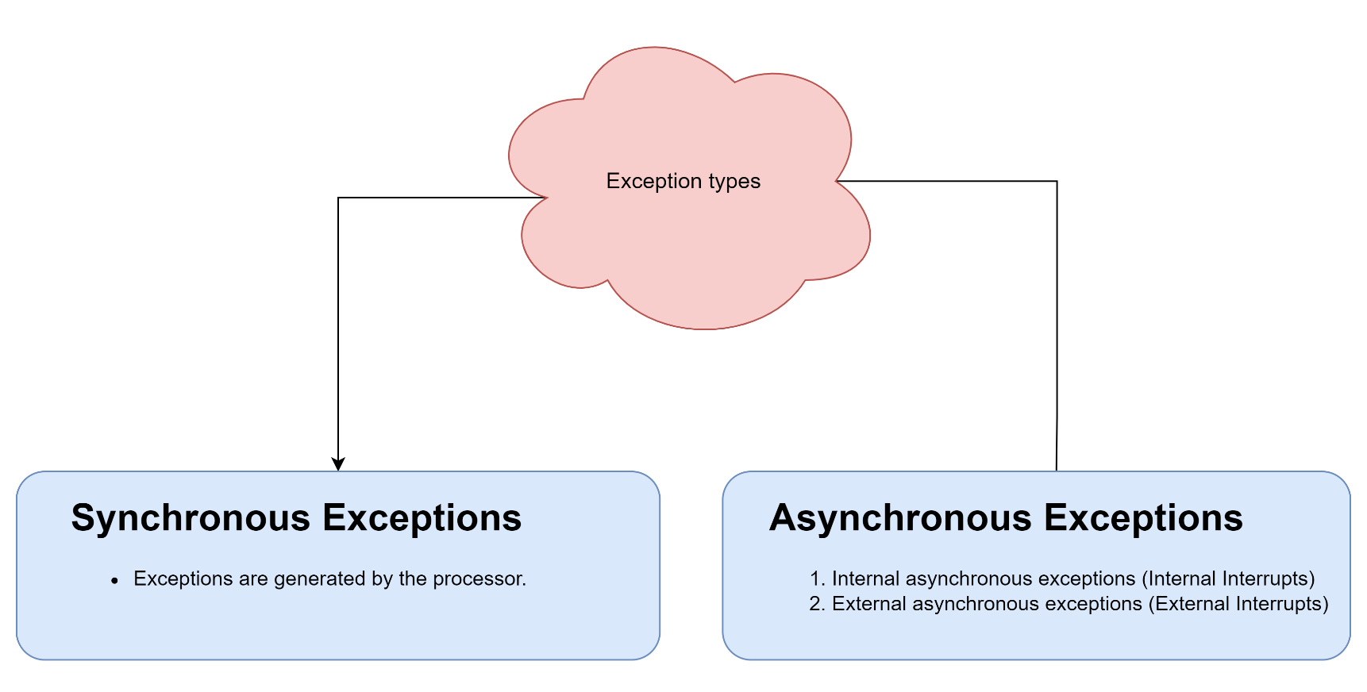
Nested Vector Interrupt Controller (NVIC)
Overview of Cortex Profiles (Cortex M)

Slide 12
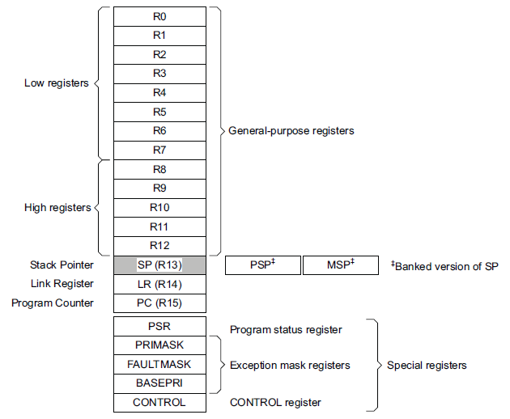
Nested Vector Interrupt Controller (NVIC)
Two processor modes:
Thread mode for User tasks
Handler mode for O/S tasks and exceptions
Stack-based exception model
Vector table contains addresses

Slide 13
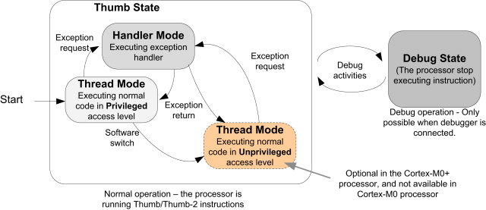
Nested Vector Interrupt Controller (NVIC)
Once An exception is happened, the processor jumps directly from Thread Mode into Handler Mode.
Handler mode – interrupt/exception processing
Handler Mode has full privilege to the MCU
Thread mode – normal processing
Privilege levels = User and Privileged
Supports basic “security” & memory access protection
Supervisor/operating system usually privileged

Slide 14
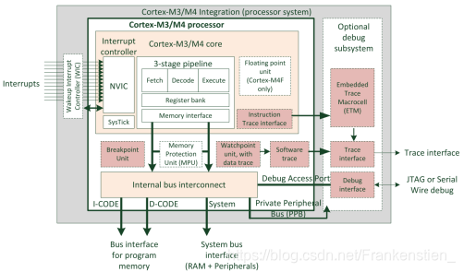
Nested Vector Interrupt Controller (NVIC)
Cortex M3/M4 Processors are 32-bit processor.
Cortex M Peripherals
CPU core
NVIC
FPU (Floating Point Unit)
MPU (Memory Protection Unit)
SCB (System Control Block)
SysTick Timer
Debugger

Slide 15
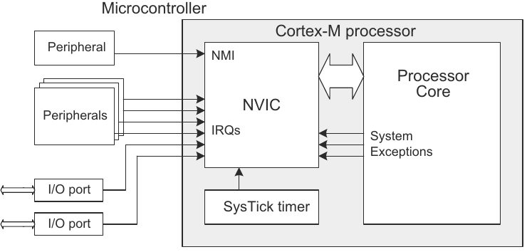
Nested Vector Interrupt Controller (NVIC)
STM32F103 microcontrollers has NVIC
Nested Interrupts
Vector Interrupt System

Slide 16
Nested Vector Interrupt Controller (NVIC)
 | Priority | IRQ | Notes
Reset | -3 | - | Power-up or warm reset
NMI | -2 | - | Non-maskable interrupt from peripheral or software
HardFault | -1 | - | Error during exception processing or no other handler
MemManage | 0 | - | Memory protection fault (MPU-detected)
BusFault | 1 | - | AHB data/prefetch aborts
UsageFault | 2 | - | Instruction execution fault -undefined instruction, illegal unaligned access
SVCcall | 3 | - | System service call (SVC) instruction
DebugMonitor | 4 | - | Break points/watch points/etc.
PendSV | 5 | - | Interrupt-driven request for system service
SysTick | 6 | - | System tick timer reaches 0
IRQ0 | Config | 0 | Signaled by peripheral or by software request
IRQ1 | Config | 1 | Signaled by peripheral or by software request

Slide 17
Nested Vector Interrupt Controller (NVIC)
32-bit vector(handler address) loaded into PC,
while saving CPU context.
Reset vector includes initial stack pointer
Peripherals use positive IRQ #s
CPU exceptions use negative IRQ #s
IRQ # used in CMSIS function calls
Cortex-M3 allows up to 240 IRQs
IRQ priorities user-programmable
NMI & HardFault priorities fixed

Slide 18
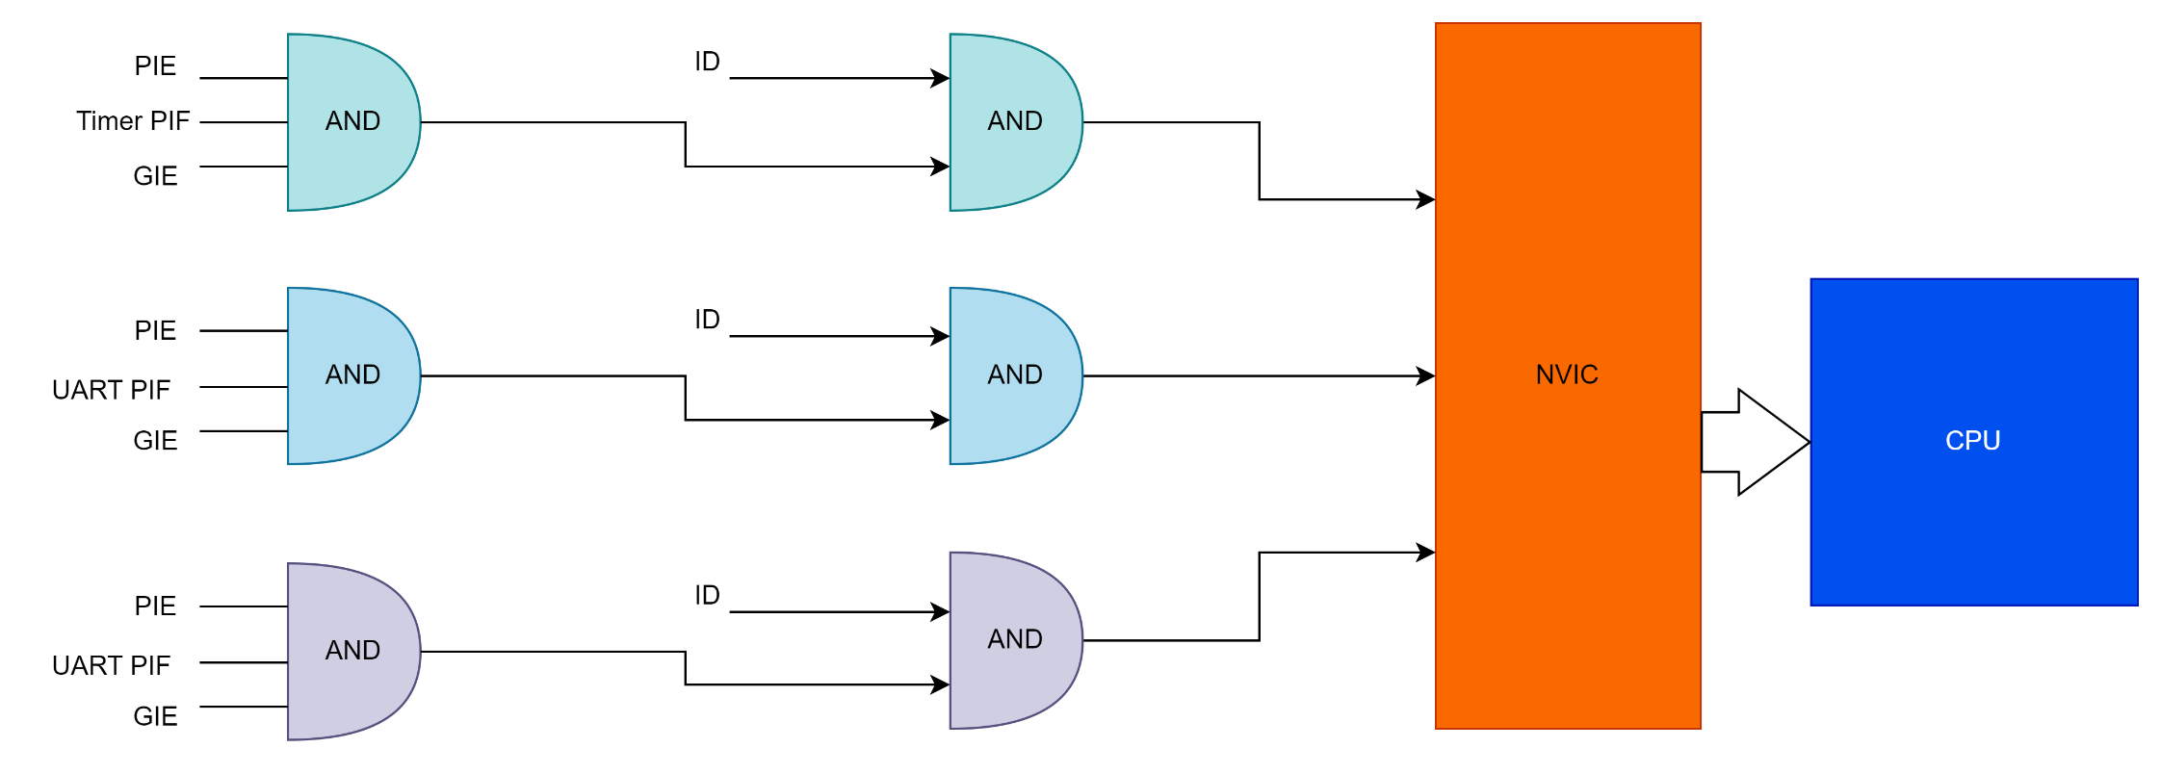
Nested Vector Interrupt Controller (NVIC)
ARM architecture has Nested Vector Interrupt Controller (NVIC)
NVIC is a mixture between the flexibility which was missed in AVR microcontrollers and Fast access time which was missed in PIC microcontrollers.

Slide 19
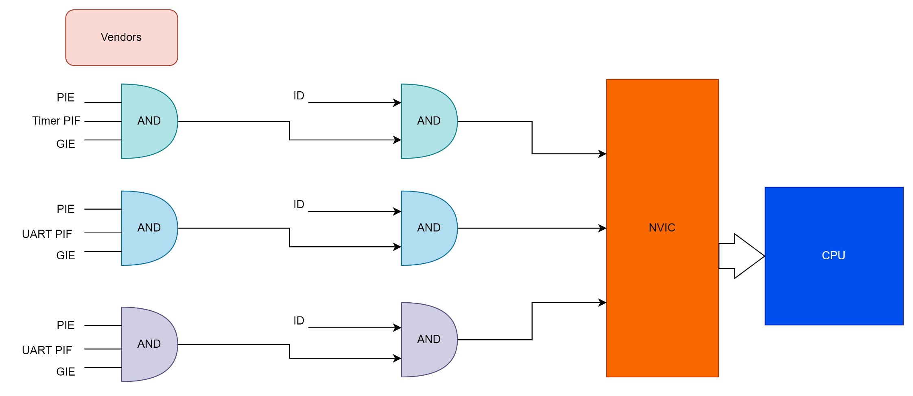
Nested Vector Interrupt Controller (NVIC)
Each peripheral has 2 enables in NVIC, one for core peripheral NVIC and the other one for the vendor.

Slide 20
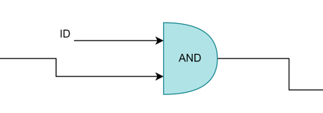
Nested Vector Interrupt Controller (NVIC)
NVIC supports up to 255 interrupts
15 Internal Interrupts
240 External Interrupts
Question:
What is the advantage we get after having another enable for core peripheral NVIC?

Slide 21
Nested Vector Interrupt Controller (NVIC)
NVIC supports up to 255 interrupts
15 Internal Interrupts
240 External Interrupts
Question:
What is the advantage we get after having another enable for core peripheral NVIC?
there’s no external interrupt could be non-maskable now ☺
Any external interrupt in ARM is masked interrupt

Slide 22
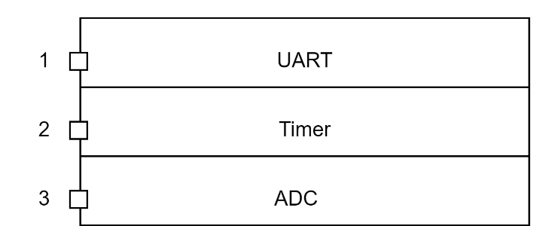
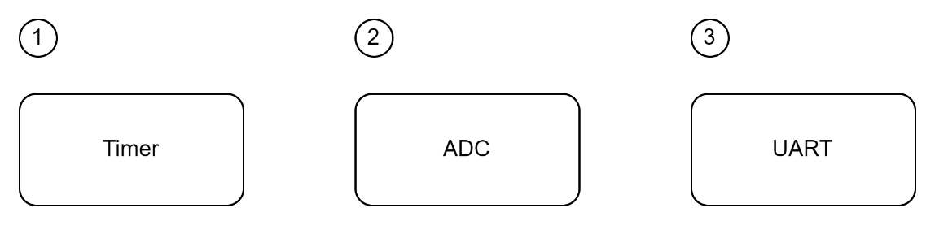
Interrupts Priorities
Each peripheral has an ID and each ID has a hardware priority and software priority.
Hardware Priority
It depends on the architecture itself how it arranged the priorities of the peripherals.
Software Priority
When software priority system is used it overwrite the hardware priorities.
Timer was the second priority in hardware priorities now it’s the highest priority.
If all the interrupts are equal in software priority then hardware priority decides which is higher priority.

Slide 23
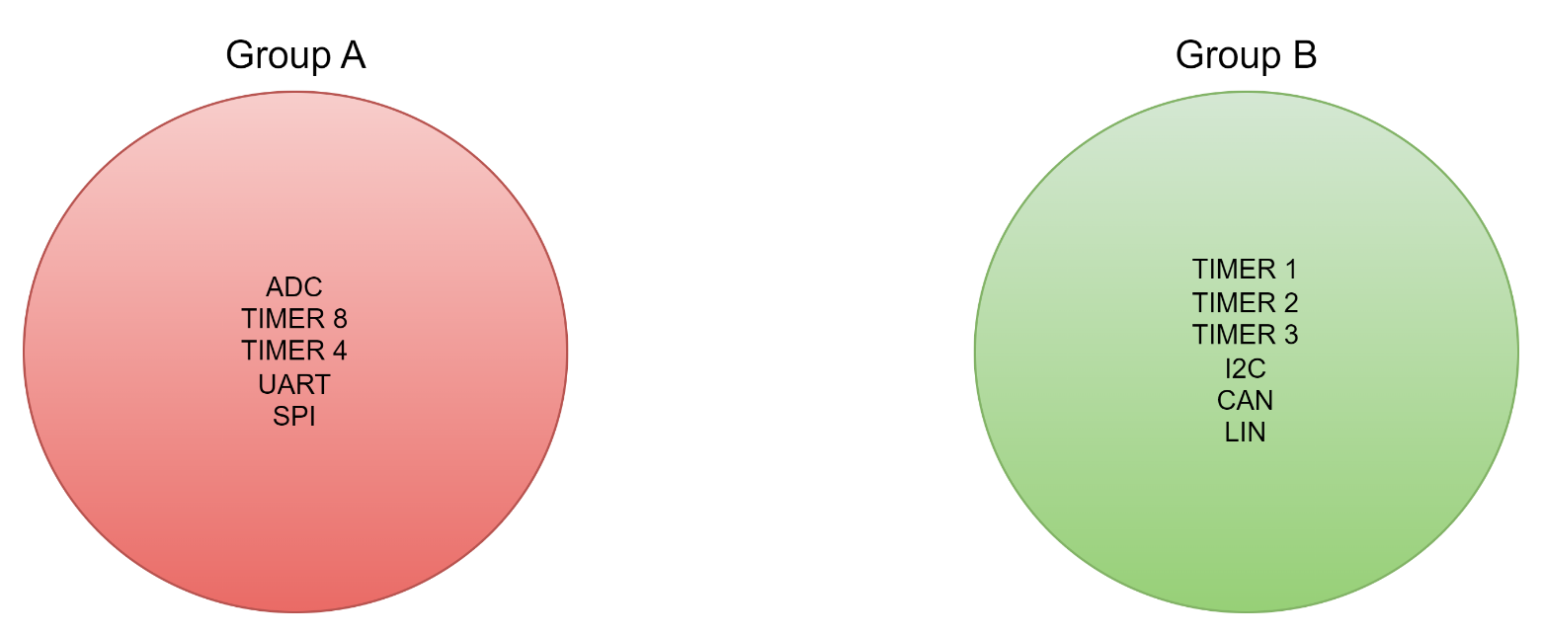
Nested Vector Interrupt Controller (NVIC)
ARM decided to make a system based on group/sub-group priority.
ARM architecture Supports Nesting.

Slide 24
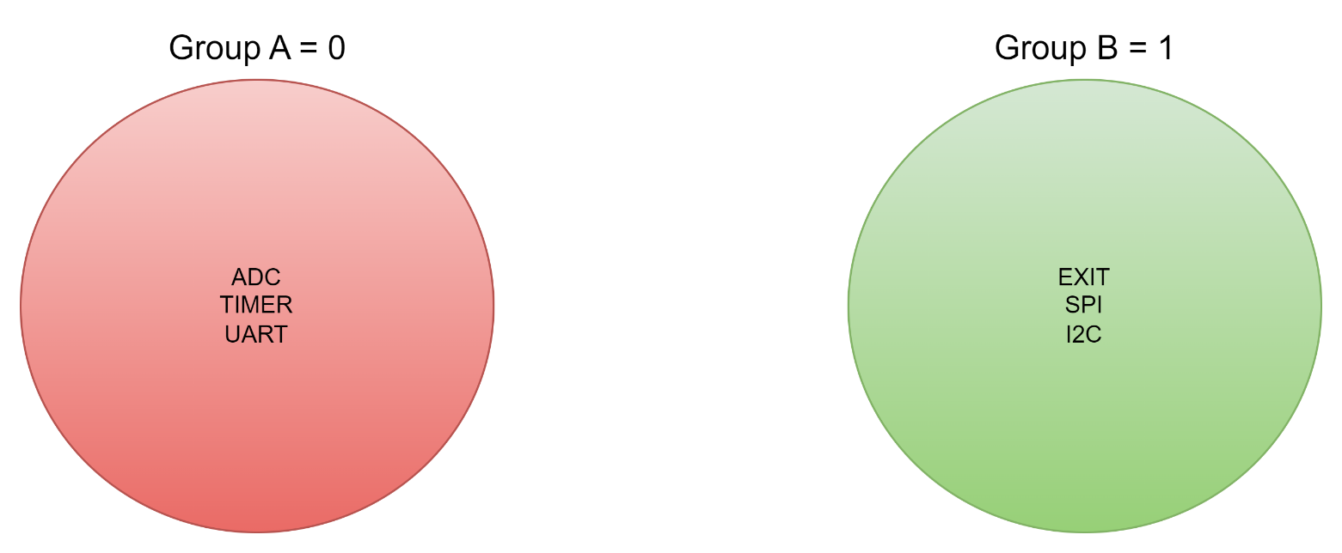
Nested Vector Interrupt Controller (NVIC)
Group Priority and Sub-Group Priority
UART can interrupt SPI
EXIT can not interrupt SPI
1.
1.
2.
2.
3.
3.

Slide 25


