Slide 1
Digital System Design
Subject Name : Digital System Design
Course Code : IT-314

Slide 2
Text-books
Digital System Design using VHDL by C.H. Roth.
Circuit Design with VHDL by Volnei A. Pedroni;

Slide 3
Reference Book
VHDL Primer by J. Bhasker; Addison Wesley Longman Pub.
Introduction to Digital Systems by M. Ercegovec, T. Lang and L.J. Moreno; Wiley
VHDL: Analysis & Modeling of Digital Systems by Z. Navabi; MGH
VHDL Programming by Examples by Douglas L. Perry; TMH
VHDL by Douglas Perry
The Designer Guide to VHDL by P.J. Ashendem; Morgan Kaufmann Pub.
Digital System Design with VHDL by Mark Zwolinski; Prentice Hall Pub.
Digital Design Principles and Practices by John F. Wakerly, Prentice Hall (third Edition) 2001 includes Xilinx student edition).

Slide 4
Overview
What is digital system design?
  Use of available digital components
    Microprocessor, e.g. Pentium
    Micro-controller, e.g. 8051
    Digital processing units, e.g. counters, shift registers.
  Combine them to become a useful system

Slide 5
Programmable logic vs. microcontrollers in prototyping
In some situation you can design a digital system using programmable logic or microcontrollers
Programmable logic – more general and flexible, economic for mass production
Microcontrollers – more specific and less flexible, cost more in mass production

Slide 6
VHDL
What is VHDL?
V H I S C → Very High Speed Integrated Circuit
Hardware
Description
Language
IEEE Standard 1076-1993

Slide 7
History of VHDL
Designed by IBM, Texas Instruments, and Intermetrics as part of the DoD funded VHSIC program
Standardized by the IEEE in 1987: IEEE 1076-1987
Enhanced version of the language defined in 1993: IEEE 1076-1993
Additional standardized packages provide definitions of data types and expressions of timing data
  IEEE 1164 (data types)
  IEEE 1076.3 (numeric)
  IEEE 1076.4 (timing)

Slide 8
Traditional vs. Hardware Description Languages
Procedural programming languages provide the how or recipes
  for computation
  for data manipulation
  for execution on a specific hardware model
Hardware description languages describe a system
  Systems can be described from many different points of view
    Behavior: what does it do?
    Structure: what is it composed of?
    Functional properties: how do I interface to it?
    Physical properties: how fast is it?

Slide 9
Usage
Descriptions can be at different levels of abstraction
  Switch level: model switching behavior of transistors
  Register transfer level: model combinational and sequential logic components
  Instruction set architecture level: functional behavior of a microprocessor
Descriptions can used for
  Simulation
    Verification, performance evaluation
  Synthesis
    First step in hardware design

Slide 10
Why do we Describe Systems?
Design Specification
  unambiguous definition of components and interfaces in a large design
Design Simulation
  verify system/subsystem/chip performance prior to design implementation
Design Synthesis
  automated generation of a hardware design

Slide 11
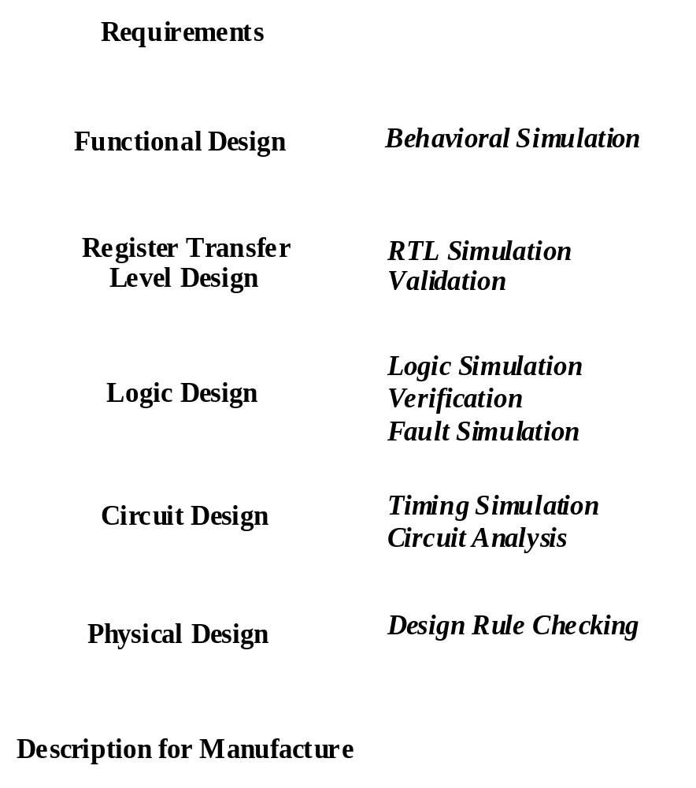
Digital System Design Flow
Design flows operate at multiple levels of abstraction
Need a uniform description to translate between levels
Increasing costs of design and fabrication necessitate greater reliance on automation via CAD tools
  $5M - $100M to design new chips
  Increasing time to market pressures

Slide 12
A Synthesis Design Flow
Requirements
VHDL Model
Functional Design
VHDL Model
Register Transfer
Level Design
Logic Simulation
Synthesis
Behavioral Simulation
(
)
VHDL
Place and Route
Timing Extraction
Automation of design refinement steps
Feedback for accurate simulation
Example targets: ASICs, FPGAs

Slide 13
The Role of Hardware Description Languages
BEHAVIORAL
STRUCTURAL
algorithms
processors
register transfers
registers
Boolean expressions
gates
transfer functions
transistors
cells
modules
chips
boards
PHYSICAL
[Gajski and Kuhn]
Design is structured around a hierarchy of representations
HDLs can describe distinct aspects of a design at multiple levels of abstraction

Slide 14
Domains and Levels of Modeling
Structural
Functional
high level of abstraction
low level of abstraction
Geometric
“Y-chart” due to Gajski & Kahn

Slide 15
Domains and Levels of Modeling
Structural
Functional
Algorithm
(behavioral)
Register-Transfer
Language
Boolean Equation
Differential Equation
Geometric
“Y-chart” due to Gajski & Kahn

Slide 16
Domains and Levels of Modeling
Structural
Functional
Processor-Memory
Switch
Register-Transfer
Gate
Transistor
Geometric
“Y-chart” due to Gajski & Kahn

Slide 17
Domains and Levels of Modeling
Structural
Functional
Polygons
Sticks
Standard Cells
Floor Plan
Geometric
“Y-chart” due to Gajski & Kahn

Slide 18
Basic VHDL Concepts
Interfaces
Modeling (Behavior, Dataflow, Structure)
Test Benches
Analysis, elaboration, simulation
Synthesis

Slide 19
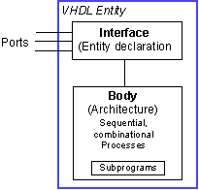
Basic Structure of a VHDL File
Entity
  Entity declaration: interface to outside world; defines input and output signals
  Architecture: describes the entity, contains processes, components operating concurrently

Slide 20
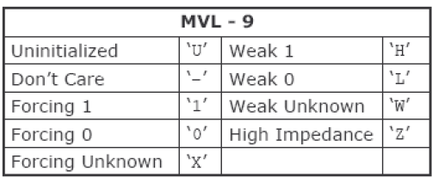
Entity Declaration
entity NAME_OF_ENTITY is
port (signal_names: mode type;
signal_names: mode type;
:
signal_names: mode type);
end [NAME_OF_ENTITY] ;
NAME_OF_ENTITY: user defined
signal_names: list of signals (both input and output)
mode: in, out, buffer, inout
type: boolean, integer, character, std_logic

Slide 21
Architecture
Behavioral Model:
  architecture architecture_name of NAME_OF_ENTITY is
-- Declarations
…..
…..
  begin
-- Statements
  end architecture_name;

Slide 22
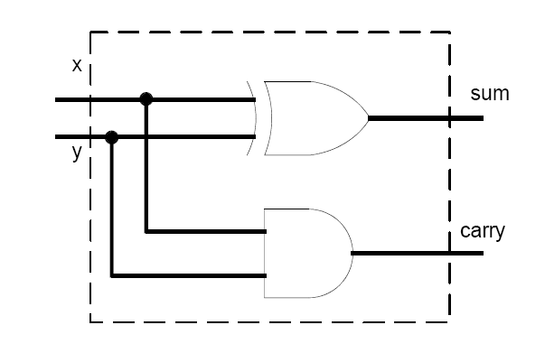
Half Adder
library ieee;
use ieee.std_logic_1164.all;
entity half_adder is
port(
x,y: in std_logic;
sum, carry: out std_logic);
end half_adder;
architecture myadd of half_adder is
begin
sum <= x xor y;
carry <= x and y;
end myadd;

Slide 23
Entity Examples …
entity half_adder is
port(
x,y: in std_logic;
sum, carry: out std_logic);
end half_adder;
FULL ADDER
A
B
C
SUM
CARRY

Slide 24
Architecture Examples: Behavioral Description
Entity FULLADDER is
port ( A, B, C: in std_logic;
SUM, CARRY: in std_logic);
end FULLADDER;
Architecture CONCURRENT of FULLADDER is
begin
SUM <= A xor B xor C after 5 ns;
CARRY <= (A and B) or (B and C) or (A and C) after 3 ns;
end CONCURRENT;

Slide 25
Architecture Examples: Structural Description …
architecture STRUCTURAL of FULLADDER is
signal S1, C1, C2 : bit;
component HA
port (I1, I2 : in bit; S, C : out bit);
end component;
component OR
port (I1, I2 : in bit; X : out bit);
end component;
begin
INST_HA1 : HA port map (I1 => B, I2 => C, S => S1, C => C1);
INST_HA2 : HA port map (I1 => A, I2 => S1, S => SUM, C => C2);
INST_OR : OR port map (I1 => C2, I2 => C1, X => CARRY);
end STRUCTURAL;
A
I₁ S
HA
I2 C
SUM
B
I₁ S
HA
I2 C
S₁
C₂
I₁
OR
I2 x
C
C₁
CARRY

Slide 26
… Architecture Examples: Structural Description
Entity HA is
PORT (I1, I2 : in bit; S, C : out bit);
end HA ;
Architecture behavior of HA is
begin
S <= I1 xor I2;
C <= I1 and I2;
end behavior;
Entity OR is
PORT (I1, I2 : in bit; X : out bit);
end OR ;
Architecture behavior of OR is
begin
X <= I1 or I2;
end behavior;

Slide 27
One Entity Many Descriptions
A system (an entity) can be specified with different architectures
Entity
Architecture
A
Architecture
B
Architecture
C
Architecture
D

Slide 28
Test Benches
Testing a design by simulation
Use a test bench model
  an architecture body that includes an instance of the design under test
  applies sequences of test values to inputs
  monitors values on output signals
    either using simulator
    or with a process that verifies correct operation

