Slide 1

First insights in the data Review of results
Ahmed Qamesh

Slide 2
Outline
Task 1
Task 2
Task 3
Task 4

Slide 3
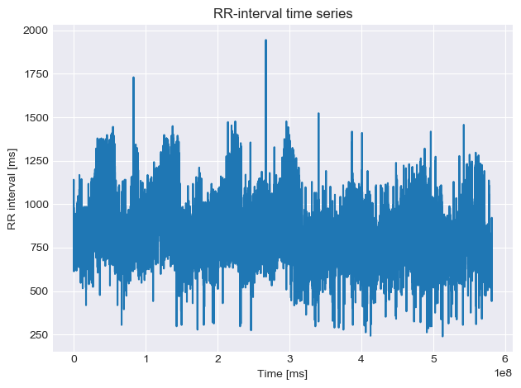
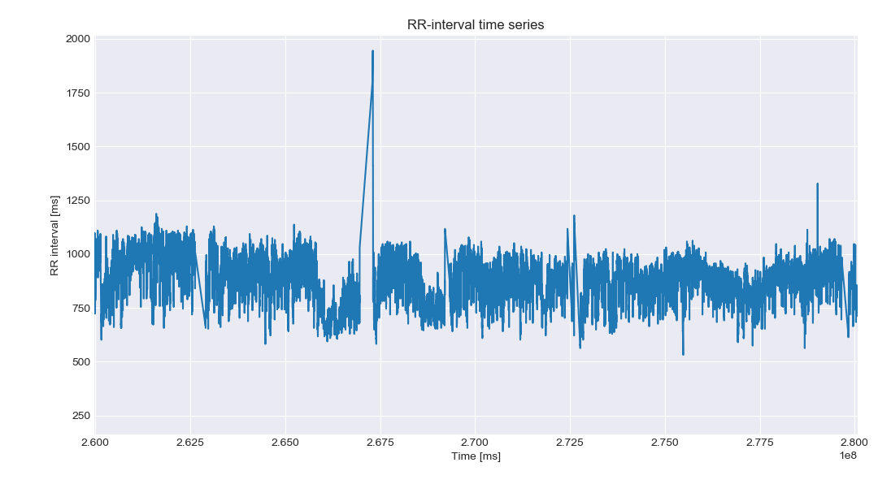
Task 1: Plotting data
Observation
RR-intervals are within [500-1500] ms.
The data shows irregular fluctuation in the RR-interval values.
RR interval fluctuation is due to the fluctuation in ecg signal.
During 160 hours of data taken, different activities must be considered.
Seizures periods.

Slide 4
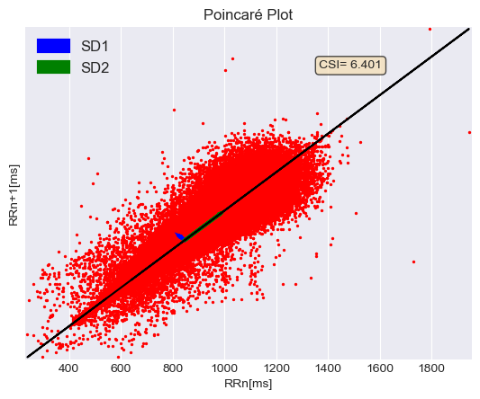


Task 2:
Implement the following three features (mean, std, CSI)
In the Poincare plot: is a scatter diagram constructed by locating points from the time series on the coordinate plane according to the pairing (I_{k},I_{k+1})
The choice of t=1 ensures a high (linear) correlation between points for most time series.
successive points with equal values (R-R intervals) will fall along the diagonal, the line of identity¹.
SD1: dispersion of points perpendicular to the line of identity^{2,3}
SD2: dispersion of points along the line of identity
SDSD : standard deviation of successive differences.
SDRR : standard deviation of RR-intervals.

Slide 5
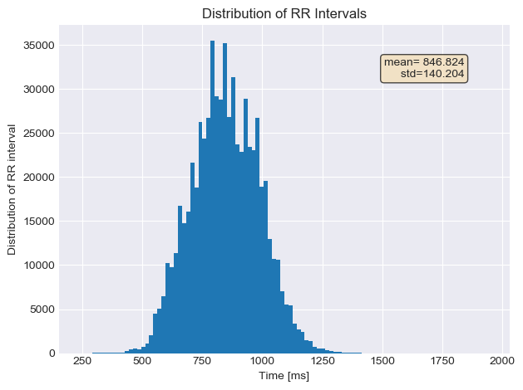
Task 2:
Implement the following three features (mean, std, CSI)
Mean = 846.824
Std = 140.204
CSI =SD2 / SD1
CSI = 6.401

Slide 6
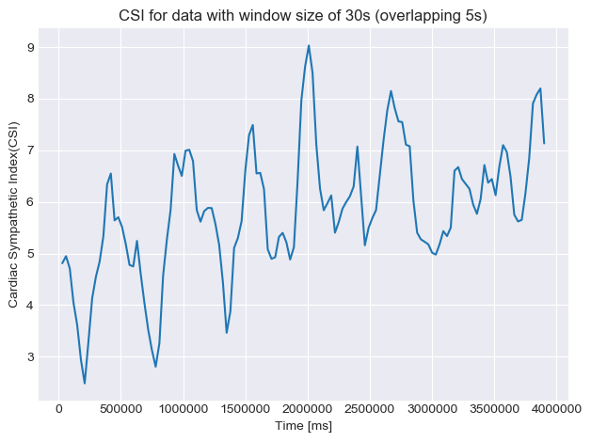
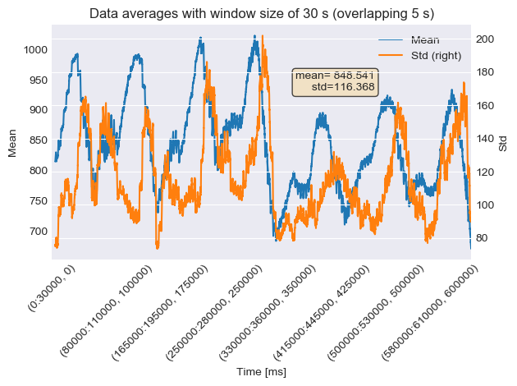
Task 3:
Features on the data with a window size of 30s and (overlap 5s)

Slide 7
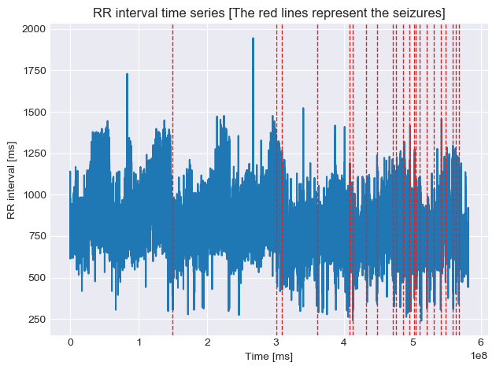
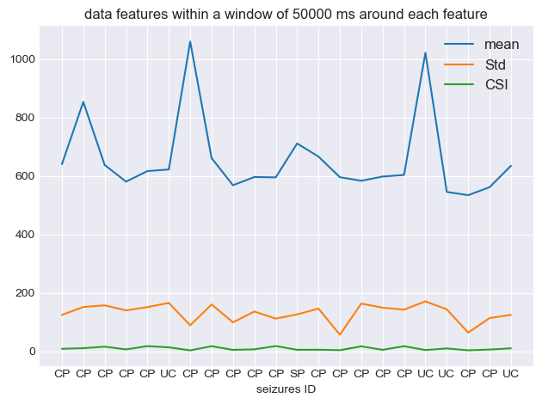
Task 4:
Features for all seizures where the data is good enough

Slide 8
Id | Seizure | Mean | Std | CSI
1 | CP | 639.83 | 124.27 | 8.30
2 | CP | 853.23 | 151.26 | 10.40
3 | CP | 637.50 | 156.97 | 15.40
4 | CP | 580.39 | 139.56 | 6.20
5 | CP | 616.46 | 150.97 | 17.38
6 | UC | 622.05 | 165.21 | 13.22
7 | CP | 1059.91 | 88.59 | 2.81
8 | CP | 660.98 | 159.90 | 17.14
9 | CP | 567.99 | 98.85 | 4.55
10 | CP | 596.078 | 135.80 | 6.51
11 | CP | 594.93 | 111.51 | 17.67
12 | SP | 710.93 | 125.97 | 4.82
13 | CP | 666.09 | 145.77 | 5.02
14 | CP | 595.51 | 56.32 | 3.55
CP : complex partial, UC : unclassified and SP : simple partial

Slide 9
Task 4:
Id | Seizure | Mean | Std | CSI
15 | CP | 583.31 | 163.08 | 16.62
16 | CP | 597.74 | 148.91 | 4.78
17 | CP | 603.21 | 142.17 | 17.21
18 | UC | 1021.26 | 170.55 | 3.95
19 | UC | 545.04 | 143.2 | 9.48
20 | CP | 534.13 | 63.52 | 3.02
21 | CP | 561.27 | 113.35 | 5.66
22 | UC | 634.56 | 124.28 | 9.89

Slide 10
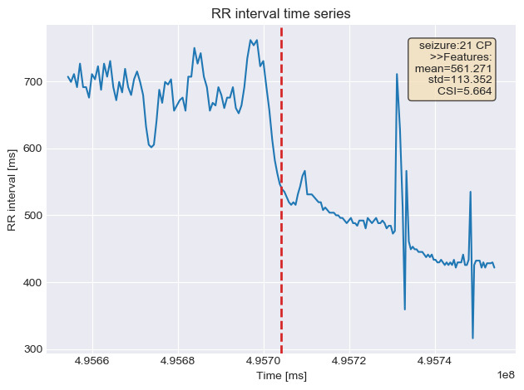
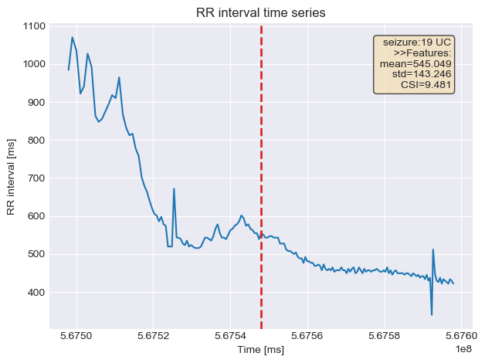
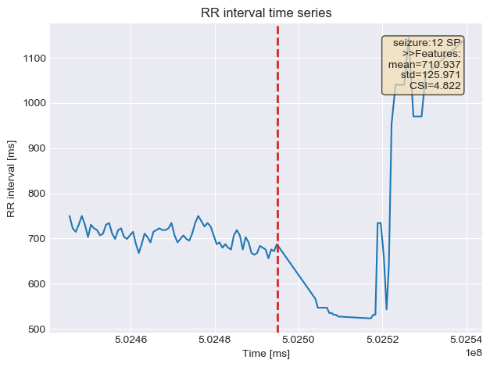
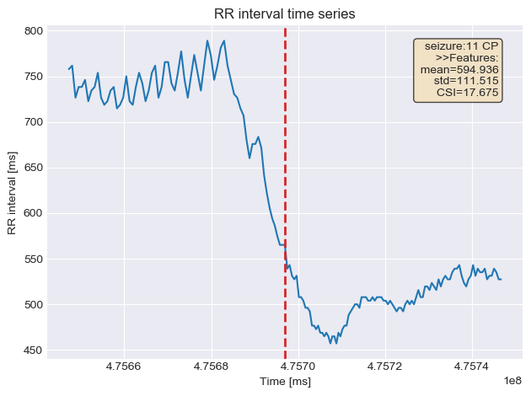
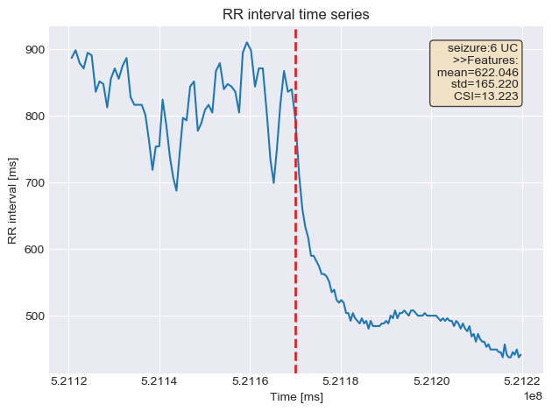
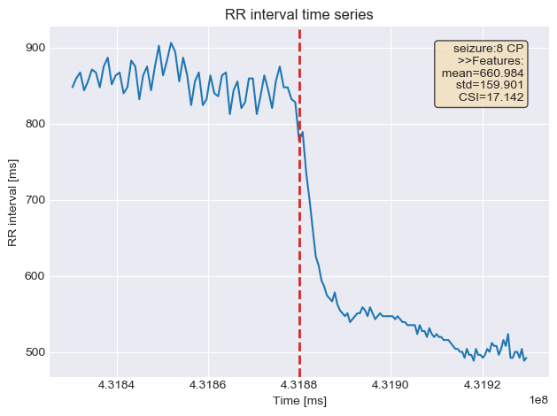
Task 4:
RR interval in a time window of 500000 ms around each Seizures

Slide 11
Thank you

Slide 12
References
[1] Huikuri, H. V. et al. Circulation 1996;93:18361844
[2] Brennan M. et al. IEEE Trans Biomed Eng 2001;48:134247
[3] Jeppesen, J et al. Using Lorenz plot and Cardiac Sympathetic Index of heart rate variability for detecting seizures for patients with epilepsy. 10.1109/EMBC.2014.6944639.

