Slide 1
eclipse
A mini project on computer graphics submitted by,
Md. Rakin Ahmed
ID: 151-15-5260
Section :M

Slide 2
Report
I tried to make a part of solar system. With the planet earth, sun and moon. I focused on relation between these three. Where earth is like the satellite of sun and the moon is like the satellite of earth .earth and moon both have their own speed of rotation around their center planet and these rotation causes solar and lunar eclipse through my project I showed how and why these occur.

Slide 3
Objective
To make the rotation moon of around the earth
To specify the exact points of solar eclipse and lunar eclipse
by aligning them in lines as they occur in the solar system

Slide 4

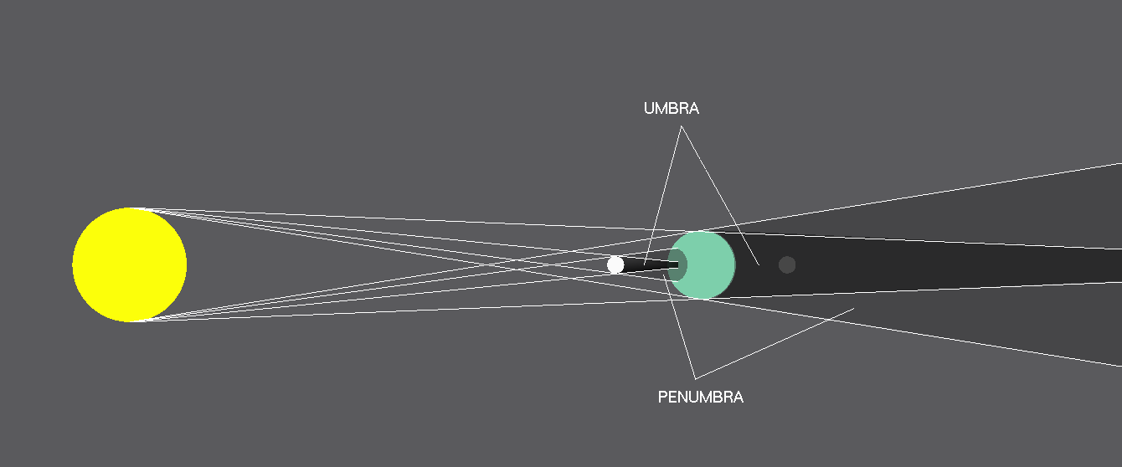
Methodology

Slide 5
Features
Occurrence of eclipses
Occurrence of solar eclipses
Occurrence of lunar eclipses

Slide 6
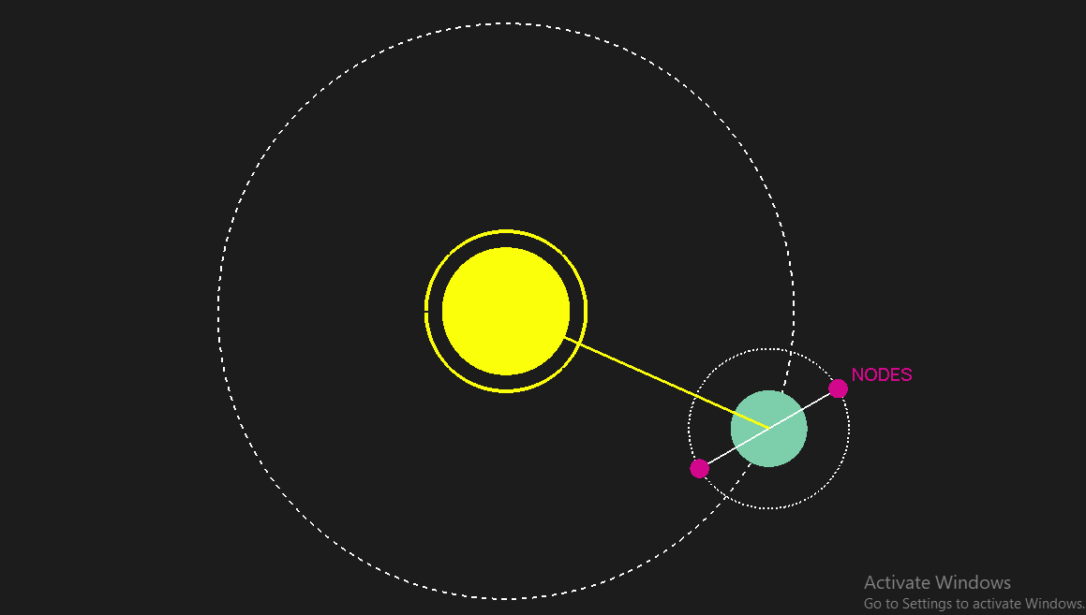
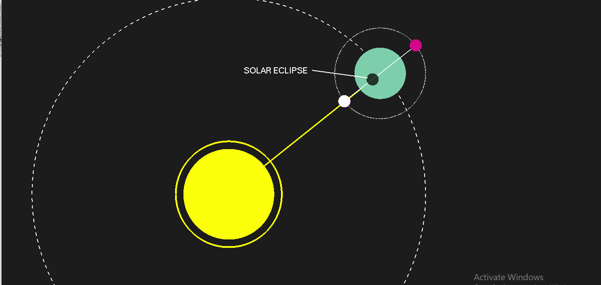
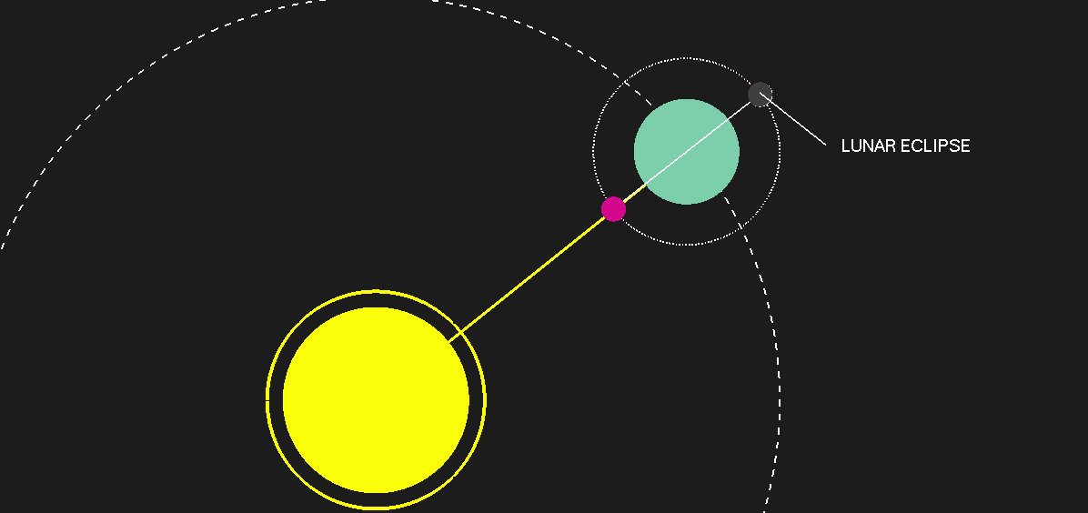
screenshots of important parts of MY project

Slide 7
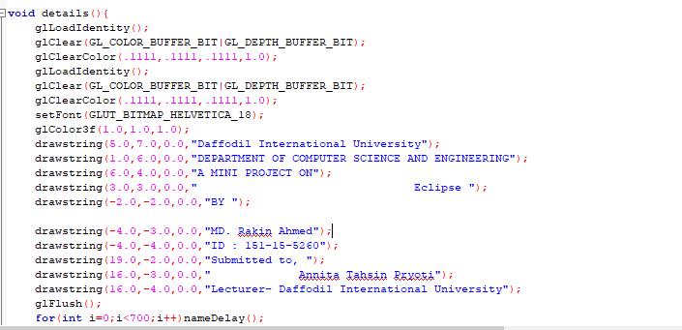
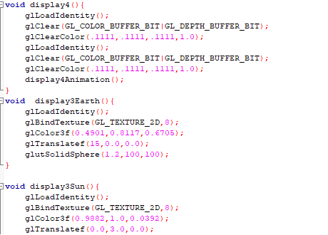
codes

